Slide 1
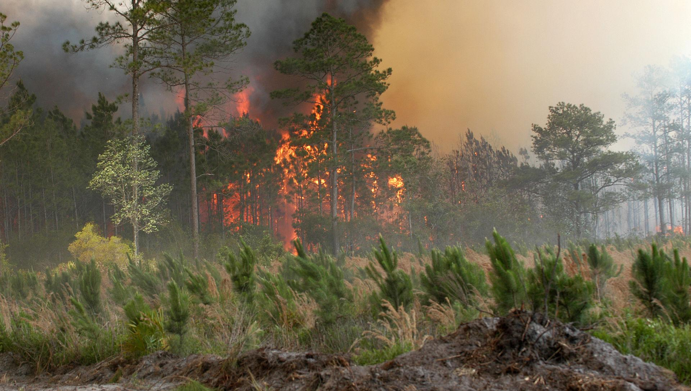

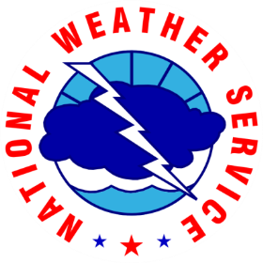
National Weather Service Melbourne
2025 - 2026 Fire Season Outlook
Zach Law
Meteorologist & Fire Program Leader
--------------------------------------------------------------------------------------------------------------------------------------------------
National Weather Service – Melbourne, FL
zachery.law@noaa.gov

Slide 2
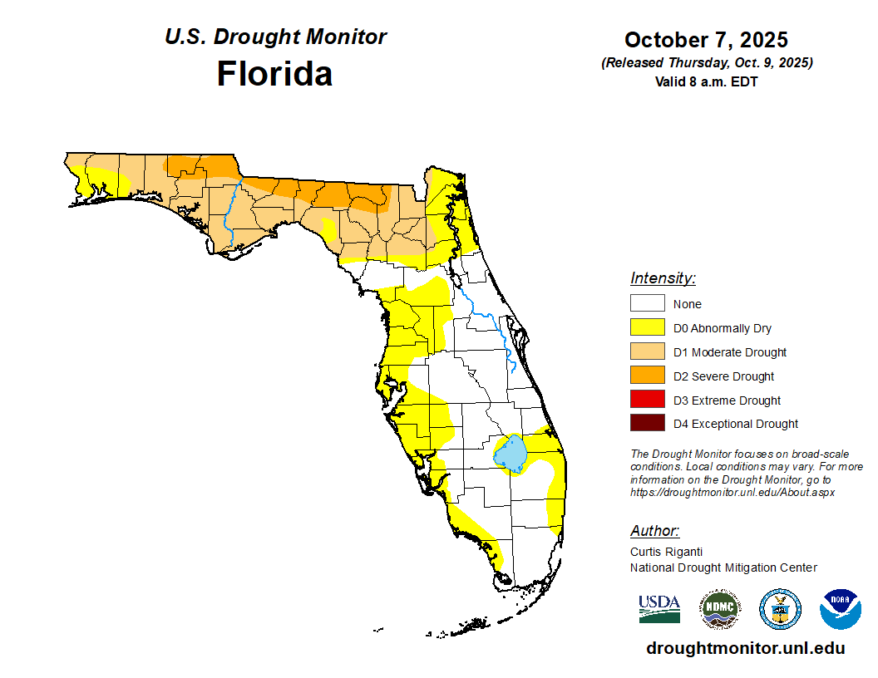
Fire Season Outlook
Overview
2025 In Review
Current Conditions
Seasonal Outlook
NWS Products & Services
Summary

Slide 3
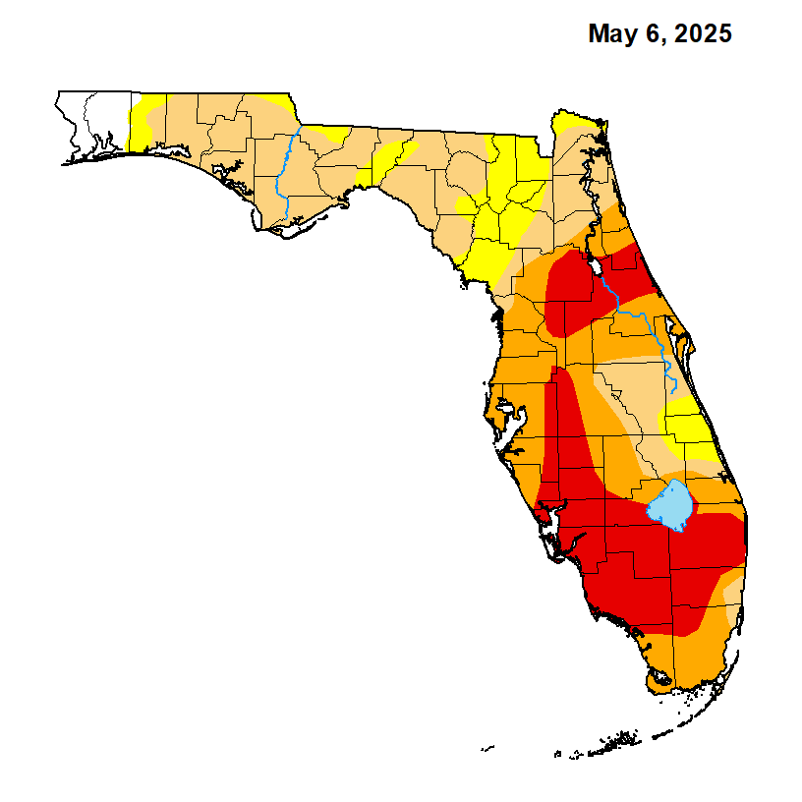
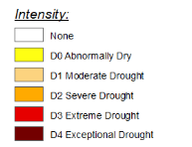
2025 In Review
NWS Melbourne Spot Requests
Seasonal Patterns:
January-February
  Preseason Burning
March
  Increasing Drought
  Red Flag Conditions - 7 Days
April-May
  Burn Bans
June
  Burn Bans Lifted
Issued 356 Spot forecasts for 2025:
303 Prescribed
53 Wildfire
NWS Melbourne Spot Requests
 | Jan. | Feb. | Mar. | Apr. | May | Jun.
Prescribed | 74 | 48 | 28 | 14 | 18 | 56
Wildfire | 1 | 4 | 27 | 12 | 5 | 2

Slide 4
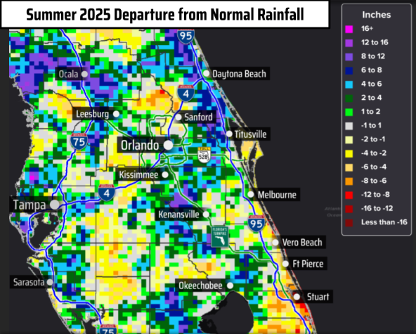
2025 In Review
Wet Season
Quiet Tropical Season (so far…)!
Scattered Summer Storms
Winners:
  S & E of Orlando Metro
  Coastal west central Florida
Losers:
  N & W of Orlando Metro
  Interior west central Florida
June, July, August

Slide 5
Where Are We Now?
Seasonal Transition
Wet Season Dry Season
Seasonal Shift In Rainfall
Summertime Storms
Fall & Wintertime Fronts
  Changing Air Mass
  More Strong Wind Events
Median Start of the Dry Season
Orlando | October 15
Daytona Beach | October 15
Sanford | October 15
Melbourne | October 17
Vero Beach | October 19
Fort Pierce | October 20
Stuart | October 23
*Actual onset of dates have high variability and can differ by several weeks.

Slide 6
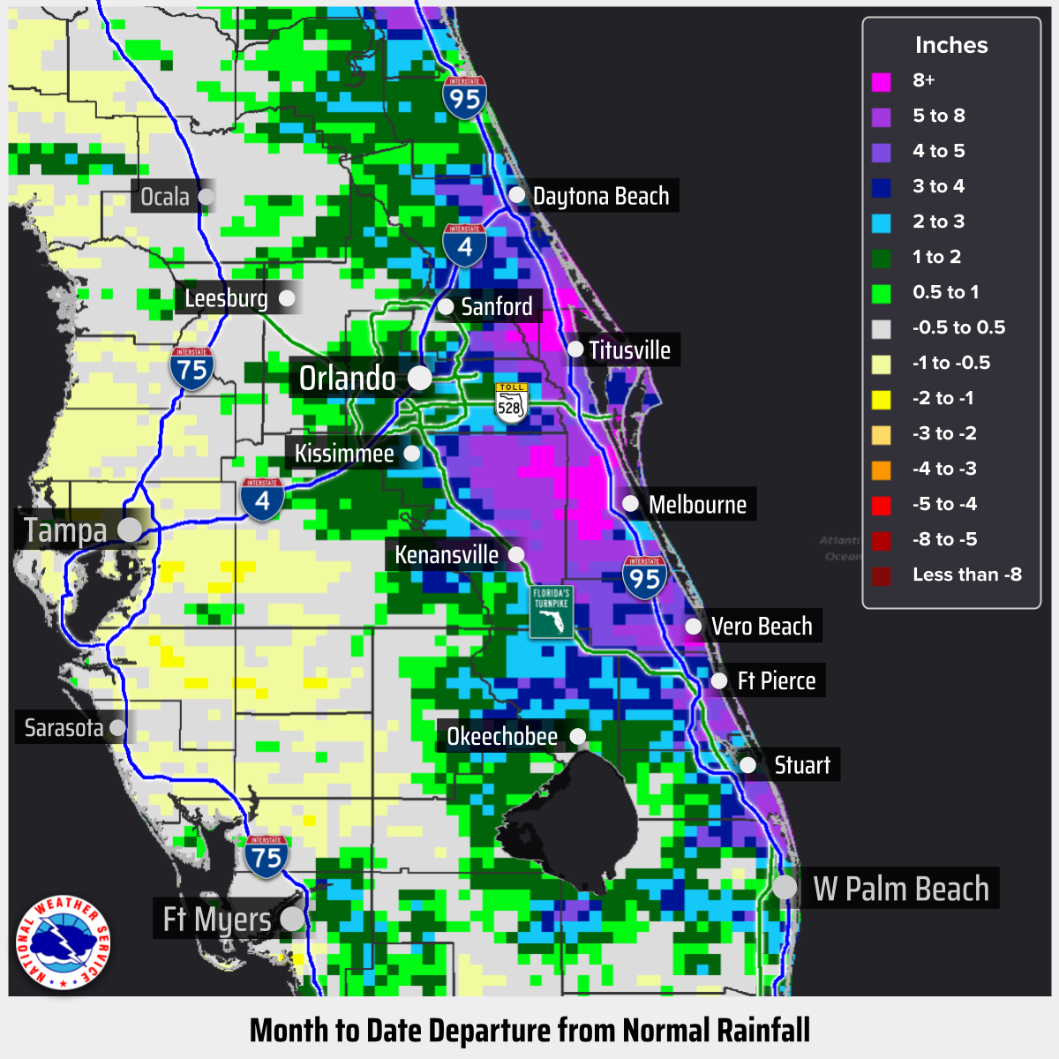
More Recent Trends
October so far…
Uneven distribution of rainfall
Heavy rainfall for east central Florida Oct 7 – Oct 11
Highest County Rainfall Totals
October 7 - October 11
County | Location | Rainfall
Brevard | Rockledge | 8.63”
Volusia | Edgewater | 7.05”
Indian River | Vero Beach | 6.87”
Martin | Stuart | 5.27”
St. Lucie | Fort Pierce | 2.57”

Slide 7
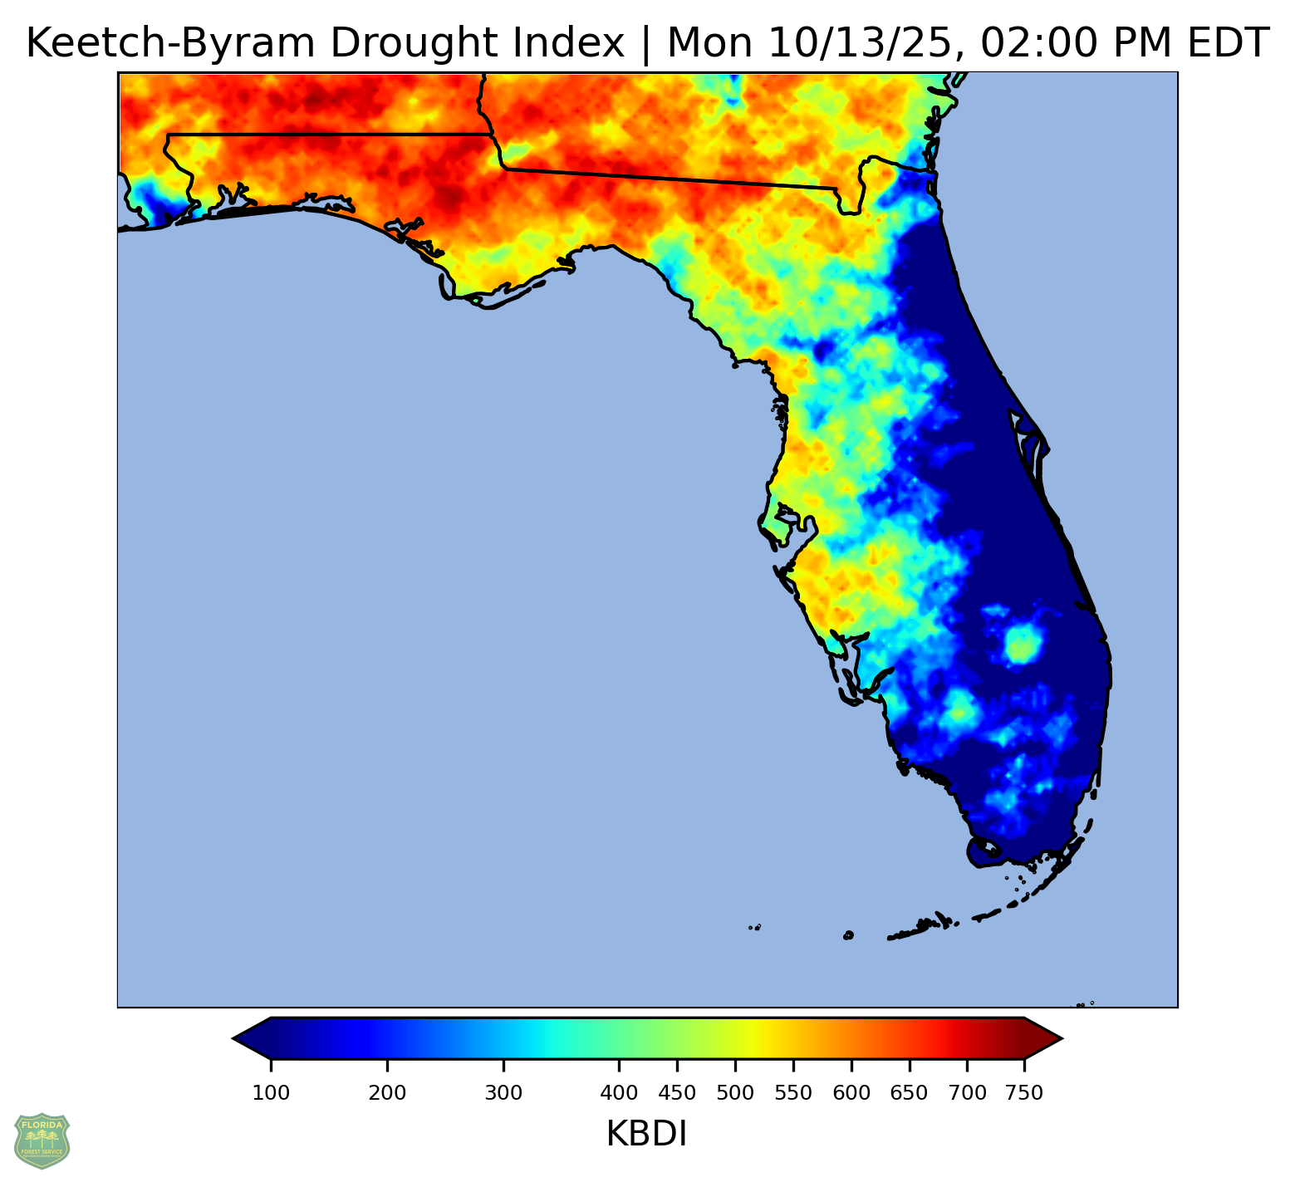
Current Conditions
Soil Moisture
Saturated eastern peninsula
Dry west central peninsula (KBDI)
Sarasota - 523
Manatee - 505
Pasco - 492
Hillsborough - 453
DeSoto - 441
Extremely Dry North Florida

Slide 8
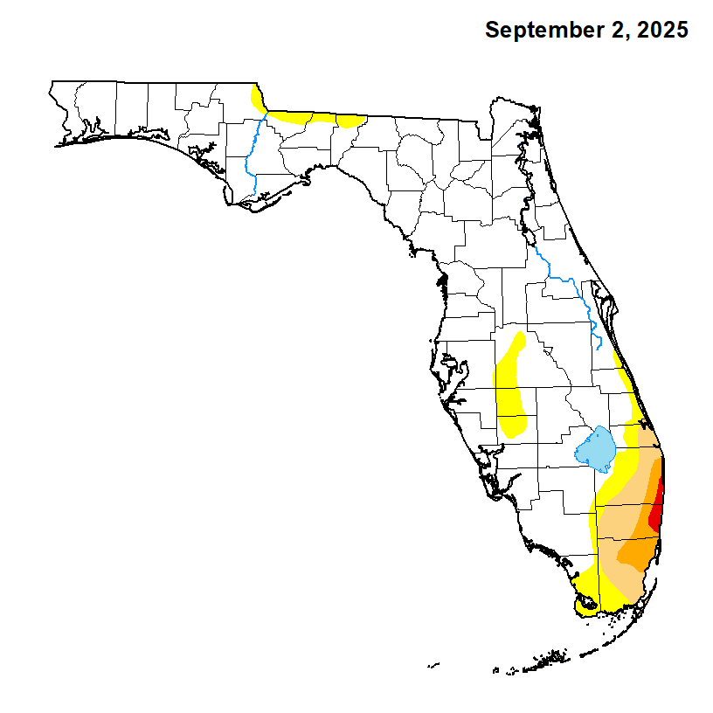
Current Conditions
U.S. Drought Monitor

Slide 9
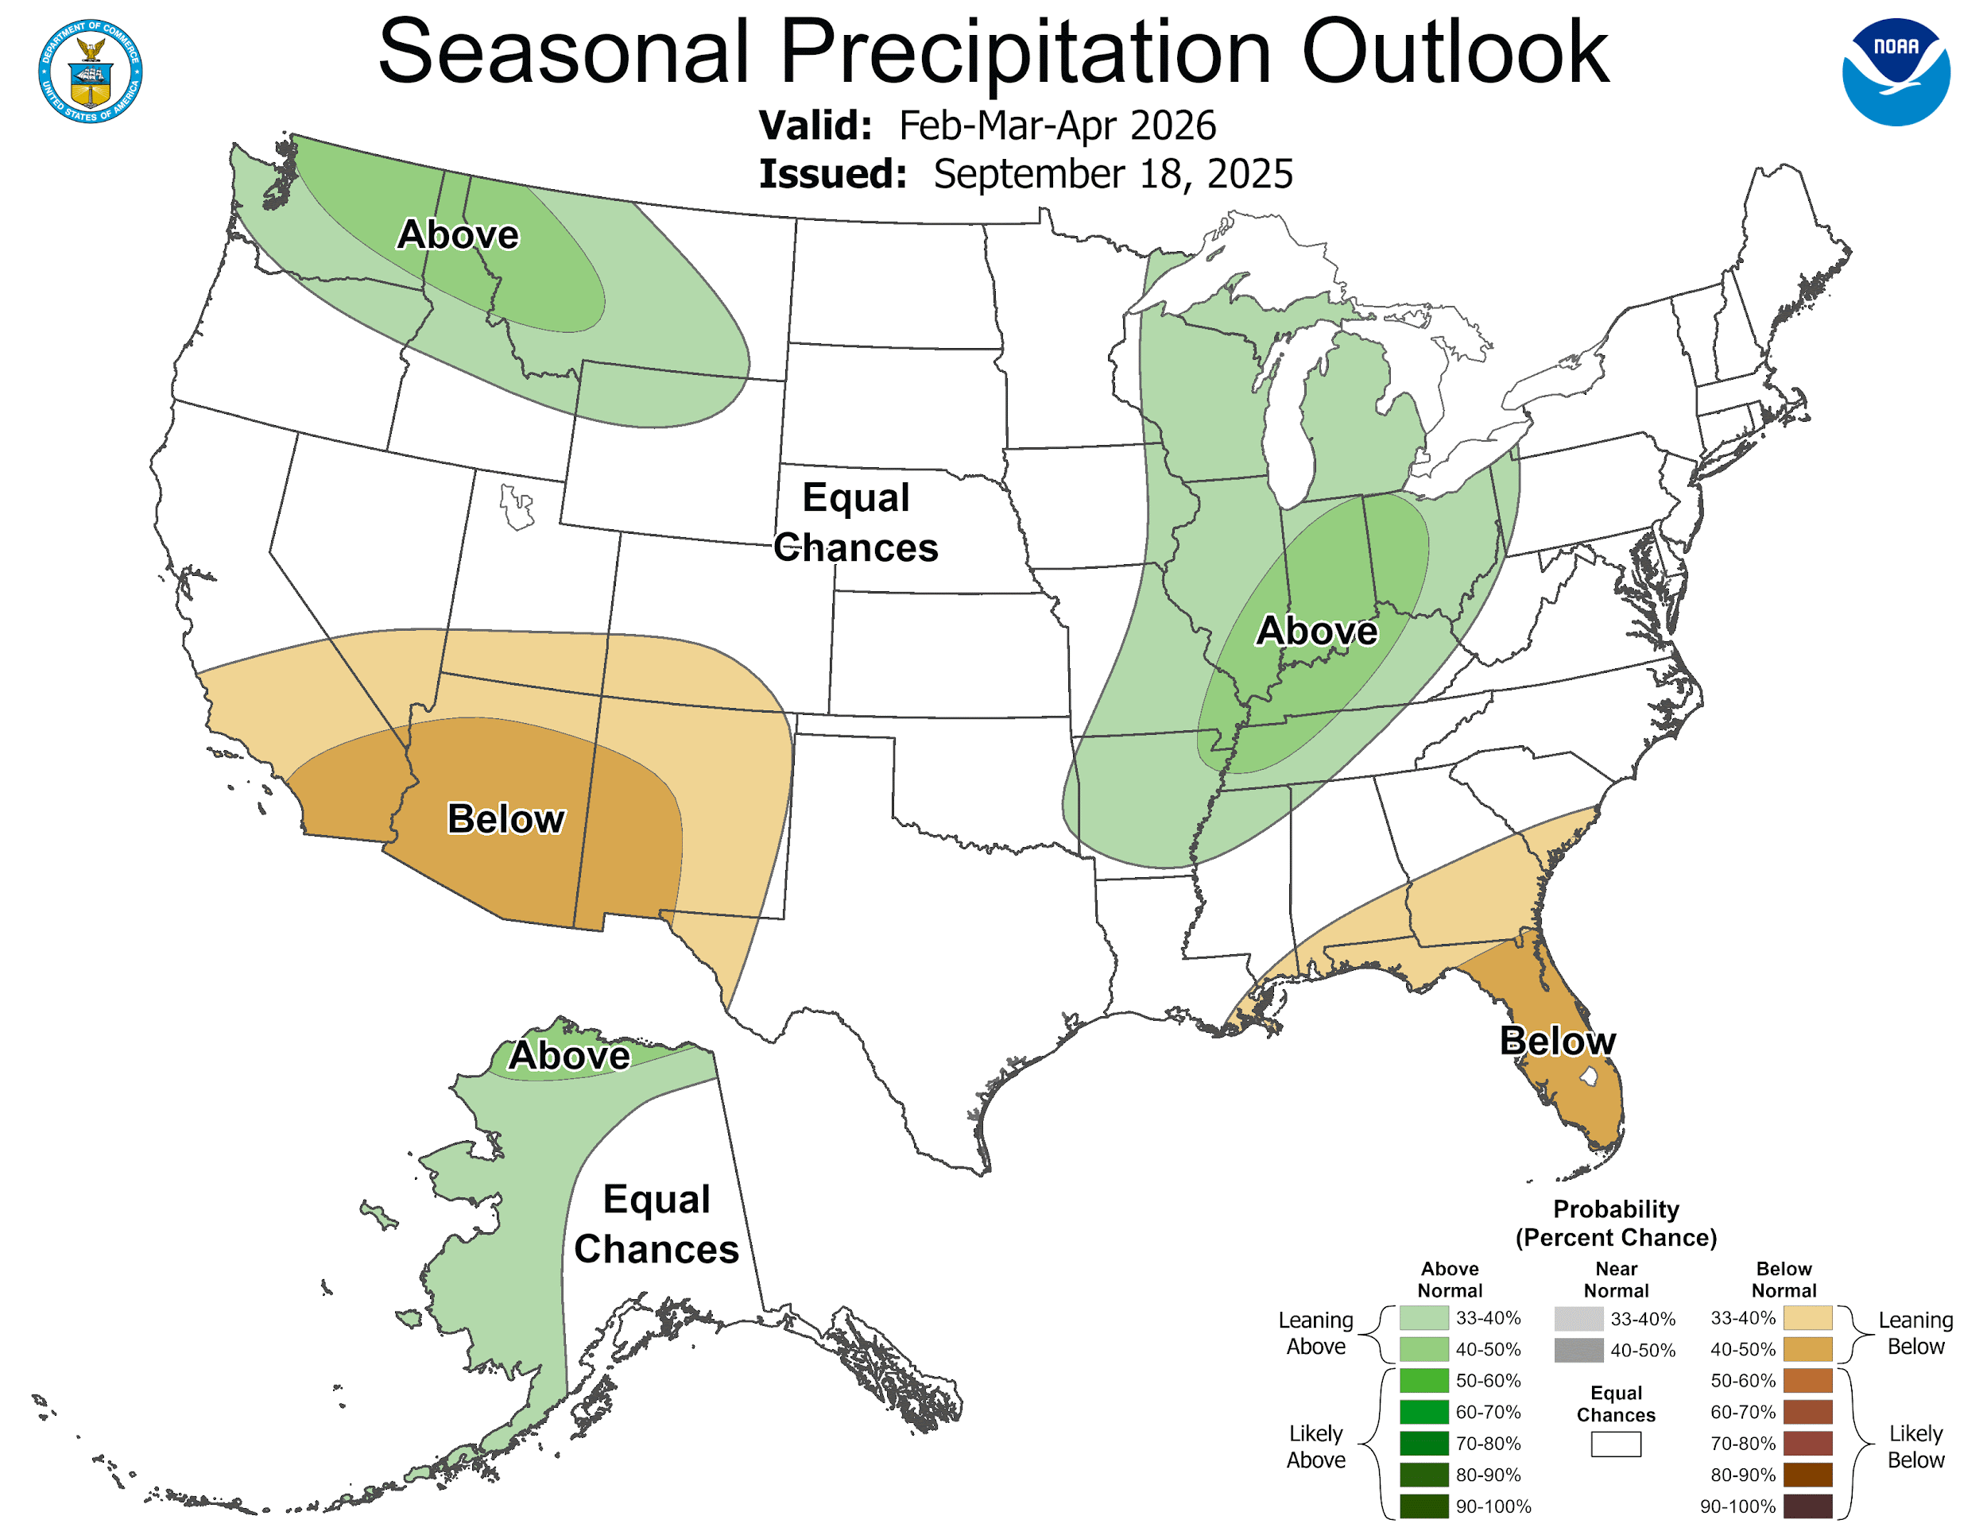
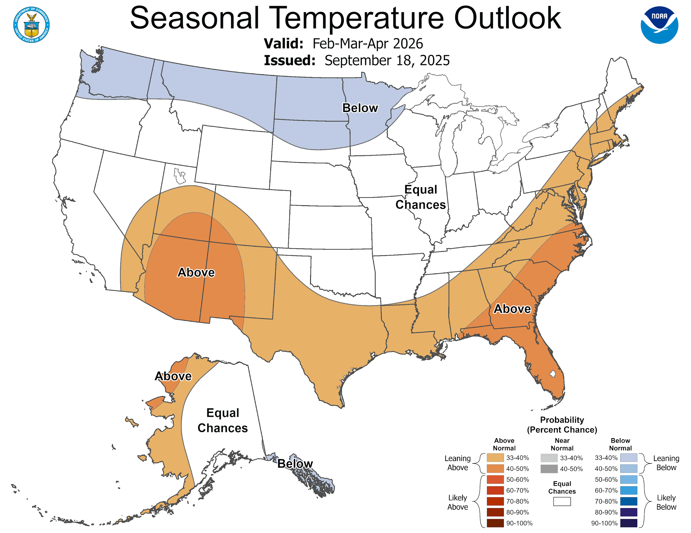
Fire Season Outlook
A Look Ahead
Note
These outlooks depict temperature and precipitation averages over three month periods!
La Nina conditions are present and favored to persist through December 2025 - February 2026.
A transitional period is forecast January - March 2026.
La Nina typically results in the jet stream being displaced to the north, which locally results in:
  Greater potential for below normal rainfall, increasing the potential for drought and wildfires
  Above normal temperatures overall, though periods of cooler than normal weather will occur (just with less frequency)

Slide 10
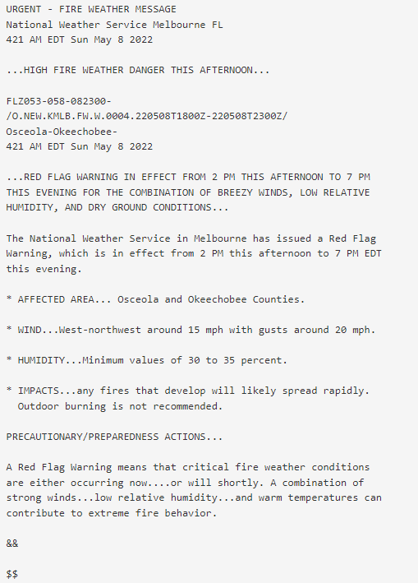
Red Flag Warnings
Local Criteria
Red Flag Warning
Alerts partners when critical fire conditions are expected to occur.
WFO Melbourne issues RFWs when:
  RH is forecast 35% or less
  and… sustained 20 ft winds are forecast at at least 15 mph
  and… “Moderate” is marked on the National 7-day Significant Fire Potential Outlook
A Fire Weather Watch can be issued a day or two in advance of potential Red Flag Conditions.

Slide 11
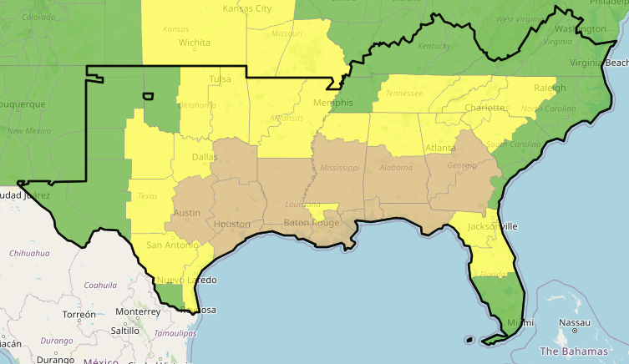
Significant Fire Potential Outlook
Southern Area
Significant Fire Potential Outlook Product
Significant fire conditions are monitored by Meteorologists at each Geographic Area Coordination Center (GACC)
Threat level is modeled out to 7-days with input of weather conditions, dryness of fuels, and available suppression resources
Updated daily on weekdays and as-needed on weekends

Slide 12
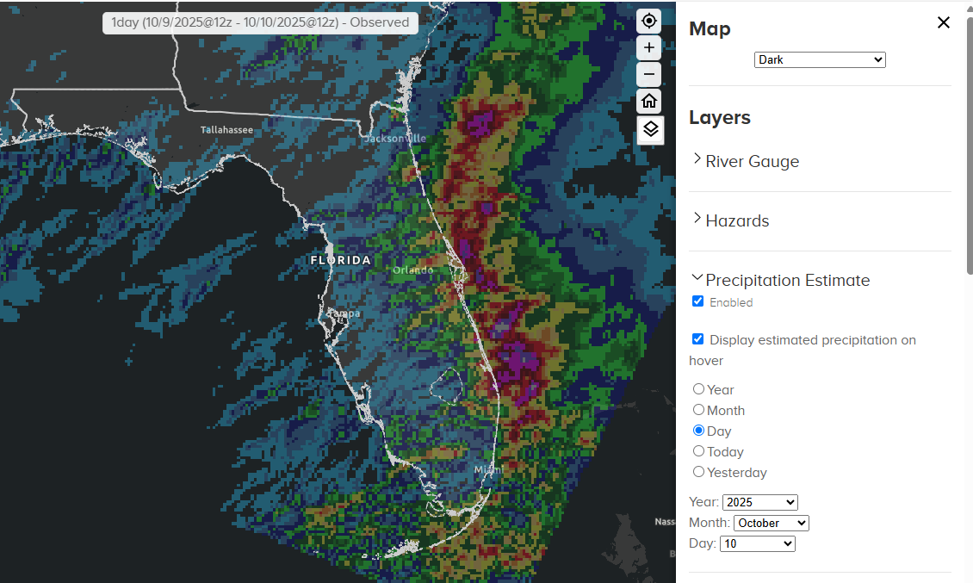
Precipitation Estimates
water.noaa.gov

Slide 13
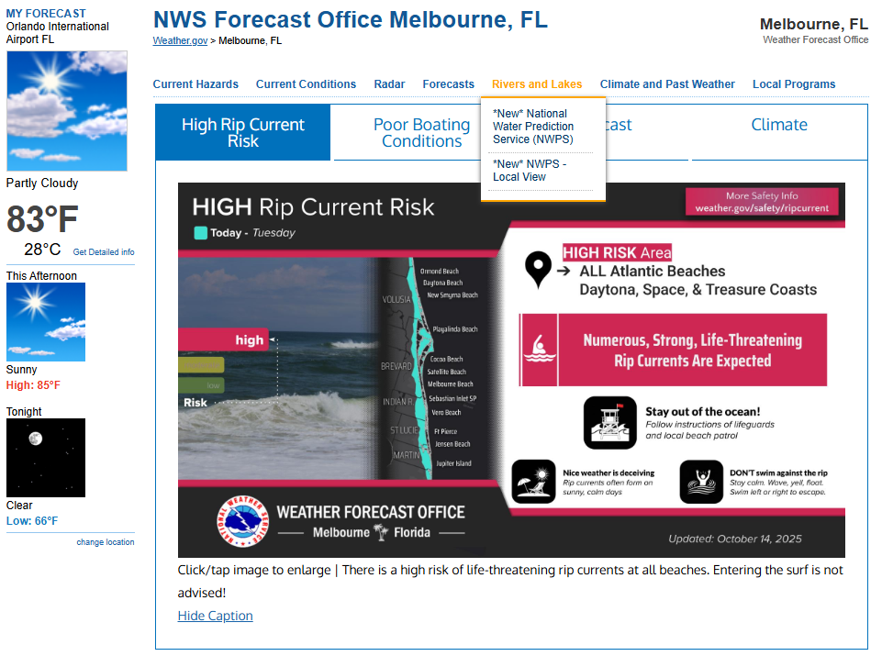
Precipitation Estimates (NWPS)
Found On Our Local Webpage!

Slide 14
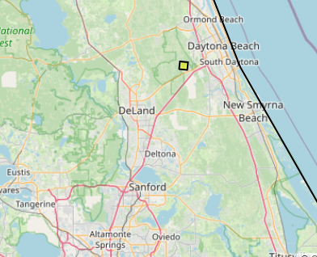
NWS Products & Services
Planning a prescribed burn
You are planning a prescribed burn at Tiger Bay State Forest early next week:
What factors are you considering?
Burn site
Antecedent conditions
Weather

Slide 15
NWS Products & Services
Planning a prescribed burn
What products are you reviewing:
A few days before the burn?
Day of the burn?

Slide 16
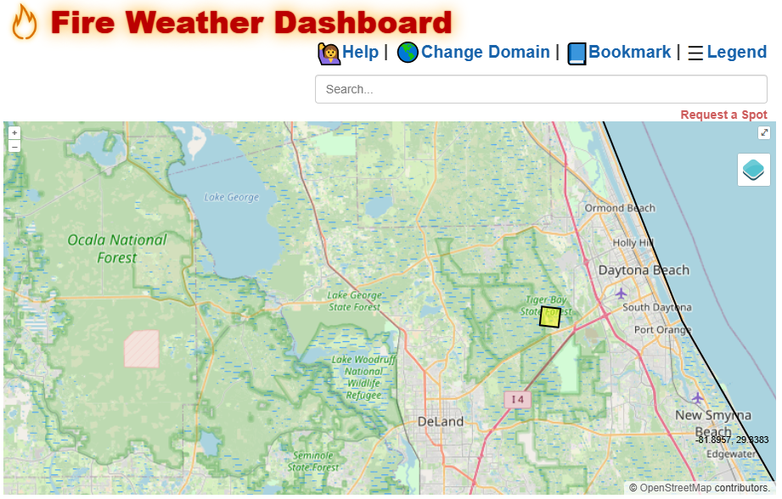
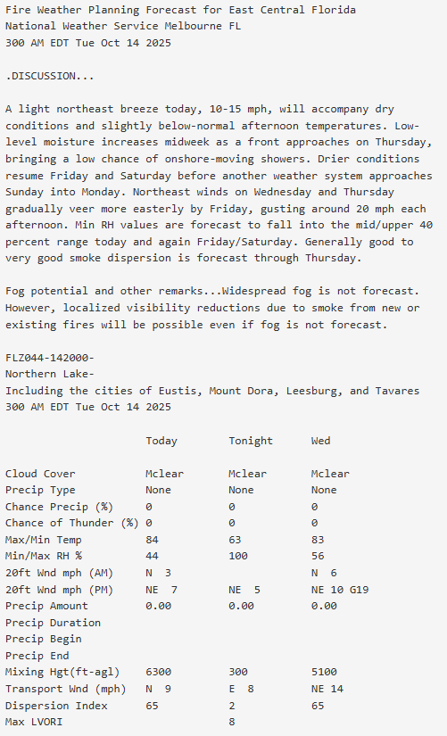
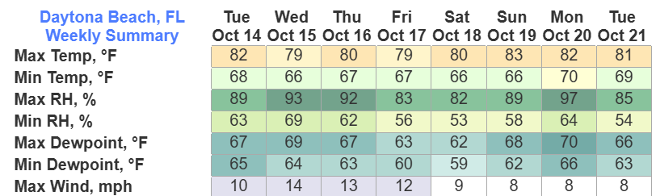
NWS Products & Services
Planning a prescribed burn

Slide 17
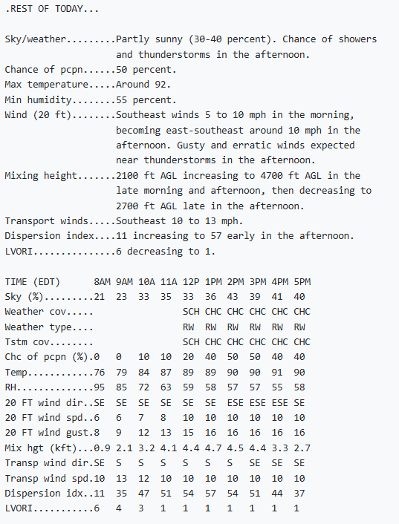
NWS Products & Services
Planning a prescribed burn
A Spot forecast has been provided from the local weather service office. Favorable winds are forecast, keeping smoke away from major highways and population centers.
It’s 12pm, thunderstorms have developed west of the burn site.
What concerns do you have?

Slide 18
NWS Products & Services
We are here for you!
Routine Products:
Fire Weather Planning Forecast
Point & Click Forecast: Fire Weather Dashboard
National Water Prediction Service: Rainfall Estimates
Situational Support:
Spot Forecasts
Phone Calls, 24/7

Slide 19
Fire Season Outlook
Three Things You Should Know
An uneven distribution of recent rainfall has lead to saturated soils across the eastern peninsula while areas across the west central peninsula remain abnormally dry.
La Nina conditions are present. Drier than normal conditions are forecast this winter and spring, resulting in greater potential for drought and an active wildfire season.
  Given current conditions on the east coast, the potential for significant wildland fires is likely to remain low for the next few months in this area, before increasing early next year.
  Dry pre-existing conditions across the western half of the peninsula and north Florida will likely increase the risk of wildfires earlier in the season.
  Occasional cold fronts will still bring opportunities for rain and cooler temperatures, just likely less than usual!
Your local National Weather Service issues routine and non-routine fire weather forecasts and advisories for the protection of life and property.
  Routine: Fire Weather Planning Forecast
  Non-Routine: Fire Weather Watch, Red Flag Warnings, and Spot Forecasts
  The Fire Weather Program Leader serves as the NWS contact for land management agencies within each National Weather Service forecast office area of responsibility.

Slide 20
Questions?
zachery.law@noaa.gov
weather.gov/mlb
Forecasts Fire
Melbourne | Jacksonville | Tampa
(321) 255-0212 Ext. 4 | (904) 741-4370 | (813) 645-2323

Slide 21
NWS Products
Fire Weather Planning Forecast
Fire Weather Planning Forecast
Fire weather forecast details (relative humidity, 20 ft. winds, mixing height, dispersion, etc.) for each zone in 12-hour forecast periods.
Includes a written forecast overview of east central Florida fire weather and a mention of potential fog development
Updated twice a day and on an as-needed basis
  3am & 3pm

Slide 22
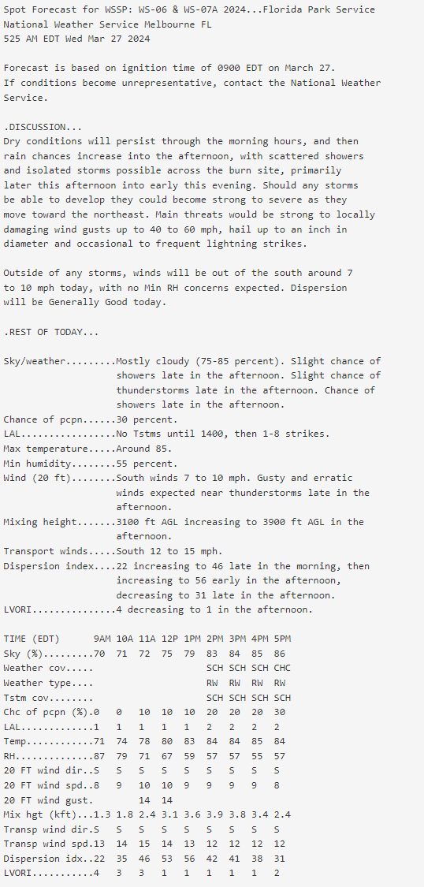
NWS Products
Spot Forecast
Spot Forecast
Fire management partners can request a Spot Forecast for a precise location ahead of a prescribed burn or during an active wildfire.
Provides greater detail (hourly) of forecasted fire weather conditions
Remember, Spot forecasts should be requested from local, state, or federal entities.

Slide 23
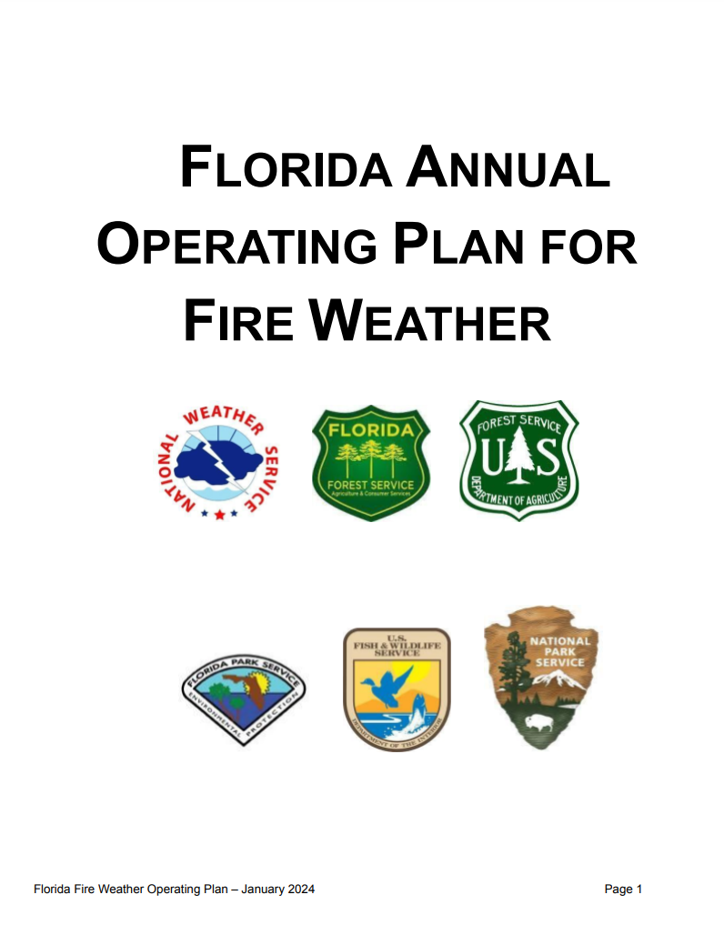
NWS Products
State AOP for Fire Weather
Fire Weather Annual Operating Plan
Governing document for fire weather procedures and cooperation among local, state, and federal agencies within the state of Florida.
Provides an overview of all fire weather related products (routine and non-routine) and corresponding criteria from each of the seven NWS Weather Forecast Offices that cover the state.
Reviewed annually by the National Weather Service.

