Slide 1
FFS Update – Fall 2025
Central Florida Prescribed Fire Council
Kissimmee, FL – October 16, 2025
John Saddler
Prescribed fire manager

Slide 2
FFS Update
Tough Year for Burning
Fairwell, Bunnell
Upcoming Training
Smoke Screen / WebOBA issues
WebOBA Replacement
Burner Review
Notes:
23-24 YTD = 1.6
24-25 YTD = 1.2

Slide 3
Authorized Prescribed Burn Acres By F/Y
(Million Acres)
Notes:
These are Fiscal Year July-June.
FY to date we are up over previous five years by almost 10%

Slide 4
Bunnell Breakup
October 24th
St. Johns County - Jacksonville
Flagler County - Jacksonville
Volusia County - Orlando
Jacksonville – 904-266-8351
Orlando – 407-888-8760
Notes:
23-24 YTD = 1.6
24-25 YTD = 1.2

Slide 5
2025-26 CPBMT Course Schedule
Quincy: November 4-6, 2025
Milton: December 3-5, 2025
Jacksonville: December 8-10, 2025
Welaka: December 8-11, 2025
West Palm Beach: January 26-28, 2026
Apopka: January 26-29, 2026
Brooksville: April 20-23, 2026

Slide 6
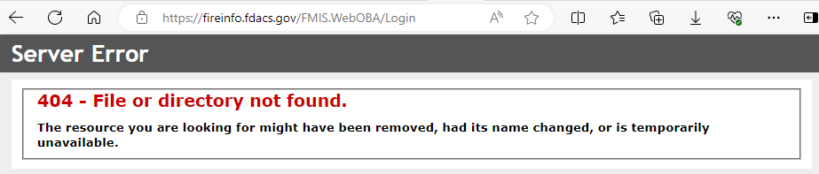
WebOBA/Smoke Screen - Issues

Slide 7
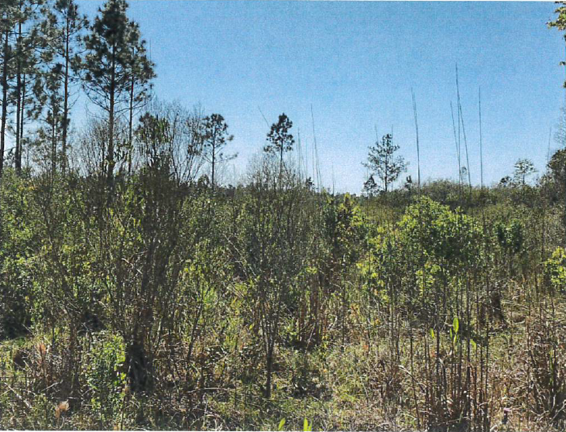
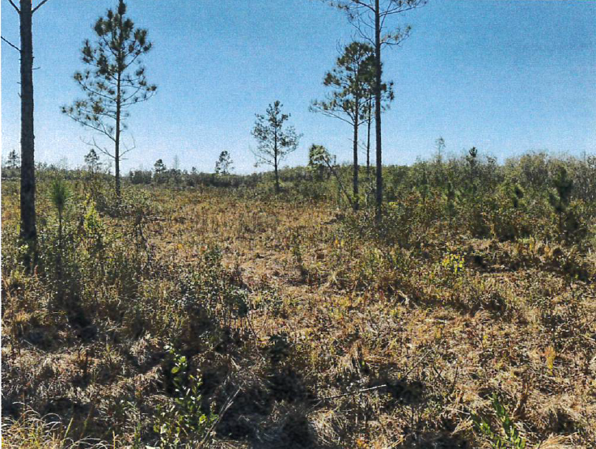
Prescribed Fire Enhancement
SRWMD – Mallory Swamp Roller Chopping
Notes:
SRWMD Mallory Swamp Roller Chopping

Slide 8
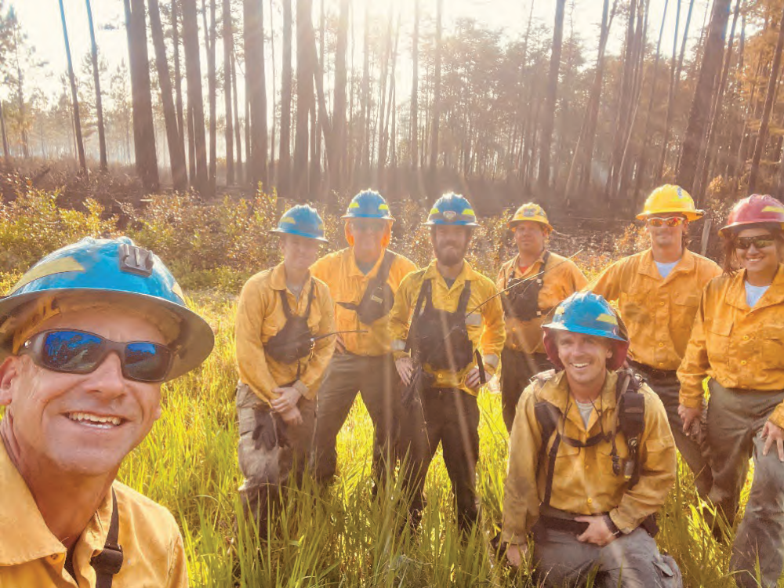
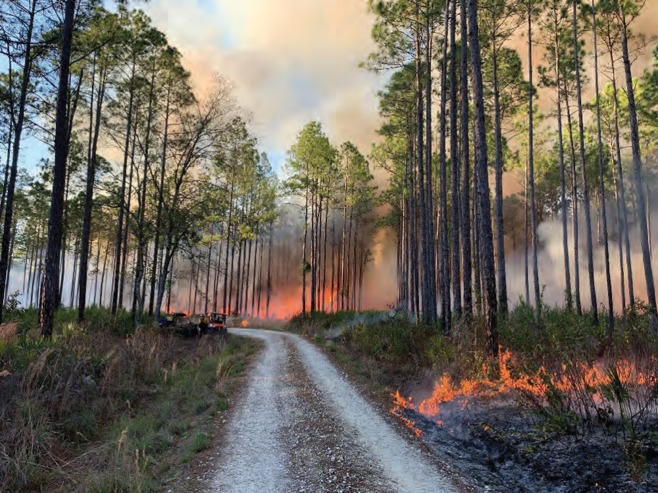
Prescribed Fire Enhancement
SJRWMD – Lochloosa and Julington-Durbin
Notes:
SJRWMD Lochloosa Wildlife Conservation Area and Julington-Durbin Preserve

Slide 9
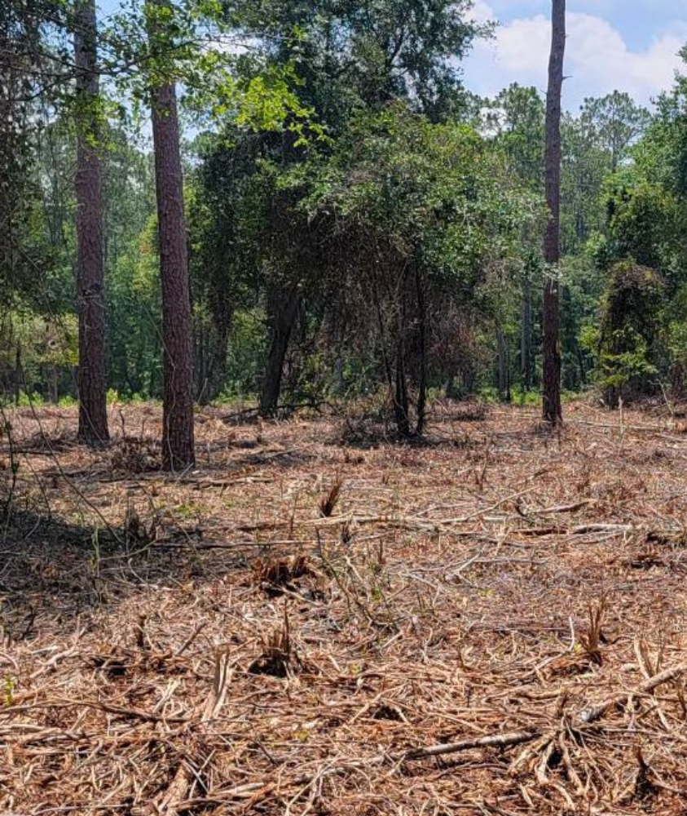
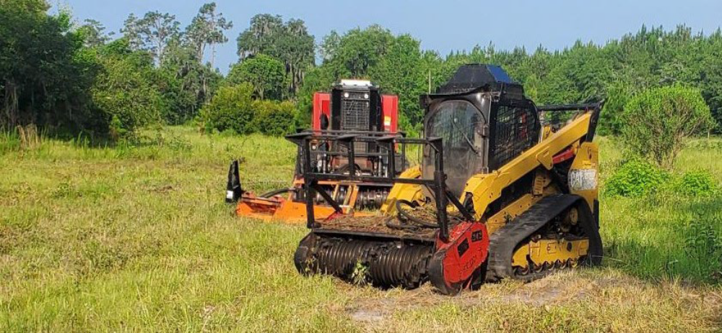
Prescribed Fire Enhancement
Big Shoals State Park
Notes:
Big Shoals SP

Slide 10
WebOBA Replacement

Slide 11
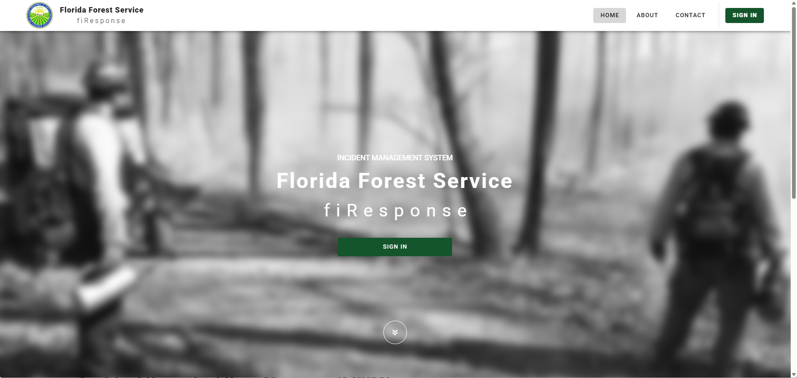
fiRespnse

Slide 12
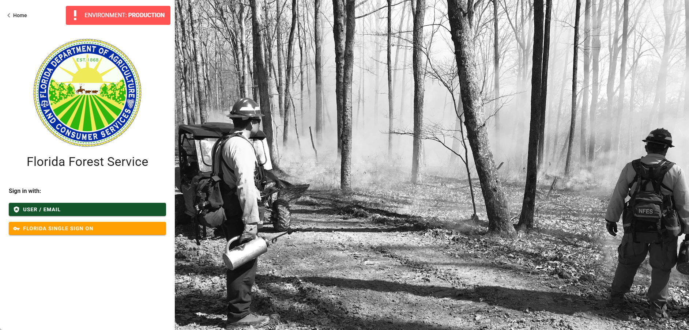
Log In

Slide 13
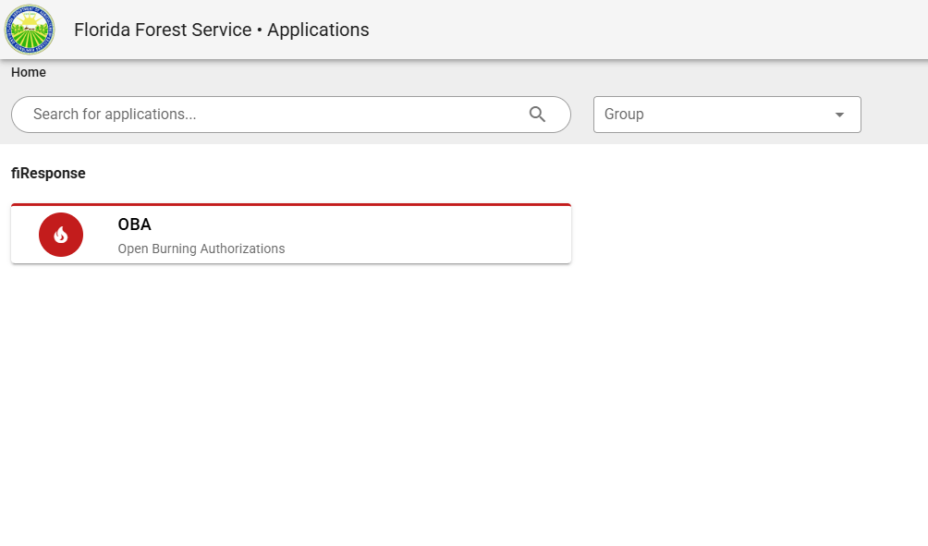

Slide 14
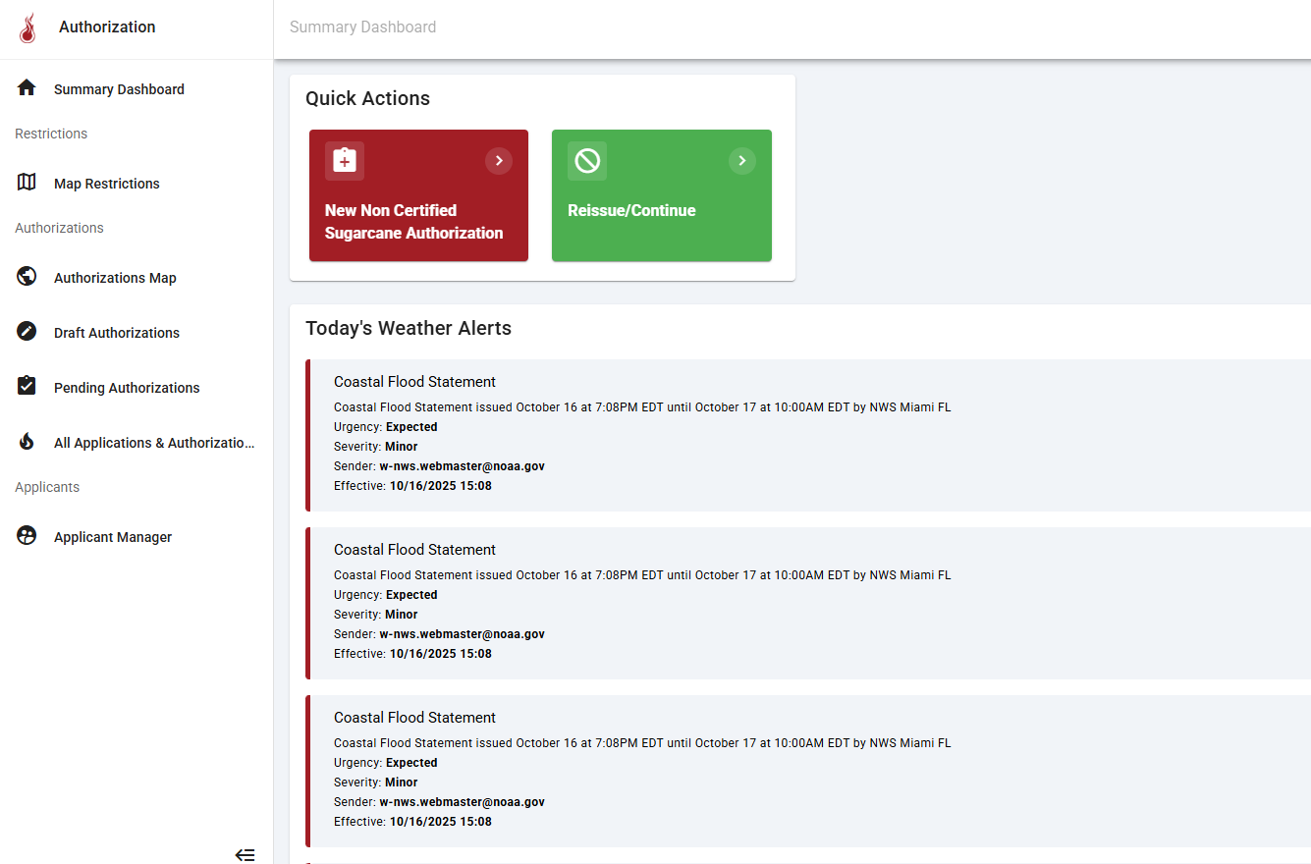
Burn Participation Log

Slide 15
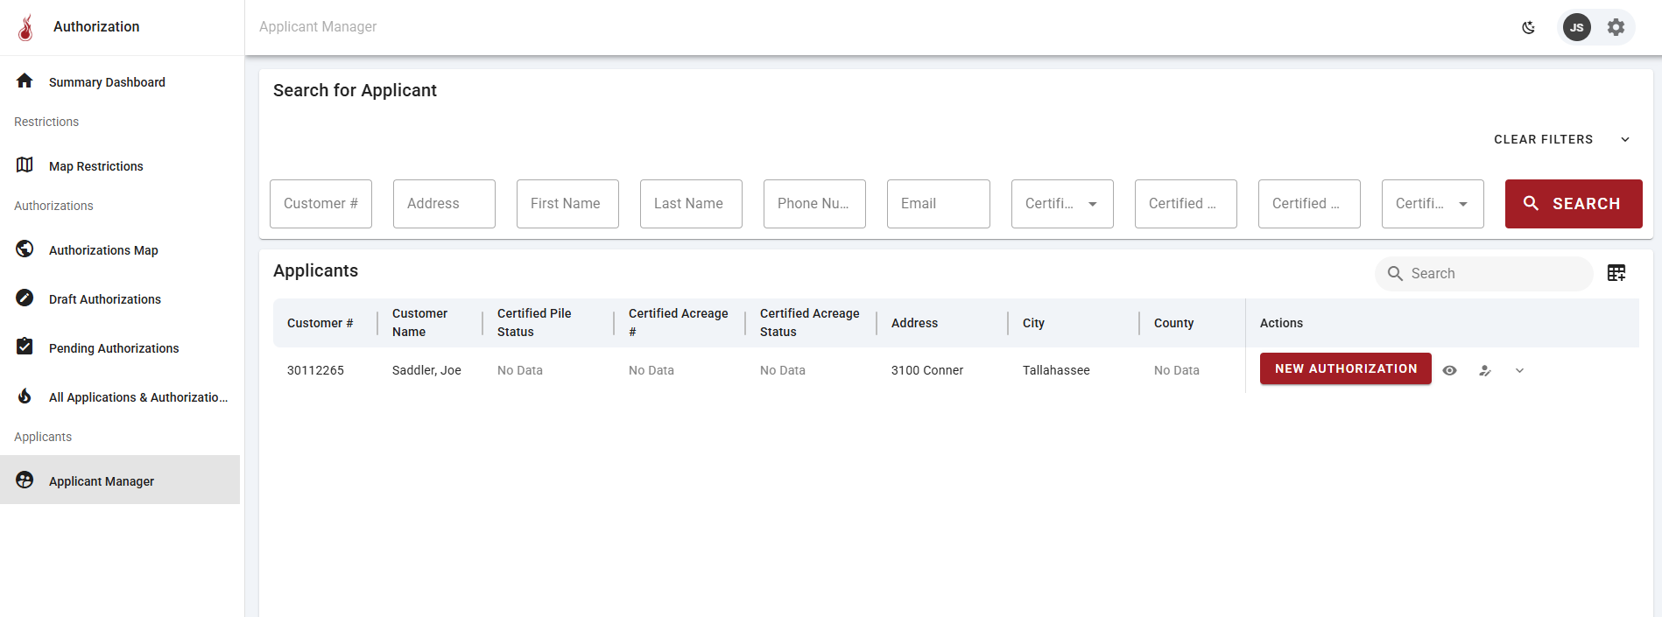

Slide 16
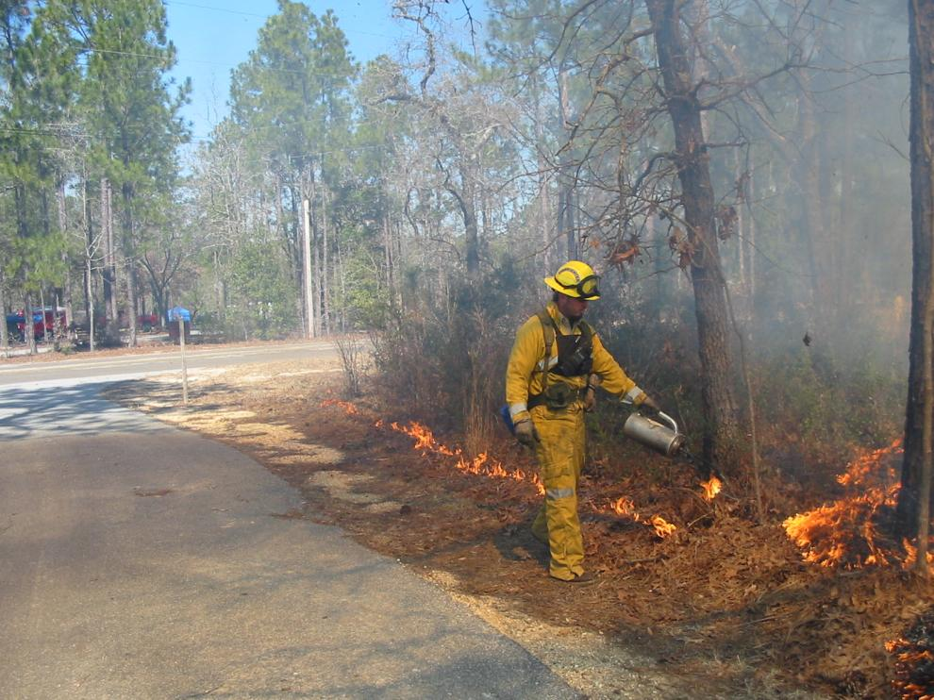
Burner Review

Slide 17
Burner Status Letters
Mailed or E-Mailed at the end of January
  Green = Status good beyond end of year
  Yellow = Status will expire at end of year
Keep your contact information current
  Used to send letters
  Add Email to your account
Let the Duty Officer know that you are doing a certified burn

Slide 18
Upcoming Events
Red Hills Fire Festival
  Tall Timbers
  January 31, 2026

Slide 19
Any Questions?
John Saddler
Prescribed fire manager
850-681-5928
John.Saddler@FDACS.gov

