Slide 1
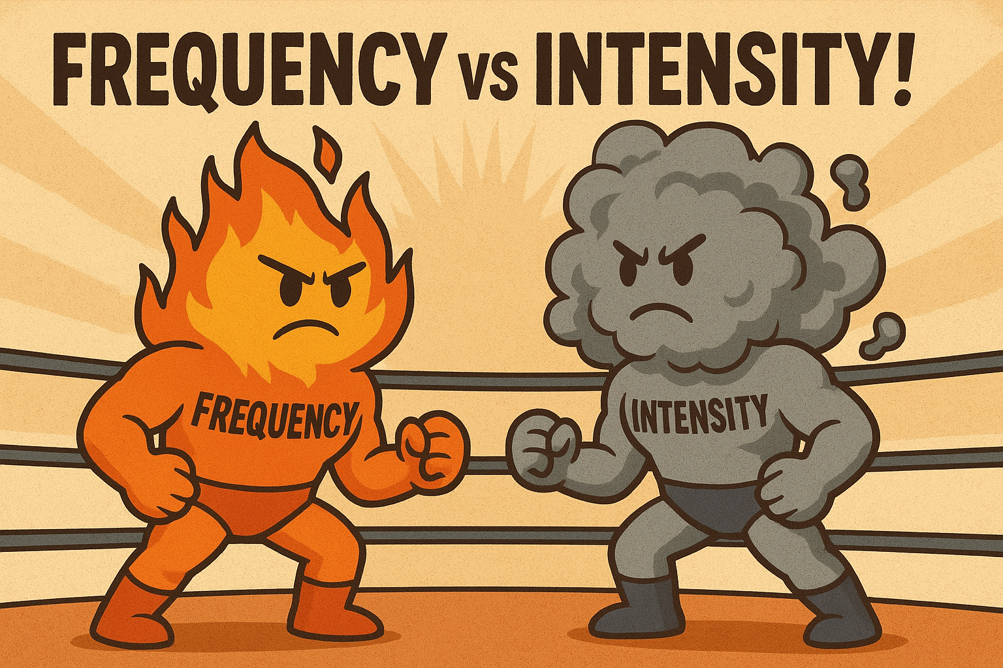
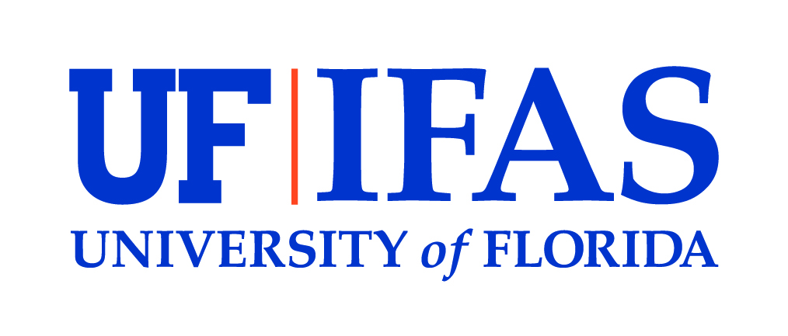

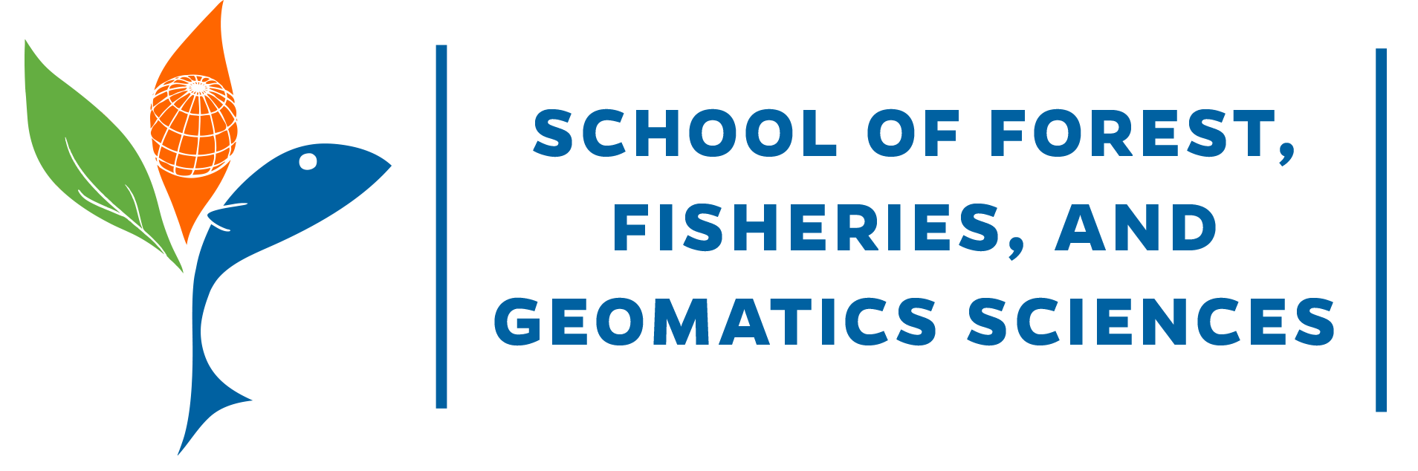
Practitioner Preferences
for
Rx Fire Smoke Impacts
Phillip Rodgers, PhD Student, University of Florida, School of Natural Resources and Environment
Advised by:
Dr. Raelene Crandall, University of Florida, School of Forest, Fisheries, and Geomatics Sciences

Slide 2

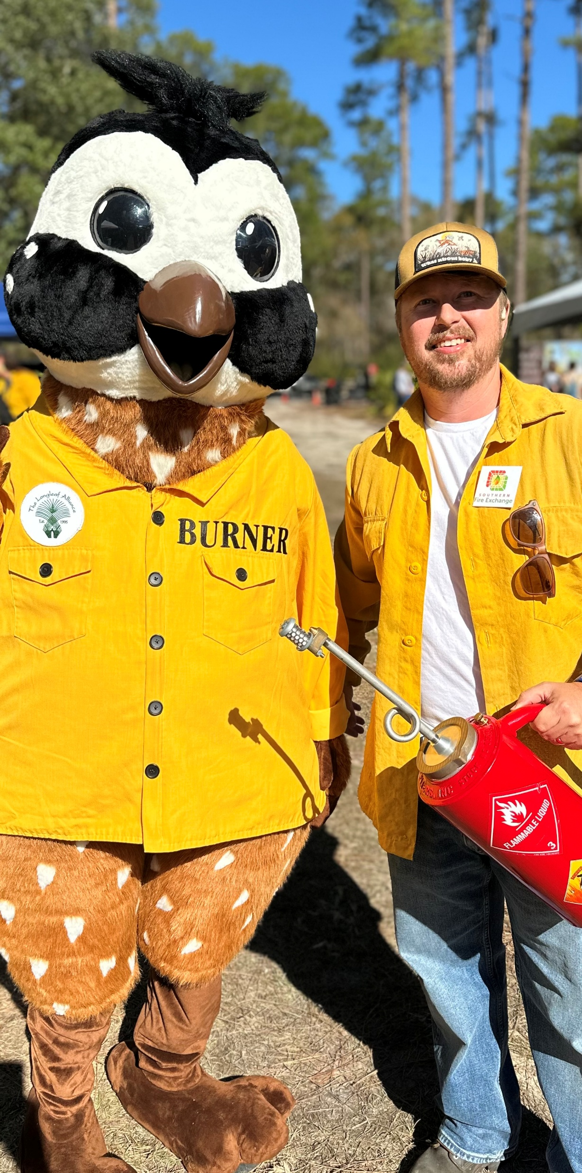
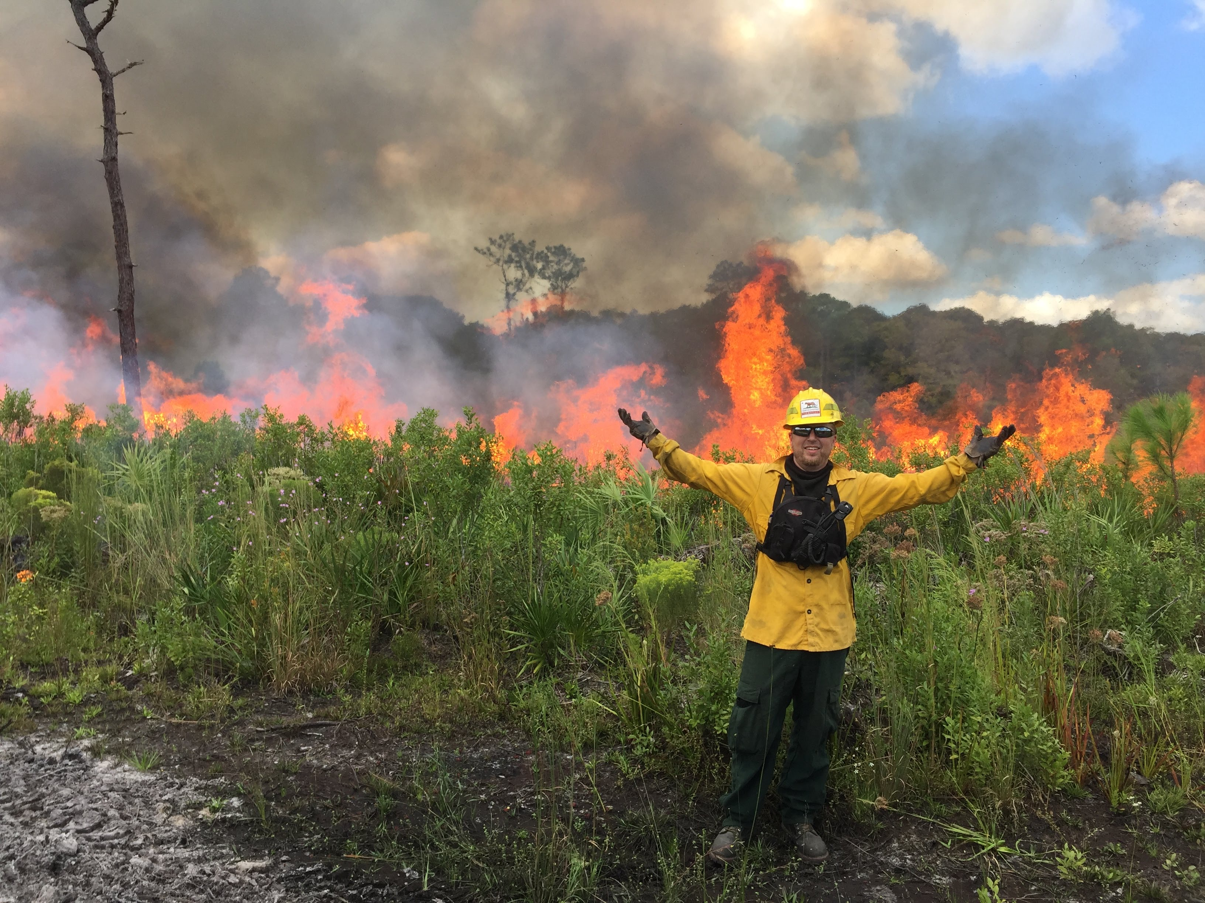
Phillip Rodgers
Notes:
PhD student advised by Dr. Rae Crandall & Conservation Social Scientist @ FWC
CPBM ‘2017’ – My time as a land manager is directly related to my research questions as a PhD student.
But I’ve spent a lot of time lighting fires and mopping up fires, and I spent even more time planning fires.
And when planning fires one thing that you always think about is where your smoke is going to go.

Slide 3
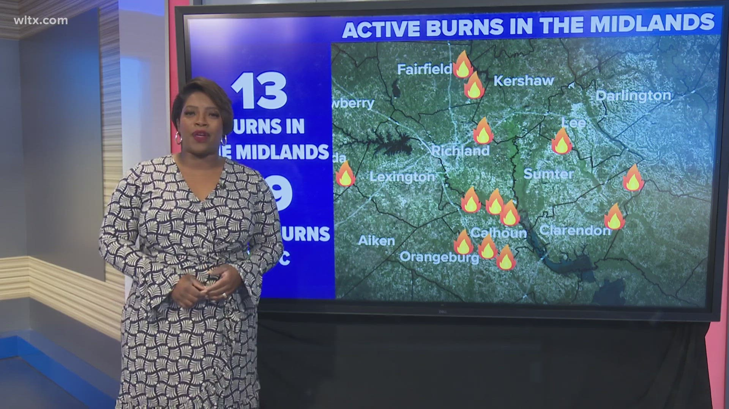
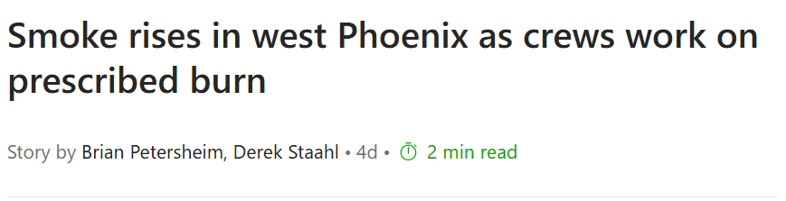
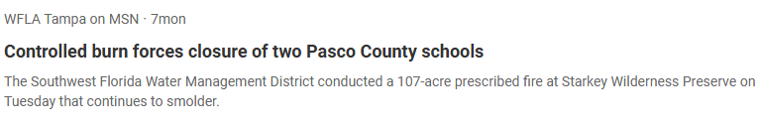
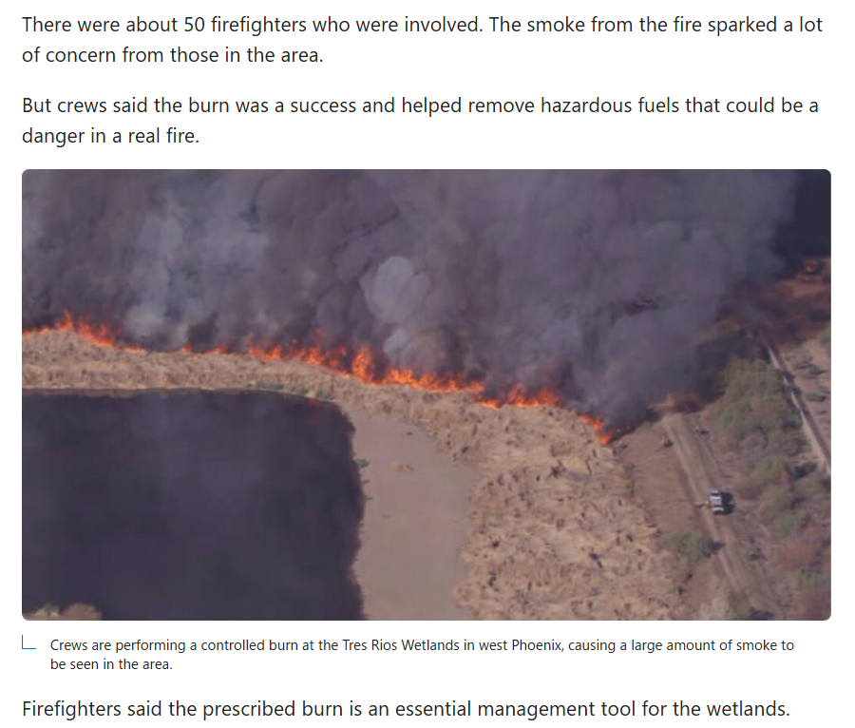
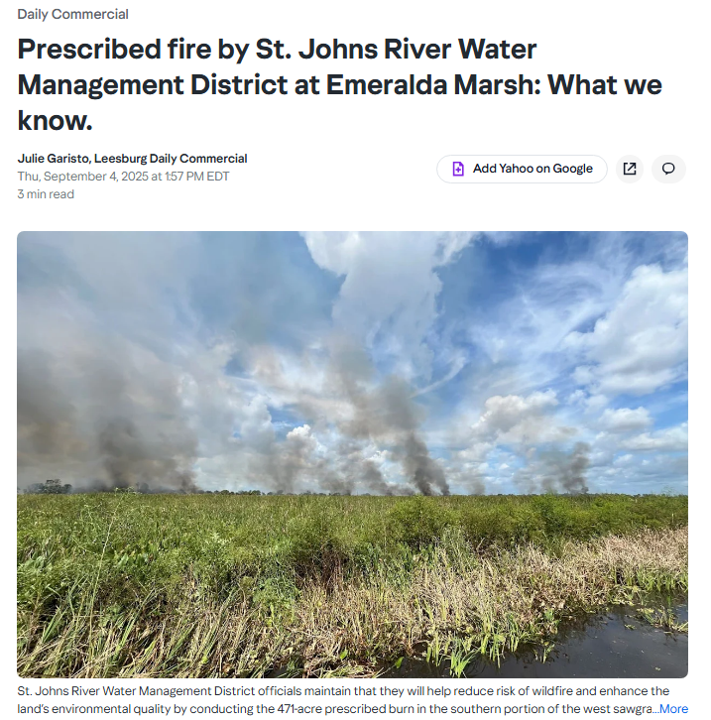
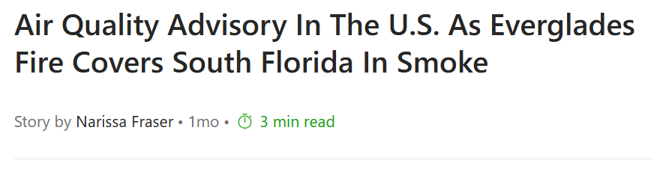
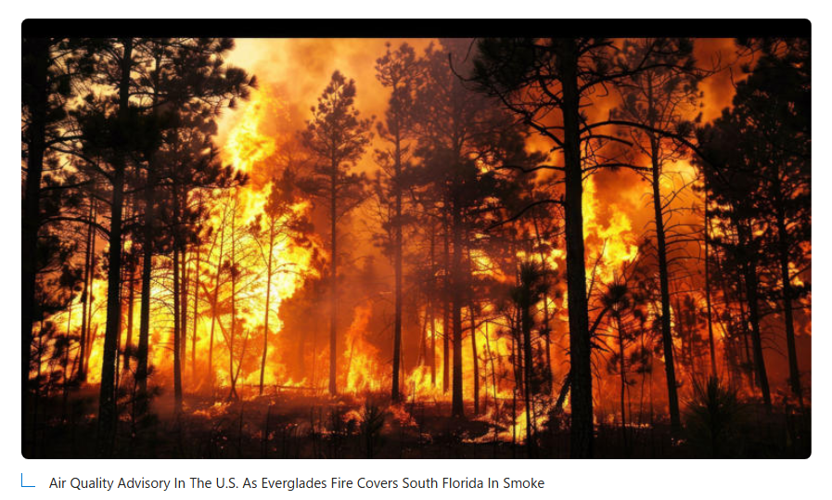
Notes:
We’re not the only ones who think about where that smoke goes.
Growing coverage of smoke from wildfires and prescribed fires.

Slide 4
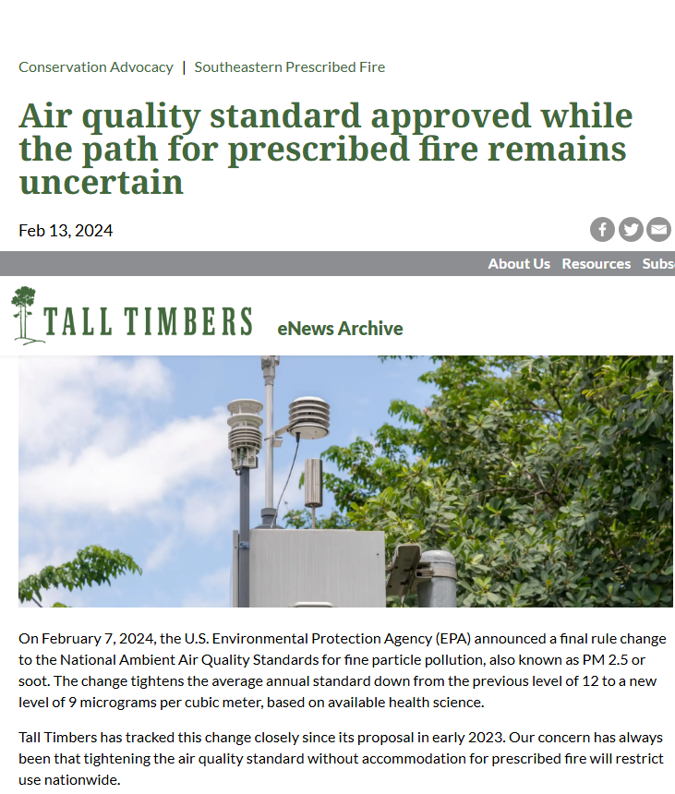
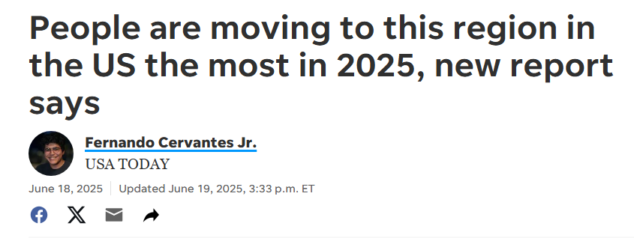
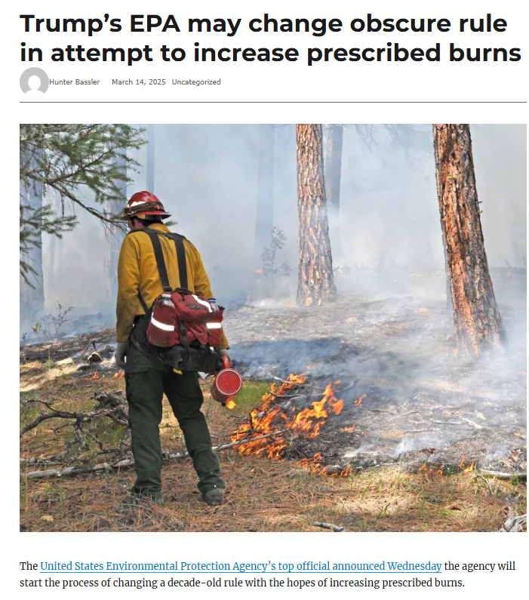
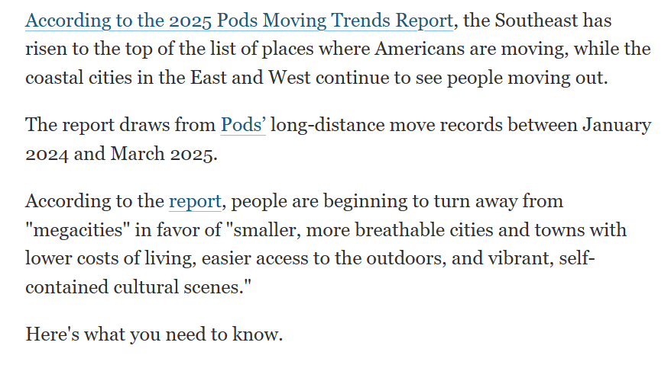
“…people appear to understand that no smoke is an unrealistic option: they will be exposed to smoke, either from a wildfire or from a prescribed burn, and so long-term trade-offs will need to be made.”
-McCaffrey (2006)
“…people appear to understand that no smoke is an unrealistic option: they will be exposed to smoke, either from a wildfire or from a prescribed burn, and so long-term trade-offs will need to be made.”
-McCaffrey (2006)
WildfireToday.com
Notes:
The EPA has been reviewing and changing ambient air quality standards, and federal rules may be changing that could potentially hinder or help efforts to use prescribed fire.
And on top of this, the SE US that leads the nation in Rx burning is also the top place that Americans are moving. For breathable cities!
McCaffrey retired from US Forest Service 2022 - 20 years of wildland fire social science work

Slide 5

Smoke Impact
Tradeoffs
Frequency
  Low 1-2 days/week
  Moderate 3-4 days/week
  High 5-7 days/week
Intensity
  Low AQI < 50, no concerns
  Moderate AQI 50 – 100, some concerns for vulnerable people
  High AQI > 100, concerns for more people
Severe Wildfire Risk Reduction
  Low minimal reduction
  Moderate reduction
  High greatly reduces risk
Research Proposal by Phillip Rodgers, Ph.D. Student, p.rodgers1@ufl.edu
Advised by Dr. Raelene Crandall, SFFGS
No one asked me what I thought.
Image created using openart.ai
Notes:
My research came from a refresher training at Disney WildnesPres….
Frequency
Intensity
Reducing the Risk from Severe Wildfire
And now Here I am in a room full of burners and I want to ask you, what are your preferences? I am going to put a QR code on the screen and you can scan that with your phone and take the survey.

Slide 6
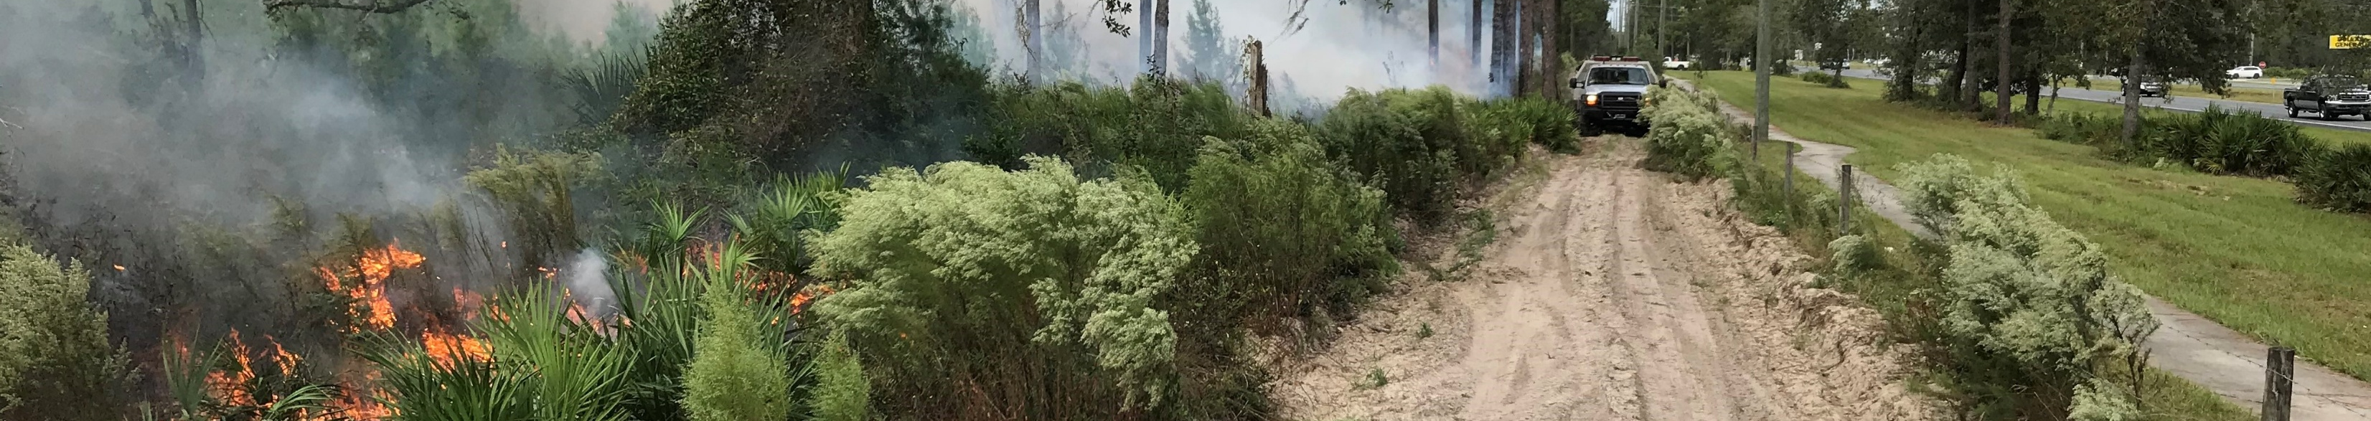
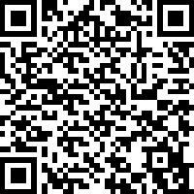
Scan the QR Code & Take the Survey
Smoke Impact
Tradeoffs
Frequency
  Low 1-2 days/week
  Moderate 3-4 days/week
  High 5-7 days/week
Intensity
  Low AQI < 50, no concerns
  Moderate AQI 50 – 100, some concerns for vulnerable
  High AQI > 100, concerns for more people
Severe Wildfire Risk Reduction
  Low minimal reduction
  Moderate moderate reduction
  High greatly reduces risk
Practitioner Preferences for Smoke Impacts Survey
https://ufl.qualtrics.com/jfe/form/SV_bxfLNEZ0vR55L26
Notes:
My research came from a refresher training at Disney WildnesPres….
Frequency
Intensity
Reducing the Risk from Severe Wildfire
And now Here I am in a room full of burners and I want to ask you, what are your preferences? I am going to put a QR code on the screen and you can scan that with your phone and take the survey.

Slide 7
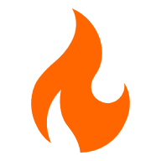

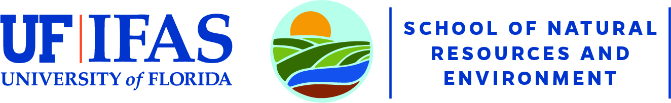
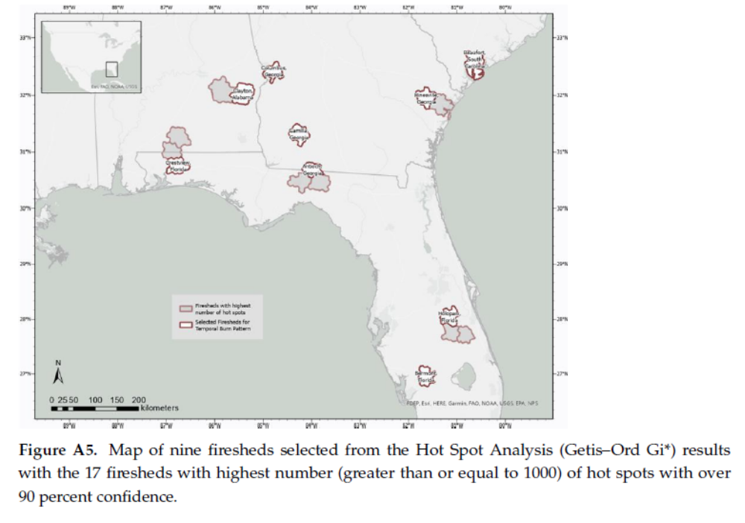
Thank you!!! Questions: p.rodgers1@ufl.edu
Coming soon…
What are the public’s preferences
for smoke impacts?
Phillip Rodgers, PhD Student, University of Florida, School of Natural Resources and Environment
Advised by:
Dr. Raelene Crandall, University of Florida, School of Forest, Fisheries, and Geomatics Sciences
Cummins et al., 2023

Slide 8

Scan the QR Code & Take the Survey
Smoke Impact
Tradeoffs
Frequency
  Low 1-2 days/week
  Moderate 3-4 days/week
  High 5-7 days/week
Intensity
  Low AQI < 50, no concerns
  Moderate AQI 50 – 100, some concerns for vulnerable
  High AQI > 100, concerns for more people
Severe Wildfire Risk Reduction
  Low minimal reduction
  Moderate reduction
  High greatly reduces risk
Practitioner Preferences for Smoke Impacts Survey
https://ufl.qualtrics.com/jfe/form/SV_bxfLNEZ0vR55L26
Notes:
My research came from a refresher training at Disney WildnesPres….
Frequency
Intensity
Reducing the Risk from Severe Wildfire
And now Here I am in a room full of burners and I want to ask you, what are your preferences? I am going to put a QR code on the screen and you can scan that with your phone and take the survey.

Slide 9
What will YOU choose?
Scan the QR code to take our 5-minute survey to help us determine practitioner preferences for Rx fire smoke impacts
Phillip Rodgers, PhD Student, University of Florida, School of Natural Resources and Environment
Advised by:
Dr. Raelene Crandall, University of Florida, School of Forest, Fisheries, and Geomatic Sciences

