Slide 1
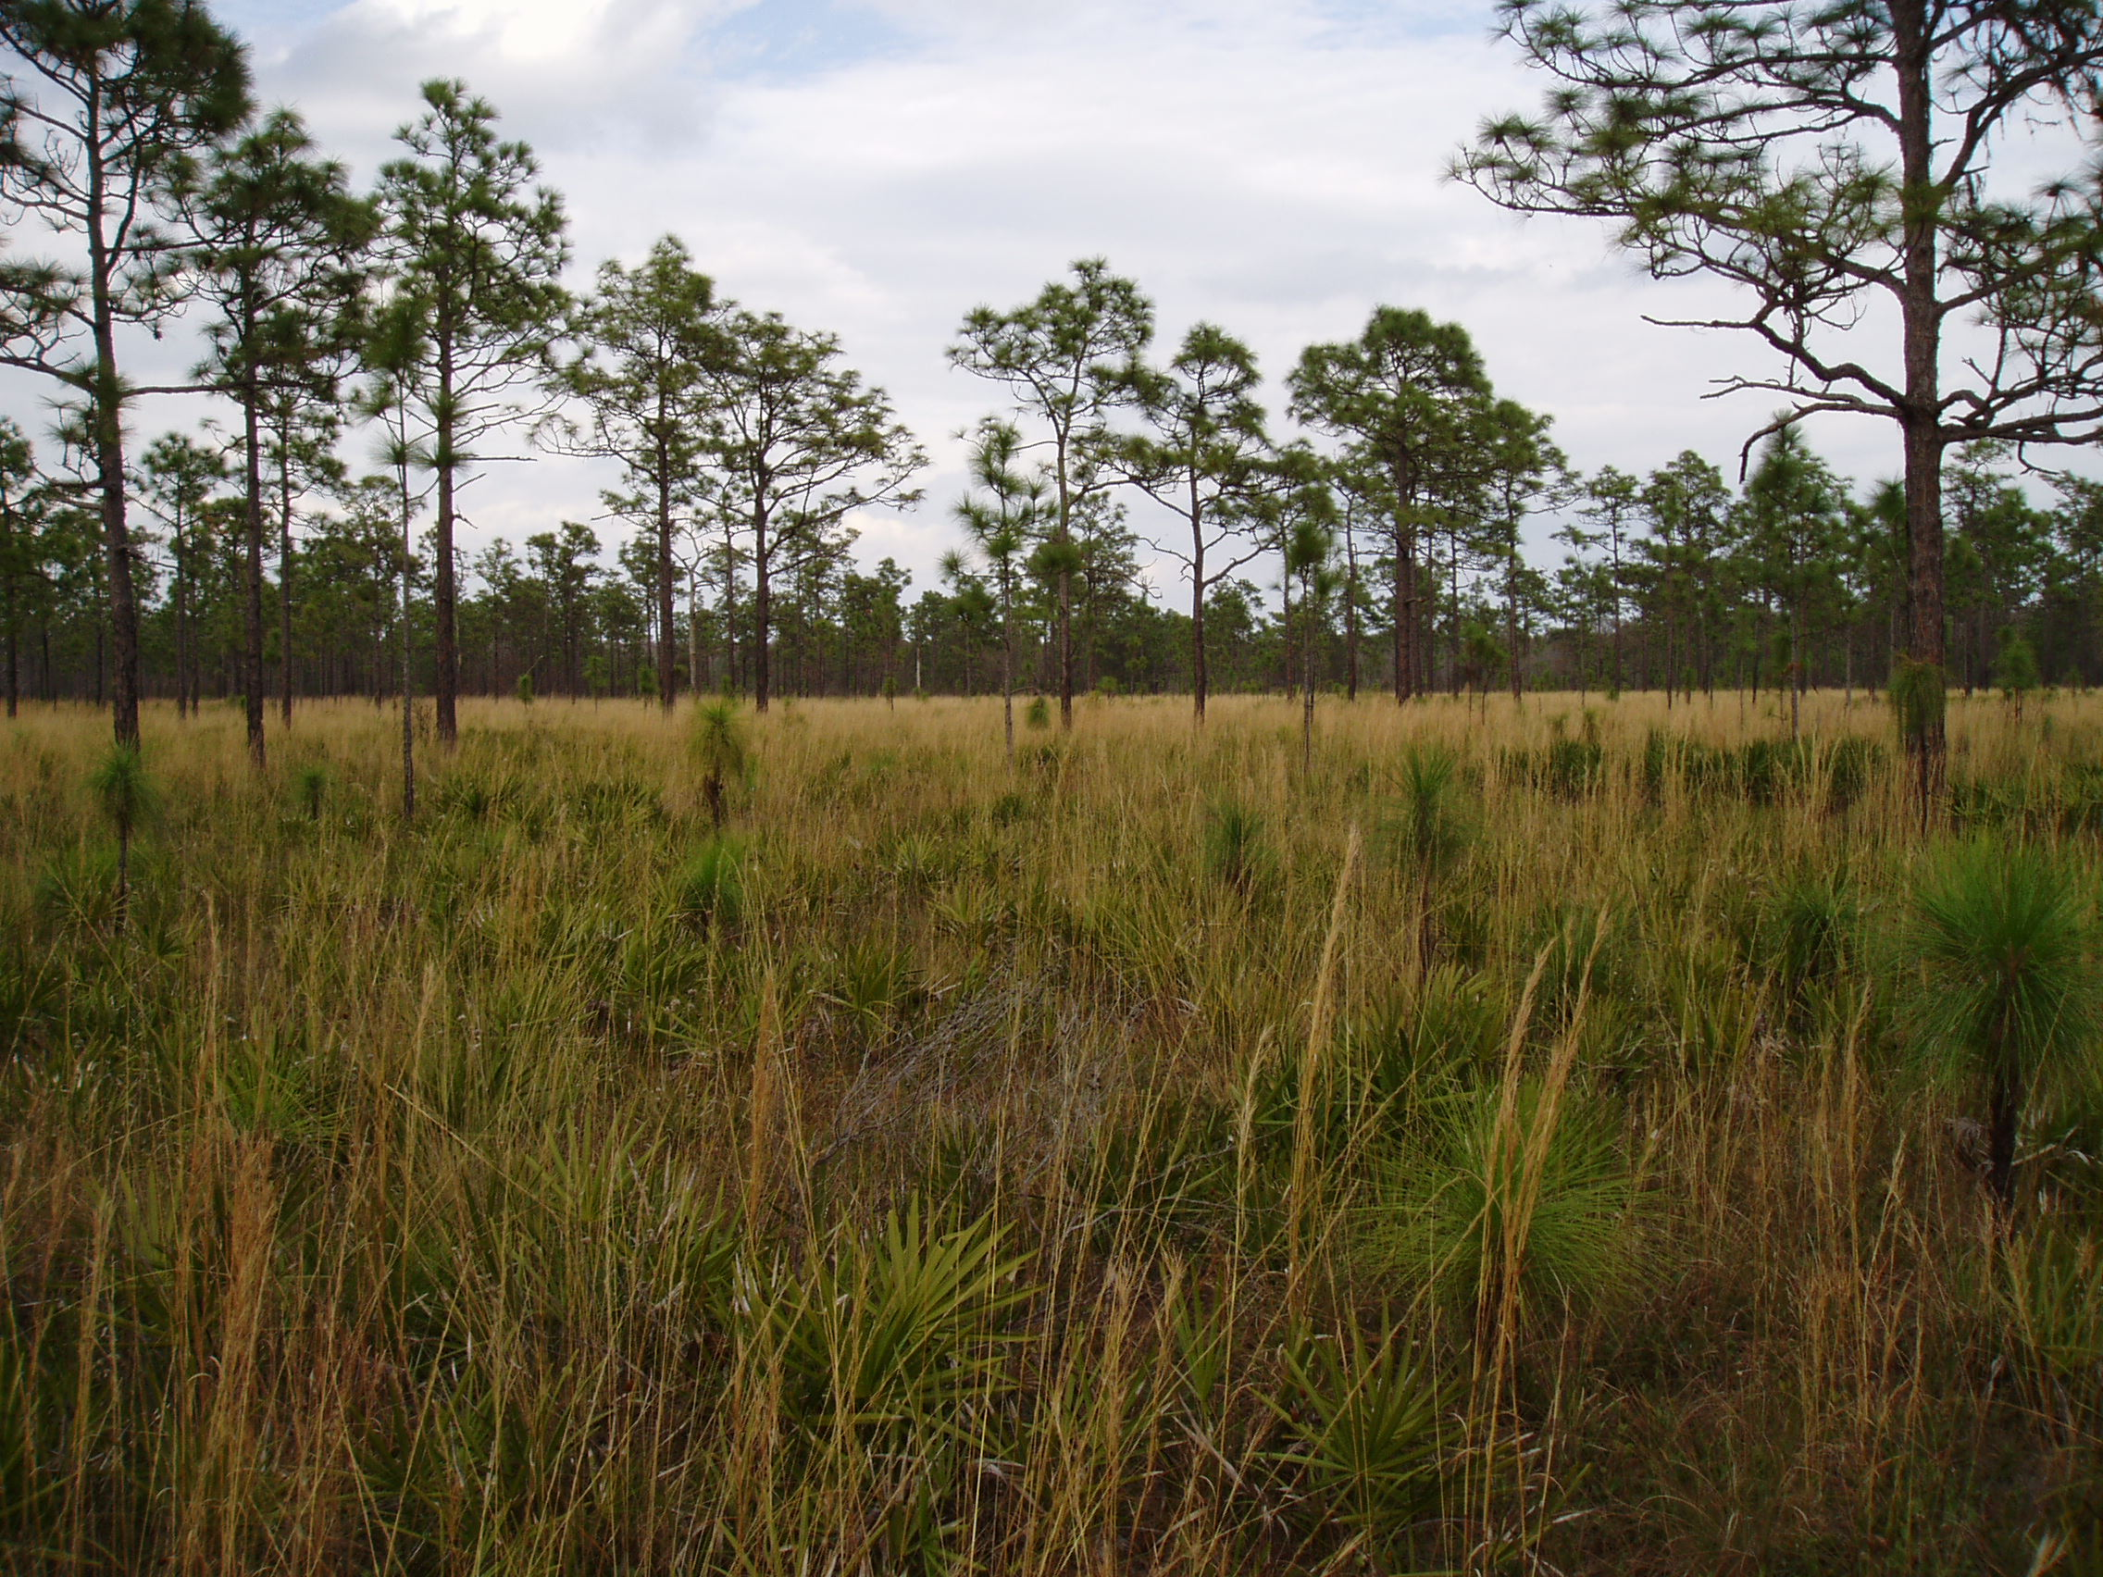

Fire in Florida
Tall Timbers Stoddard Prescribed Fire Academy
and a Coalition Update
Zachary A. Prusak
Wildland Fire Training Specialist
Chair, Coalition of Rx Fire Councils
zprusak@talltimbers.org

Slide 2
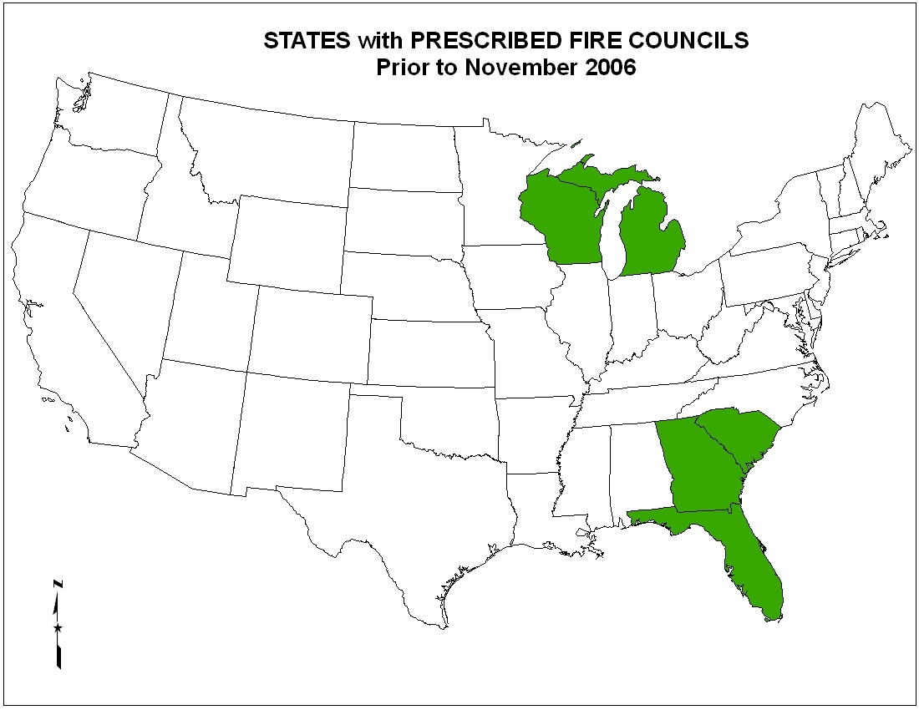
Fire in Florida

Slide 3
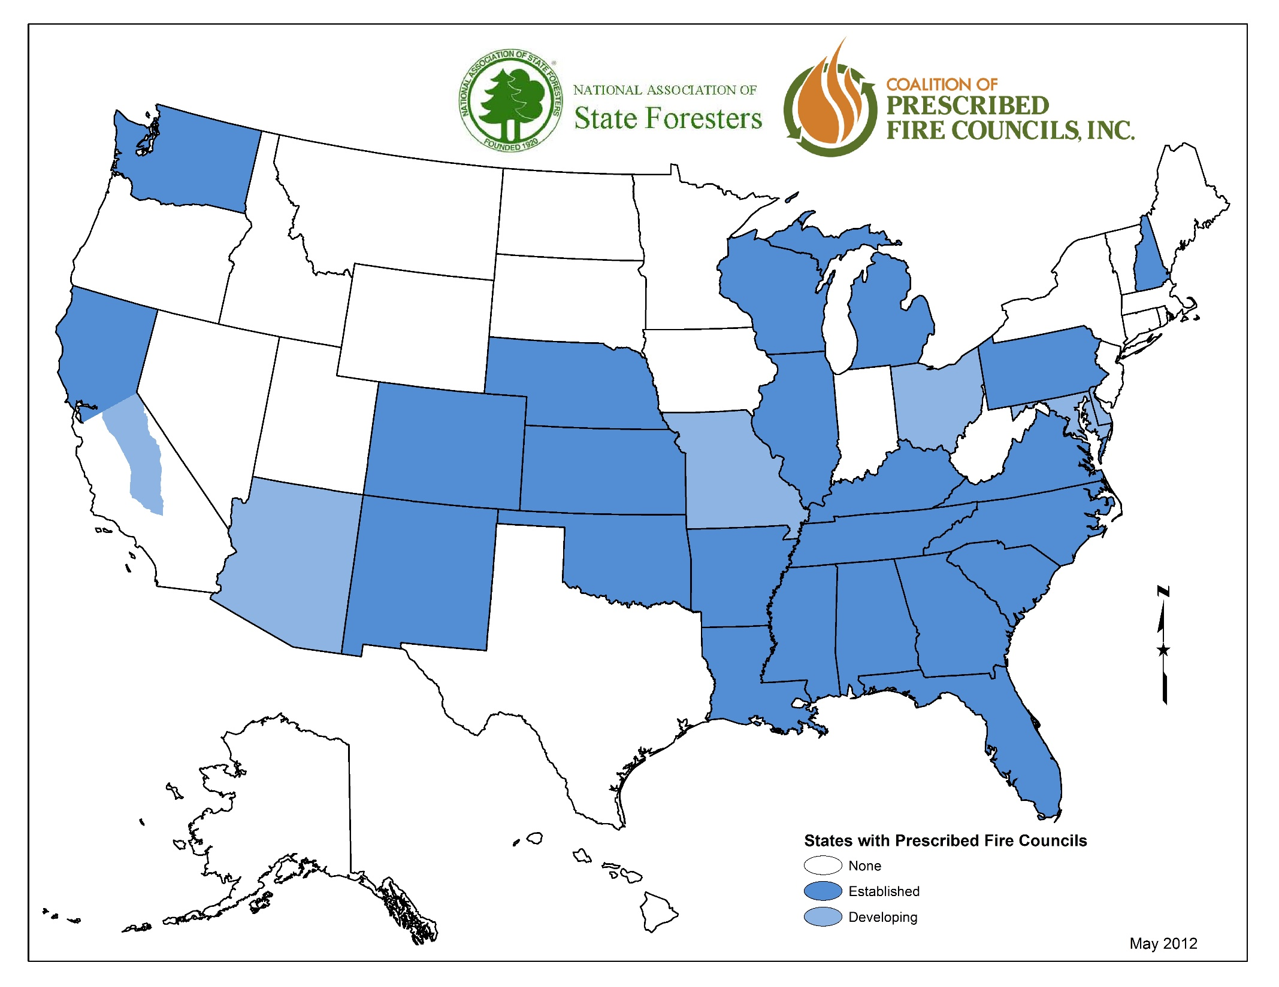
Fire in Florida

Slide 4
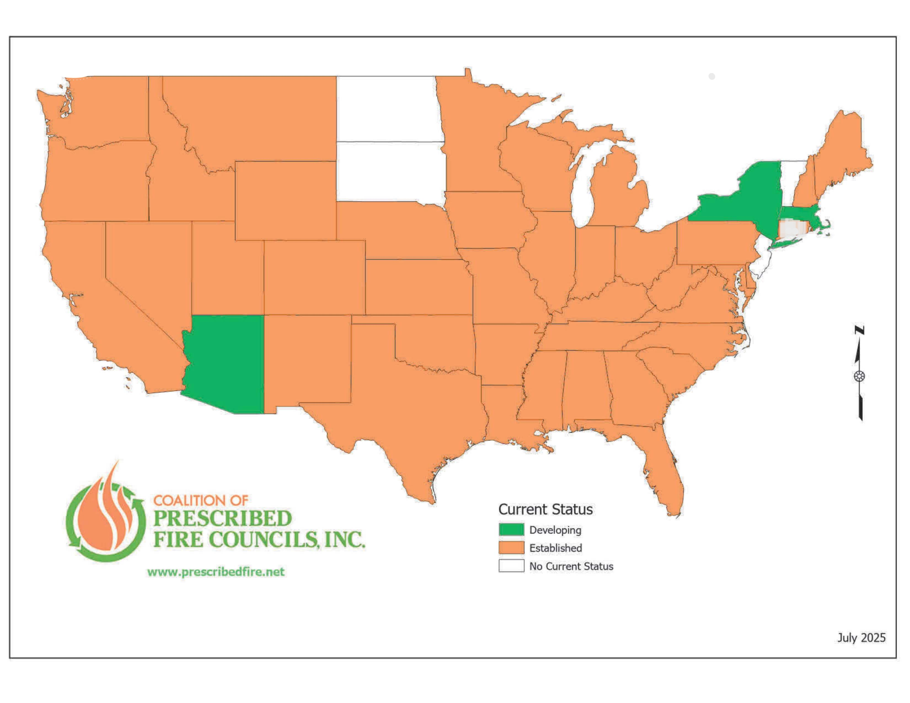
Fire in Florida

Slide 5

Fire in Florida
Stoddard Prescribed Fire Academy
By providing the latest in prescribed fire information through online learning and in-the-field experiences, the Tall Timbers Stoddard Rx Fire Academy will serve to strengthen the prescribed fire community, bringing a wide variety of experience and knowledge together.

Slide 6
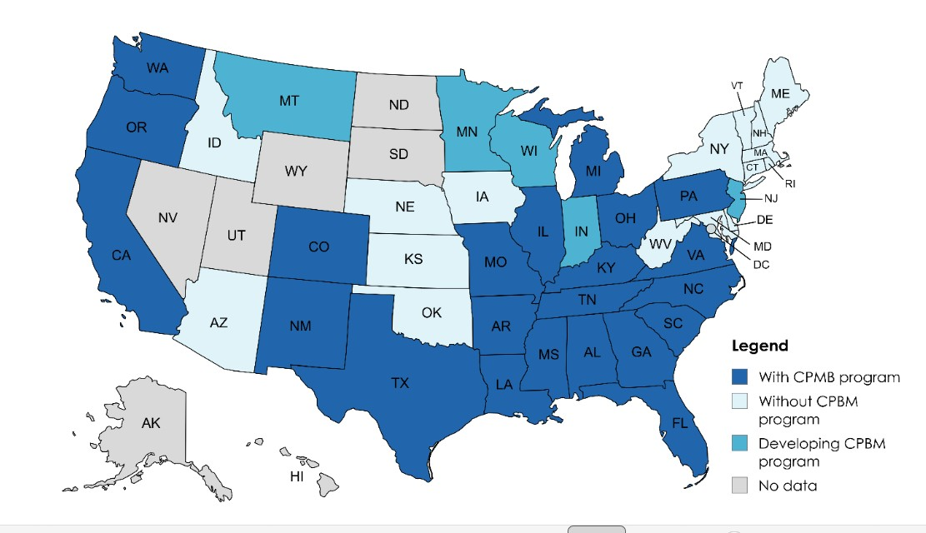
Fire in Florida
Notes:
At the time of our study there were 22 states with CPBM programs, five states developing programs, and 16 states without programs (Figure 2). We were unable to find a representative for the remaining seven states but our understanding is that none of these states have CPBM programs and the total nationwide numbers are 22 with programs, 5 in development, and 23 without programs.

Slide 7
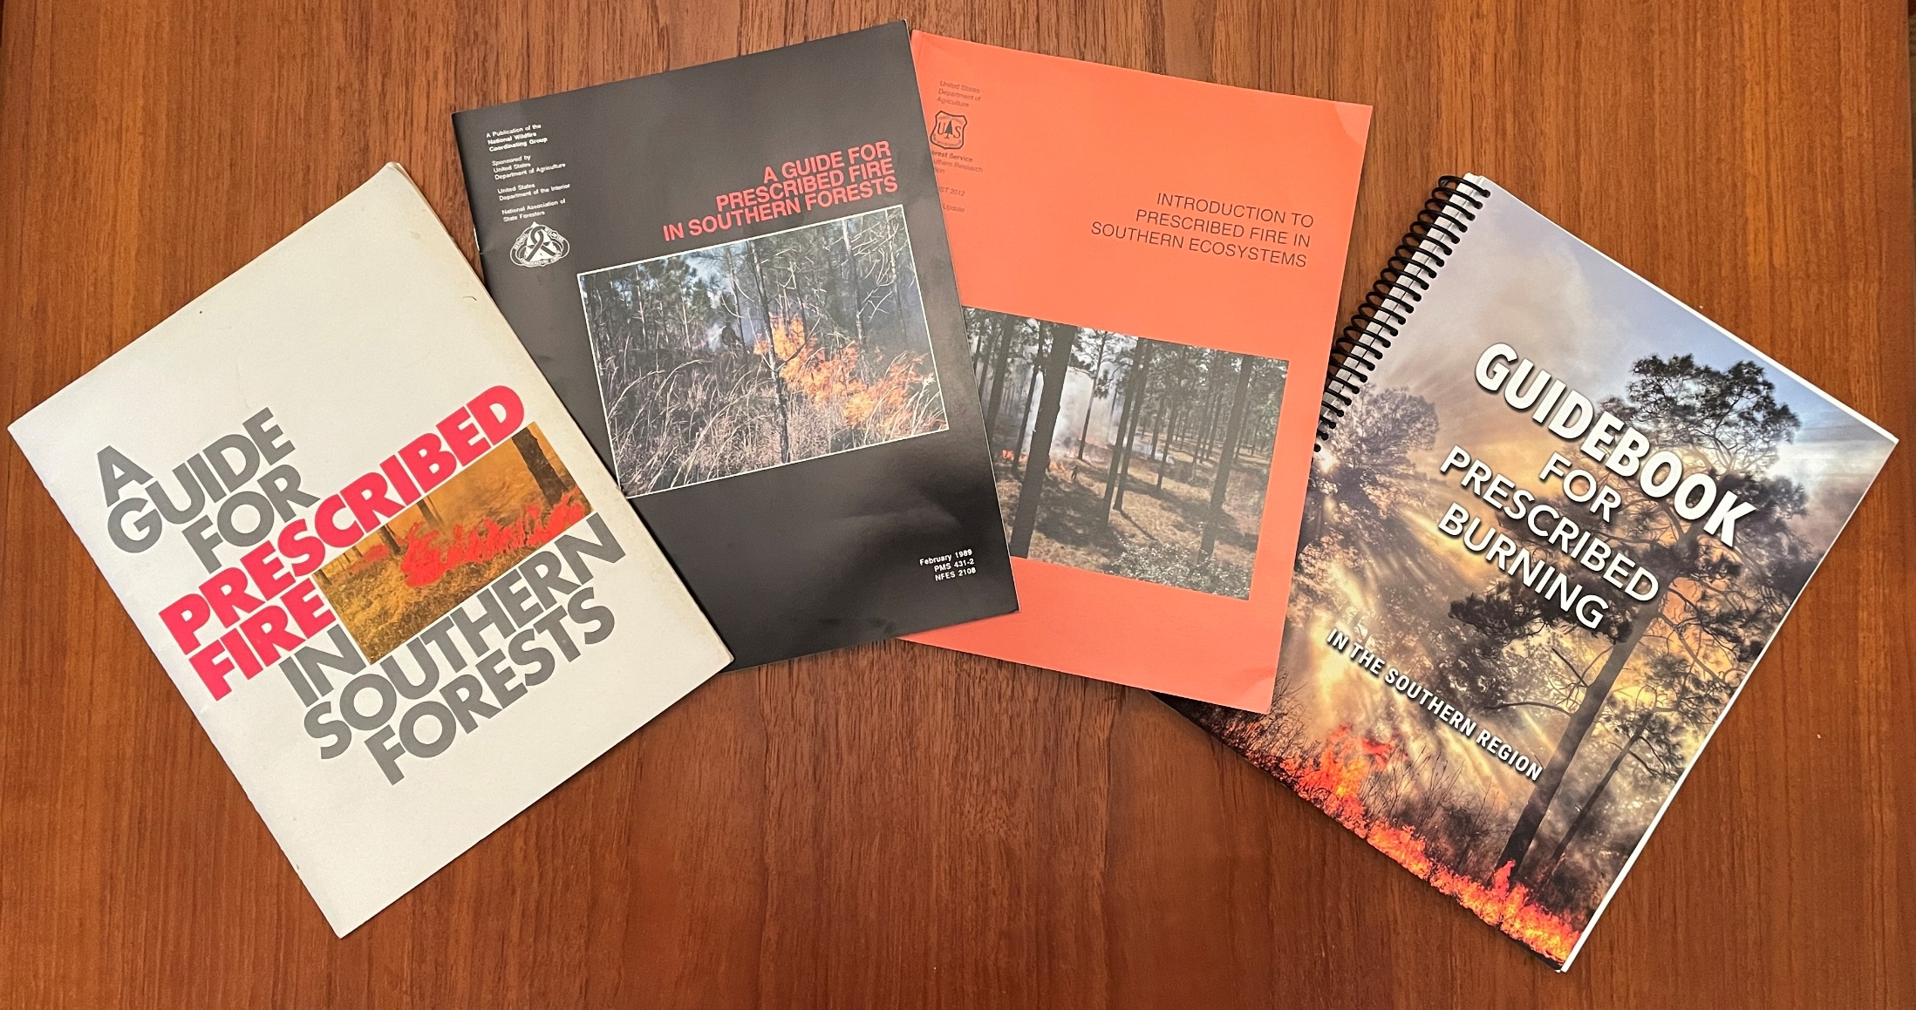
Fire in Florida

Slide 8
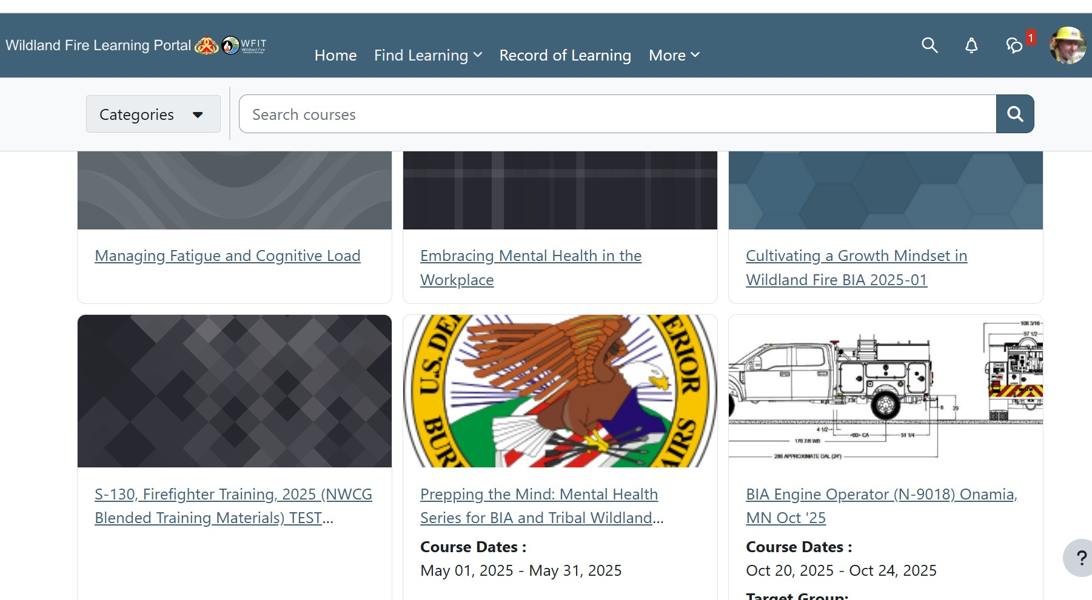
Fire in Florida

Slide 9
Fire in Florida
The Academy’s online content hosted by the Tall Timbers Fire Learning Portal is designed to augment and enhance concepts learned at state CPBM courses while simultaneously allowing continuing education opportunities for subjects not currently covered in state courses.
-Interviews with multi-generational burners and fire leaders
-NWCG courses and/or content
-Office Hours
-Mentor-guided Task Book for the Apprentice/Mentorship Program will be closely aligned with local PBA’s and their Rx fire schedules
-Prescribed Fire Pocket Guide (RxFPG)

Slide 10
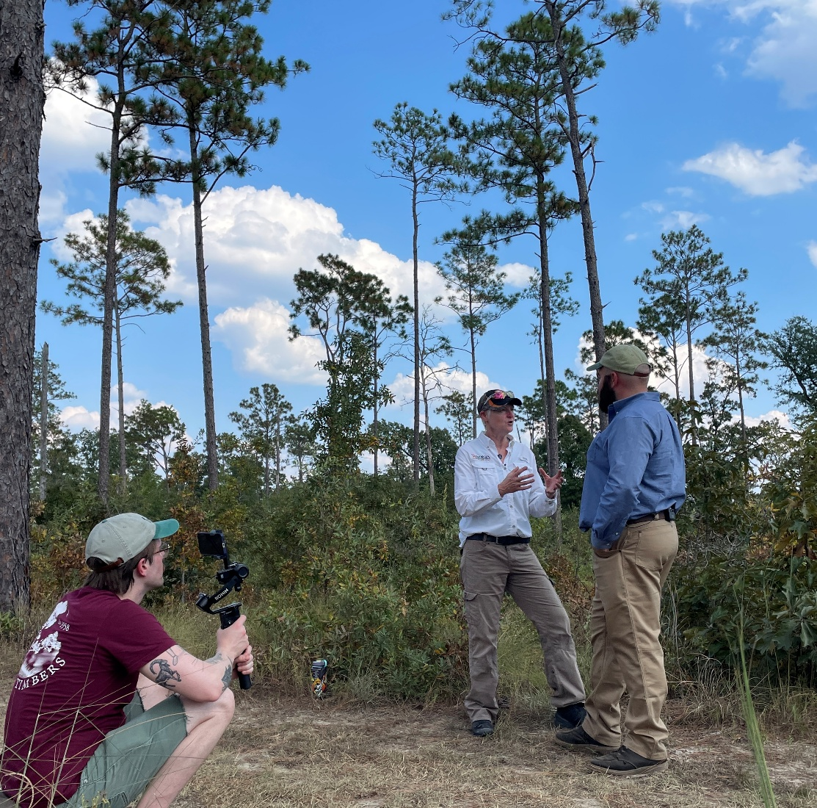
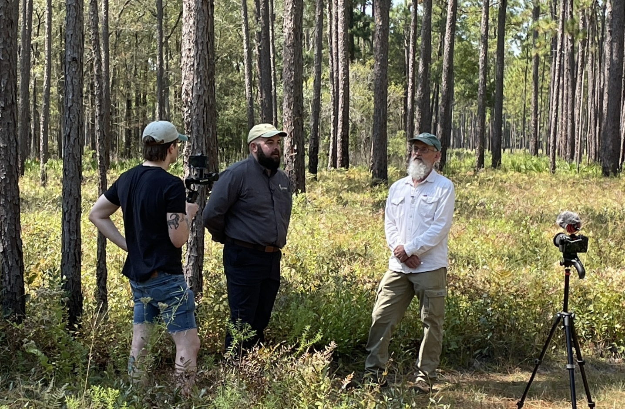
Fire in Florida

Slide 11
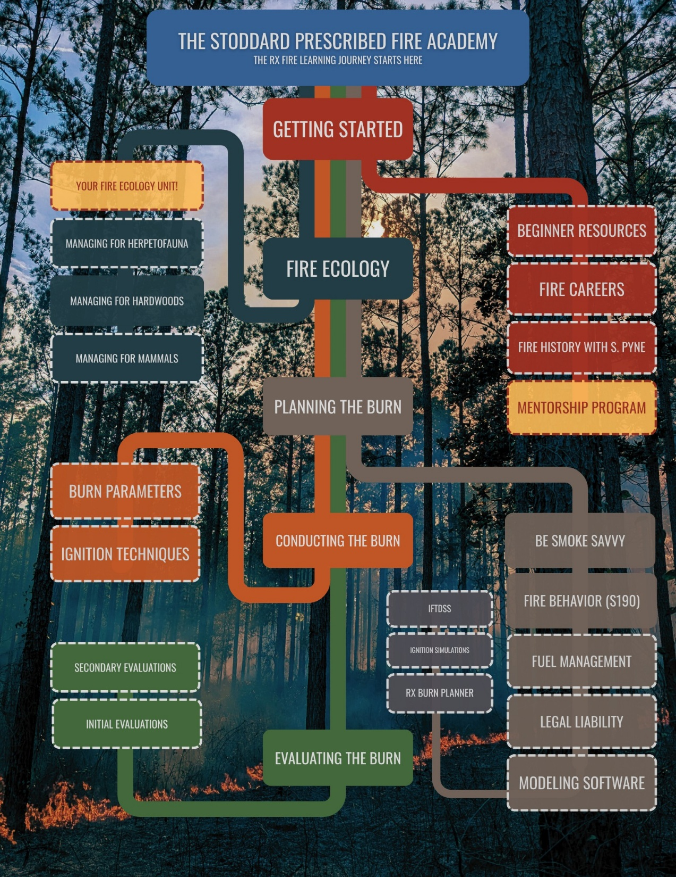
Fire in Florida

Slide 12
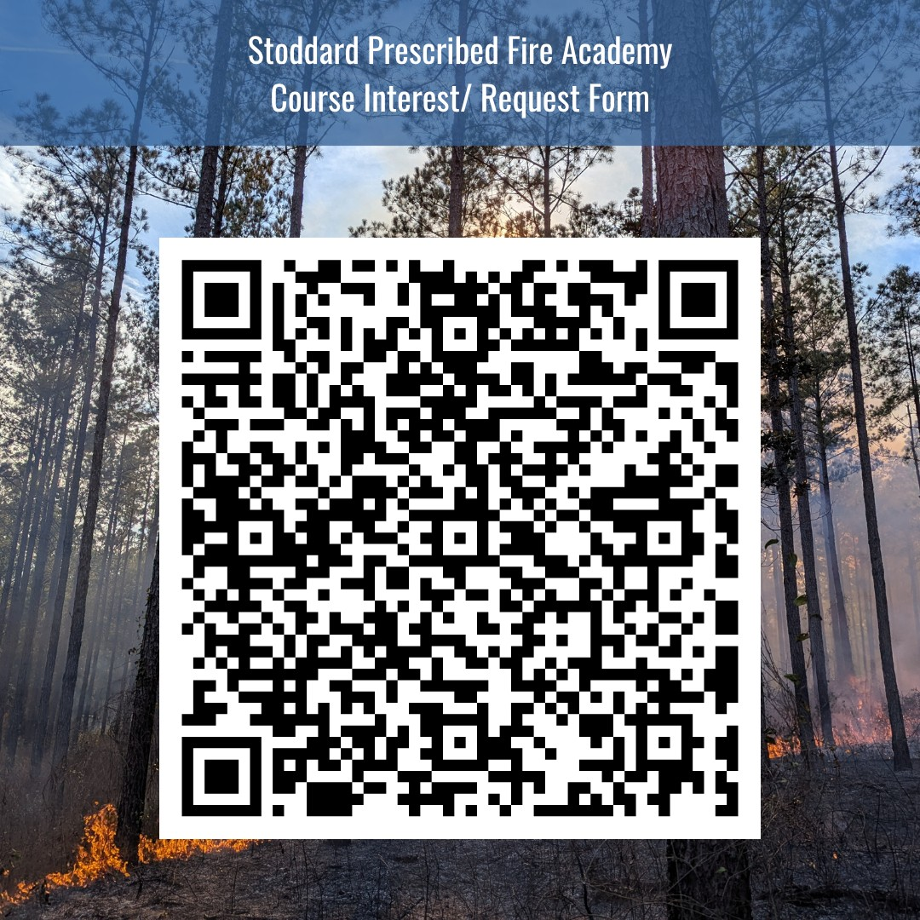
Fire in Florida

Slide 13
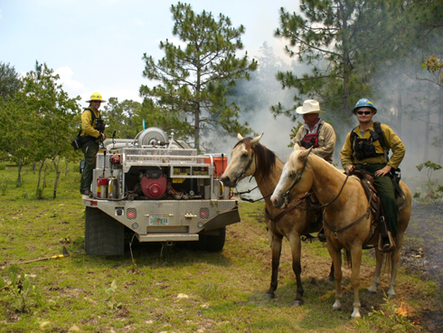
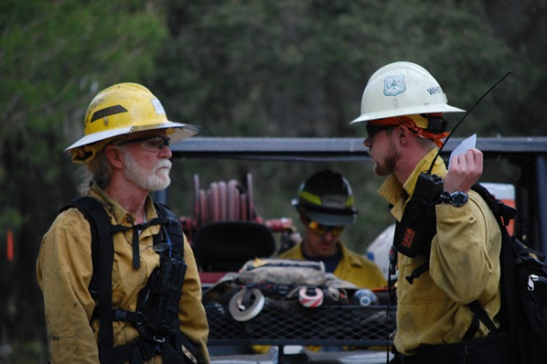
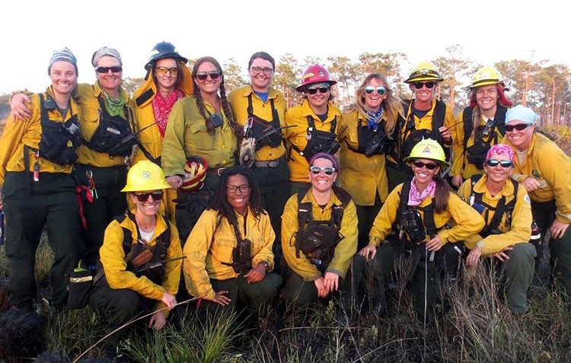
Fire in Florida
Questions?

