Slide 1
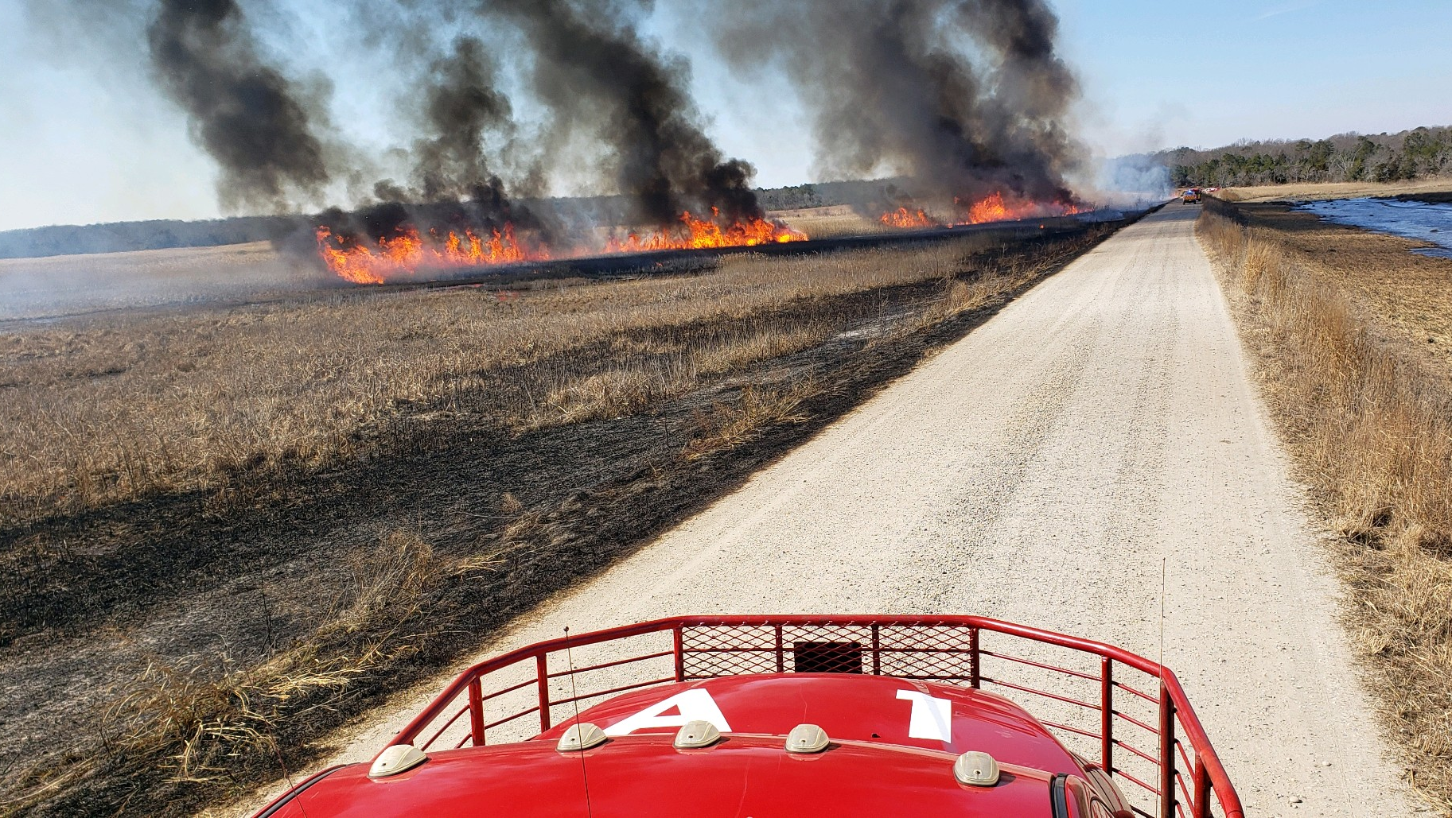
PERSPECTIVES OF A SAFETY OFFICER
“EYES WIDE SHUT”
WILLIE CIRONE

Slide 2
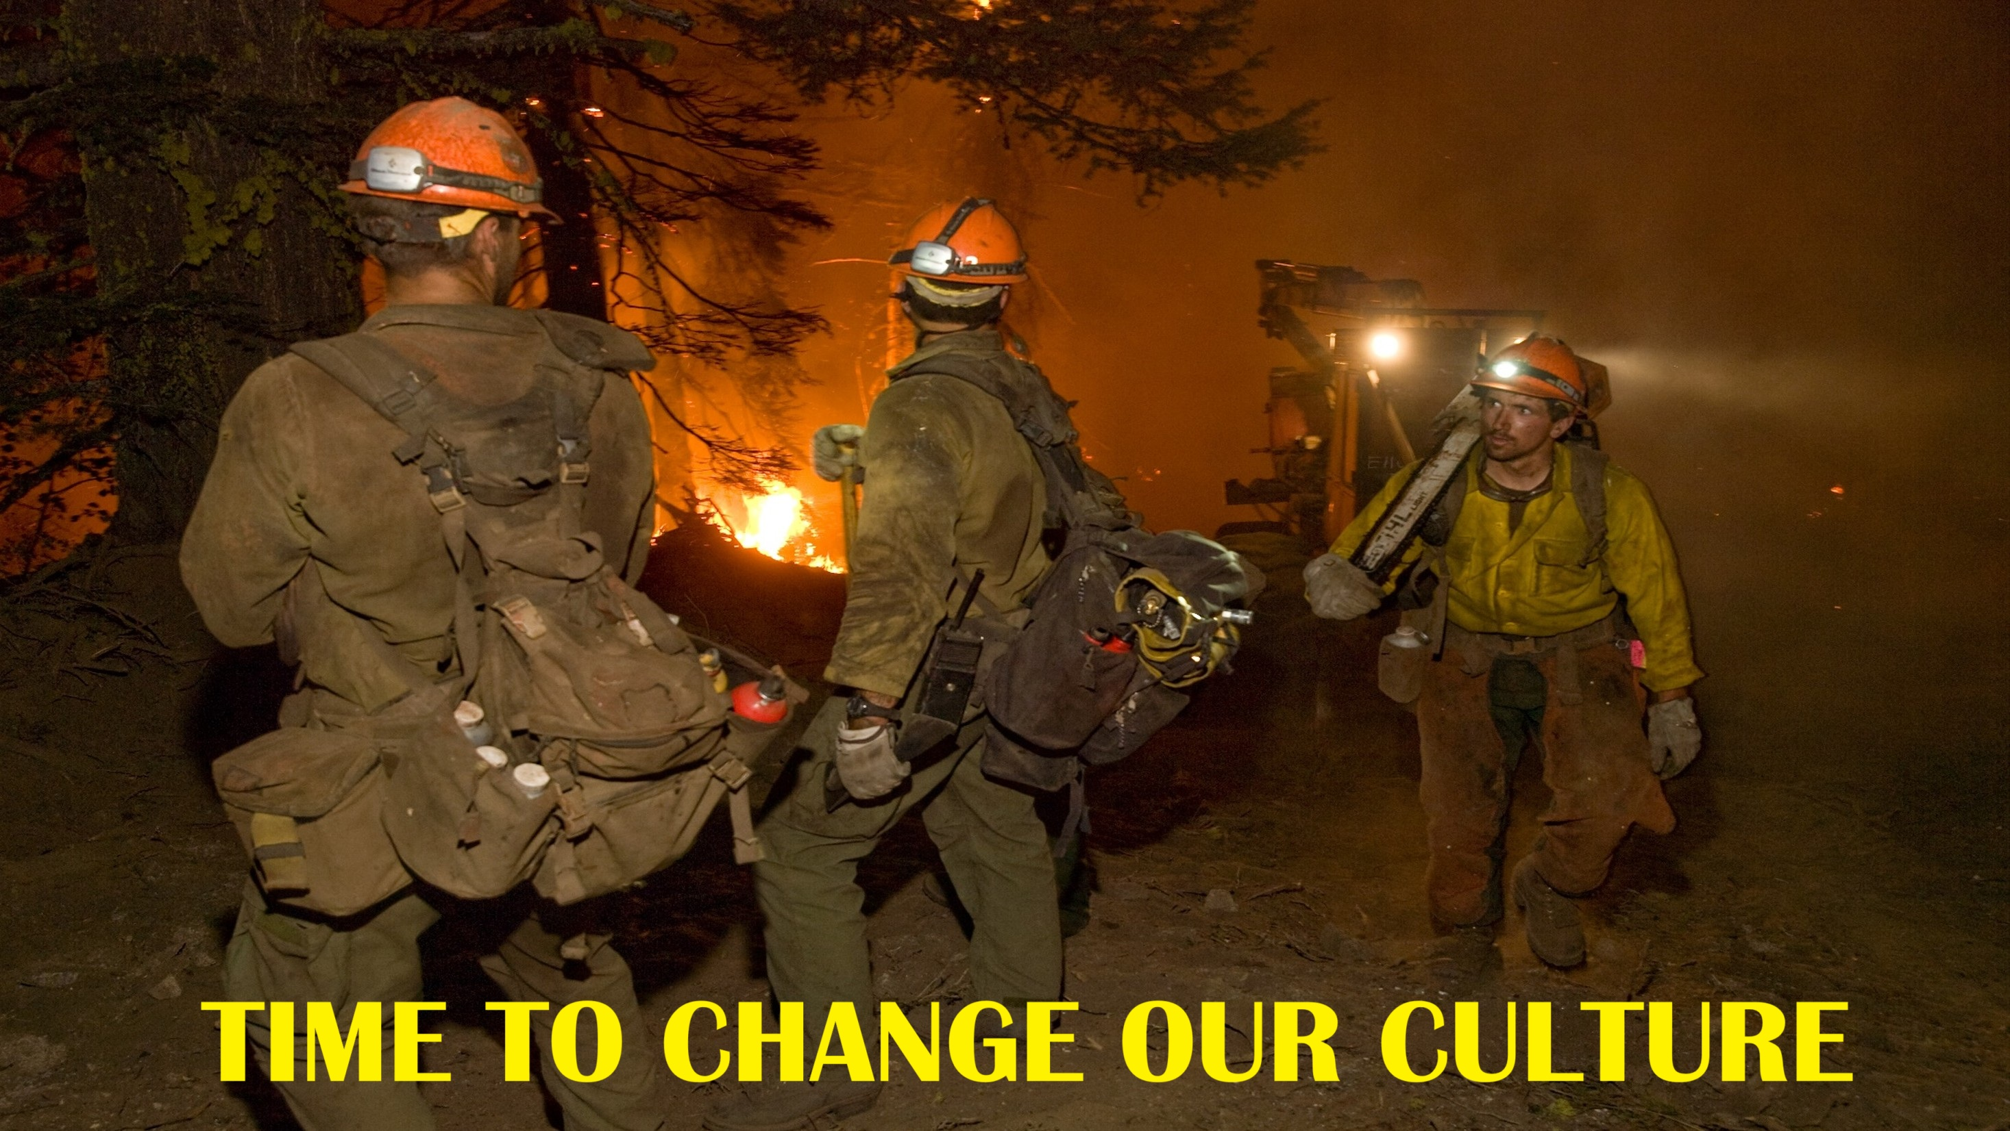

Slide 3
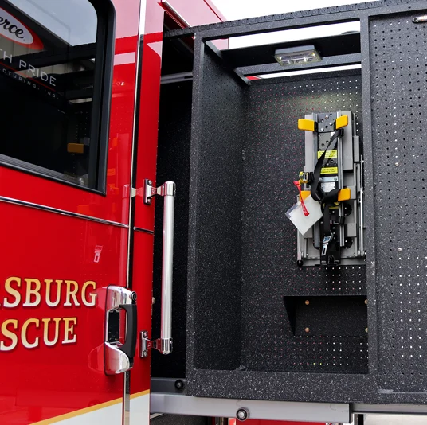
STRUCTURE ENGINE CLEAN COMPARTMENT
CONCEPT
ALL CONTAMINATED GEAR GOES IN A OUTSIDE COMPARTMENT

Slide 4
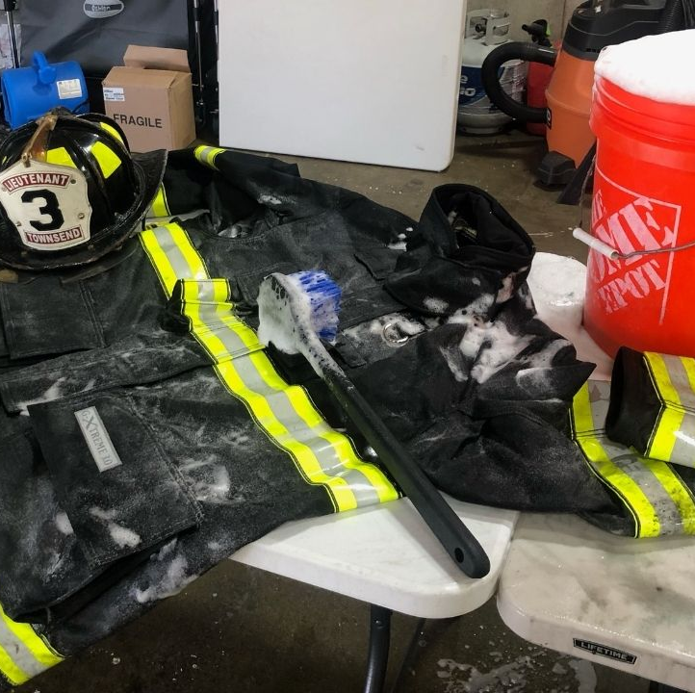
DO YOU CLEAN YOUR PPE
????

Slide 5
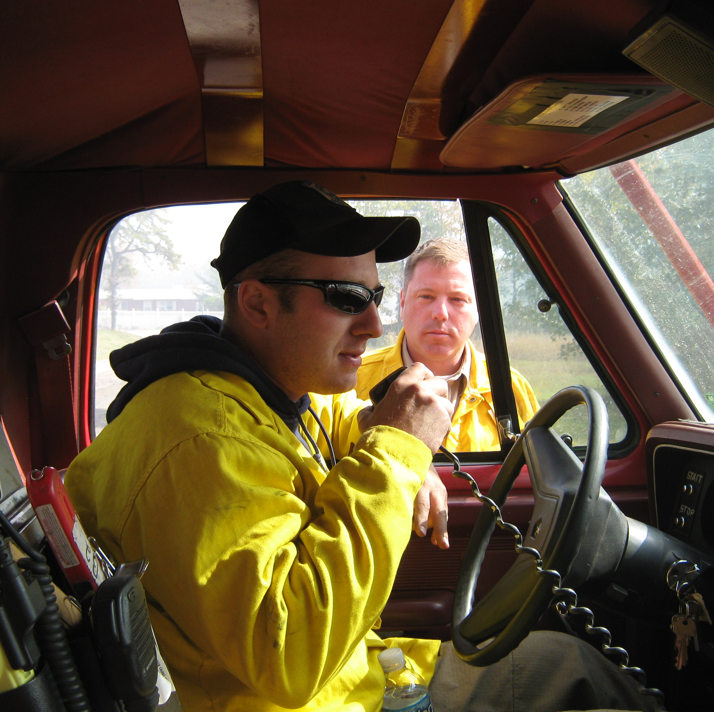
CLEAN CAB ASSESSMENT
STUDY
40-50% WORSE INSIDE THE CAB THAN OUTSIDE WITH THE AC ON
WHY???

Slide 6
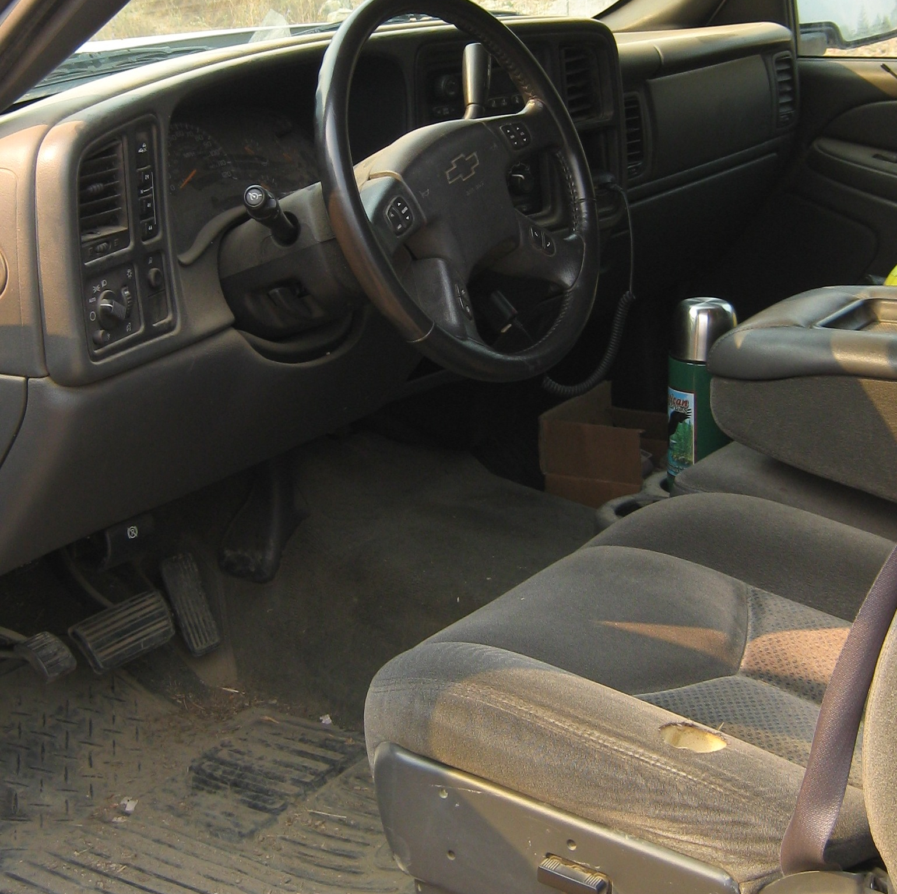
CLEAN CAB ASSESSMENT
STUDY
HOW OFTEN DO YOU DECON YOUR RIGS?
WHAT NEEDS TO BE DECONNED?

Slide 7
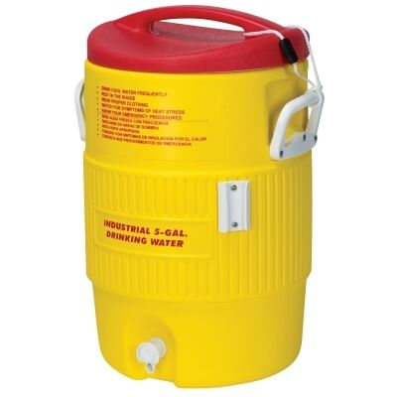
WATER COOLERS
WHAT'S GROWING IN YOURS??

Slide 8
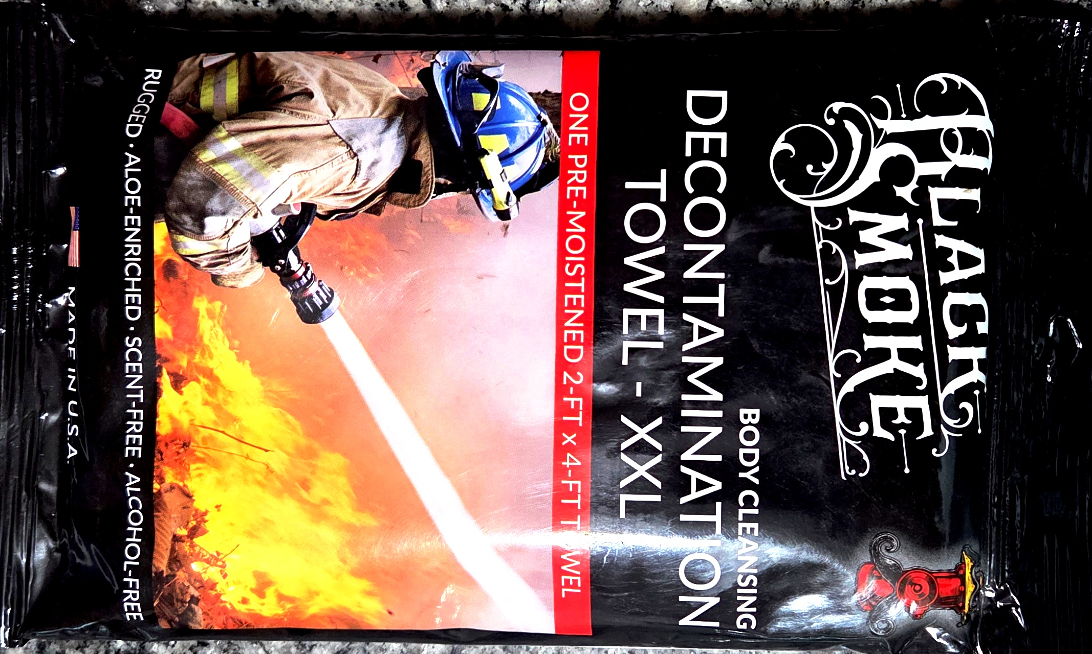
DECON TOWEL
94 TO 97% EFFECTIVE
THESE ARE NOT THE SAME AS STANDARD WIPES

Slide 9
CANCER STUDY FOR DECONTAMINATING
PPE-TRUCK CAB
DAWN
CITRO SQUEEZE
KRIKLANDS

Slide 10
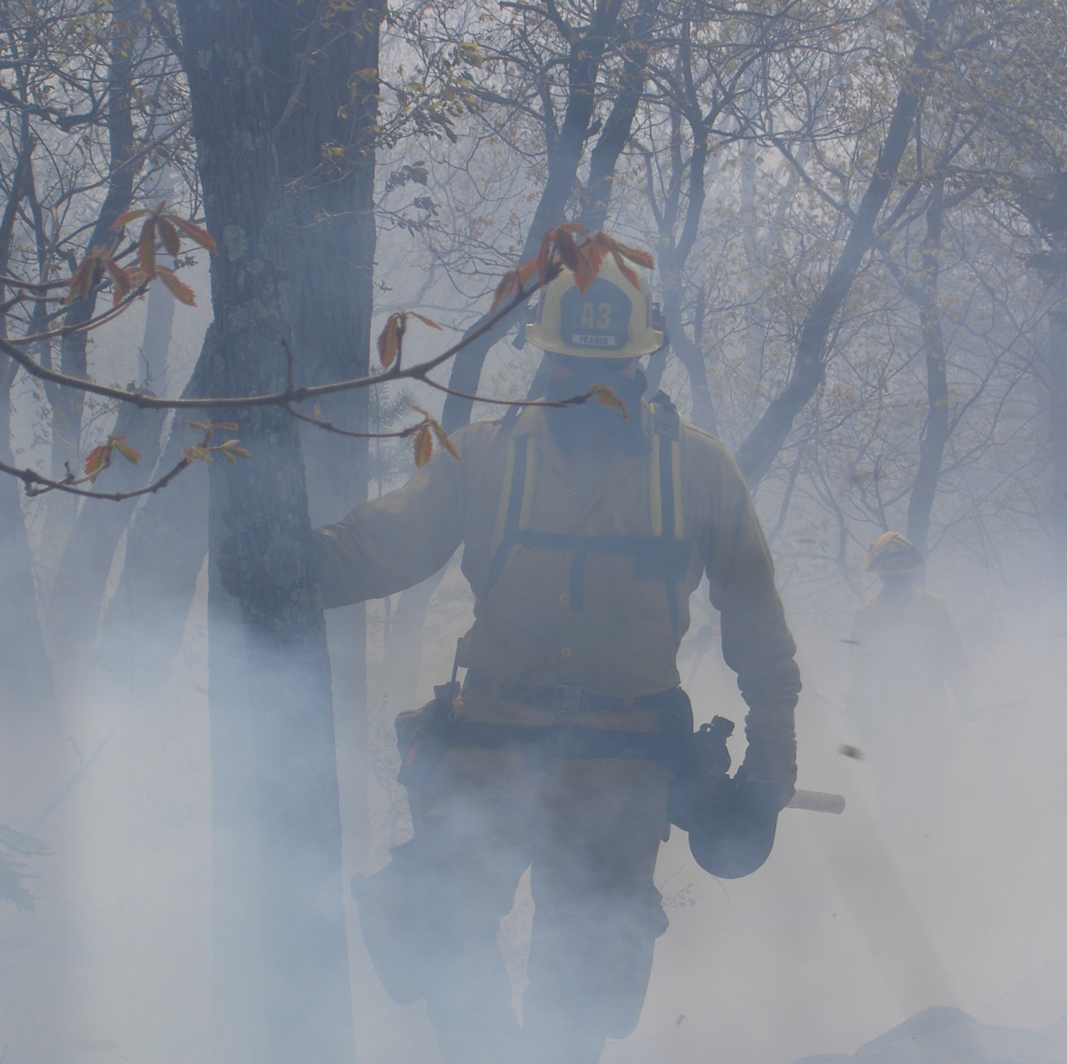
SMOKE
WHAT IS YOUR AGENCY DOING TO REDUCE SMOKE INTAKE??

Slide 11
HIGHER RATES OF SKIN, KIDNEY, LUNG, AND OTHER CANCERS COMPARED TO THE GENERAL POPULATION
CARCINOGENS
POLYCYCLIC AROMATIC
HYDROCARBONS

Slide 12
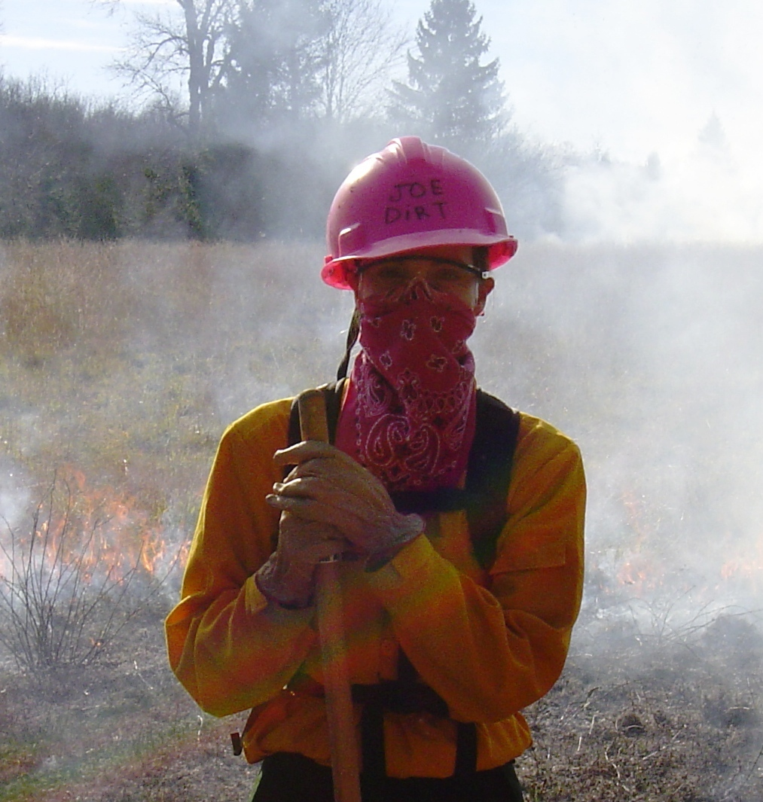
BANDANA
10% EFFECTIVE

Slide 13
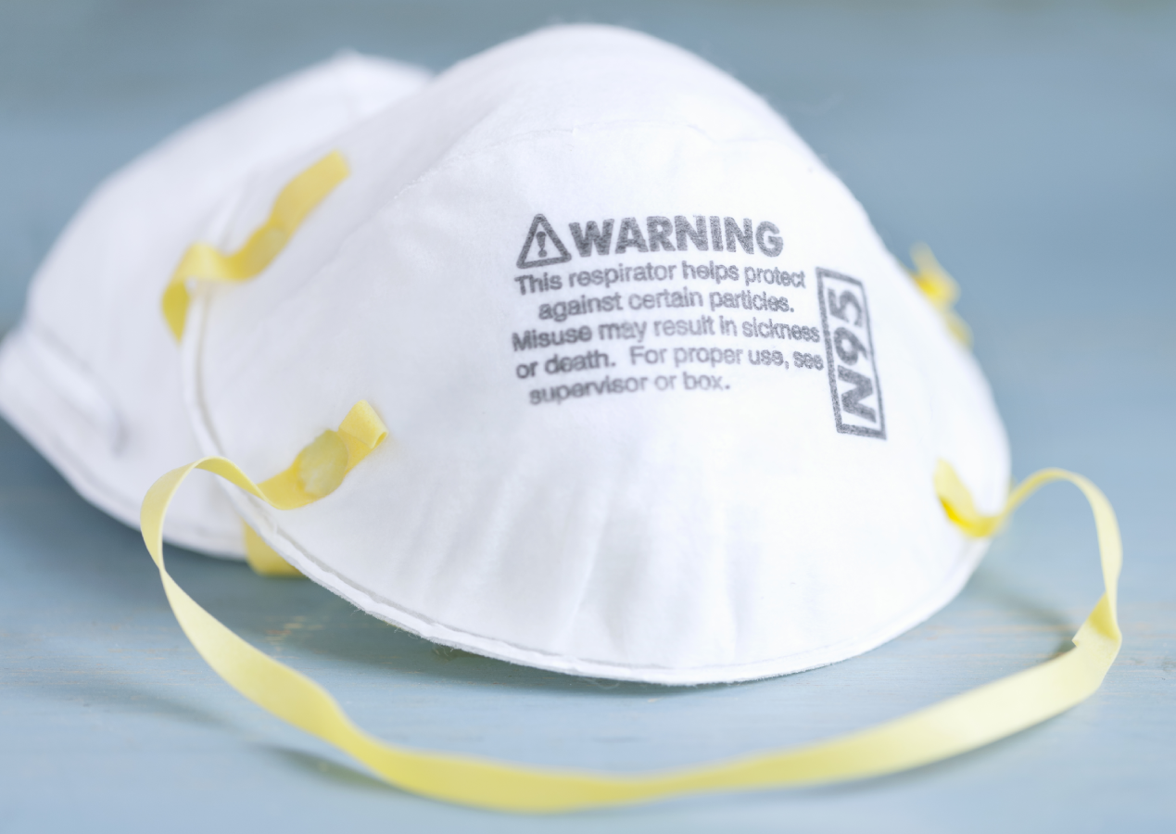
N-95 MASK
95% EFFECTIVE FOR PARTICLES
NOT EFFECTIVE FOR GASSES

Slide 14
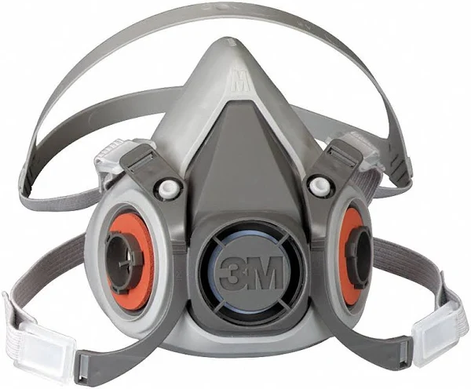
NIOSH CONCLUDES NO MASK FOR WILDLAND FIREFIGHTERS
FIT
FORM
FUNCTION
FILTER EFFICIENCY

Slide 15
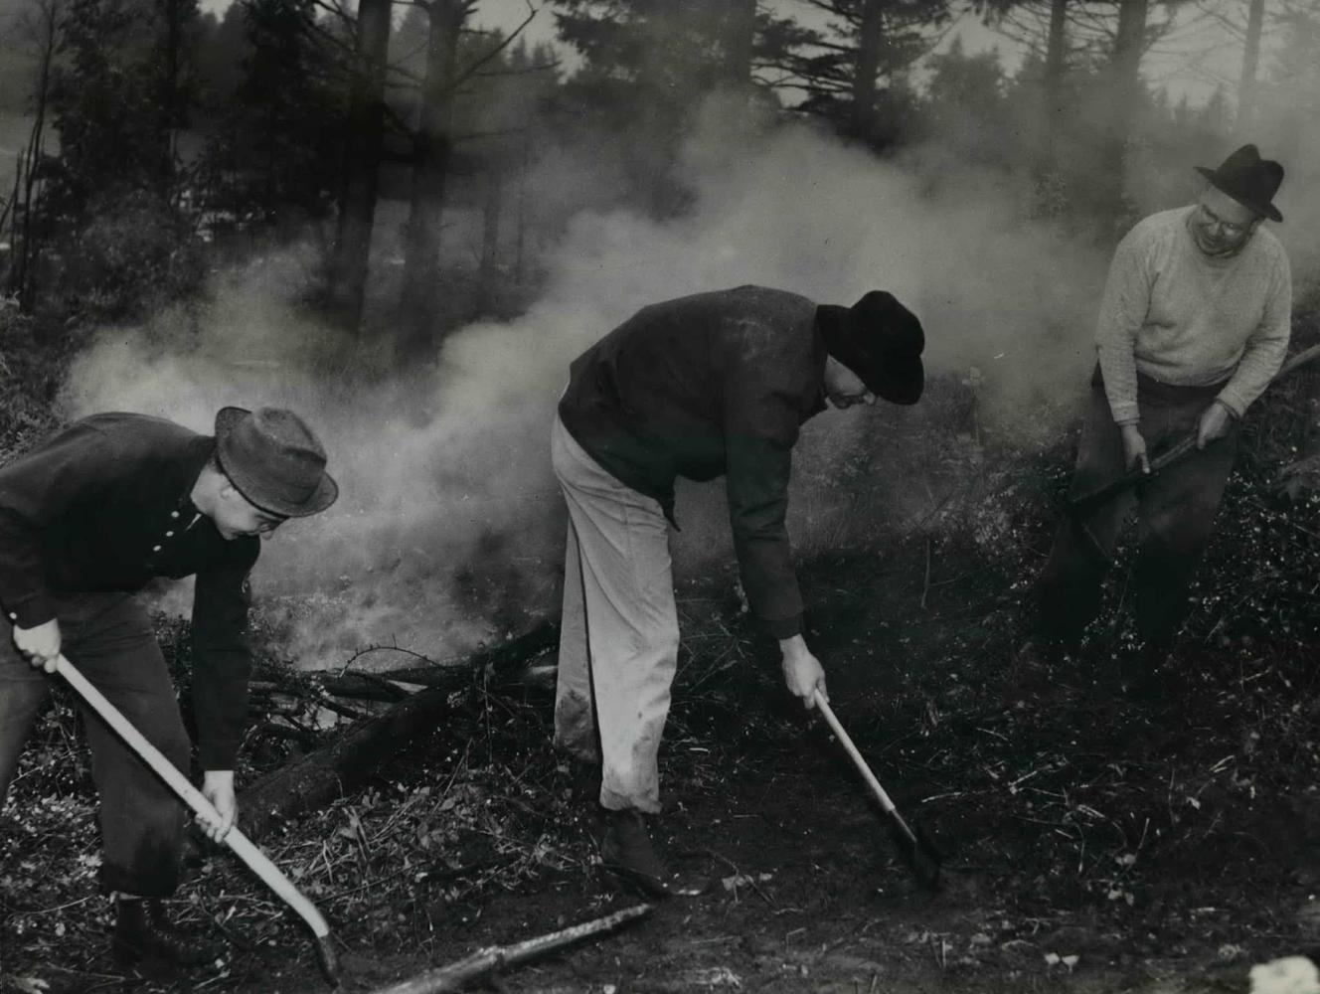
HOW ARE WE GOING TO CHANGE OUR CULTURE??

Slide 16

ARE YOU READY TO CHANGE YOUR CULTURE?
THANK YOU

