Slide 1
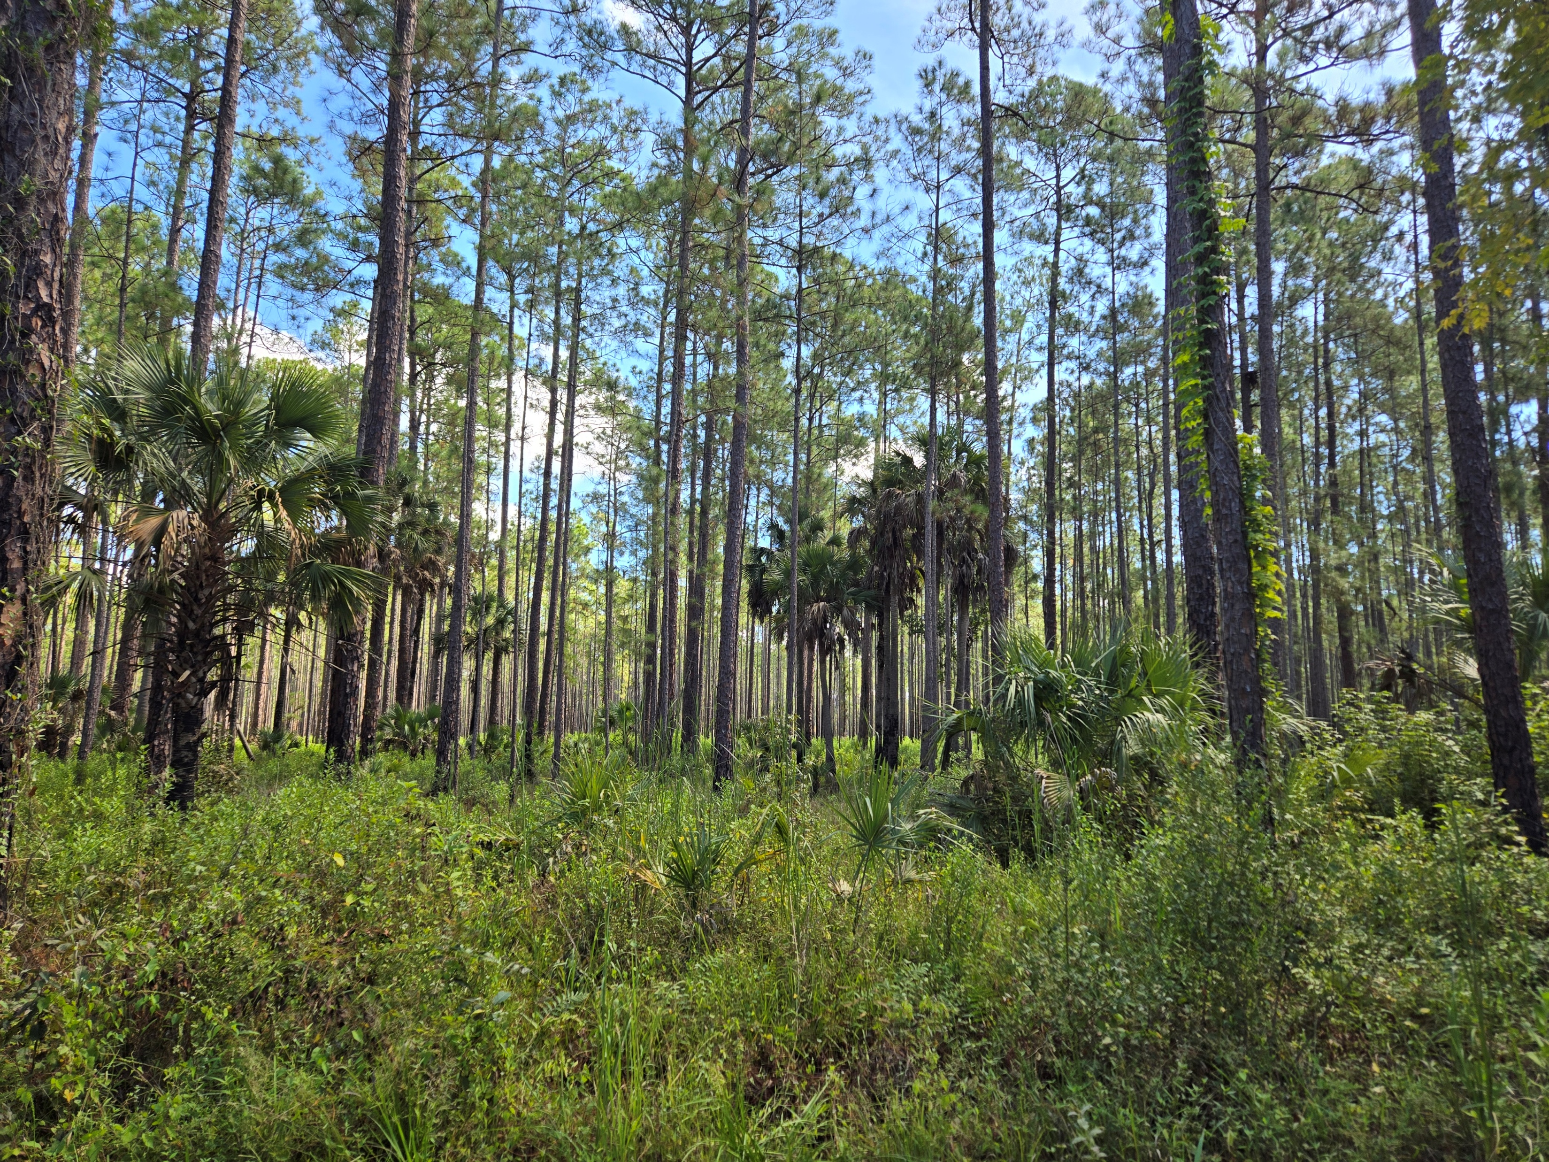
Lethal Bronzing in Natural Ecosystems
Brianna Benitez, Biologist and Survey Coordinator
Florida Forest Service, Forest Health Section

Slide 2
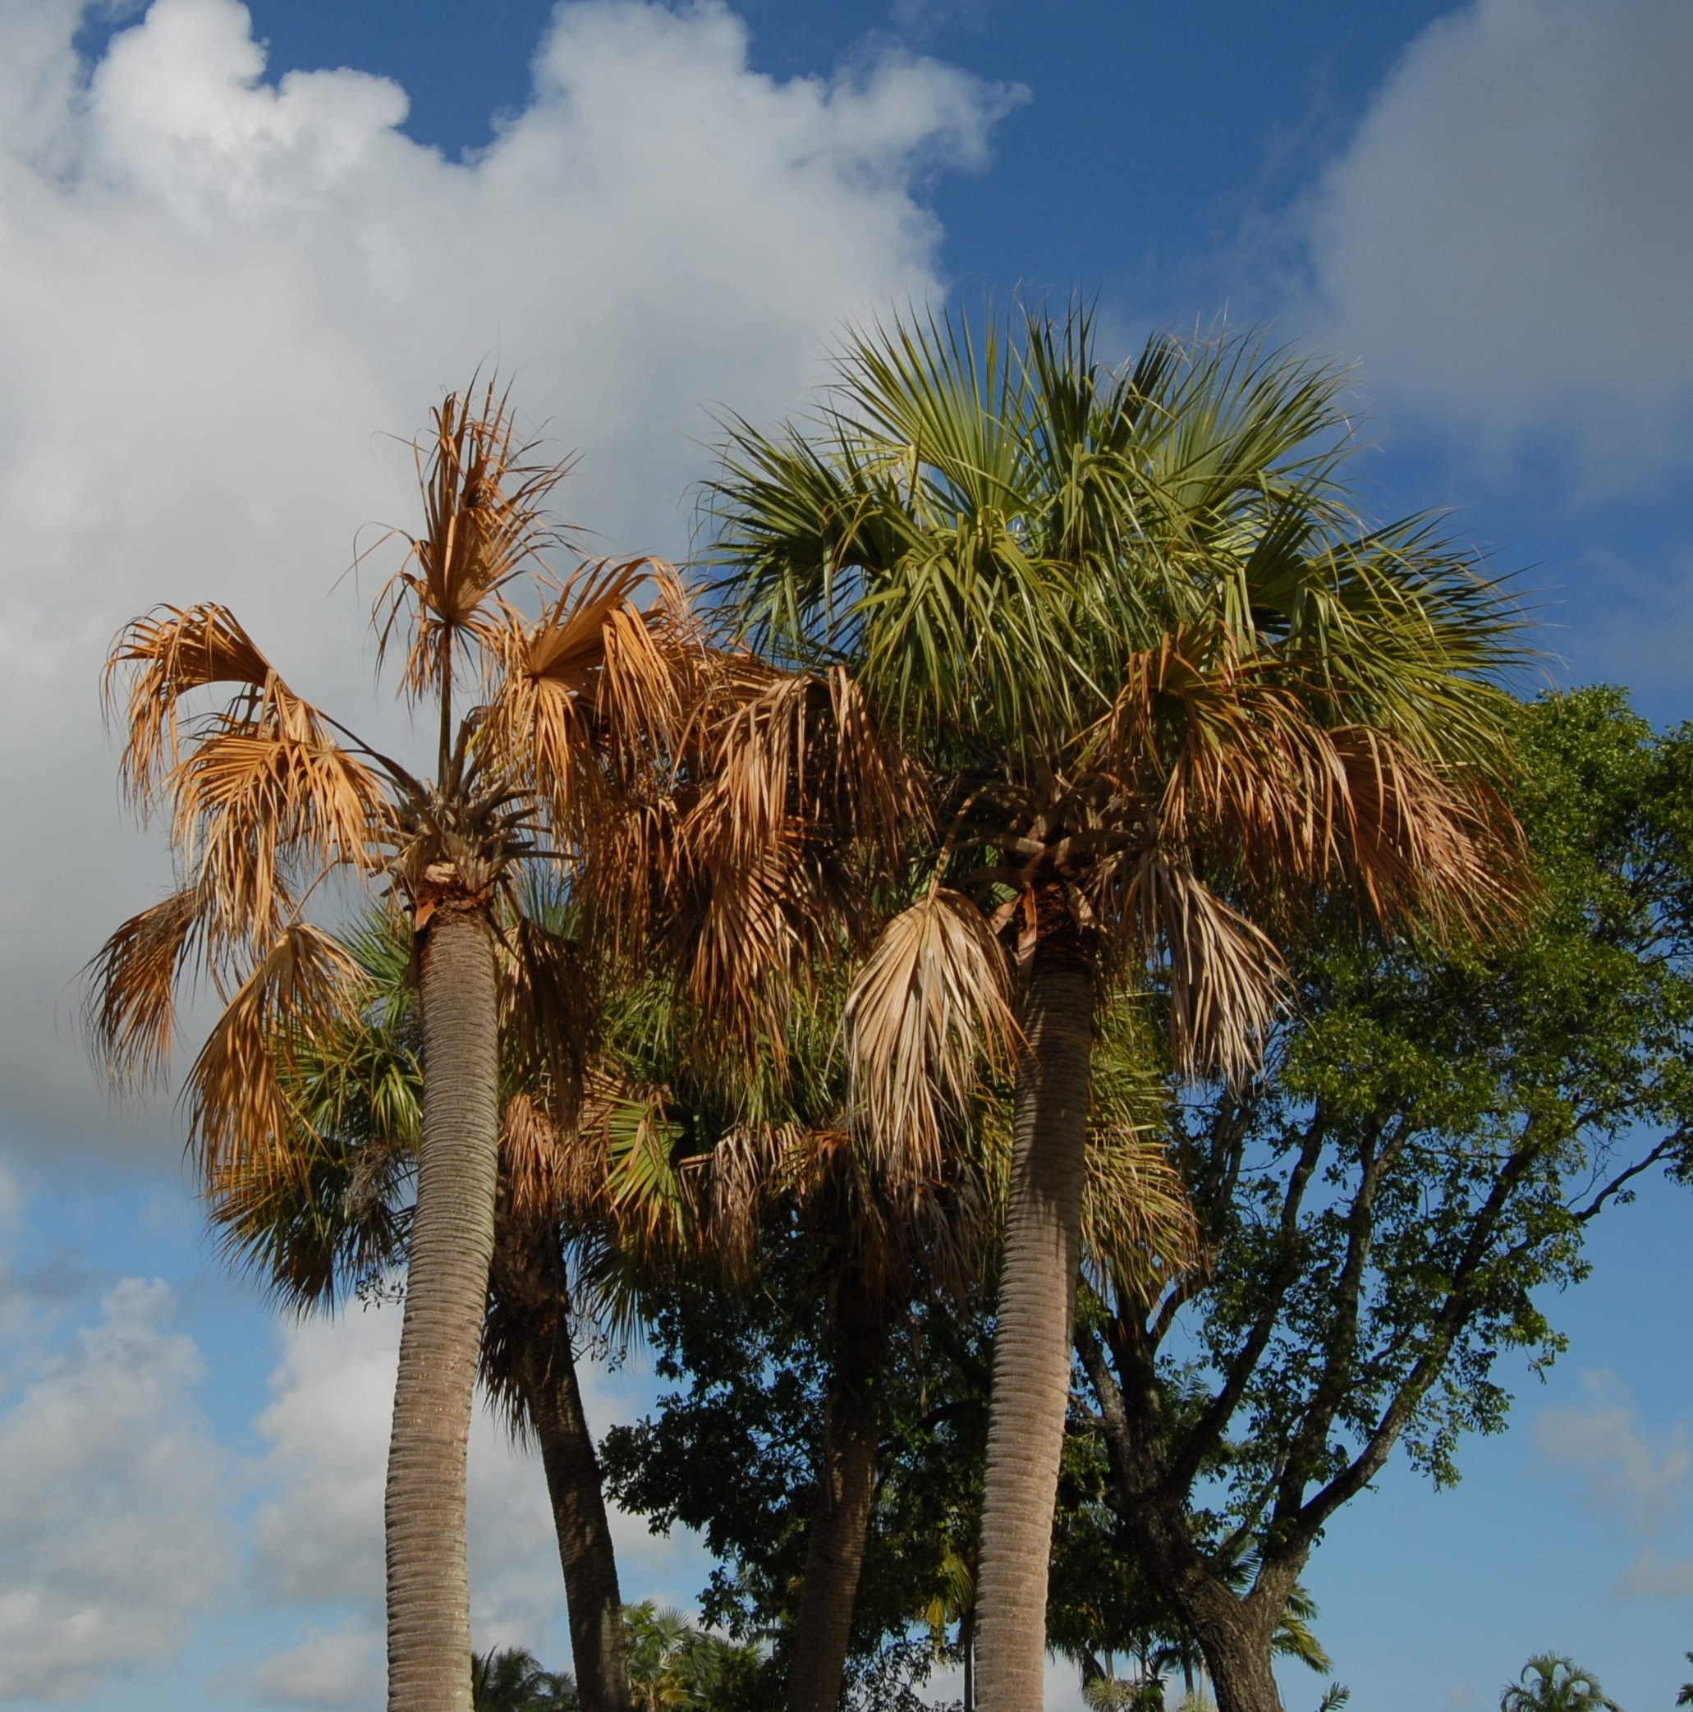
Lethal Bronzing
Previously known as “Texas Phoenix Palm Decline” (found in TX, on Phoenix spp., early 2000s)
Caused by Candidatus Phytoplasma aculeata
  Phytoplasmas = bacteria lacking a cell wall (3-layered membrane)
  Extremely “fastidious” outside of their plant hosts or insect vectors.
  Requires DNA methods to positively diagnose.
Found in Florida (Tampa area) in 2006, has since spread through much of the state
Not the genus name!
Means it can’t be maintained in culture.
Notes:
I couldn’t think of a good native phloem vascular disease, so I’ll tell you a little about lethal bronzing disease, an emerging problem that is devastating palm trees in Florida. This was previously known as Texas Phoenix Palm Decline because it was first found in Texas, on Phoenix palms. Its caused by a phytoplasma, a wimpy type of bacterium that doesn’t have a cell wall, and can’t live outside of either the palm or the insects that carry it. It requires DNA-based methods to positively diagnose. It has been found in Florida since 2006 when it was detected in the Tampa area, and has been spreading quickly ever since.
By the way, when you see a scientific name starting with the word “Candidatus” that’s not the genus name. Under longstanding international rules for recognizing scientific names to microorganisms, cultures of the organism have to be maintained in public reference collections. When you have an organism like this phytoplasma that can’t be kept alive in a pure culture, its scientific name isn’t considered official, even if there is so much evidence from DNA and so forth that basically everyone accepts its identity. In that case, publications about the organism will use this Candidatus label, as a way of saying, “This name isn’t official, but we all know what we’re talking about.”

Slide 3
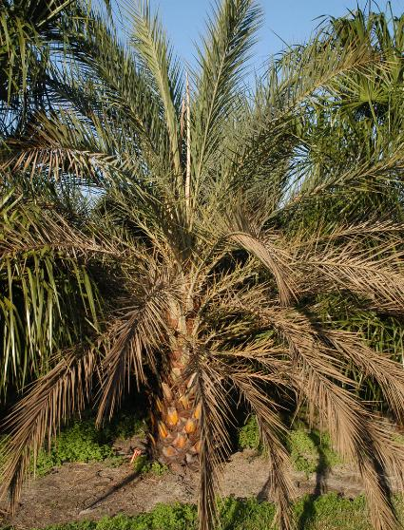
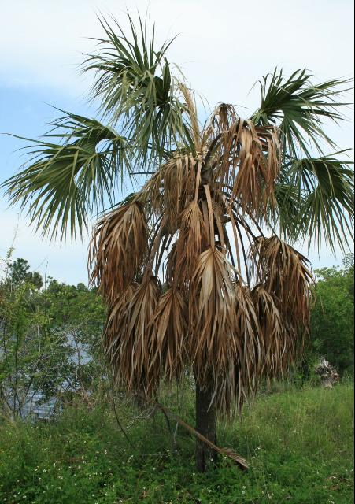
Lethal Bronzing Symptoms
Typical progression:
Sudden, early drop of all fruit within a few days, followed by death of inflorescence (if present)
Fronds wilt and turn brown:
  Oldest leaves first
  Starting at leaf tips
Spear leaf dies (and plant is effectively dead) when:
  Phoenix spp.: < 1/3 of oldest fronds are dead
  Cabbage palms: ~2/3 of oldest fronds are dead
Palm roots may become rotten and soft – stem may be unstable
Notes:
The symptoms are vague, and not very diagnostic. If the palm happens to be producing fruit or flowers at the time, one of the first symptoms is that the fruit will drop off early and the flower stalks will die. Then the fronds or leaves of the plant will start to die, starting with the oldest ones at the bottom. Then at some point, the newest growth just emerging from the top, called the spear leaf, will die – and that’s when you know the plant is effectively dead. But you may have a period when the older leaves at the bottom and the newest leaf at the top are both dead, and there’s a ring of green leaves in the middle that lives for a little longer. Meanwhile, the roots may start to die from starvation, and the whole palm may be more likely to fall over.

Slide 4
Brown, Dead Spear Leaf
Phoenix palm
Cabbage palm
Notes:
Just giving you a better view of those pictures here.

Slide 5
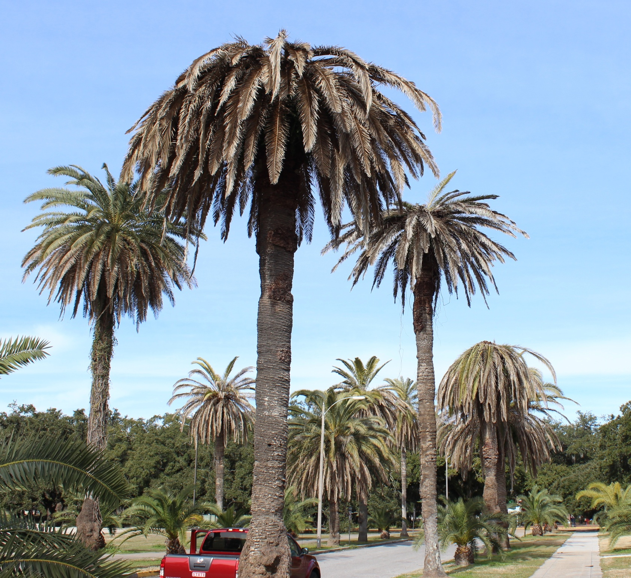
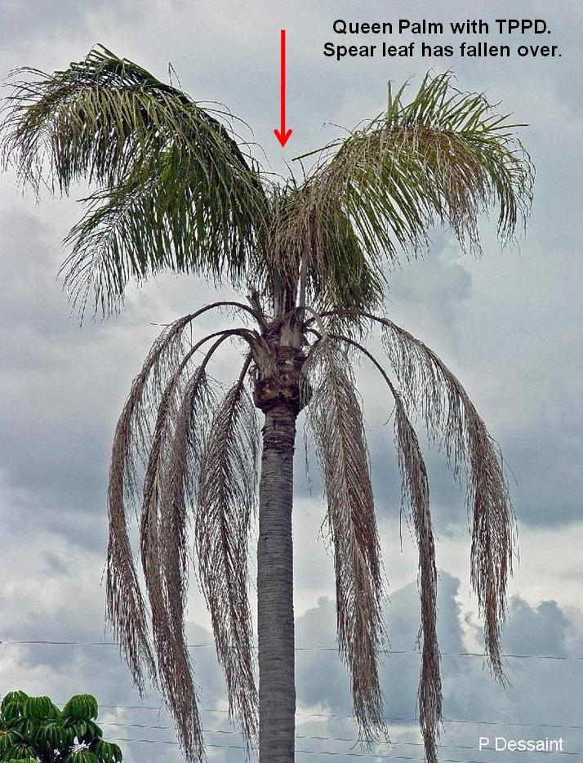
Queen palm
Canary Island Date Palms
Notes:
And here are some more examples at different stages of decline. Scenes like this are becoming very common in many urban areas of Florida.

Slide 6
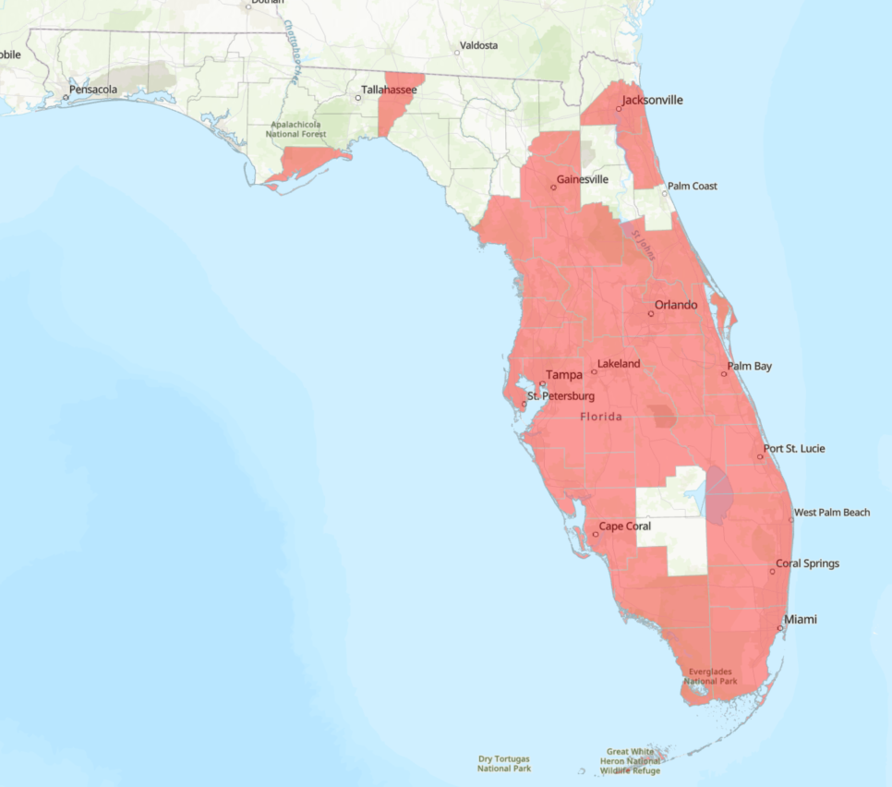
Lethal Bronzing Disease – Current FL Distribution
Also in parts of Texas & Louisiana, recently discovered in Mexico
Notes:
Here is the current county distribution map of lethal bronzing in Florida. It has spread rapidly since 2006, and likely is in some of these other counties without being officially confirmed yet. It has likely been spread around much more rapidly by human movement of infected plants.

Slide 7
Lethal Bronzing
Acrocomia aculeata | Coyol Palm
Adonidia merrillii | Christmas Palm
Arenga engleri | Dwarf Sugar Palm
Attalea butyracea | Yagua Palm
Bismarckia nobilis | Bismarck Palm
Brahea brandegeei | San Jose Hesper Palm
Butia odorata | Pindo Palm
Carpentaria acuminata | Carpentaria Palm
Cocos nucifera | Coconut Palm
Livistona chinensis | Chinese Fan Palm
Phoenix canariensis | Canary Island Date Palm
Phoenix dactylifera | Edible Date Palm
Phoenix roebelinii | Pygmy Date Palm
Phoenix sylvestris | Wild Date Palm
Pritchardia pacifica | Fiji Fan Palm
Pseudophoenix sargentii | Buccaneer Palm
Rhapidophyllum hystrix | Needle Palm
Sabal mexicana | Mexican Palmetto
Sabal palmetto | Cabbage Palm
Syagrus romanzoffiana | Queen Palm
Trachycarpus fortunei | Chinese Windmill Palm
Confirmed hosts so far:
Many ornamental species
Plus Florida’s native “state tree!”
Notes:
Lethal bronzing causes the gradual wilt and death of the palm. It usually starts with the wilting of the lower fronds and death of any flower or fruit stalks that may be present. As it wilts from the bottom up, at some point the spear leaf at the top-center dies, and then you know the tree is basically a goner. It affects a very wide range of palms – unfortunately, including the Sabal palmetto that is Florida’s “state tree.”

Slide 8
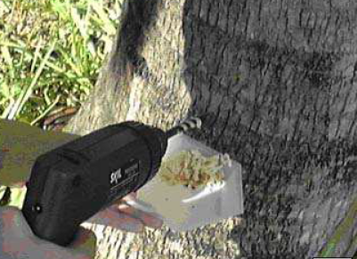
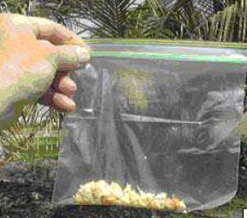
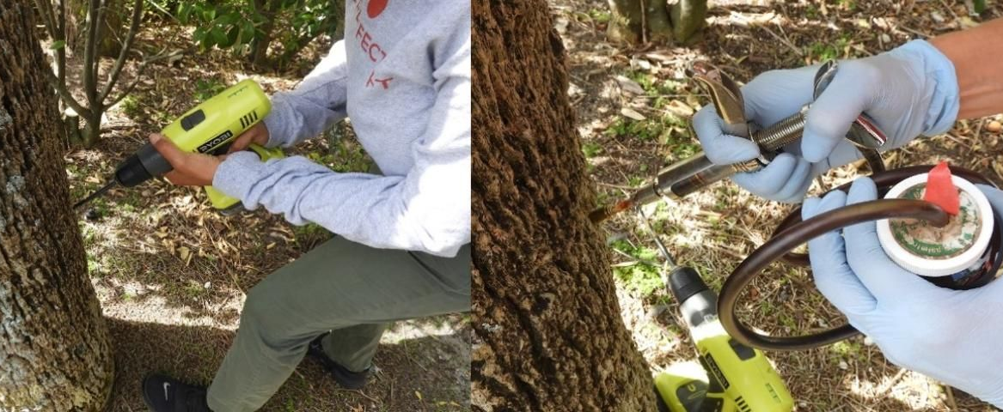
Lethal Bronzing Disease – Detection & Management
Can only be reliably diagnosed from PCR/sequencing done on stem tissue.
  Requires wood tissue drilled out from main stem.
  Causes permanent injury.
For prevention on healthy palms: stem injection with an antibiotic, oxytetracycline (OTC)
  Must be repeated every 3 months.
Once a palm is showing symptoms, treatment is not recommended.
  Quickly remove infected palms to reduce local risk of infection.
At state/regional scale: avoid moving infected plants.
  Difficult to screen nursery plants
  Sampling of spear leaf possible, but false negative rate higher
Notes:
This is a disease that is particularly difficult to diagnose and manage. Again, the phytoplasma can’t be cultured in a petris dish, so it requires DNA-based methods to get a positive diagnosis. And unfortunately, it can’t be reliably detected in leaves, so you have to drill out some wood from the main stem of the tree. And as you all know, palms have no mechanism to seal over injuries, so this causes permanent damage. Personally, I only do this if I already have a strong suspicion that the tree may be infected. And there is a preventative treatment available. Since phytoplasmas are a type of bacterium, they can be controlled with the same sort of antibiotics that we use to treat bacterial infections in people, namely oxytetracycline, or OTC. So, if you have infected palms in the area, and you want to protect a healthy palm, you can inject its stem with an OTC solution. This again involves drilling into the stem, but there are systems where you can then install an injection port into that hole, and periodically return to push in the OTC solution. Unfortunately, this has to be repeated at least once every three months in order to remain effective. Once a tree is showing any symptoms, it’s not recommended to try to save it – at best, you might make it die more slowly, and that just means that you’re keeping an infected tree around to spread the disease for a longer period of time. At the large scale, another important point is that we need to avoid moving around infected trees with the landscape and nursery trade. But that’s difficult to regulate, because we have no way to screen nursery trees for the disease that doesn’t permanently damage the palms.

Slide 9
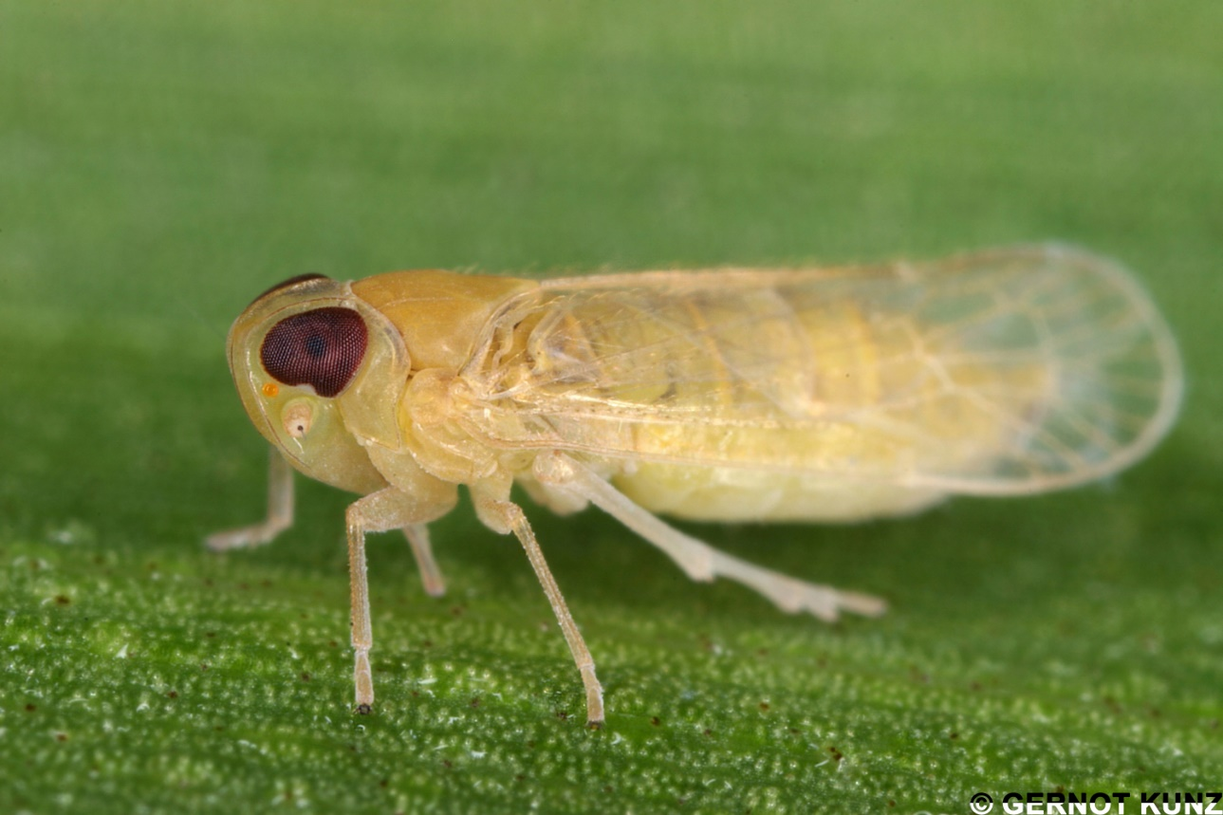
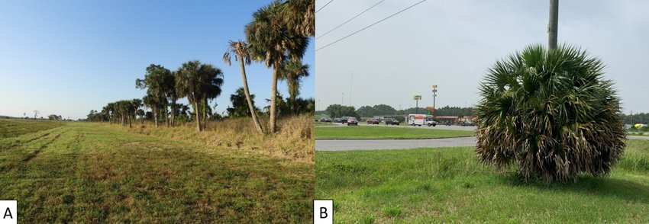
Lethal bronzing vector(s)
Presumed to be transmitted by planthopper insects that feed on phloem sap.
One confirmed vector: Haplaxius crudus (the American palm cixiid).
  Proven to transmit the pathogen with painstaking laboratory experiments.
That species must feed on grasses in the juvenile stage – maybe palms not growing near grasses will be safe?
But there are many other palm-feeding planthoppers that have not yet been fully tested.
Notes:
It was long assumed that this phytoplasma was transmitted by planthopper insects that feed on phloem sap, like others are. And in recent years, one planthopper has been confirmed as a vector, the American palm cixiid. That species feeds on grasses in the juvenile stage, and only moves to palms as an adult. That raises the possibility that palms that are growing where there aren’t many grasses – such as in many forests – might be safe. But this has not yet been demonstrated, and it’s possible that other planthoppers may also spread the pathogen. There are survey projects planned to see how much this disease is impacting native palms in forests.

Slide 10
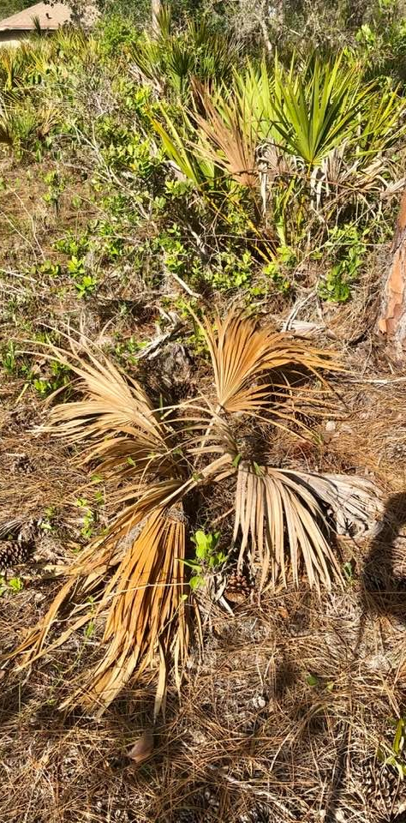
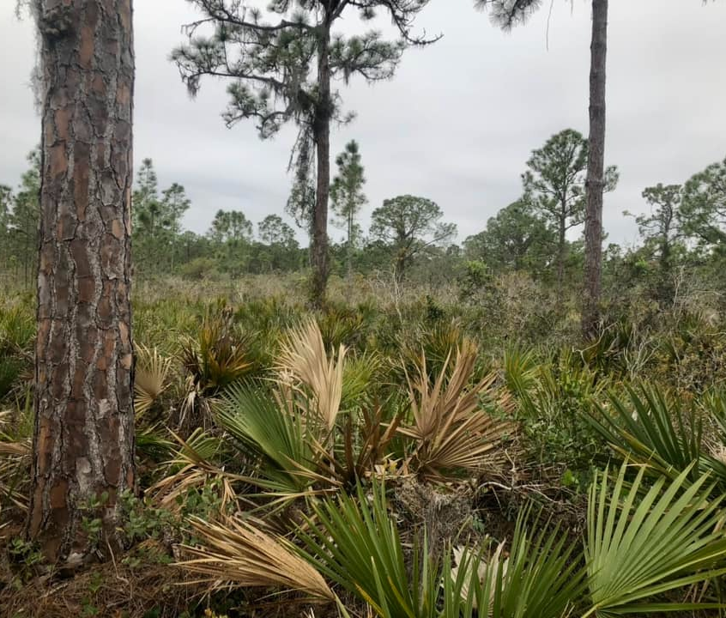
New host detection!
Scrub palmetto, Sabal etonia
A Florida-precinctive (endemic) palm species found in sandhill habitats
Grows from underground stems (difficult to sample)
Area with many plants dying in Highlands County reported in June 2023, confirmed positive for the LBD phytoplasma.
No grasses nearby. Alternate vector?
Notes:
In 2023, we found lethal bronzing in another native palm species, the little scrub palmetto that grows only in the very dry, sandy habitats of central Florida. This species grows with underground stems, so I had to dig them out in order to collect wood samples to test for the phytoplasma. There really weren’t any grasses around these plants, so we’re trying to sample for other planthoppers that feed on palms in that area, to see if something else is transmitting the pathogen.

Slide 11
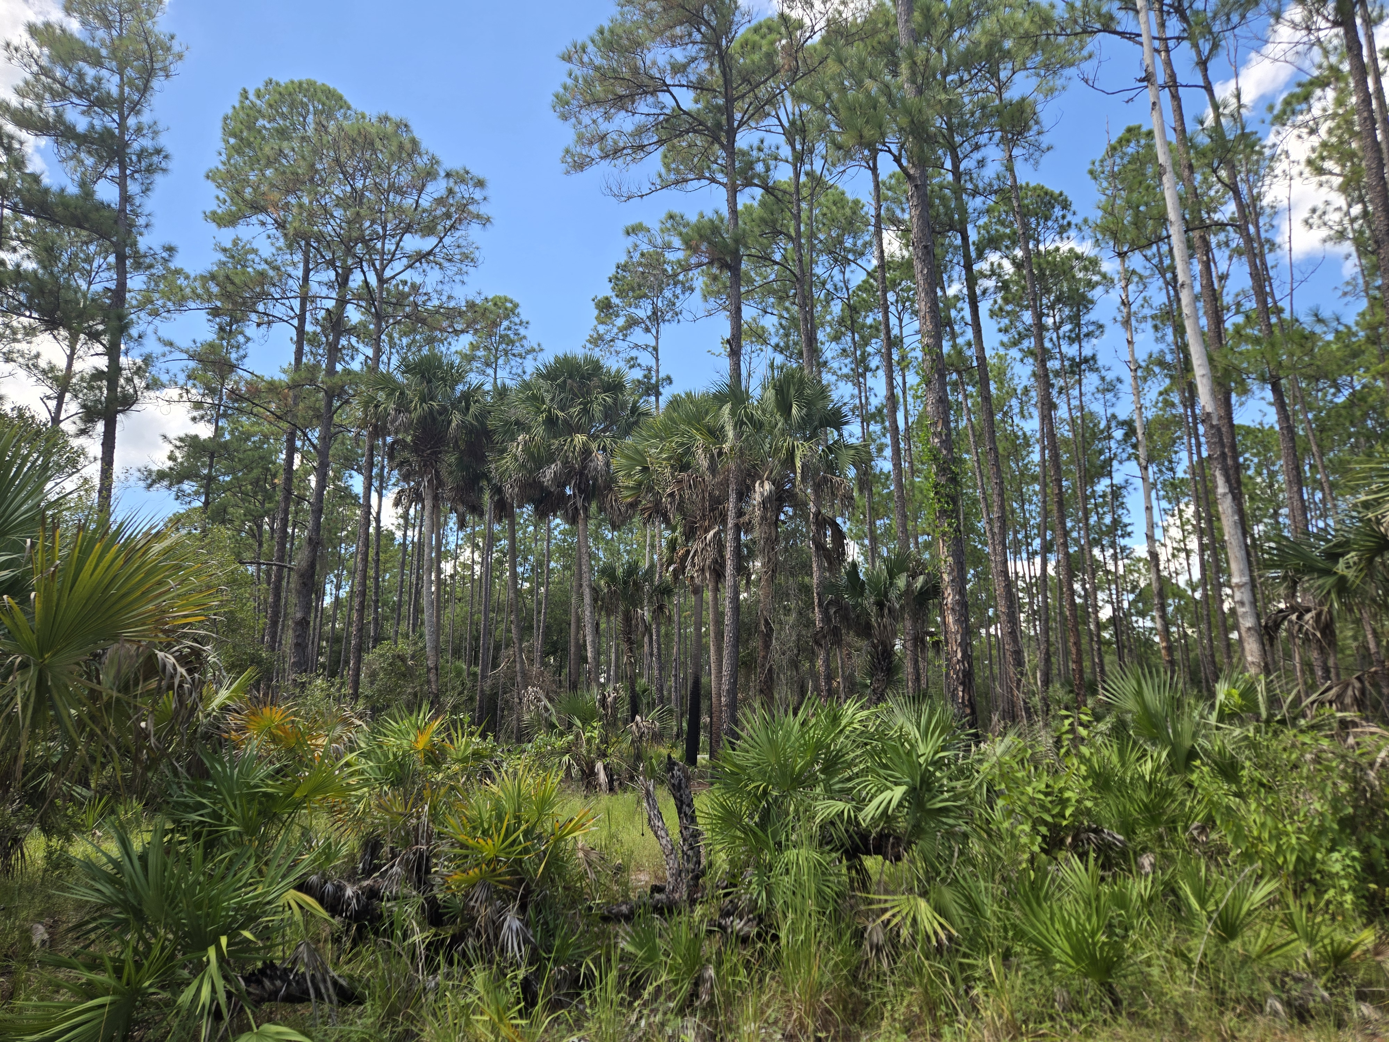
Questions to answer
Is LB causing significant mortality to our native palms in forested or natural settings, in regions where the pathogen is currently known?
If yes,
  How widespread is it?
  What is/are the primary vector(s) in those settings?
  Are there any associations with groundcover species or management history, including prescribed fire?
Notes:
Make note that FL gets about 10 new species on insects per year, not all pests and not all vectors, but what happens when you have the right combination?

Slide 12
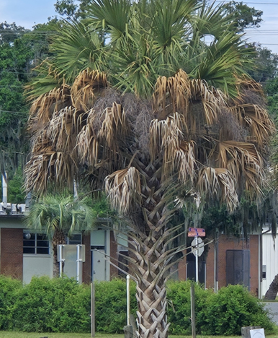
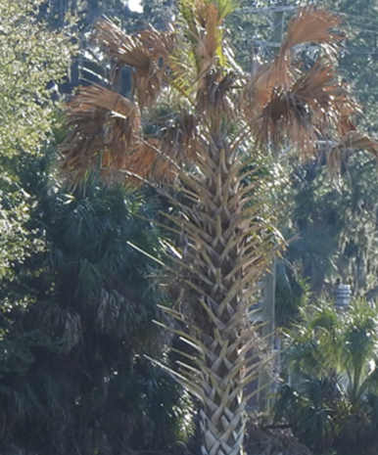
Current survey progress
Locating palms with 2/3rds of necrotic fronds or more
Confirming presence of pathogen near forested/natural areas
Ideally in a variety of habitats, but focusing on areas with more grasses first
  Taking percent grass cover estimates
Target species: Sabal palmetto, Sabal etonia, Phoenix spp.

Slide 13
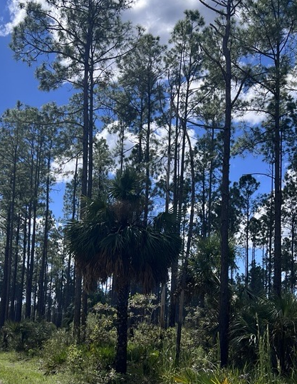
Current survey progress
6 sites visited across north and central Florida
  Tiger Bay State Forest
  Withlacoochee State Forest
  Lake George State Forest
  Conservation Golf Course*
Double extraction protocol and confirmation using qPCR assay with primers/probes developed by Dr. Brian Bahder, UF/IFAS FLREC

Slide 14
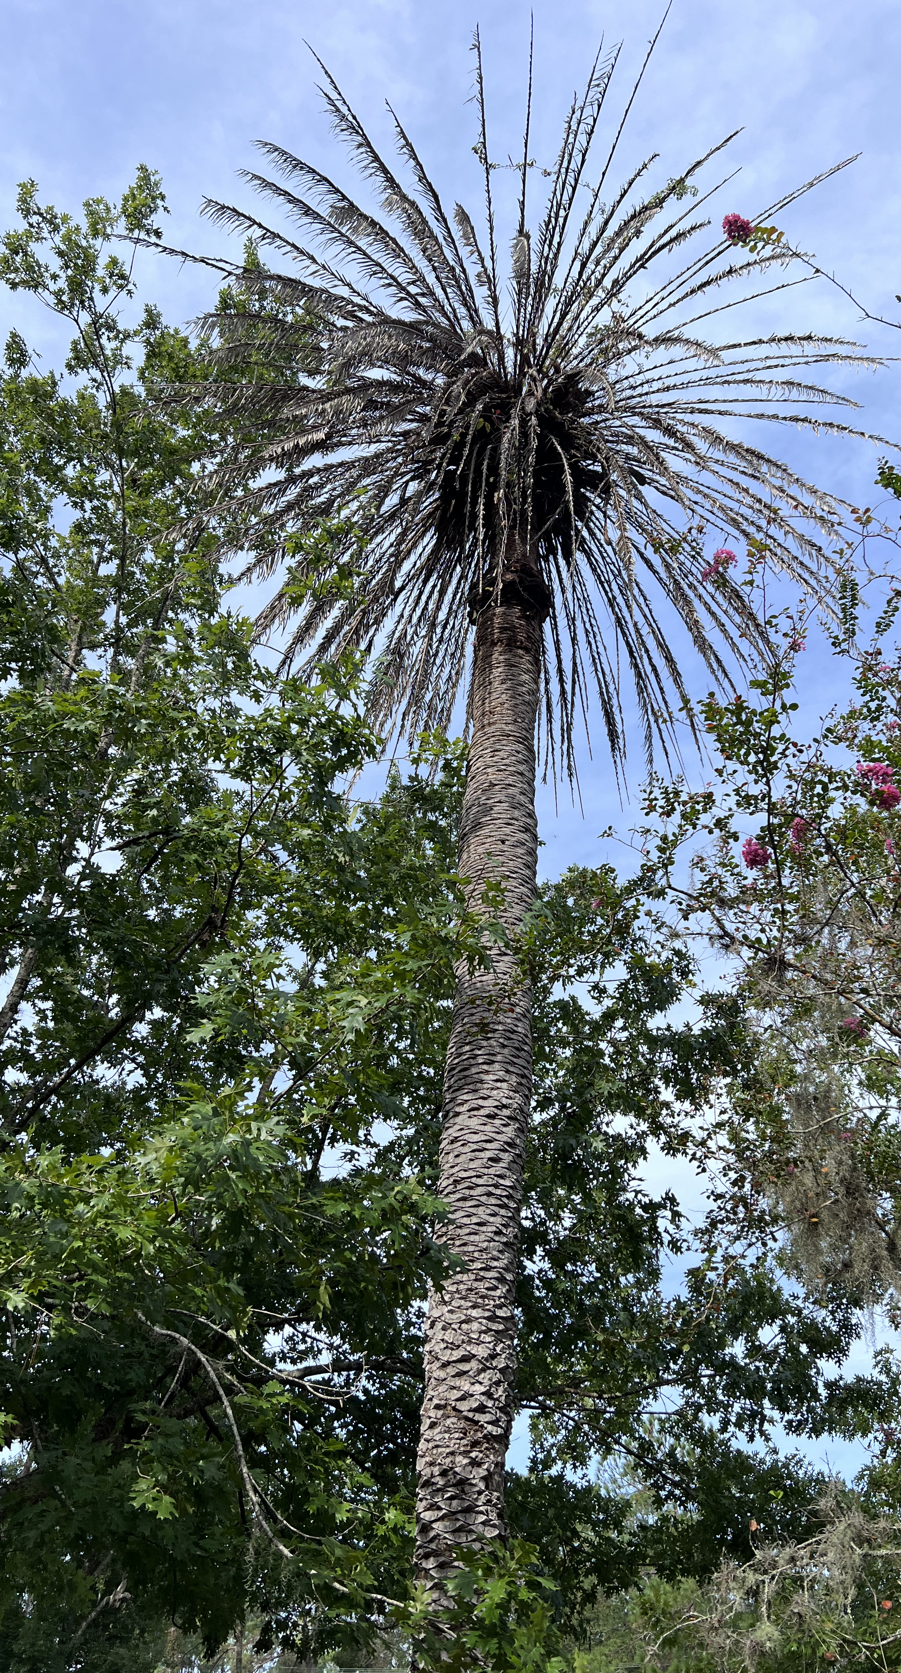
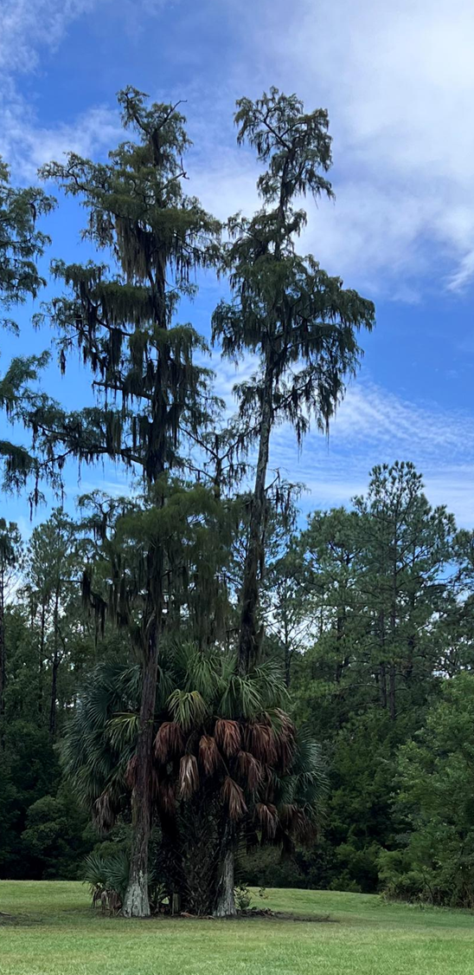
Conservation Based Golf Course
Unique opportunity to assess a managed area next to a more “natural” one
  Ability to identify source of inoculum
So far have confirmed two positives: in managed and mowed areas only
  Tested ten other palms in natural areas near confirmed positive palms showing signs of decline, all were negative for the phytoplasma

Slide 15
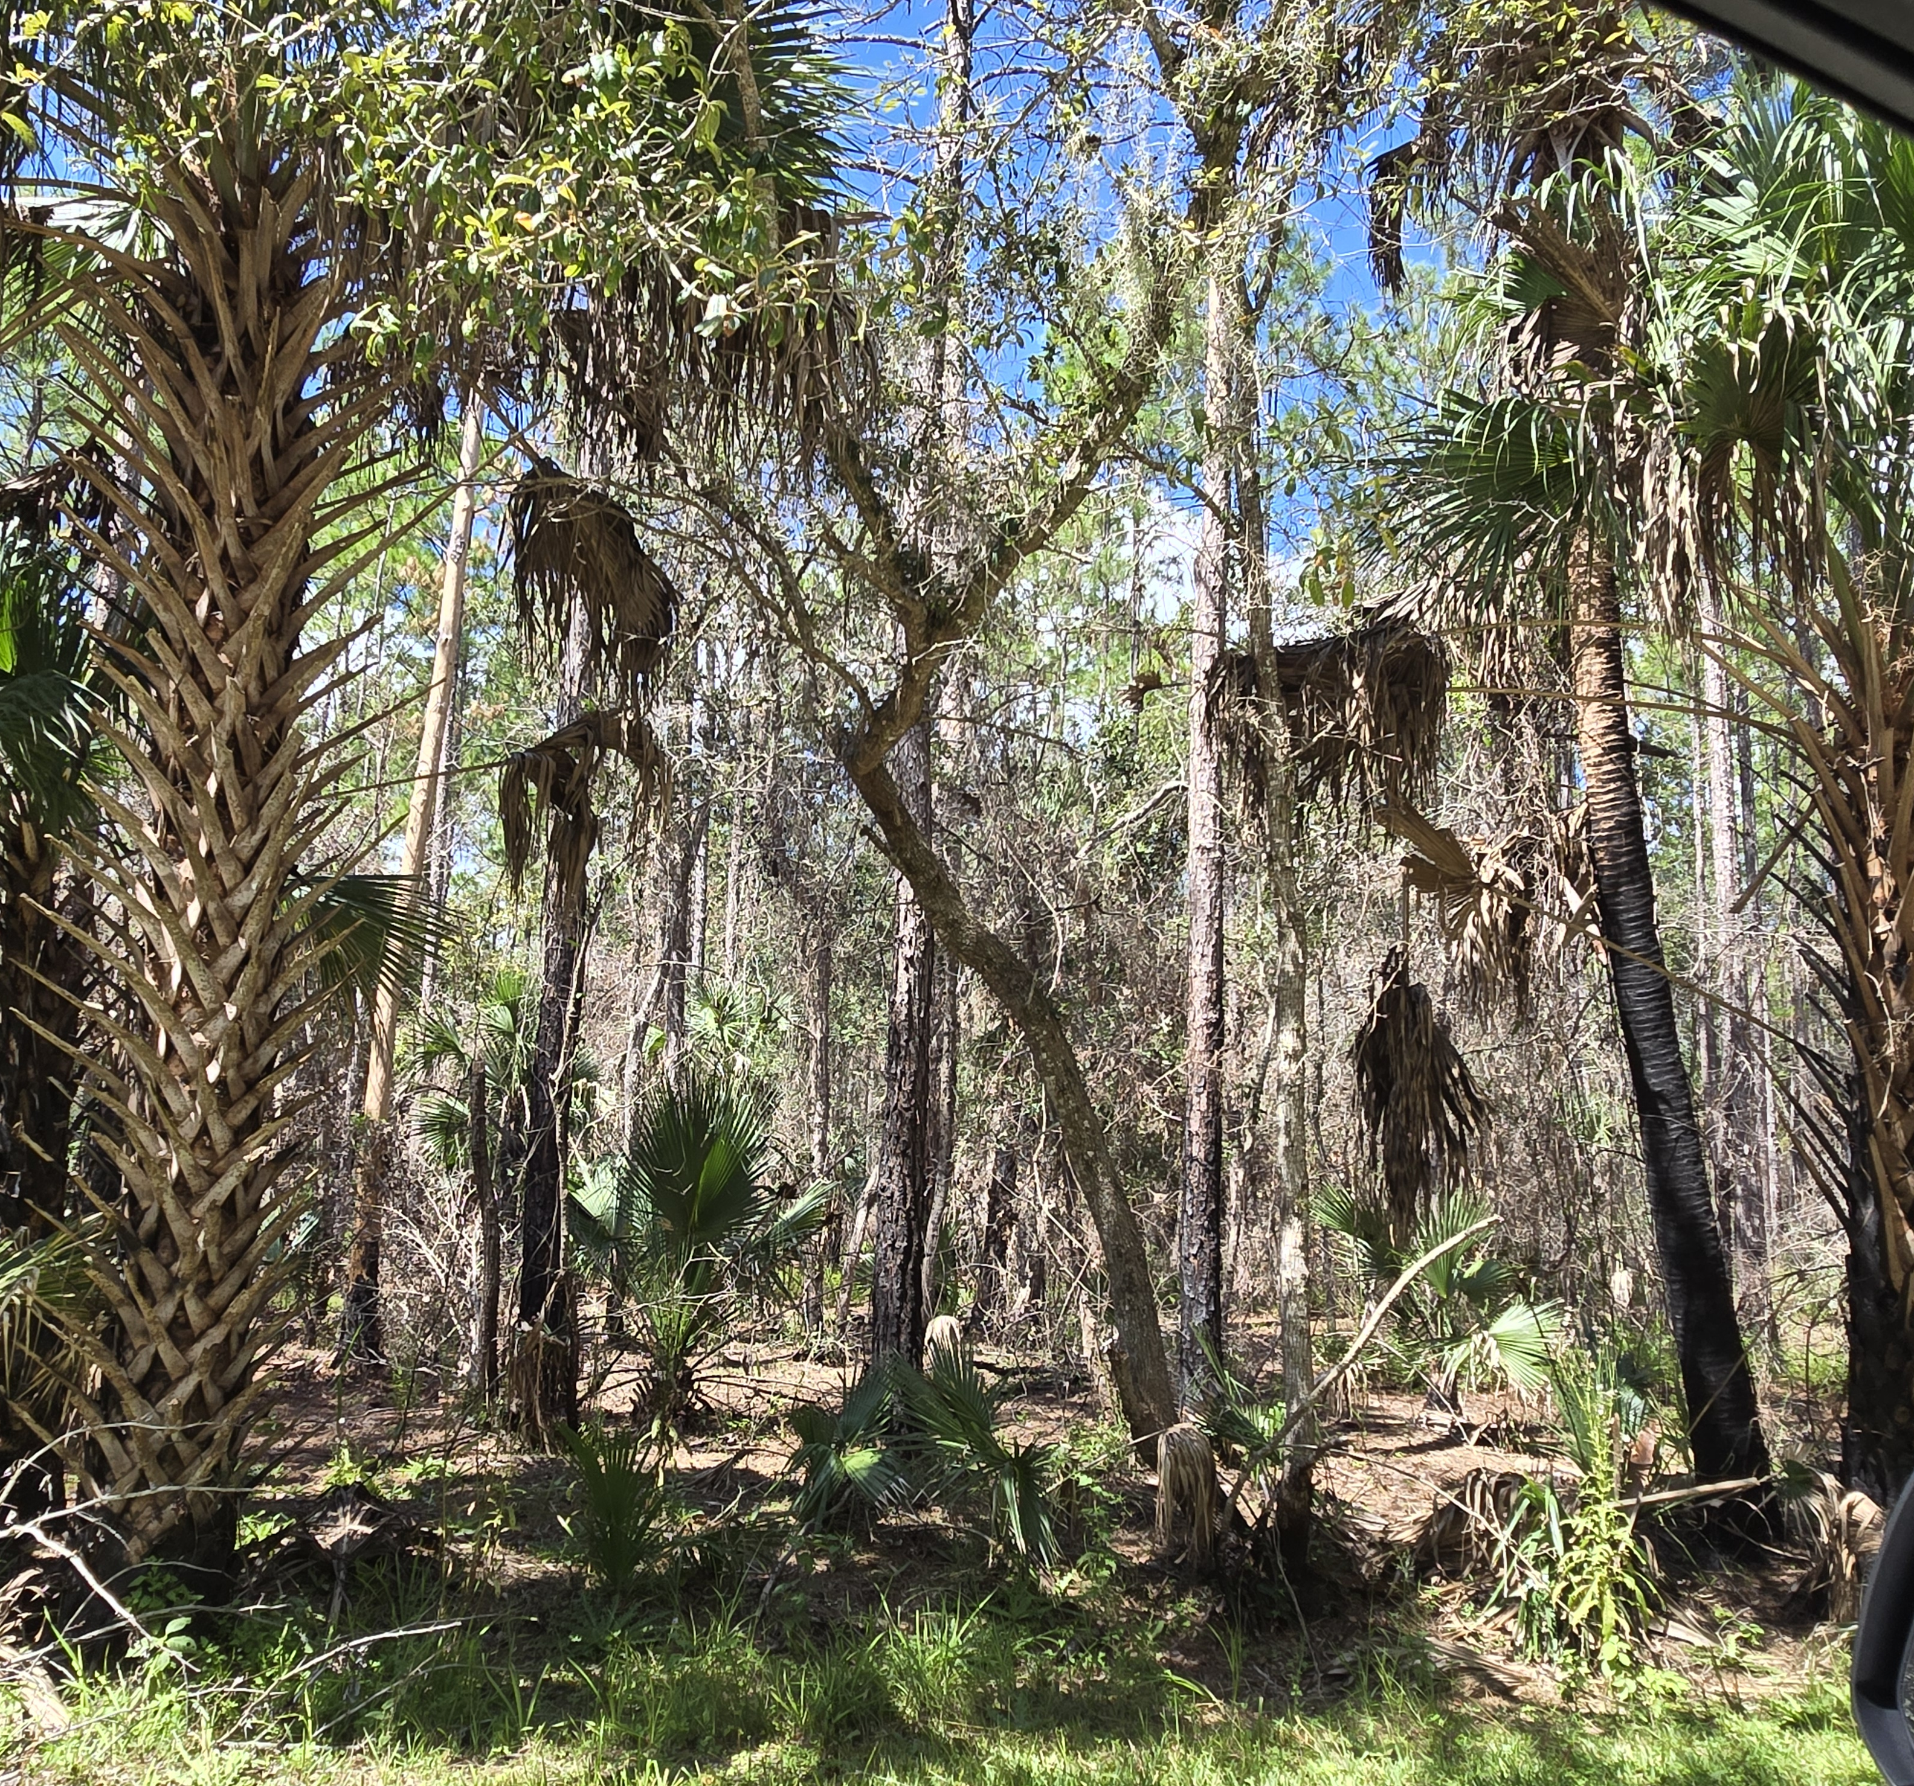
Next steps
Continue to survey more state forests and natural areas
  Always taking tips from State Lands, County Foresters, AND YOU!
  In process of obtaining State DEP Research and Collecting permit
Assess any positives in new habitats for associations with potential vector insects
Evaluate the ecological impacts on palm survival and forest composition

Slide 16
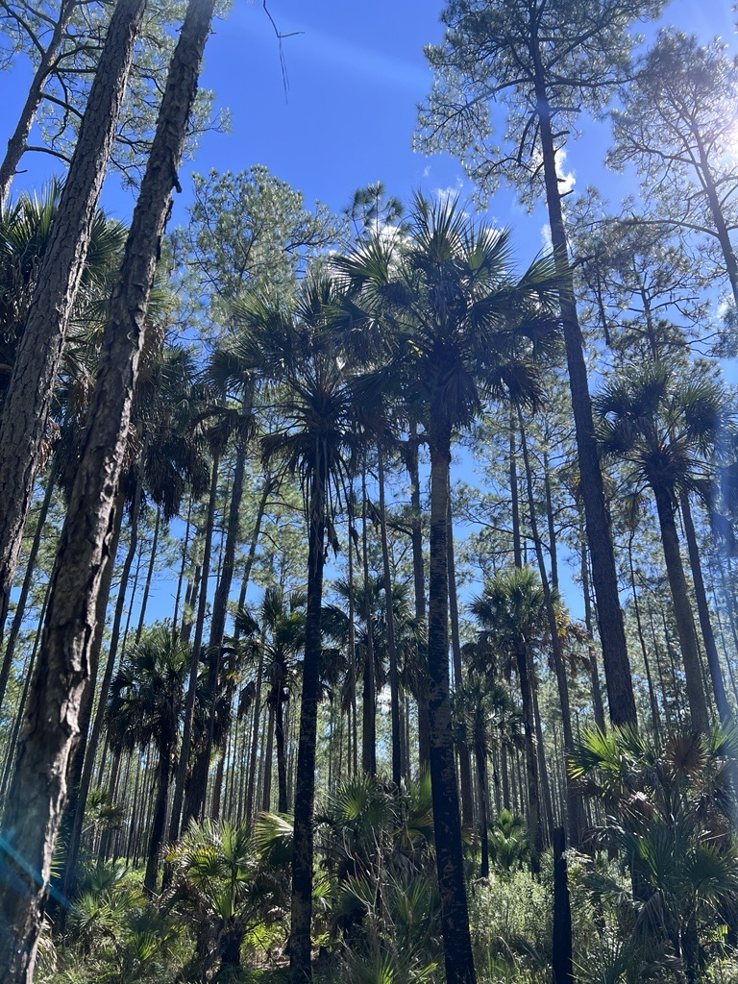
Palms, Fire, and Lethal Bronzing?
Palms in FL are relatively fire adapted
Palm mortality from fire commonly observed when they are smaller, with apical meristems closer to the soil surface (McPherson and Williams, 1998).
Lethal bronzing tends to impact older palms most notably, but can infect any age palm
  Potential to change vertical fuel loads
  Change in fine fuel load dynamics

Slide 17

Report weird palms!
Please contact Brianna Benitez at 352-385-4690 or Brianna.Benitez@FDACS.gov if you see any suspicious declining palms in natural or forested areas

Slide 18
Ornamental Palms? Call UF/IFAS!
Can send to Dr. Brian Bahder at FLREC
https://www.bahderlab.com/services
Can send to Dr. Carrie Harmon at GNV PDC
https://plantpath.ifas.ufl.edu/extension/plant-diagnostic-center/

