Slide 1
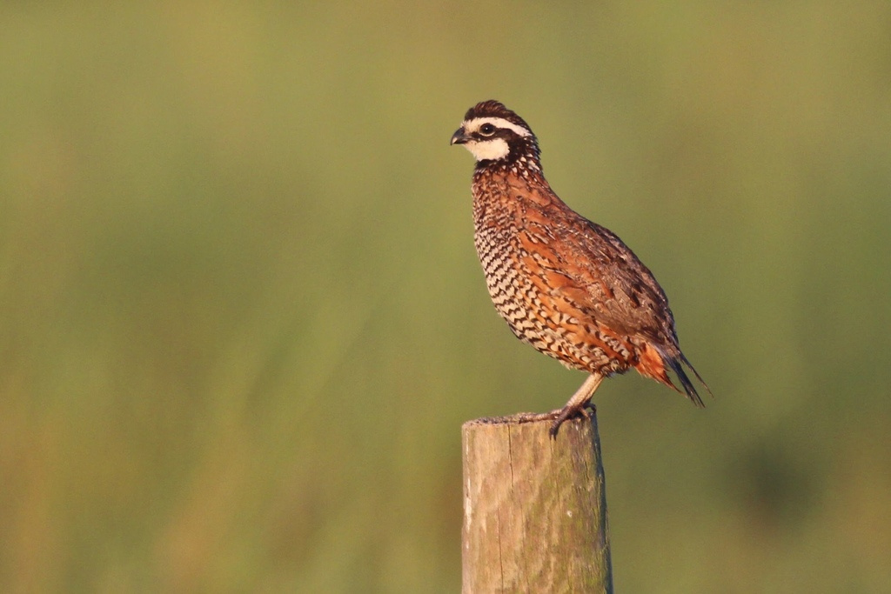
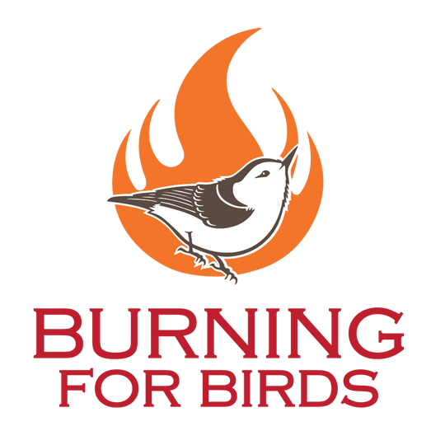
How Prescribed Fire Ignited a Conservation Collaborative for Birds
Presented by:
Heather A. Obara, Esq.
Associate Director
Alachua Conservation Trust

Slide 2
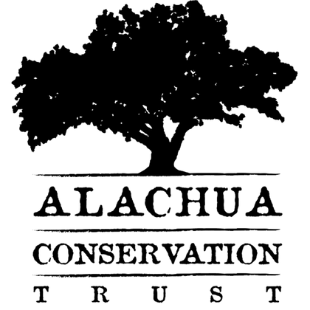

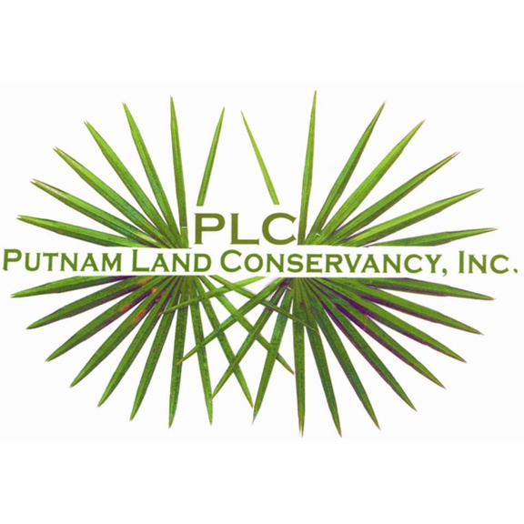
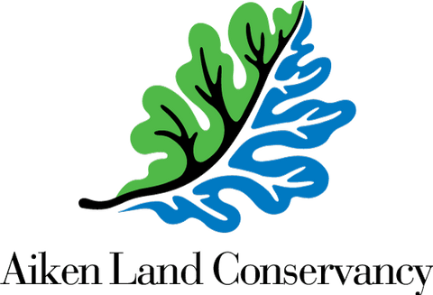

Burning for Birds Conservation Collaborative
The Conservation Collaborative seeks to engage private landowners with prescribed fire in ways that benefit fire-adapted landscapes and restore needed habitat for declining Southeastern U.S. bird species.
Notes:
At the heart of ACT's mission is land conservation.
We have nearly 35 million acres of Land in Florida and much of that land is facing significant development pressure due to rapid population increases.
Over 22 million people in Florida (2024). Nearly 38 million people projected to be living in Florida by 2070. In the next 50 years, we will see a population increase of 11 million people.
Approximately 1,200 people move to Florida every day. And more residents are moving inland from the coasts.
This is why conservation is important. We need to protect public lands today for Florida’s future.

Slide 3
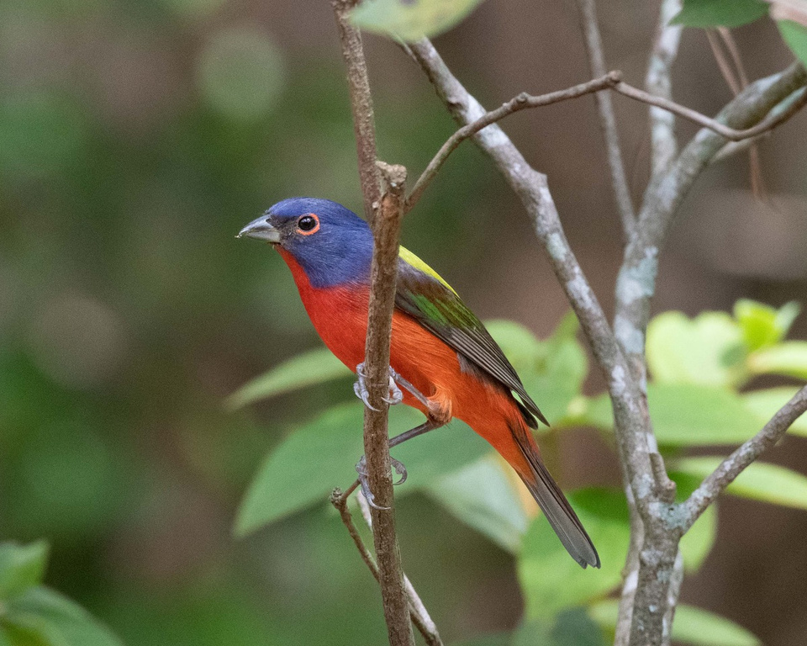


Cornell Land Trust Bird Conservation Initiative
Annual RFP in January & Proposals due March 1st
  Capacity and Partnership Project: 6 grants of $10,000 each (competitive)
  Management and Restoration Project: 8 grants of $25,000 each (competitive)
  Conservation Collaborative Grants: $50,000 grants (solicited)
Painted bunting by Warren Nielsen

Slide 4
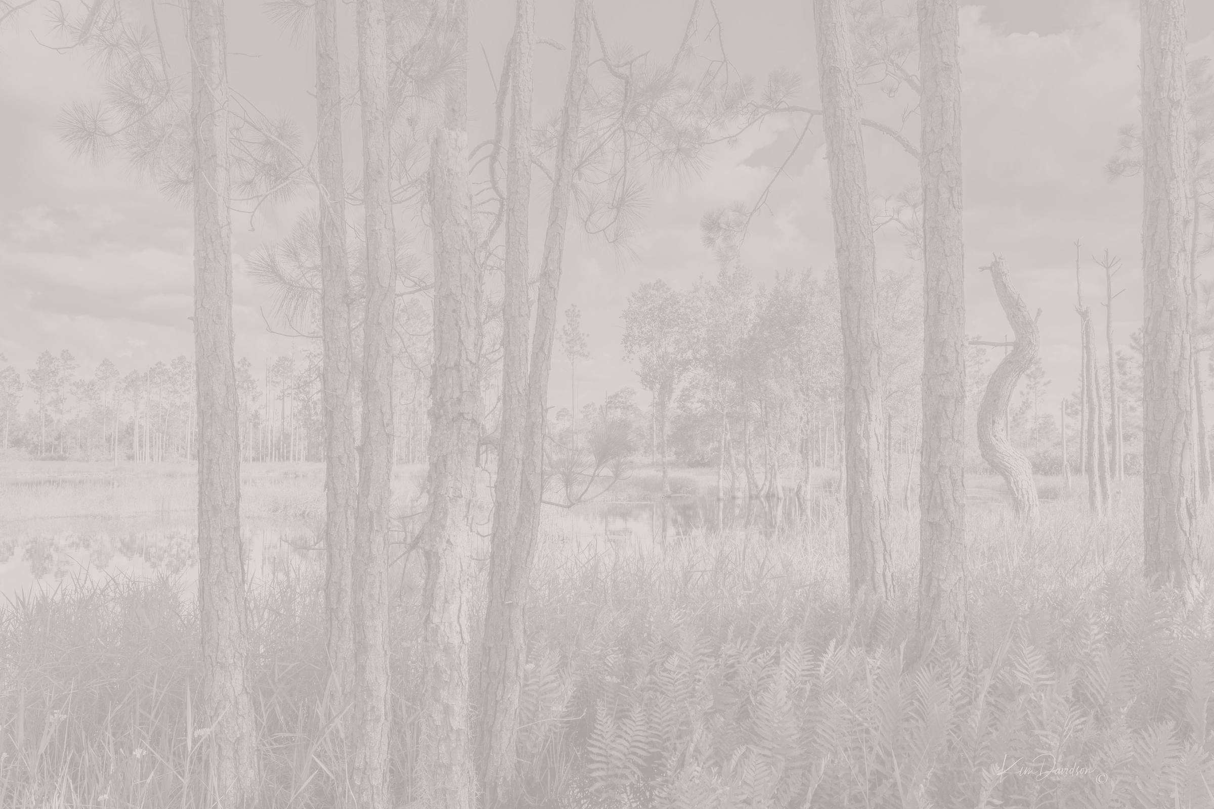
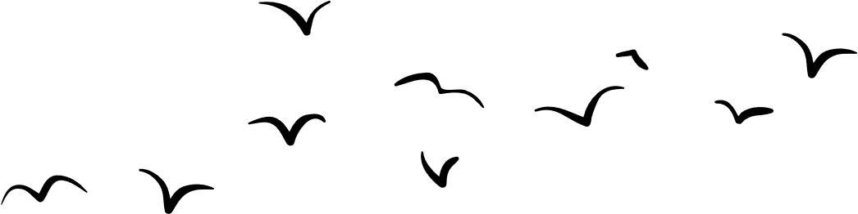
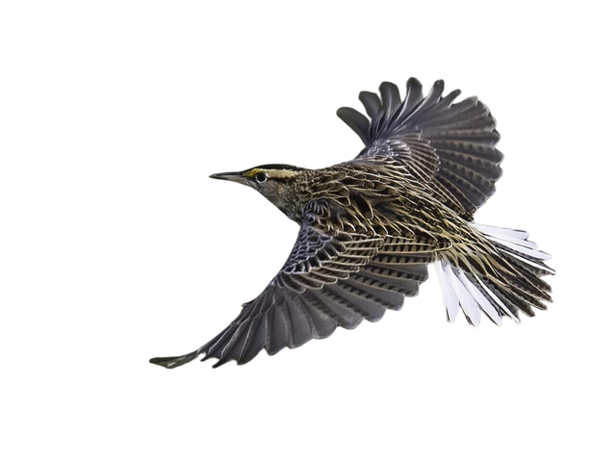
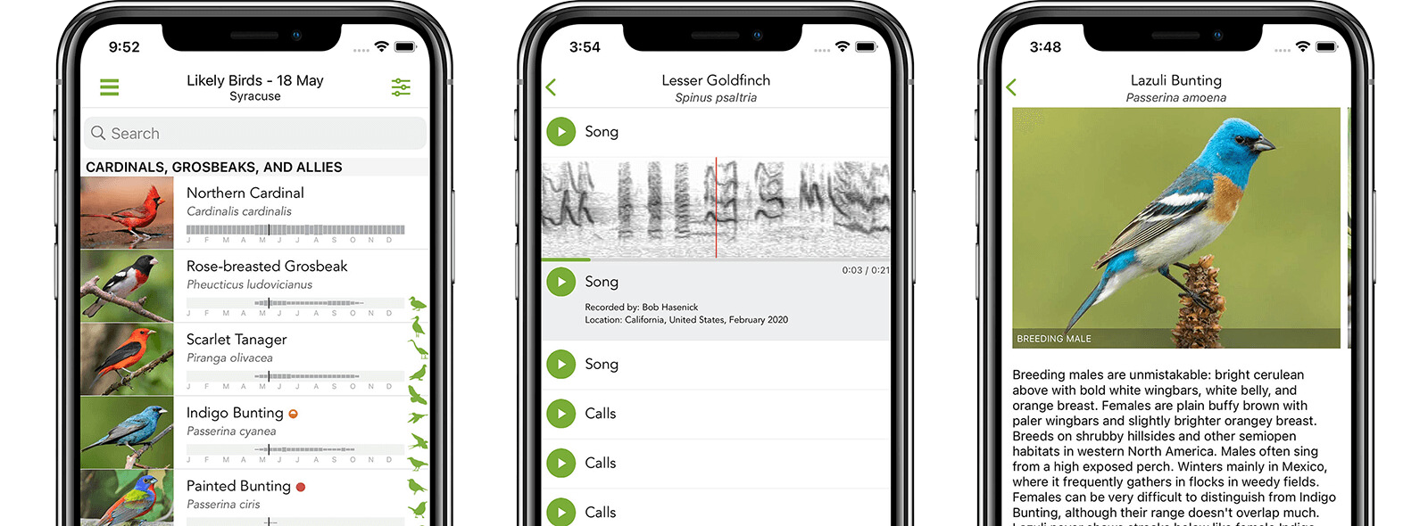
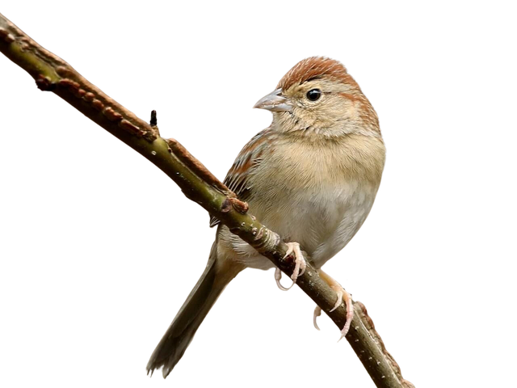
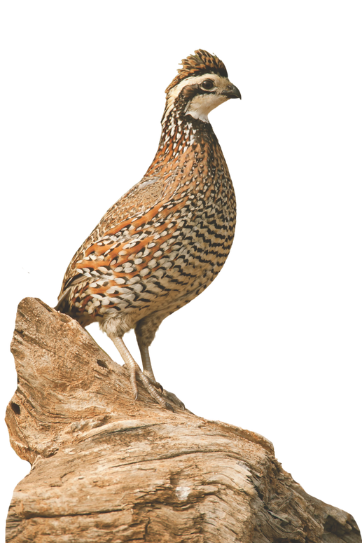
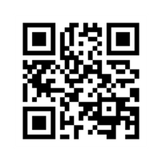
DISCOVER BIRDS LIKE NEVER BEFORE WITH eBIRD & MERLIN BIRD ID
Powered by Cornell Lab of Ornithology – advancing bird conservation worldwide
Bachman’s Sparrow (Peucaea aestivalis). Photo by Bob Friedrichs, Cornell Lab of Ornithology, Macaulay Library
Eastern Meadowlark (Sturnella magna). Photo by Micheal Stubblefield, Cornell Lab of Ornithology, Macaulay Library
Graphic Courtesy of Cornell Lab of Ornithology
Learn more by visiting allaboutbirds.org or by downloading
eBird and Merlin Bird ID in the app store!
Take photos to discover new bird species!
Record bird calls to identify species!
Learn about the characteristics of
your bird!
Discover Birds
  Use Merlin to identify birds instantly by sight or sound.
  Learn about their behavior, habitat, and migration patterns.
  Works offline—perfect for exploring anywhere.
Log Your Sightings
  Track your bird observations with eBird and create personal lists.
  Contribute to global bird research and conservation efforts.
  See what others are spotting in your area or around the world.
Join a Global Community
  Access bird guides for thousands of species worldwide.
  Connect with bird enthusiasts and researchers.
  Help protect birds by sharing your data.
Northern Bobwhite (Colinus virginianus)

Slide 5
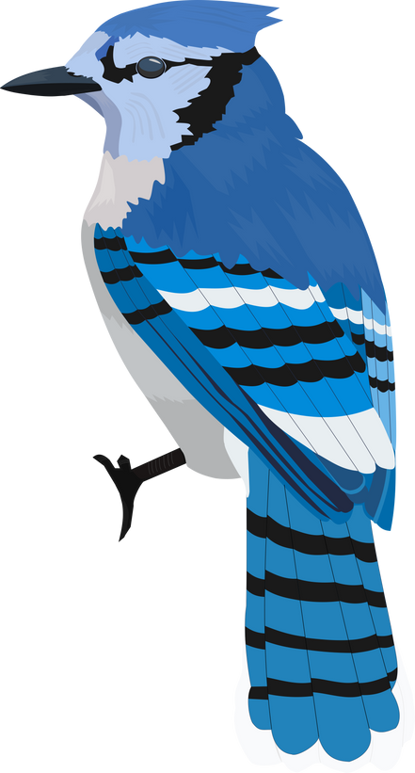
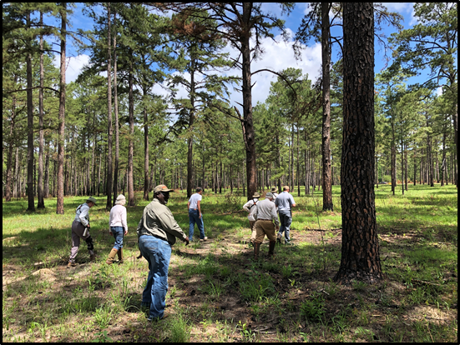
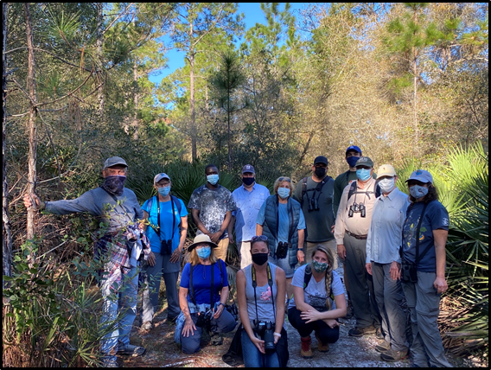
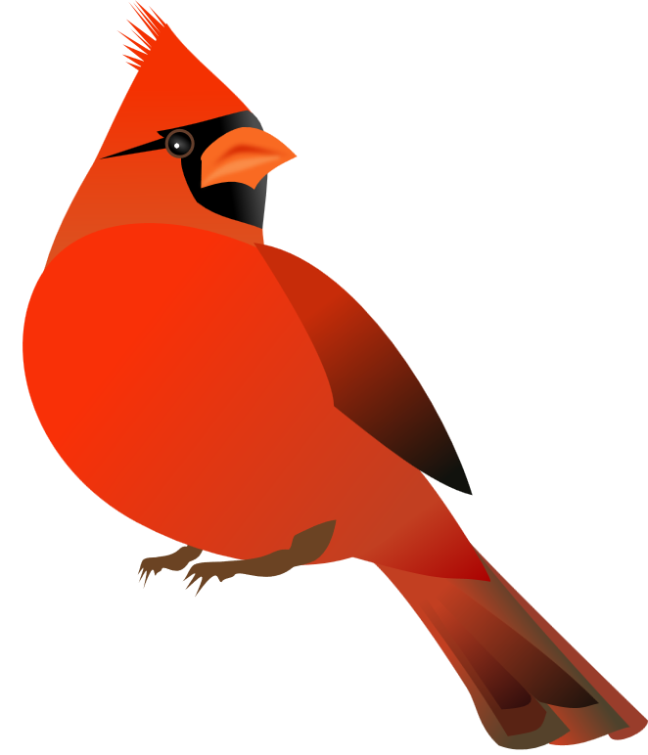
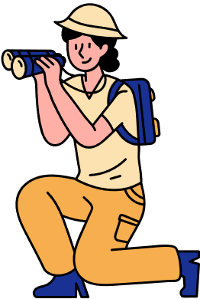

The Spark is Lit
  Recognition that:
    Avian species are declining due to lack of suitable natural habitat
    Knowledge gaps about birds on private lands
    Birds are connectors
    Conservation Easement monitoring and birding go hand-in-hand
  Resulted in closer partnerships and stronger landowner relationships
Photo by Peter Kleinhenz
Photo by Rex Rowan

Slide 6
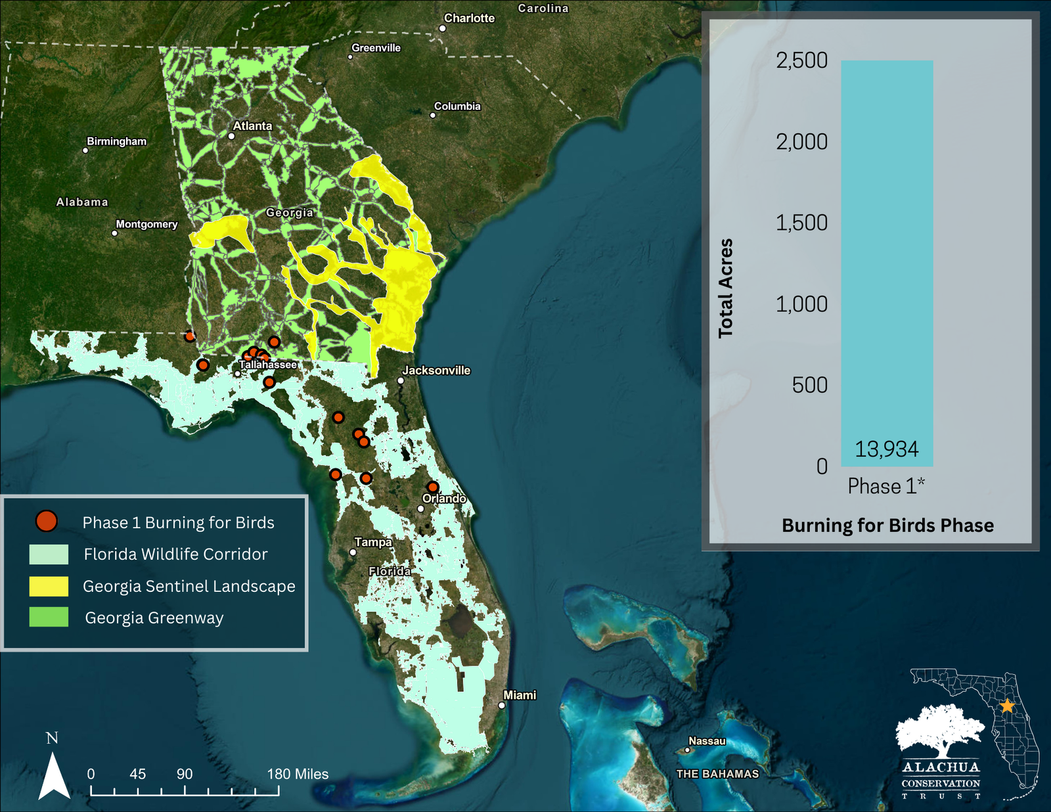
Phase I
  $5,000 Capacity & Partnership Grant (now $10,000)
  15 properties surveyed across 3 partner land trusts
  *Acreage includes entire property under easement
  Focus on properties from Central Florida to Southern Georgia
  No prescribed fire component although some properties had experienced fire in the past
  Virtual public outreach events focused on eBird

Slide 7
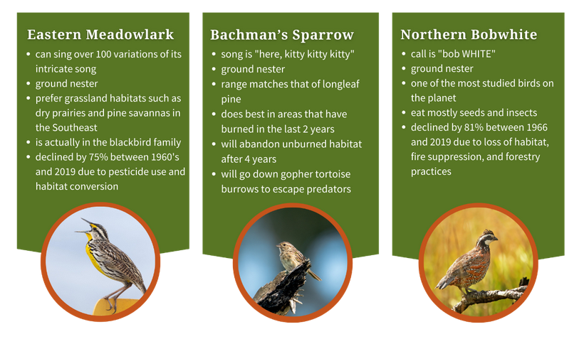
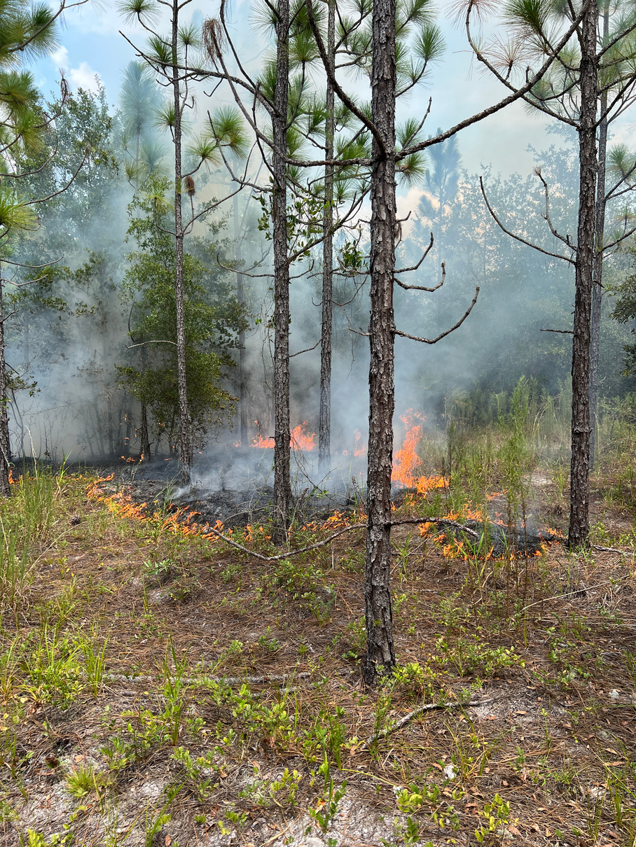
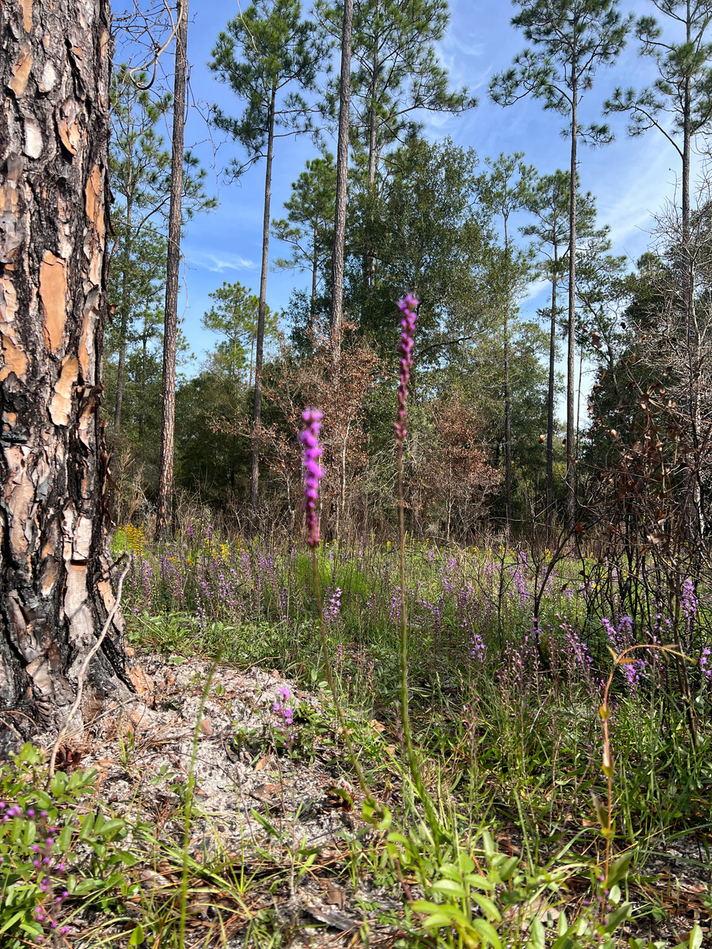
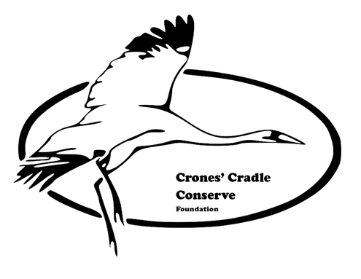
Taking the Next Steps - ACT
August 2023
Crones’ Cradle Conserve
760 acres (162-acre burn unit)
Marion County, FL
October 2023
Phase 2 Target Bird Species
On growing season burns:
“From a wildlife aspect, it’s what you’re looking for. It’s not about if we really like it, it’s about if they really like it.”
Kevin Guinn, Crones’ Cradle Land Manager

Slide 8
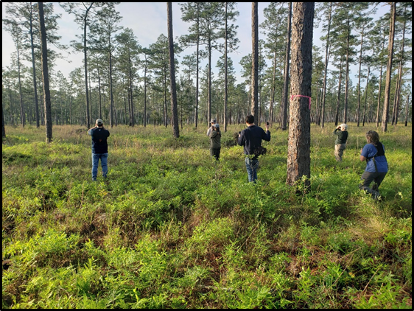
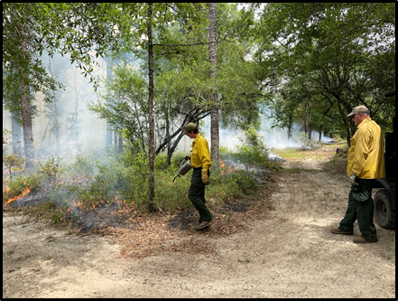
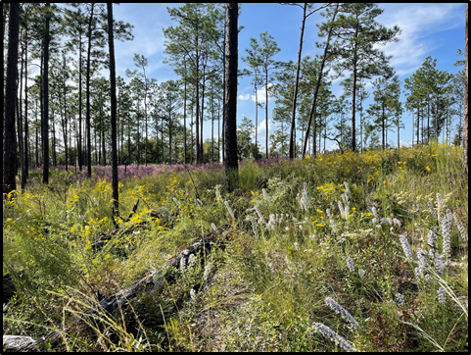
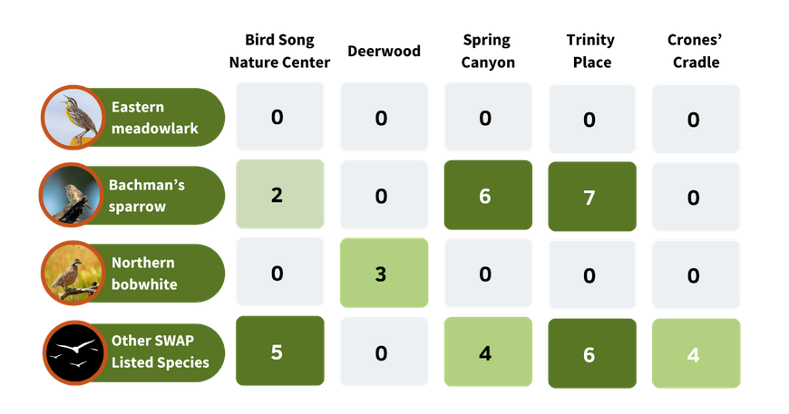
The Flame Spreads - Tall Timbers
Growing season fire with pre- and post-burn bird surveys
Photo by Helen Roth
Photo by Heather Levy
Photo by Peter Kleinhenz
After the burn
Phase 2 Bird Survey Results

Slide 9
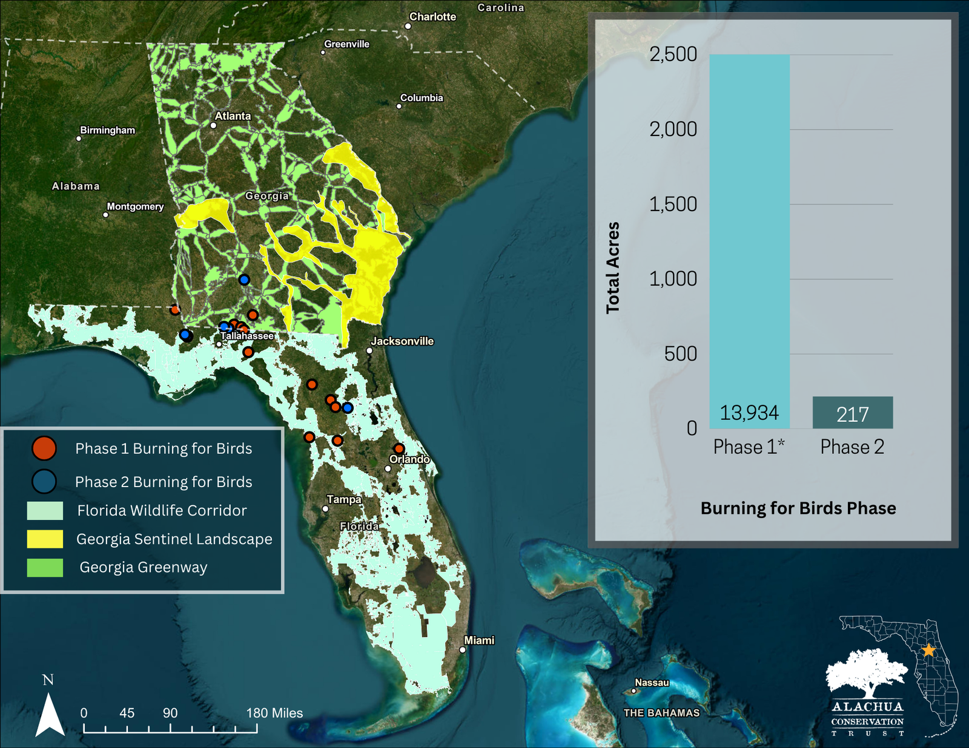
Phase 2
  $25,000 Management & Restoration Grant
  9 properties surveyed across 2 partner land trusts
  Only burn acreage shown
  Focus on properties from North Central Florida to Southern Georgia
  Story Map helped expand outreach to general public and landowners
  Some challenges associated with 12-month timeline

Slide 10
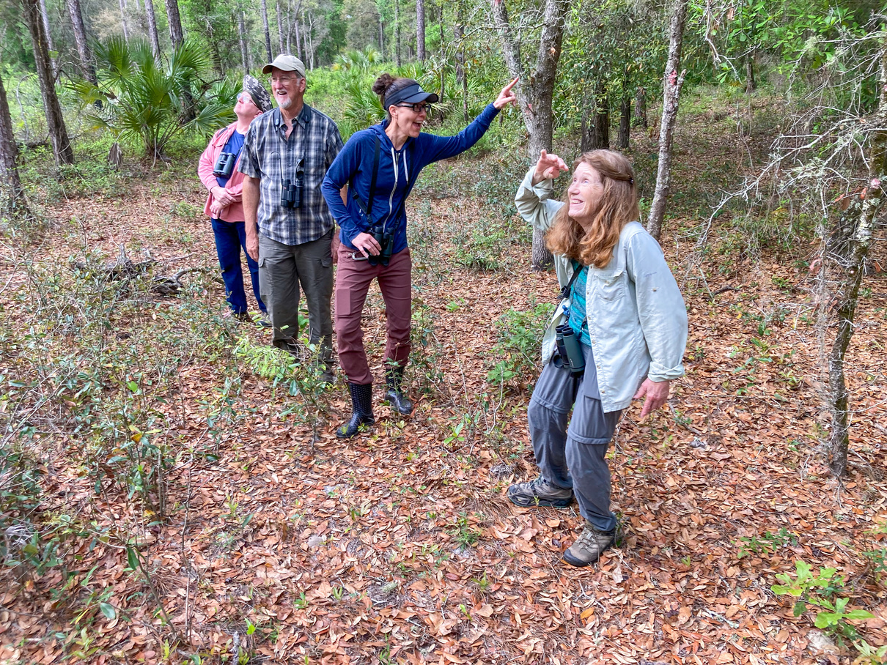
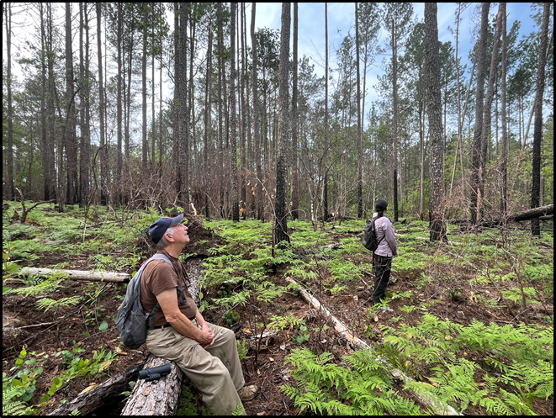
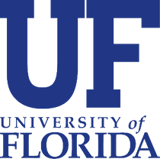
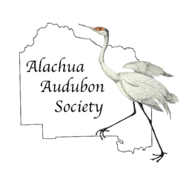
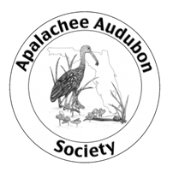
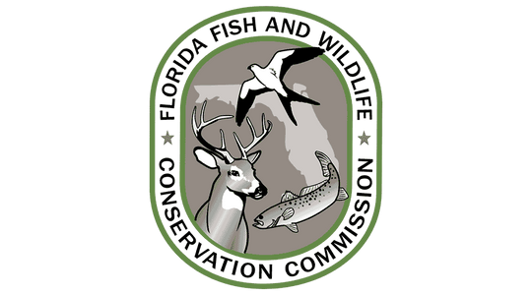
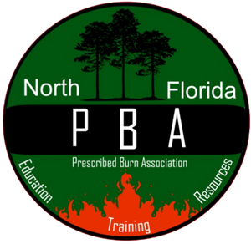
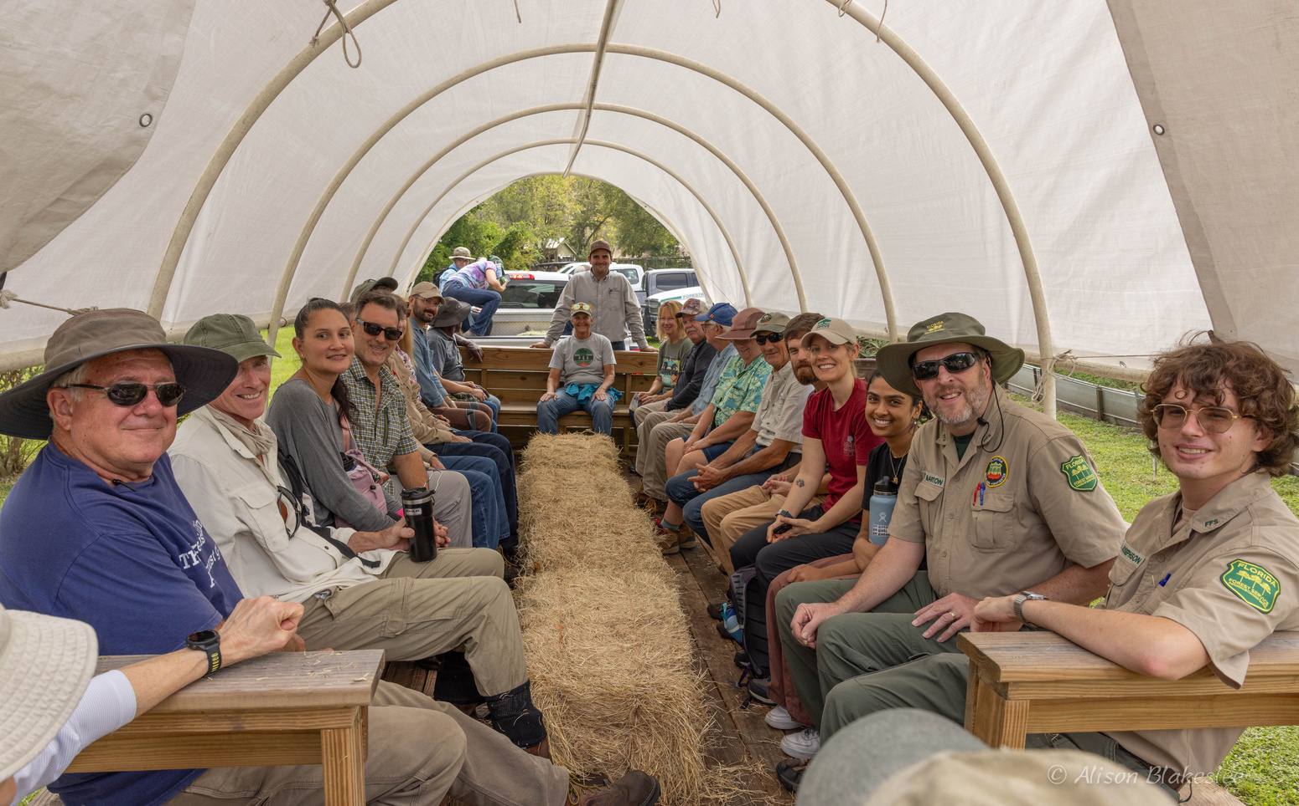
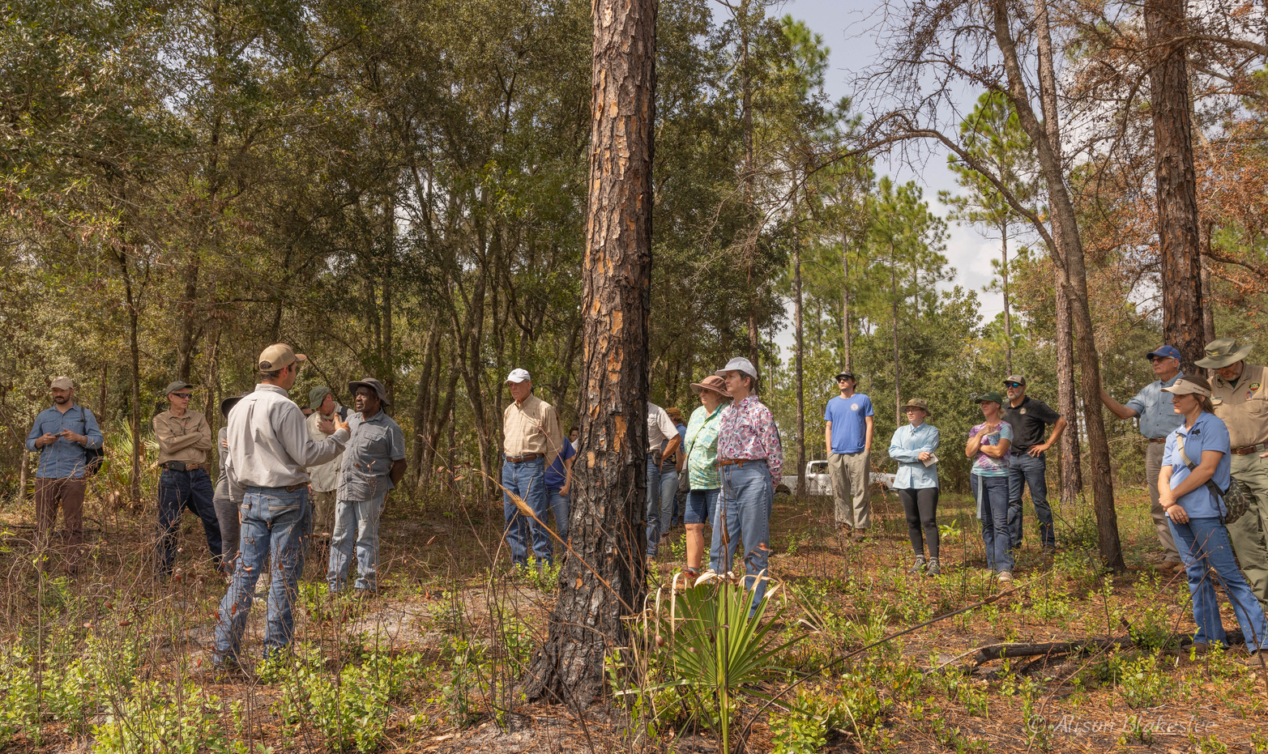
Partnership Building & Public Engagement
Connections strengthened
Bird surveys with
Alachua Audubon
Just wandering through
NFPBA
Landowner Tour

Slide 11

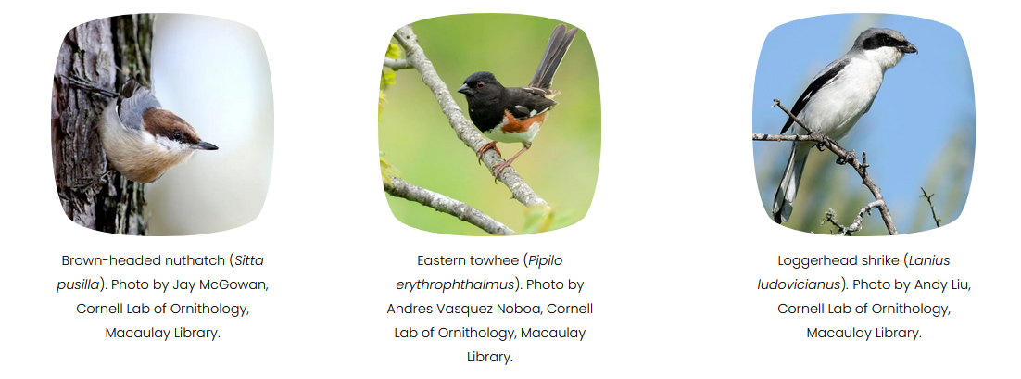
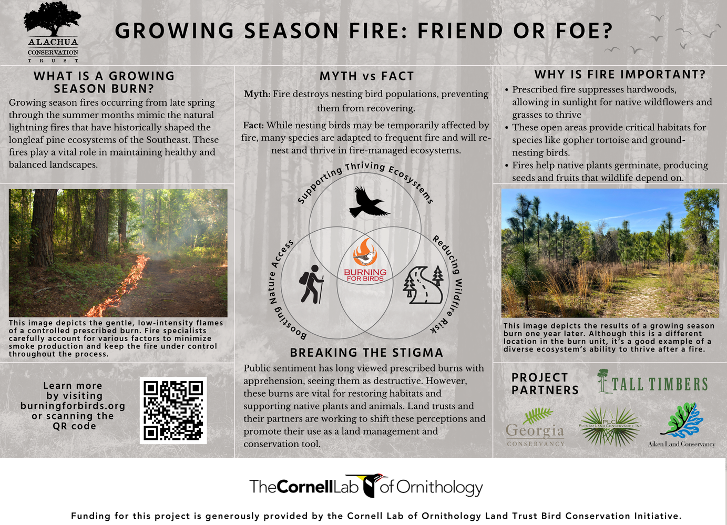
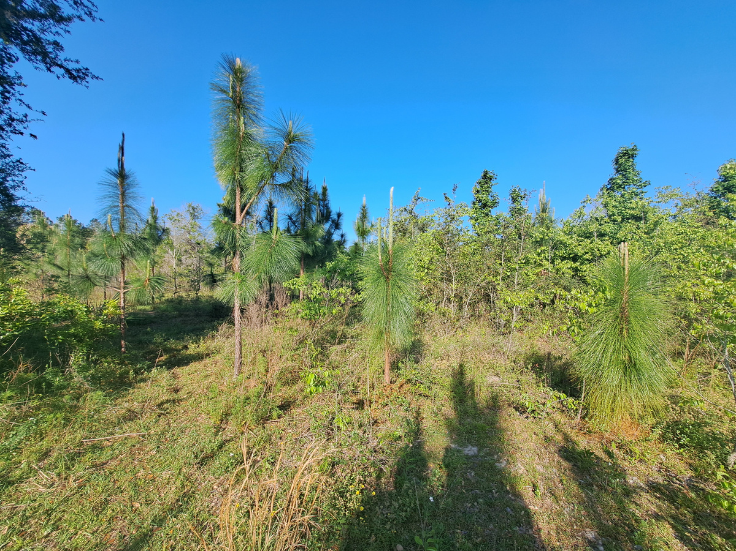
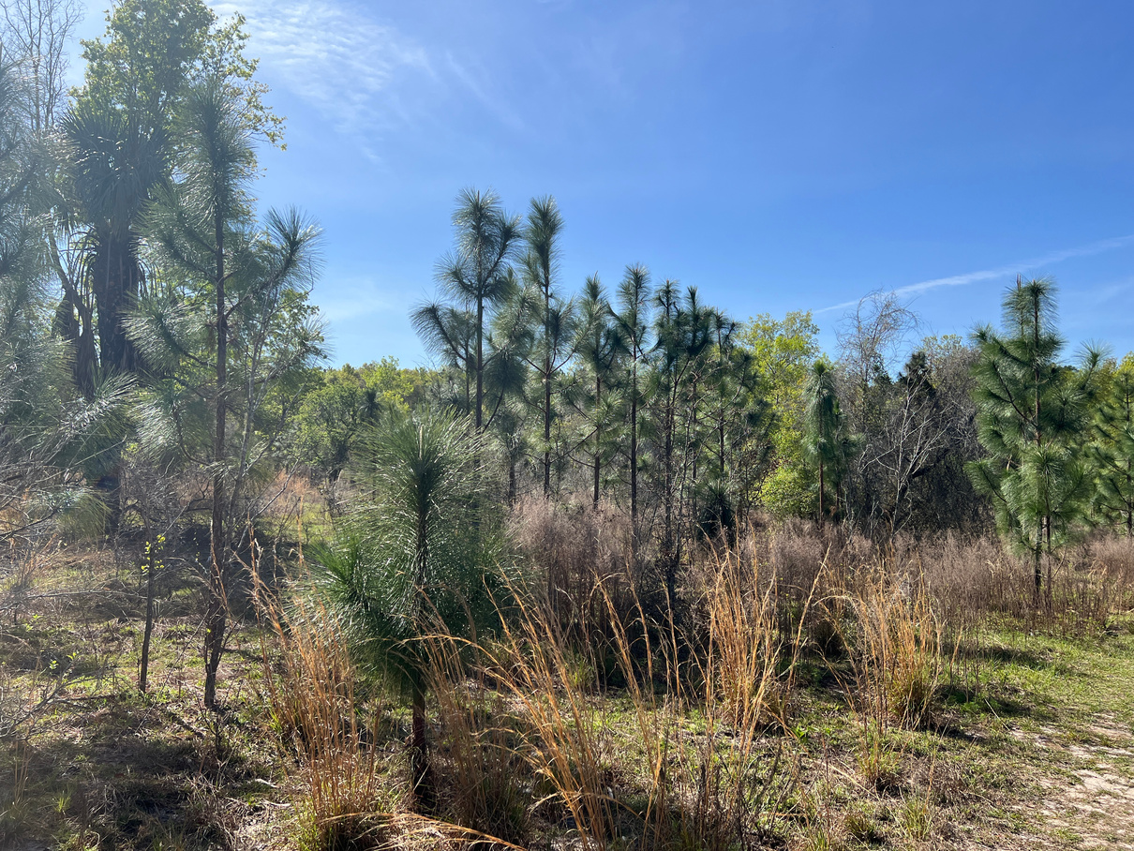
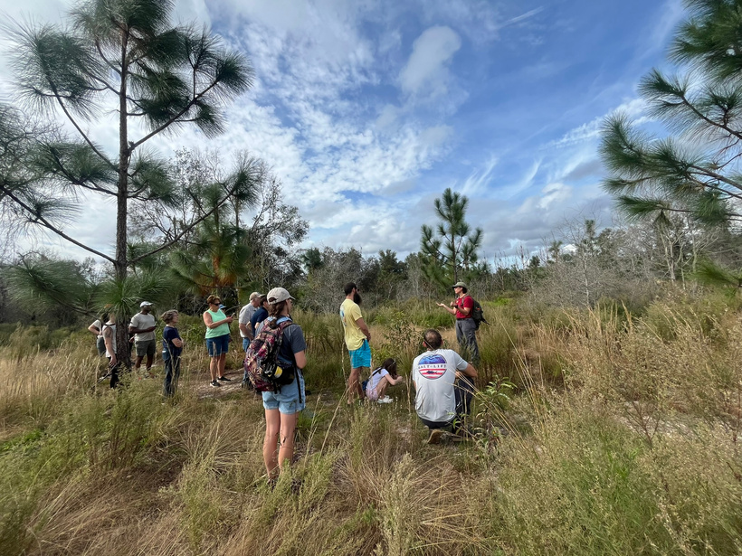
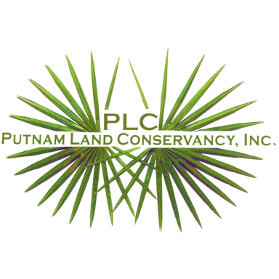
Spreading Our Wings - ACT/PLC
Core Partners
Little Orange Creek Nature Preserve
2,883 acres (68.5-acre burn unit)
Alachua County, FL
April 2024
March 2025
ACT/PLC Landowner Tour
Additional target species

Slide 12
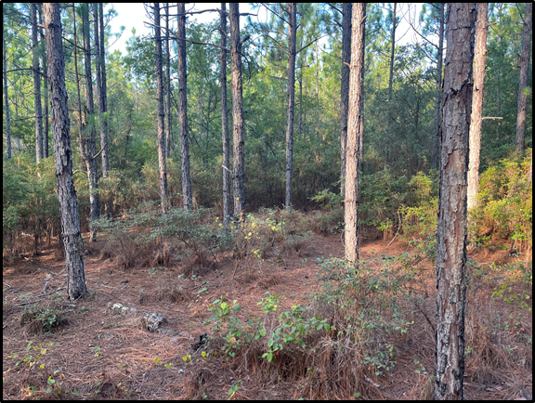
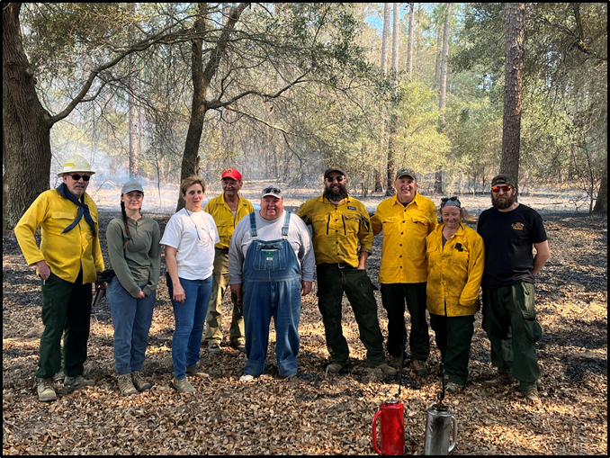
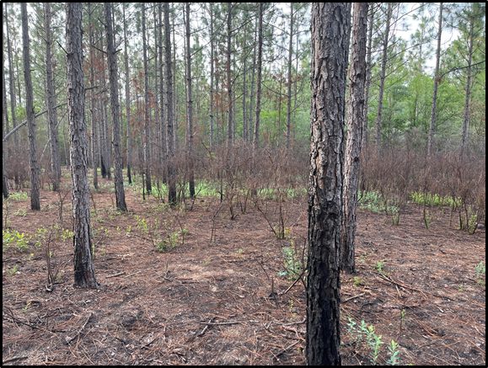
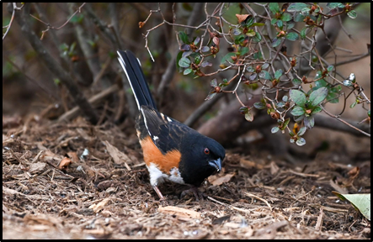
A New Fire Begins - Aiken Land Conservancy
  Expanding the Burning for Birds Conservation Collaborative as a new partner
  Flexible funding with the Cornell Grant Program
  The challenge of reintroducing fire
  Implementation takes partnership
  Results:
    282 acres burned
    18 people engaged (landowners & volunteers)
    20 SWAP-listed birds documented
    Over $72,000 in funding secured
Before
Photos by Peter Kleinhenz
Photo by Peter Kleinhenz
After
Photo by Patty Masten

Slide 13
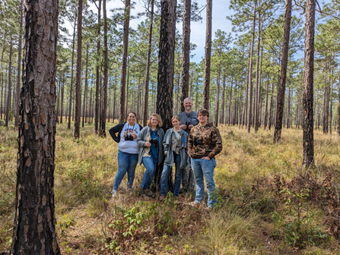
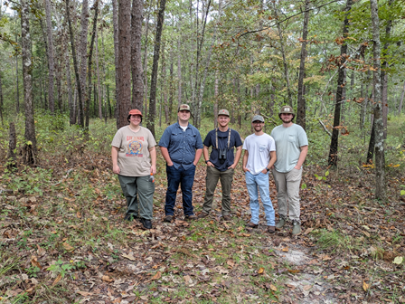
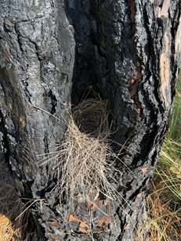


Educational Component - Tall Timbers
Southern Regional Technical College (SRTC) Wildlife Survey students working with Tall Timbers
SRTC students learning about habitat and land management from seasoned landowners

Slide 14





Growing Our Impact – Georgia Conservancy
Georgia Conservancy Burning for Birds Story Map:
https://arcg.is/0eiaqG

Slide 15


Getting Results
Phase 3 Final Results
 | ALC | ACT/PLC | Georgia Conservancy | Tall Timbers | TOTALS
# of acres burned | 282 | 68.5 | 1280 | 636 | 2266.5
# of landowners | 5 | 1 | 5 | 7 | 18
# of volunteers | 12 | 25 | N/A | 14 | 51
# of outreach events | N/A | 2 | 3 | N/A | 5
# of event attendees | N/A | 40 | 68 | N/A | 108
# of Individuals Documented | ALC | ACT/PLC | Georgia Conservancy | Tall Timbers | TOTALS
Pre-burn
Bobwhite Quail | 0 | 0 | 0 | 16 | 16
Bachman's Sparrow | 0 | 0 | 0 | 16 | 16
Brown-headed Nuthatch | 10 | 0 | 14 | 30 | 54
Eastern Towhee | 4 | 1 | 16 | 53 | 74
Loggerhead Shrike | 0 | 0 | 0 | 0 | 0
SWAP-listed Species | 85 | 0 | 21 | 69 | 175
Post-burn
Bobwhite Quail | 0 | 0 | 1 | 13 | 14
Bachman's Sparrow | 0 | 0 | 0 | 46 | 46
Brown-headed Nuthatch | 13 | 0 | 25 | 27 | 65
Eastern Towhee | 6 | 5 | 10 | 58 | 79
Loggerhead Shrike | 0 | 0 | 0 | 1 | 1
SWAP-listed Species | 111 | 3 | 36 | 114 | 264
One or more post-burn surveys remaining
Eastern towhee by Tedd Greenwald
Bachman’s sparrow by Tedd Greenwald

Slide 16

Phase 3
  $50,000 Conservation Collaborative Grant
  18 properties surveyed across 5 core partners
  Only burn acreage shown
  Focus on properties from North Central Florida to South Carolina
  Burning for Birds website launched
  18-month timeline allowed for incorporation of two growing seasons

Slide 17

Thank
You!
  Burning for Birds: www.BurningforBirds.org
  Cornell Land Trust Bird Conservation Initiative: www.birds.cornell.edu/landtrust
  Cornell Small Grant Program: www.birds.cornell.edu/landtrust/grant-directory/
  All About Birds: www.allaboutbirds.org
  eBird: www.ebird.org

