Slide 1

FFS Update – FALL 2021
Central Florida Prescribed Fire Council Meeting 10/01/2021
John Saddler
Prescribed Fire Manager

Slide 2
FFS Update
Good Year for Burning
Upcoming Training
Prescribed Fire Enhancement Program
Air Quality Index
Why Prescribed Fire?
Burner Review

Slide 3
Authorized Prescribed Burn Acres By F/Y
(Million Acres)
Notes:
2020/2021 was a little higher than last year.
Considering the wet winter and COVID-19 I think we did pretty good.

Slide 4
2021-22 CPBMT Course Schedule
?
Notes:
As with most things this year, the pandemic has had significant impact
Since our office are closed to the public, we have not been able to schedule our regular courses.
As we do not know when they will be open, we do not know when the courses will be scheduled.
Periodically check our website for updates

Slide 5
Prescribed Fire Enhancement Program
Funding to Enhance Rx Burning
  Florida Fish and Wildlife
  Florida Park Service
  Northwest Florida Water Management
  Suwannee River Water Management
  St. Johns River Water Management
  Southwest Florida Water Management District
  South Florida Water Management District
Notes:
Sith year for the program.
Over the years this has been a very successful program that has helped get more quality prescribed fire acres across the state.
Reduced Funding last year and this year
Projects were completed on time.
NWFWMD – Cleared 36 acres of hurricane Michael Damage
SRWMD – Heavy mowing of nearly 100 acres
SJRWMD – Purchased water handling and ignition equipment
SWFWMD – 250 acres of mechanical fuel reduction
SFWMD – purchased a 400-gallon water handling unit
FWC – 1,070-acre areal burn
Park Service – Purchased water handling equipment

Slide 6

Why Prescribed Fire?
Prescribed Fire Messaging Campaign
  Statewide Campaign – 3 years
  Working With Tall Timbers
  Third year starting in January
Notes:
New Messaging Campaign to promote the use of prescribed fire.

Slide 7
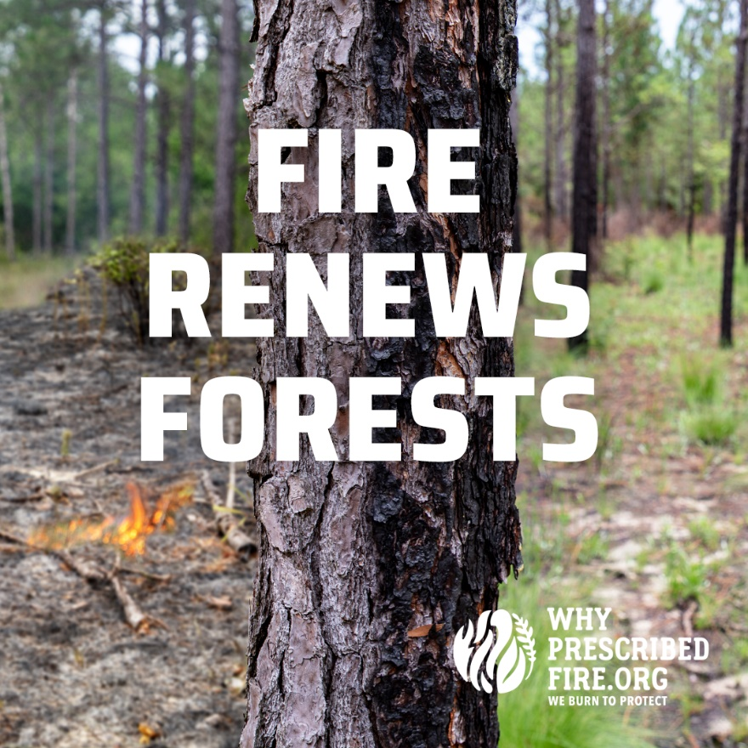
Why Prescribed Fire?
Social Media Campaign
  Key Audience
    WUI Residents
    Environmentally Engage Residents
  Target Area
    50 Zip Codes in Florida
    Areas that experience regular burning
Notes:
Why Prescribed fire is primarily a social media campaign
Key audience was people that live in areas that are near prescribed burn areas and also environmentally engaged citizens.
We used Zip Codes determine focus areas

Slide 8
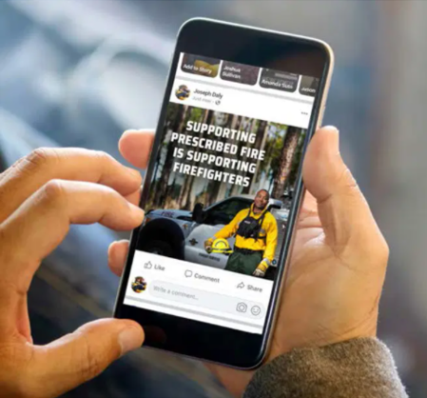
Why Prescribed Fire?
Social Media Numbers
  1.8 Million YouTube views
  6.4 Million impressions on Facebook and Instagram (not including partner posts)
  50 target ZIP codes across Florida
Notes:
Here are some rough numbers from this year’s campaign.

Slide 9
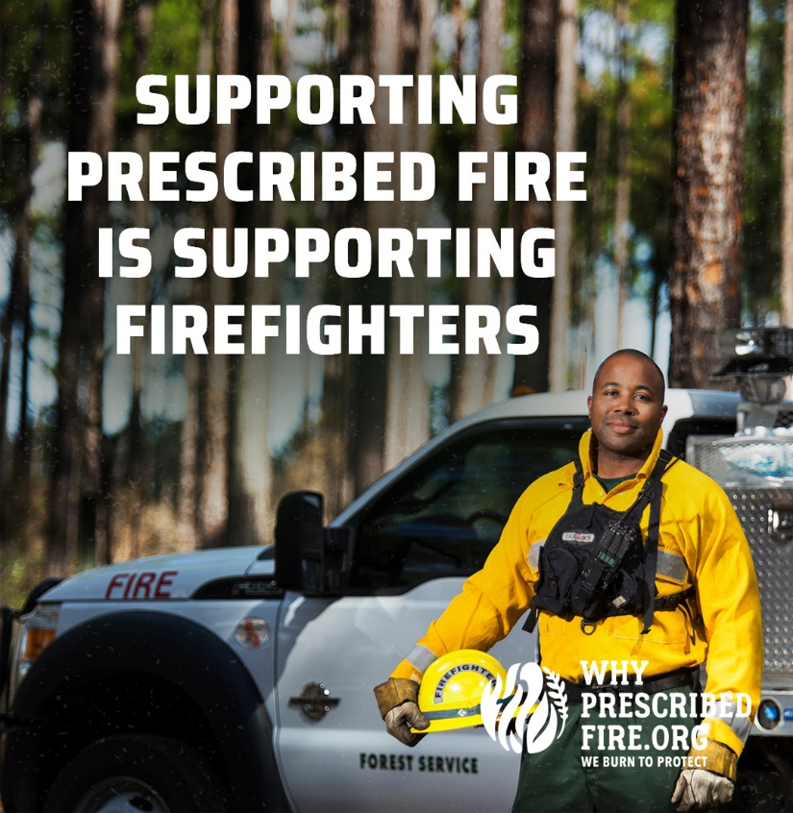
Why Prescribed Fire?
Moving Forward
  Plan on starting in January
  Utilize TV media
  Organic Social Media only
Notes:
This year will be different from pervious years.
Instead of paid social media ads, we will be using paid tv.
We will still be using some social media, but it will be organic and not paid.

Slide 10
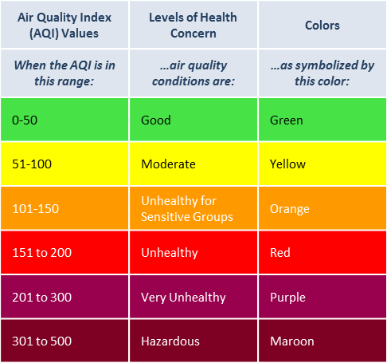
Air Quality Index (AQI)
Notes:
What is Air quality index?
Think of the AQI as a yardstick that runs from 0 to 500. The higher the AQI value, the greater the level of air pollution and the greater the health concern. For example, an AQI value of 50 or below represents good air quality, while an AQI value over 300 represents hazardous air quality.
For our purposes we will focus on the first three ranges, Good, Moderate and Unhealthy for Sensitive groups

Slide 11
Air Quality Index (AQI)
Base burn authorization issuing level on AQI forecast
Forecast is available 4pm day before
AQI values
  0-50 - Routine Authorizations
  51-100 - Will look at other factors such as winds, mixing height and dispersion
  101 or Above – will not issue in those areas, by County

Slide 12
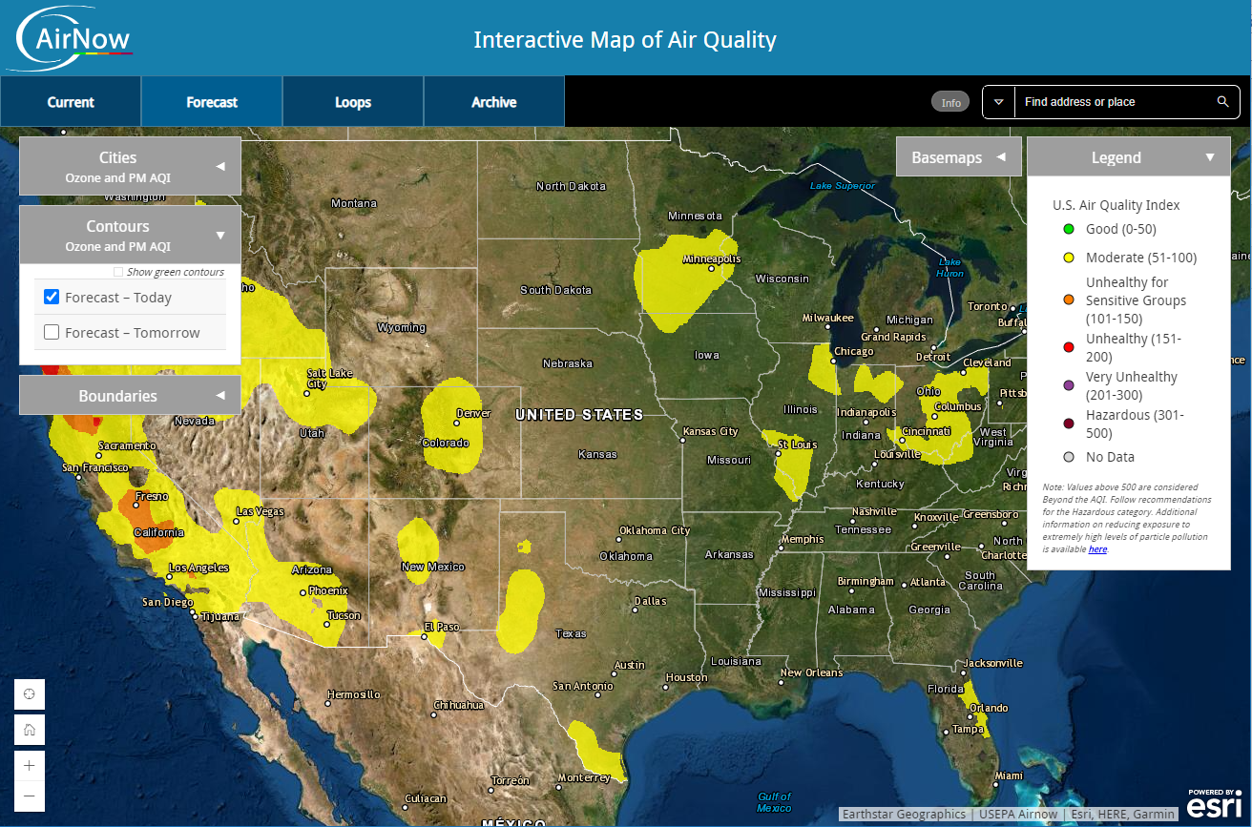
Air Quality Index (AQI)
Notes:
Here is the air now AQI forecast map for the lower 48.
On the left you can choose the forecast for today or tomorrow.

Slide 13
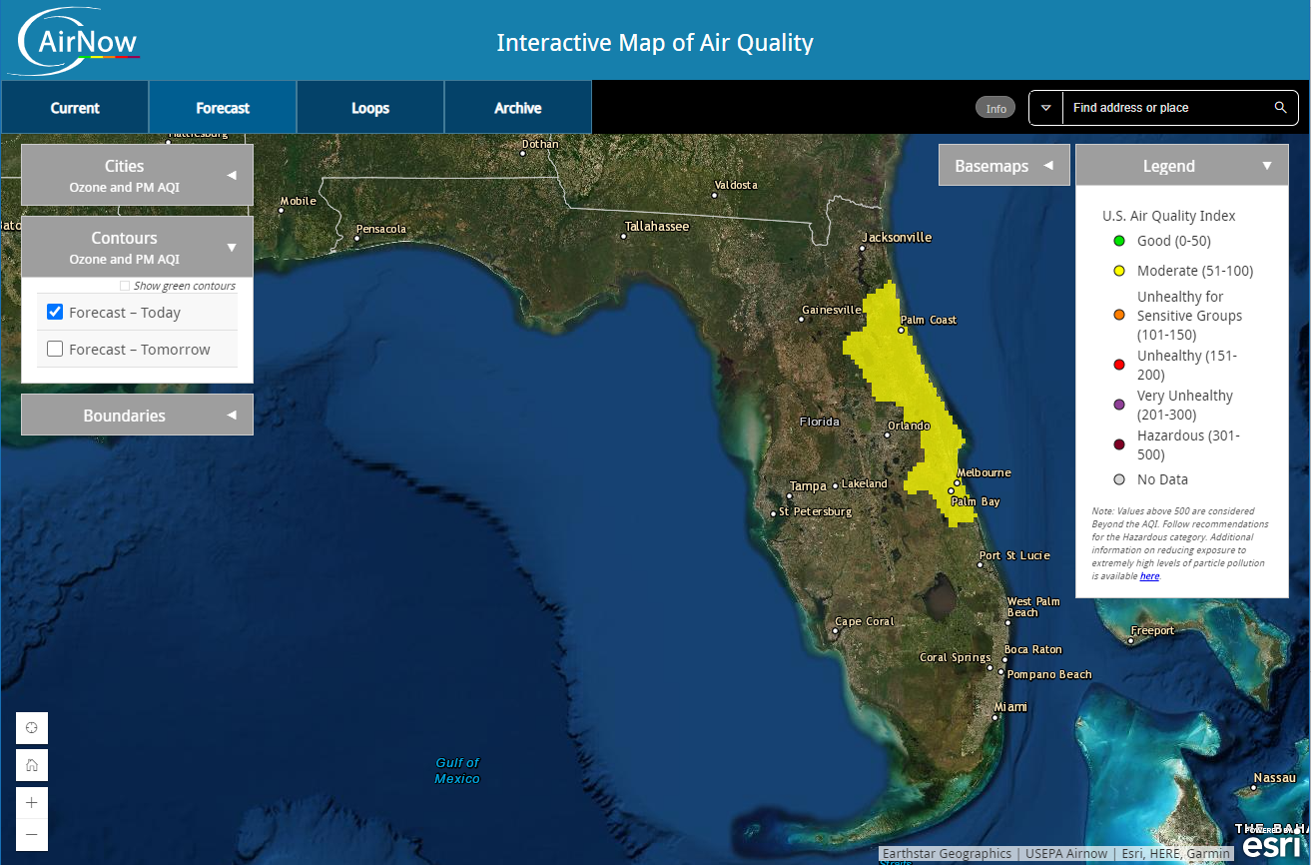
Air Quality Index (AQI)
Notes:
Here is Florida. In General, florida has pretty good air quality there is some moderate areas forecast along the East Coast.

Slide 14
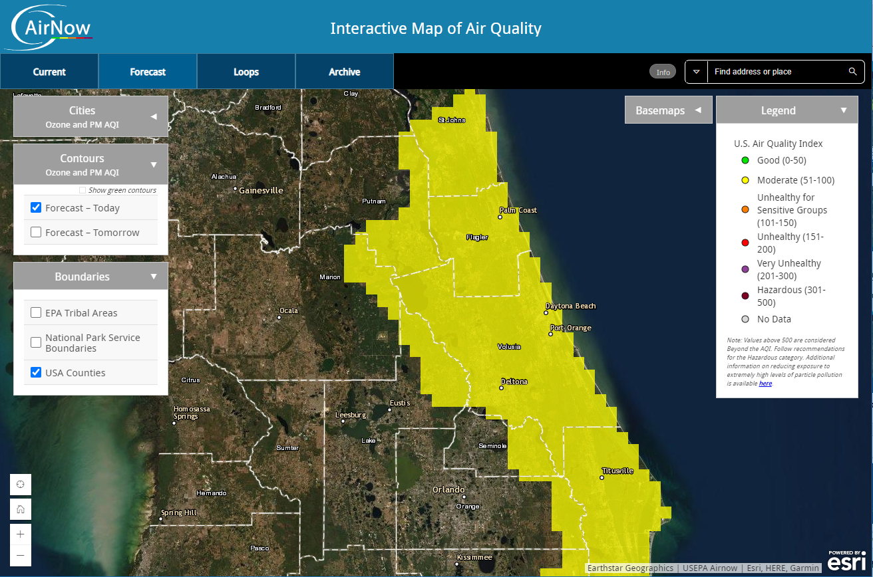
Air Quality Index (AQI)
Notes:
IF you zoom in closer you cans see the county lines.
In this example; Flagler, Volusia and Brevard Counties are fully covered by moderate forecast.
St. Johns, Putnam, Marion, Lake, Seminole Orange, and Osceola have partial coverage.

Slide 15
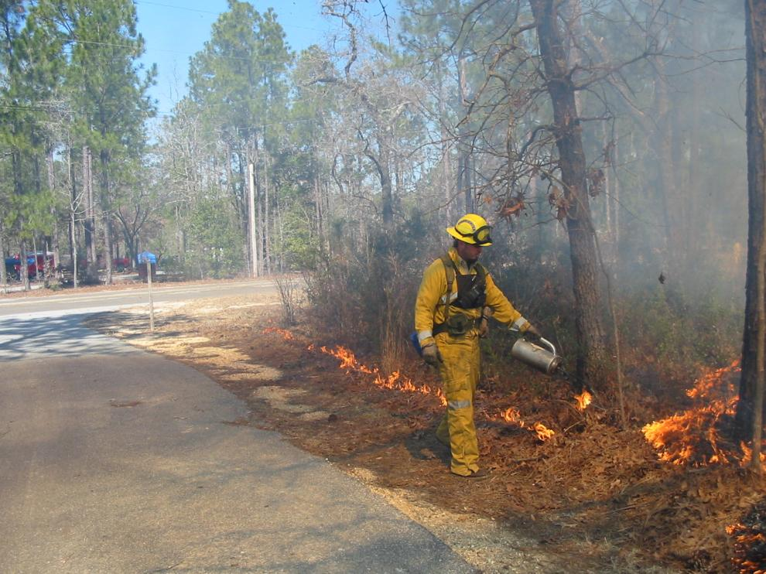
Burner Review

Slide 16
Burner Status Letters
Mailed or E-Mailed at the end of January
  Green = Status good beyond end of year
  Yellow = Status will expire at end of year
Keep your contact information current
  Used to send letters
  Add Email to your account
Let the Duty Officer know that you are doing a certified burn
  WebOBA system requires this
Notes:
We will be emailing status updates to those that have an email associated with their account. If you want to get email status update, log into WebOBA and add your email address.

Slide 17
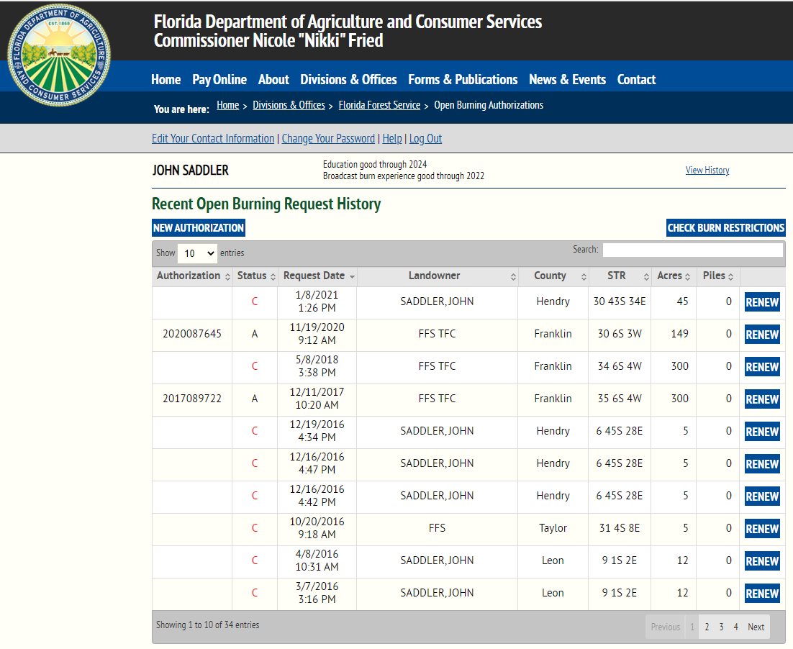
Web-OBA
Notes:
We encourage the use of WebOBA.
If you use WebOBA make sure to have an email address in your contact information. When your request is processed you should get an email with either your authorization number or notification (and reason) for a denied request.

Slide 18
Check Your Status

Slide 19
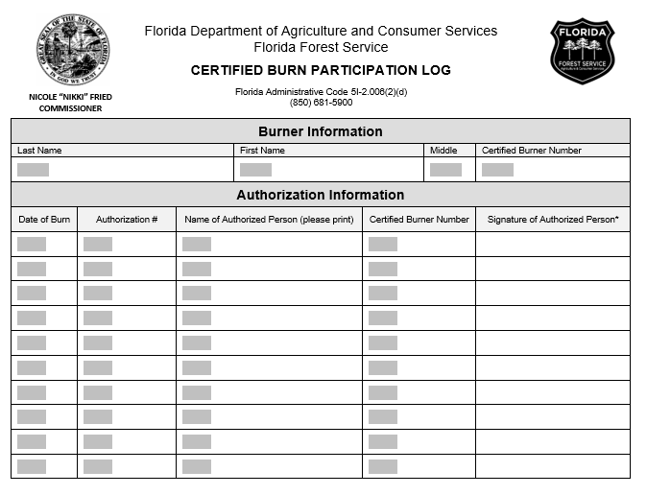
Burn Participation Log
Notes:
If you mainly participate in burns, you can use the attached form to submit your burn activity. Please be sure to fill in all the fields when submitting your information.

Slide 20
Things to Remember
Your prescription is a legal document
  Make sure information is complete
  Make sure information is correct
  Signature with date
  Add authorization number
  Take it to the burn
  Keep it in your files for future use
  Tell us you are doing a certified burn

Slide 21
Other Items
Simple Smoke Screen Tool Is Back!
  http://fireweather.fdacs.gov/Simple-Smoke/
R.I.P. - FFS Spot Weather
  Use NWS Fire Weather Dashboard
  https://www.weather.gov/dlh/fwd
Credit for this meeting
  Need to sign in with your information

Slide 22
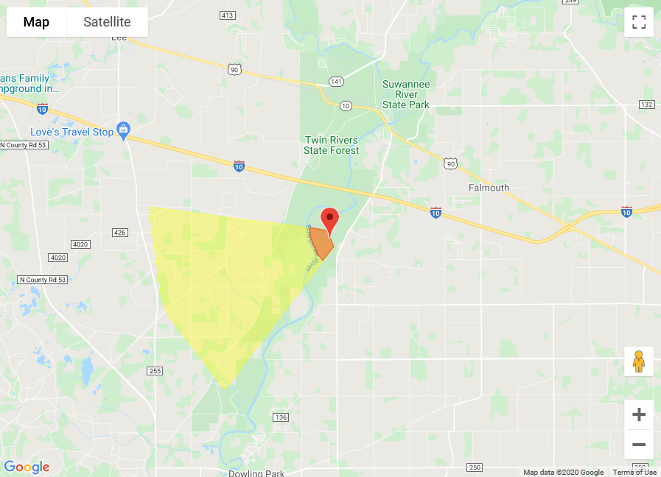
Other Items
Prescribed Fire Awareness Week – January 24th
Flatwoods Fire and Nature Festival – Virtual
Simple Smoke Screen Tool Is Back!
  http://fireweather.fdacs.gov/Simple-Smoke/
We are all in this together!
  AQI, Smoke, Containment
Notes:
Here is an example of the simple Smoke Screen tool. Unlike the FFS smoke screening tool, this does not use any forecast information, you have to input the wind direction manually.

Slide 23
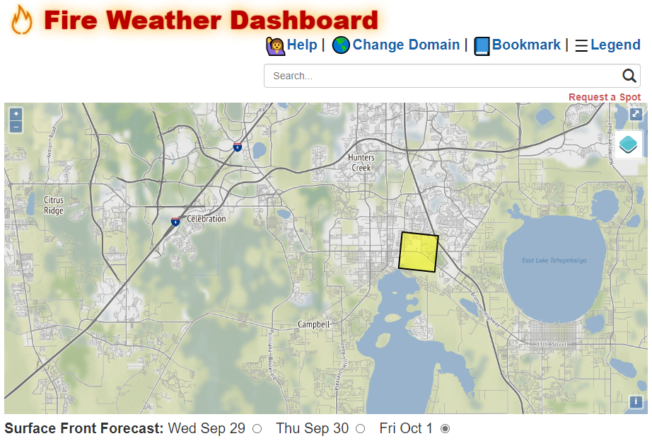
Notes:
Once at the Fire Weather Dashboard, click on the location and you get a forecast for the area inside the square. The square is about 1.5 miles on each side.

Slide 24
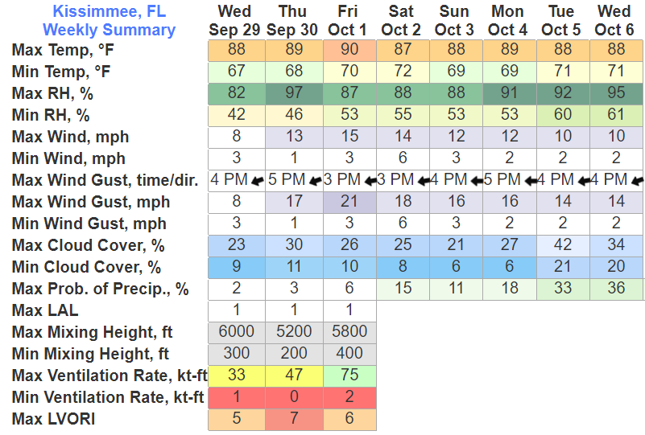
Weekly Summary in Kissimmee
Notes:
You get a weekly forecast for the area. Note that some of the products only go out three days.

Slide 25
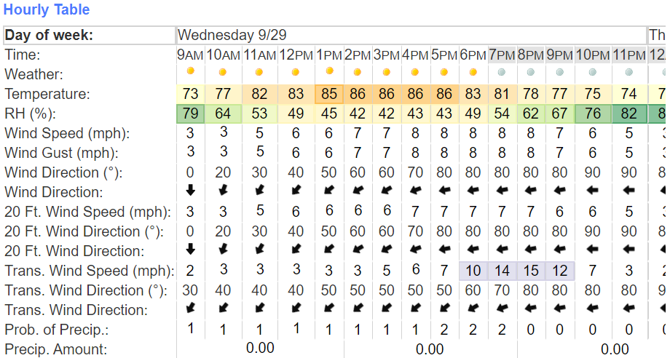
Hourly Summary in Kissimmee
Notes:
Here is the hourly summary for the same location.

Slide 26
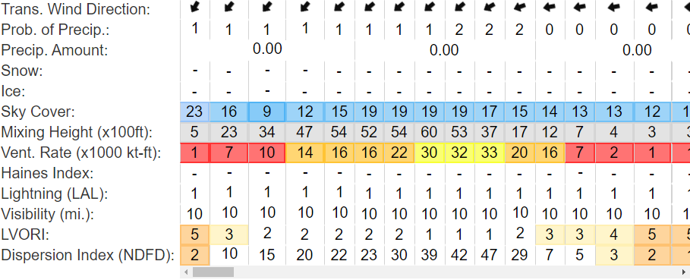
Hourly Summary in Kissimmee Cont.
Notes:
This is a continuation of the hourly forecast that includes some important information such as LVORI and Dispersion.

Slide 27



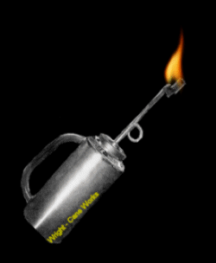
Questions?
Contact
John Saddler
850-681-5928
John.Saddler@FDACS.gov

