Slide 1
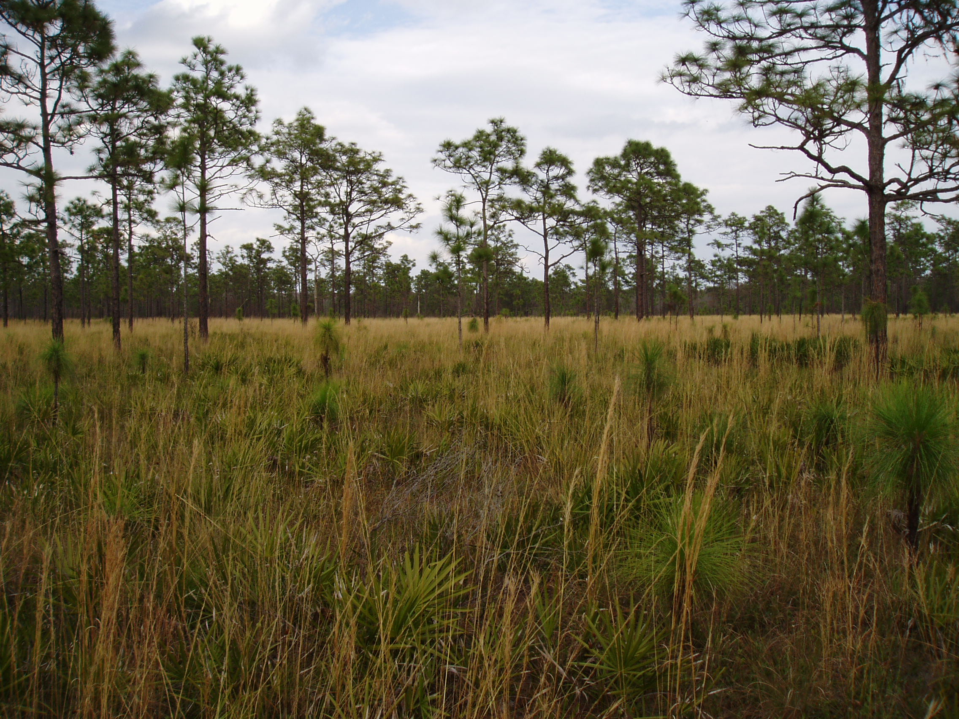
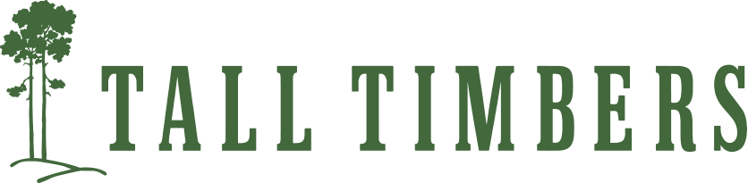
Fire in Florida
Fire Training in the Time of COVID
Zachary A. Prusak
Wildland Fire Training Specialist
zprusak@talltimbers.org
Notes:
This has been a stressful time, but I have come away with the idea that we had an opportunity to re-evaluate what has worked in training and what can be improved in order to increase access, mentoring, and ultimately come away with a stronger fire community. To respectfully paraphrase Gabriel García Márquez, let’s talk about fire training in the time of COVID.

Slide 2
Fire in Florida
Terminology
LMS – Learning Management System: A software application that contains a wide variety of tools for the administration, documentation, tracking and delivery of educational courses and training programs that are developed, delivered and taught all in one space. This supports both asynchronous and synchronous learning.
(Canvas, Moodle, Blackboard, etc.)
Asynchronous Learning: This consists of on-demand and self-paced learning and uses such tools as videos, documents, quizzes and discussion boards.
Notes:
Asynchronous - This does not mean that students are not interacting with each other or the instructor, but this implies that they are not interacting simultaneously.

Slide 3
Fire in Florida
Terminology
Synchronous Learning: A group of students are engaging in learning simultaneously. In the old days, this meant traditional classroom face-to-face learning, but with the advent of other tools like Zoom or discussion boards/forums, synchronous learning can now be integrated within an LMS.
“Virtual” and “Online” can be used interchangeably when referring to training or learning that occurs within an LMS or similar platform.
Hybrid Course or Hybrid Training: A portion of the course occurs virtually within an LMS, and a portion occurs in-person, whether in a classroom or field day.

Slide 4
Fire in Florida
The Challenge: we need increased fire training and mentoring in the coming decades, both from a controlled burning and firefighting standpoint.
“The maturing Pyrocene is not a pretty sight. We need to relearn how to coexist with it because it isn’t going away.”
S. Pyne
Two recent surveys in the NE and SE US:
Difficulty accessing training
Insufficient capacity of instructors
Training coordination often falls short
Interest in more collaboration
There is a lack of virtual components that would help reduce travel and course delivery costs
Notes:
Surveys conducted by the Northeast and Southeast Regional Cohesive Strategy Committees of the Cohesive Wildland Fire Management Strategy and the Southeast Regional Partnership for Planning and Sustainability:
Difficulty accessing training both NWCG and state Certified Burn Manager courses
Insufficient capacity: There are not enough qualified personnel to offer training, particularly hands-on opportunities and mentoring of novice burners. There are more personnel in need of training than qualified personnel available to conduct training.
Interest in diversifying training formats
I think you could also build on that to say that it's likely the same in all of natural resources (since we'll have people from those programs) and not just in fire

Slide 5
Fire in Florida
S130/S190/L180 Basic Wildland Firefighting Suite Hybrid
-All Units and testing material converted
-50 students, all from Florida
-Mix of private, county and state
S131 Firefighter Type 1 Virtual
-Units and testing material converted
-40 students from nine states
-21 organizations
Notes:
I have created and facilitated close to a dozen hybrid trainings since June 2020, so let’s talk about two of them
Tallahassee to Coral Gables
S131: CA, OR, WY and FL

Slide 6
Fire in Florida
Partnered with UF/NATA, utilized Canvas as the LMS and Zoom for meetings
S130/S190/L180
-Three weeks to complete 33 hours of online work
-Field Day component utilized partner sites, 10 students each
-Staff: two from NATA, myself and six to 12 Field Day instructors per site
S131
-Two weeks to complete nine hours of online work
-Staff: two from NATA, myself and four instructors for three-hour Zoom scenario day
Notes:
NATA is Natural Areas Training Academy
Online work variety of narrated videos, quizzes, knowledge checks, group discussions
for five days 10 students each (COVID restrictions).
Very willing partners, from six to 12 Field Day instructors live fire ABRP, DWP, 2 at OSBS and UCF (Fire Council involvement as well)

Slide 7
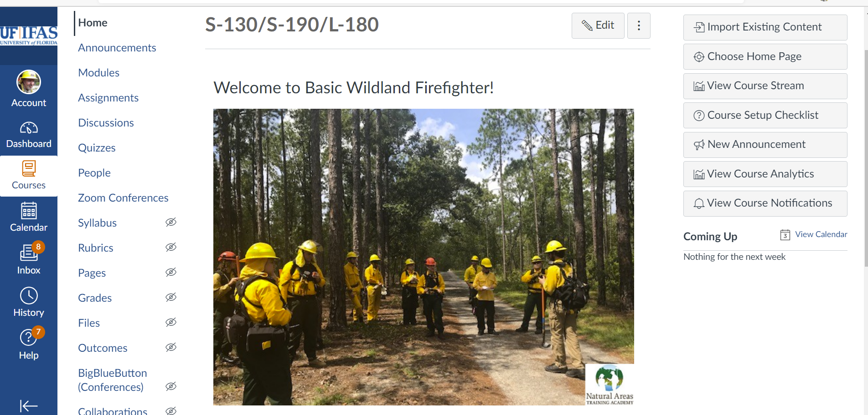
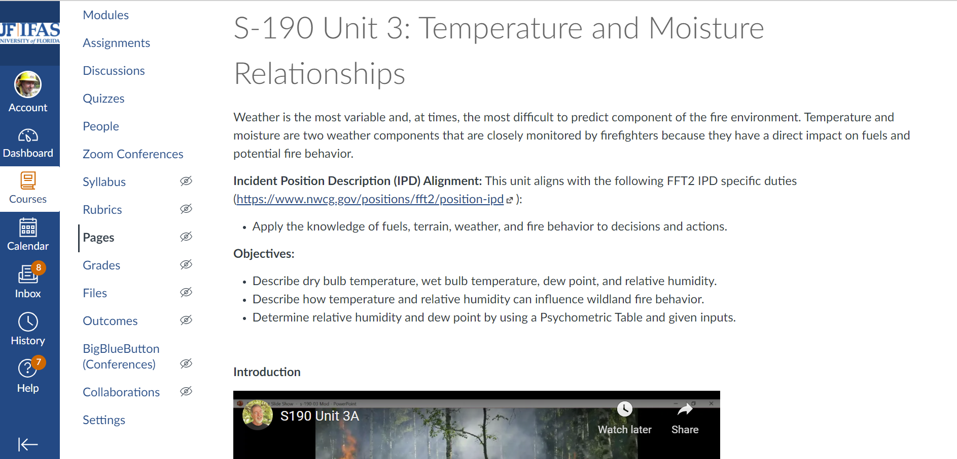
Fire in Florida
Notes:
How/If did you make it interactive? Was there a networking component? : Zoom and office hours, student introductions and discussions mandatory

Slide 8
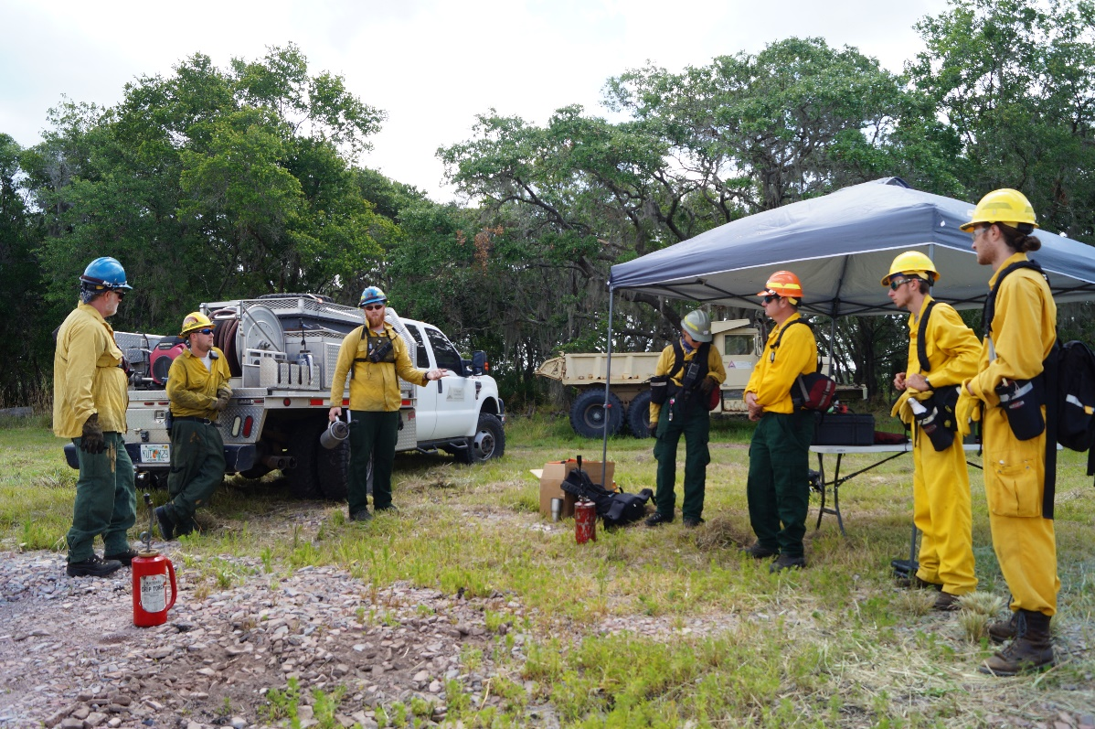
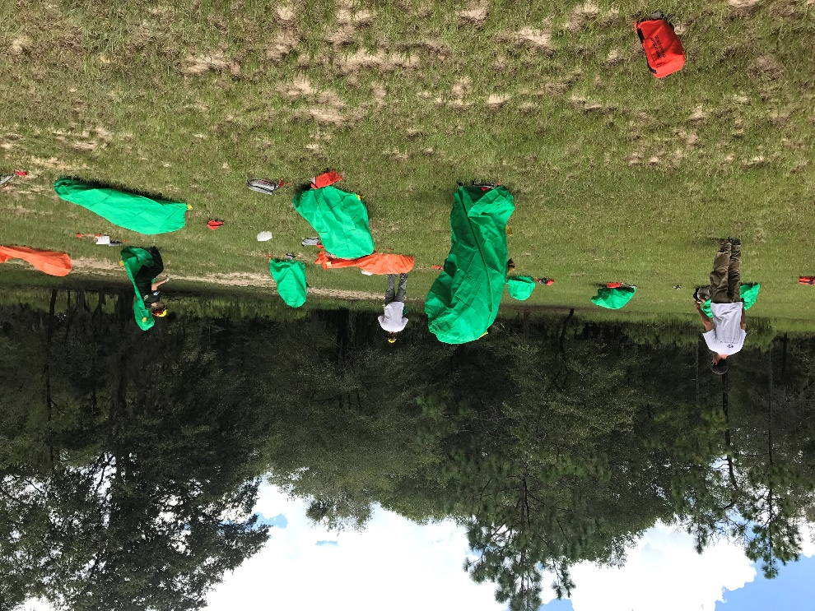
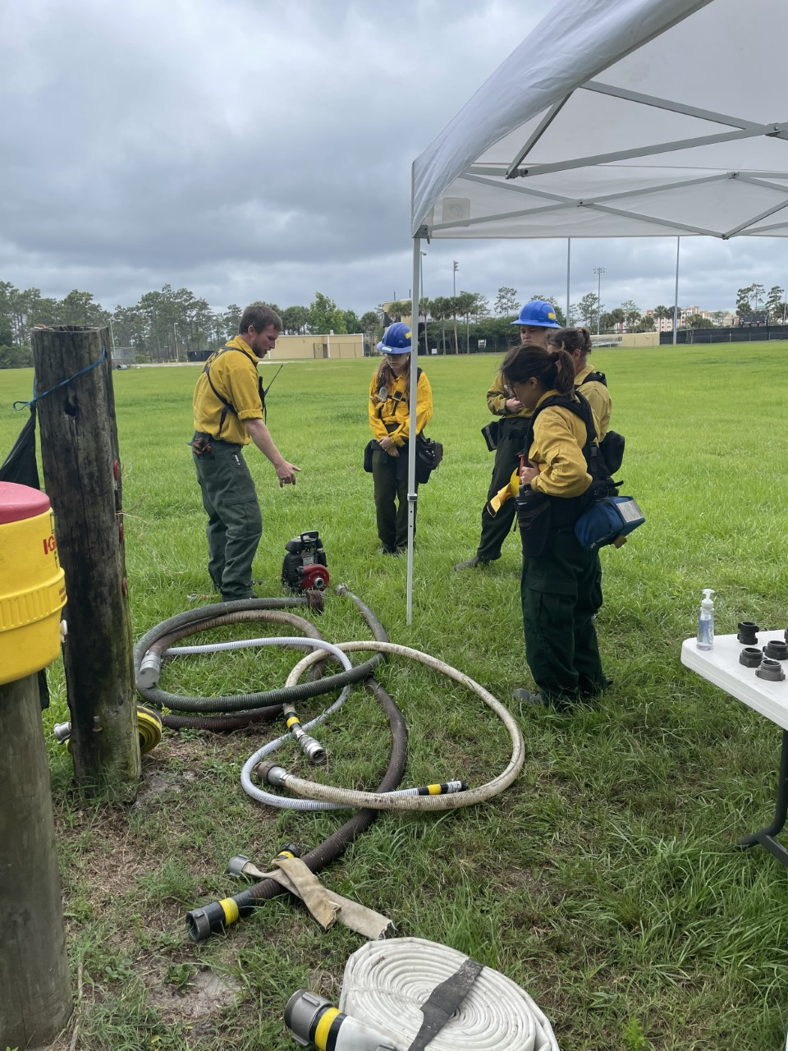
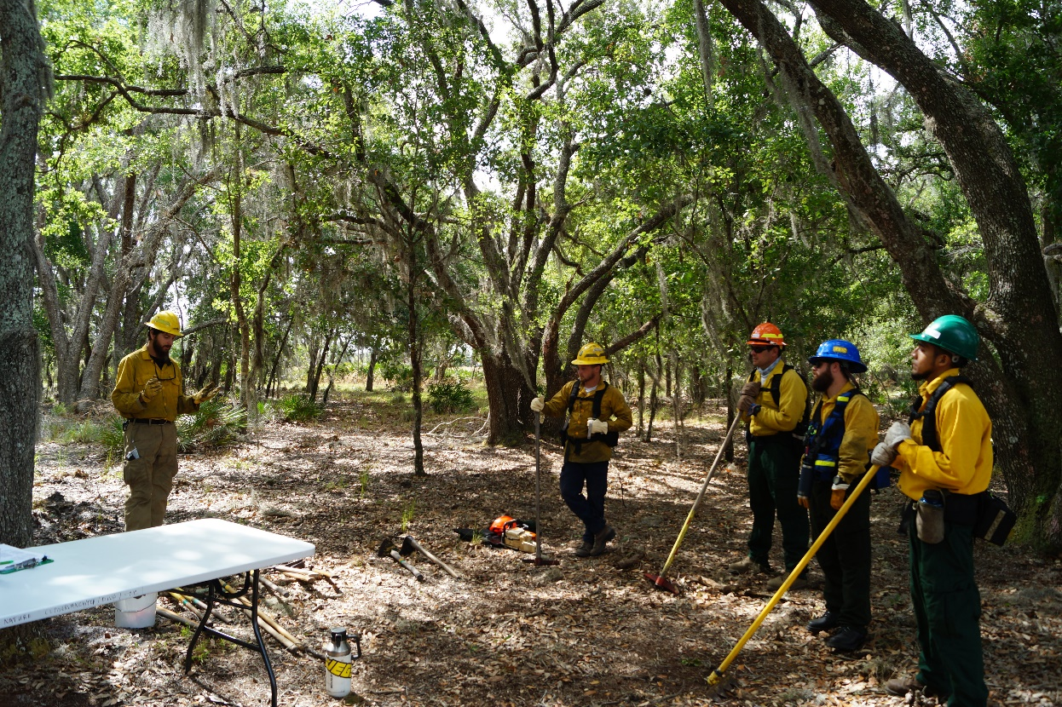
Fire in Florida
Notes:
Field Day, there is not replacing hands-on experience for fire training and experiential learning methods

Slide 9
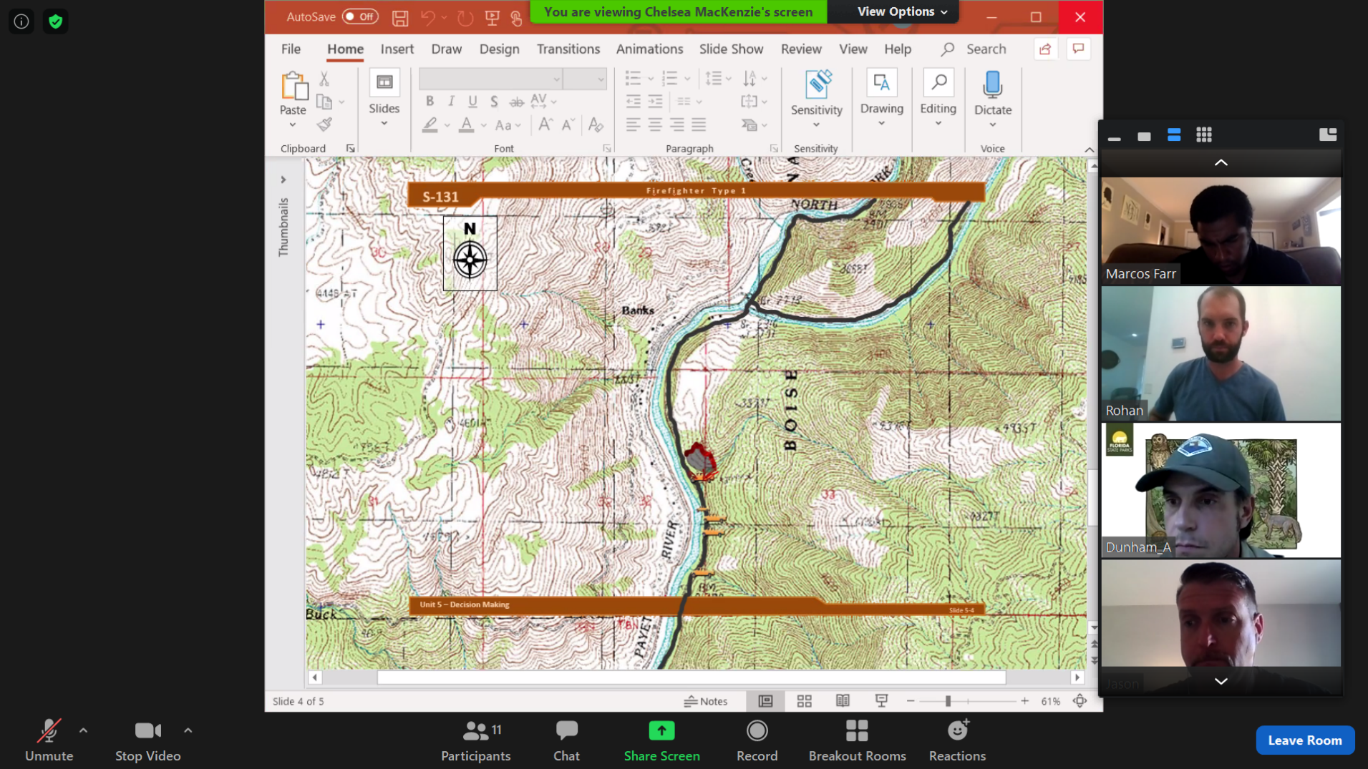
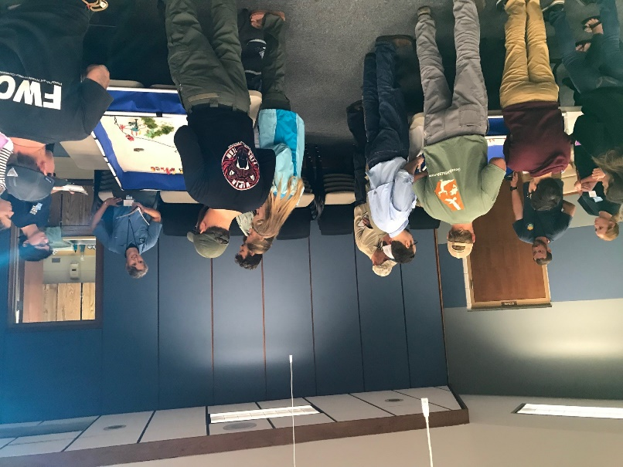
Fire in Florida
Notes:
How/If did you make it interactive? Was there a networking component? Smaller Zoom crowd per scenario, skilled facilitators with experience in walking students through their Risk Management decisions

Slide 10
Fire in Florida
Challenges
-Finding people who can develop and teach an online course
-Learning curve for students who have never taken an online course
-Need some form of an LMS
-Sending students physical materials
-Internet access may be limited, need a computer/smart phone
Pros
-Increased accessibility and flexible “at your own pace” time
-Less expensive overall
-More diverse instructor pool, able to switch out Units/material easily
-Less on-site logistics
-Increase in student diversity
Cons
-Some students prefer face-to-face training
-Inexperienced students may be intimidated by platform
-Are they paying attention?
Lessons Learned
-Increase the amount of synchronous office hours
-Be sure to craft testing methods to learning objectives

Slide 11
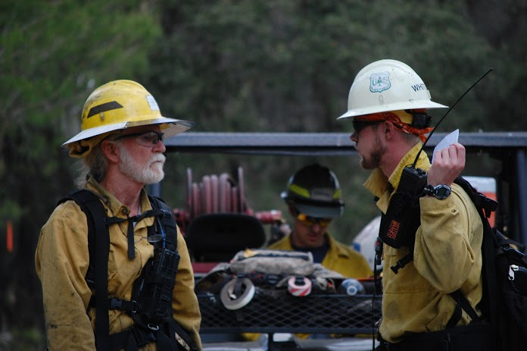
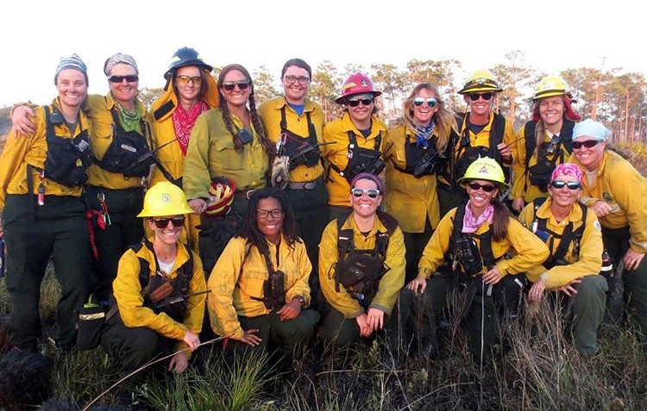
Fire in Florida
The Future of Hybrid Fire Training
-Post-course surveys were positive
-Wide-range of possibilities: integrating hybrid training with Fire Councils, Prescribed Burn Associations for sites and instructors/mentors
-High-tech sand tables? Also Articulate and H5P
-Global reach, increase the diversity of languages and sites
-Partnering with Universities/Extension for “Master Burner” courses
-A “virtual hub” of more streamlined fire training accessibility and increased capacity to meet the needs of the future
-Training App
-Collaborations are springing up that did not exist previously
Notes:
The future of Hybrid Fire Training
-Post-course surveys All of the post-course surveys had similar percentages of a majority of attendees wanted to attend similar formats, even when COVID restrictions are relaxed.
-High-tech sand tables (but I’d caution with getting lured by tech, make sure you have excellent instructors, uses S131 example)
-Partnering with Universities strengthened (utilize their evolving learning methods)
The new world of a fire training academy that is not constrained by the walls, but is more virtual or blended learning experiences but would eventually move to more in-person learning including the potential of working toward a regional RxB training academy
that unites the fire community and diversifies the instructor pool, potentially on a global scale, with connections based on virtual training hubs. I'll have my "pragmatic cynical optimist" hat on that day! Thank you for coming to my TED talk, now does anybody have a million dollars?

