Slide 1
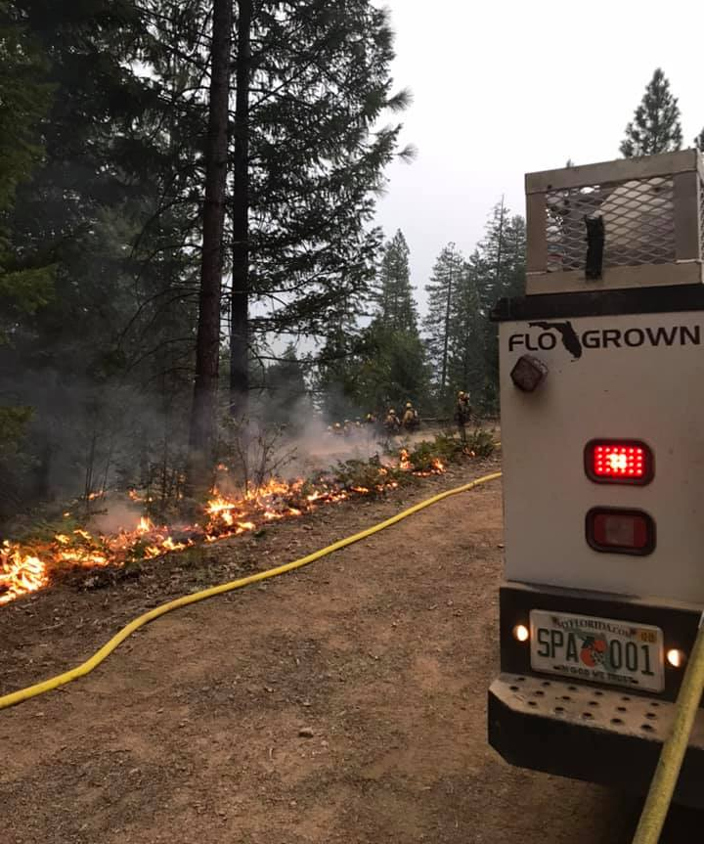
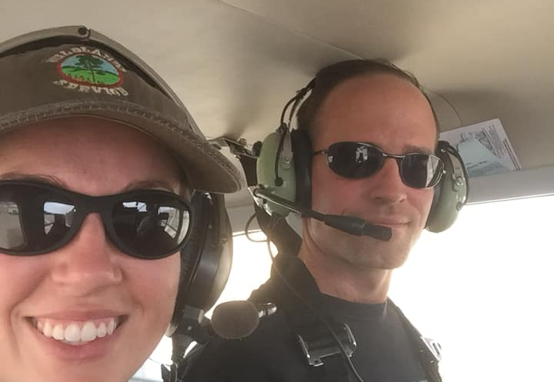
FL Burners Value in Western Fire Contracting
David Hogrefe
10-1-2021

Slide 2
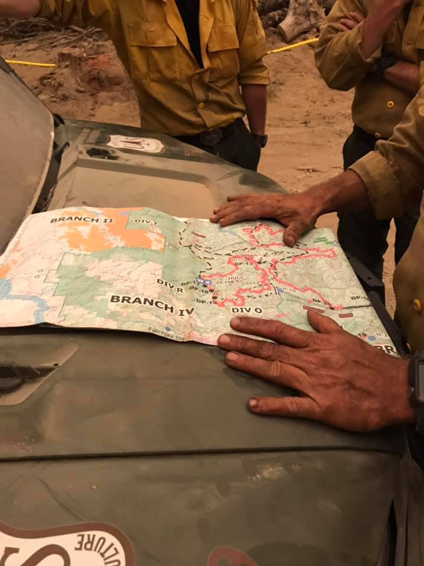
Minimum Requirements:
What to do to get ready for 22
ICS-100, L-180, S-130, S-190, IS-700
Arduous pack test (45lbs 3mi in 45 mins or less)
RT-130 annual
Proper PPE
Fire shelter
Radio
Bring your task books!
Notes:
Check s classes

Slide 3
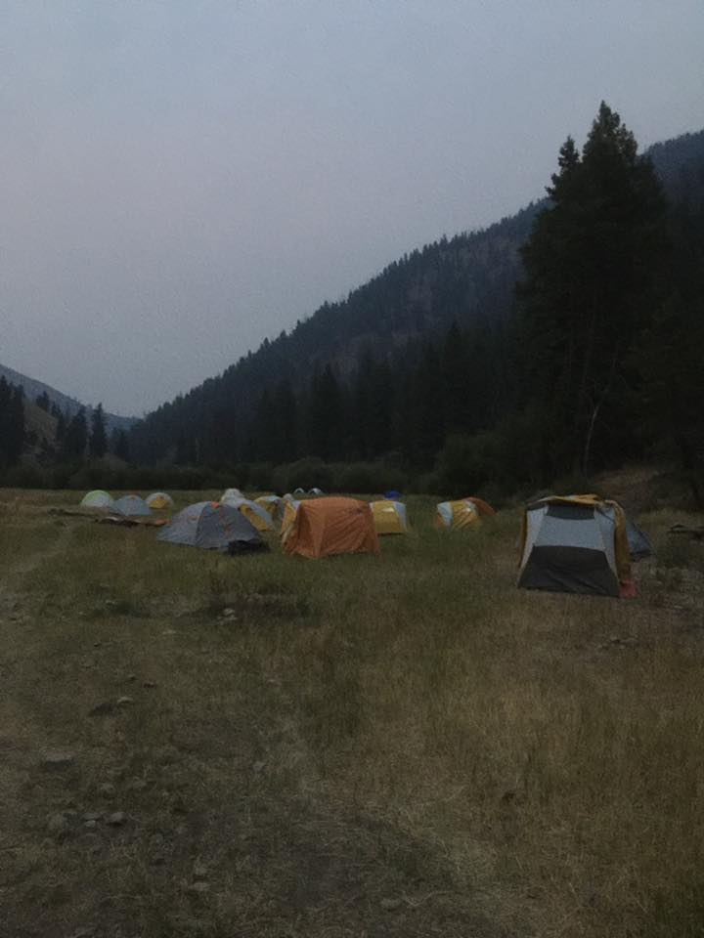
What to Bring
Where are you going?
Incident complexity
-- Type 1
-- Severity
-- IA
Local weather?
Time of year?
Driving out? Flying out?
-- Gear weight
Be ready to camp/spike out

Slide 4
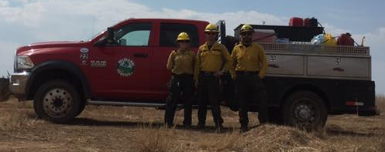
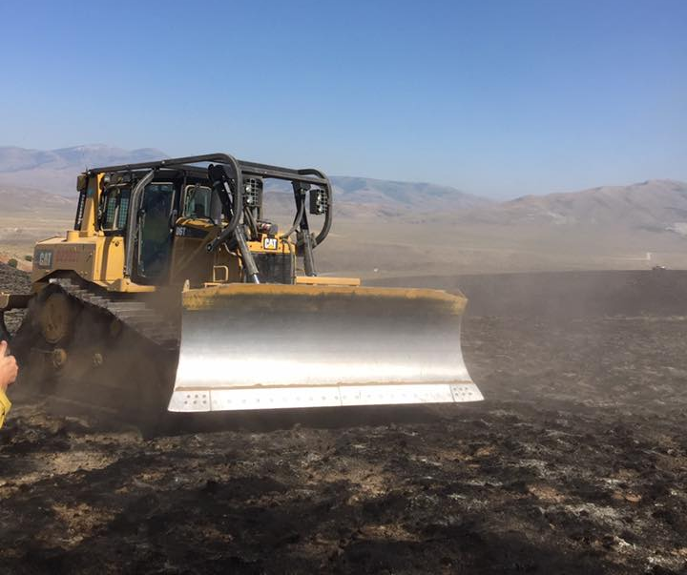
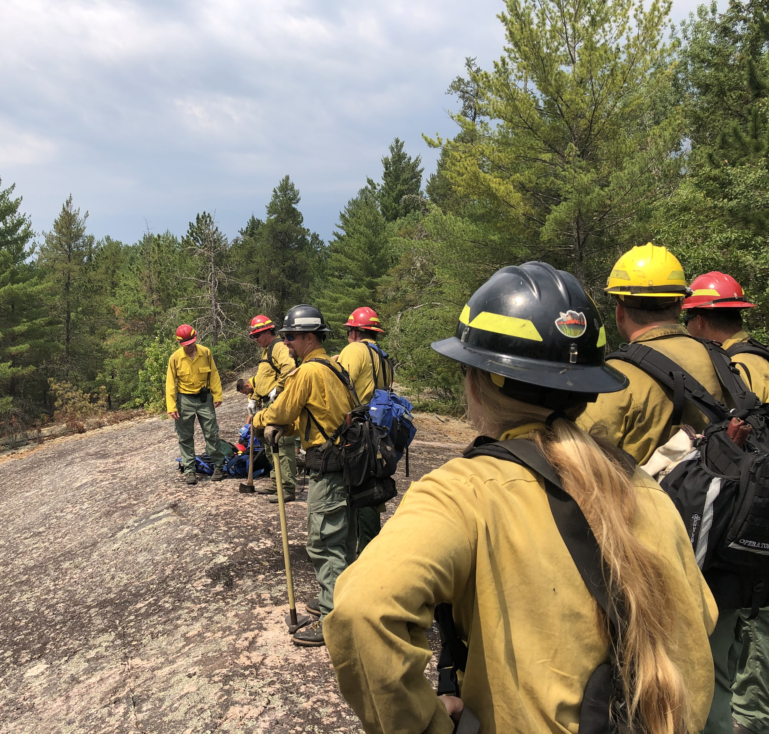
Resource Types to Consider
ENGINES
DOZERS
HAND
CREWS

Slide 5
Florida Western Fire Contractors
Southeast Forest Resources – Owner Steve Guckian
Wildlands Fire Service – Owner Doug Williams
Bird Dog – Owner Carlos Guiterrez
Attack One – Owner Kevin Carter
Williams Fire – Owner Darryl Williams

Slide 6
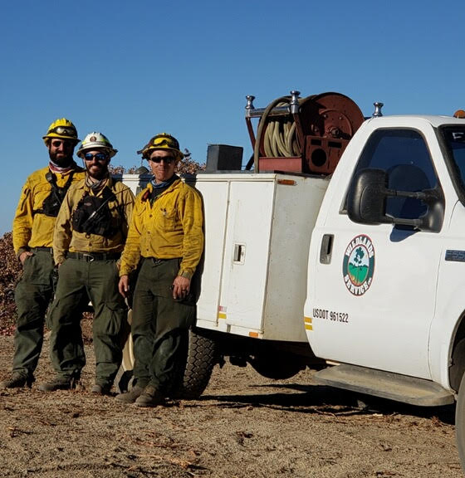
North Complex Fire
Plumas Nat’l Forest
Engine Boss Mike Orlando
9/8/2020
215,000 acres in 24 hours
Organized the clearing of a safety zone before fire front arrival
45mph winds
200ft flame lengths
Sheltered in equipment (Hot inside)
In safety zone for 24hrs; 3 fire fronts
Smoked in at night & blocked in by down trees
Saved the lives of 11 people and millions of dollars in equipment
*Info from Palm Coast Observer Oct 22nd 2020 article
Notes:
Palm Coast Observer Oct 22nd 2020

Slide 7
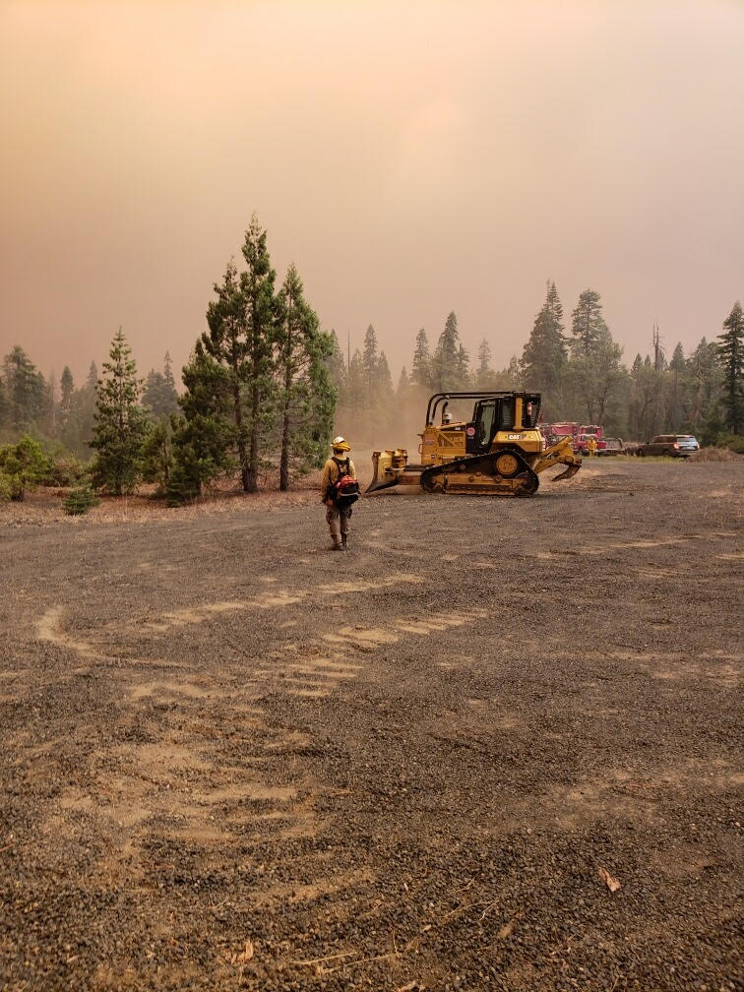
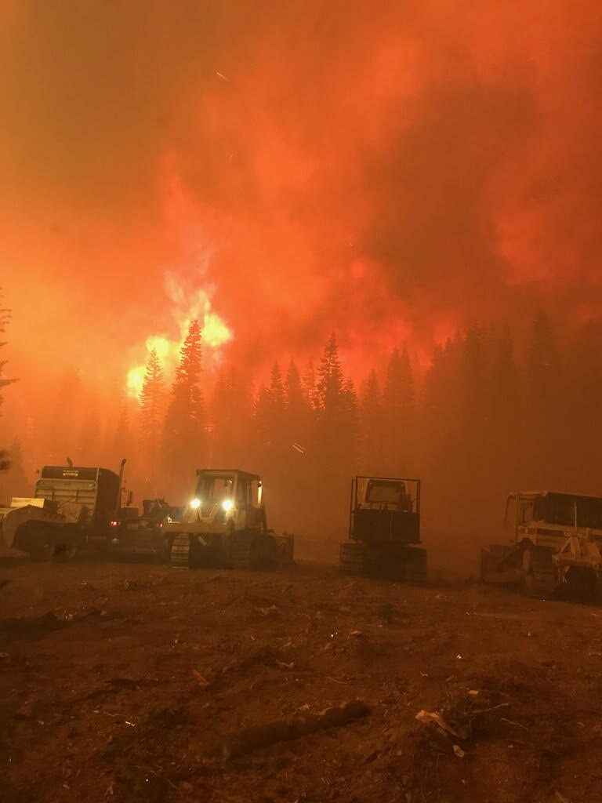
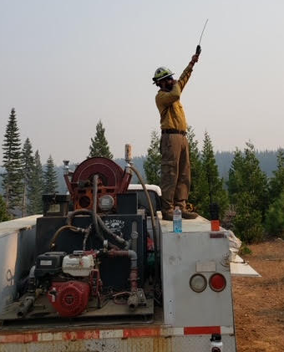
Relaying fire’s
progression to air support
Enlarging a
Safety Zone
Sheltering in equipment

Slide 8
