Slide 1
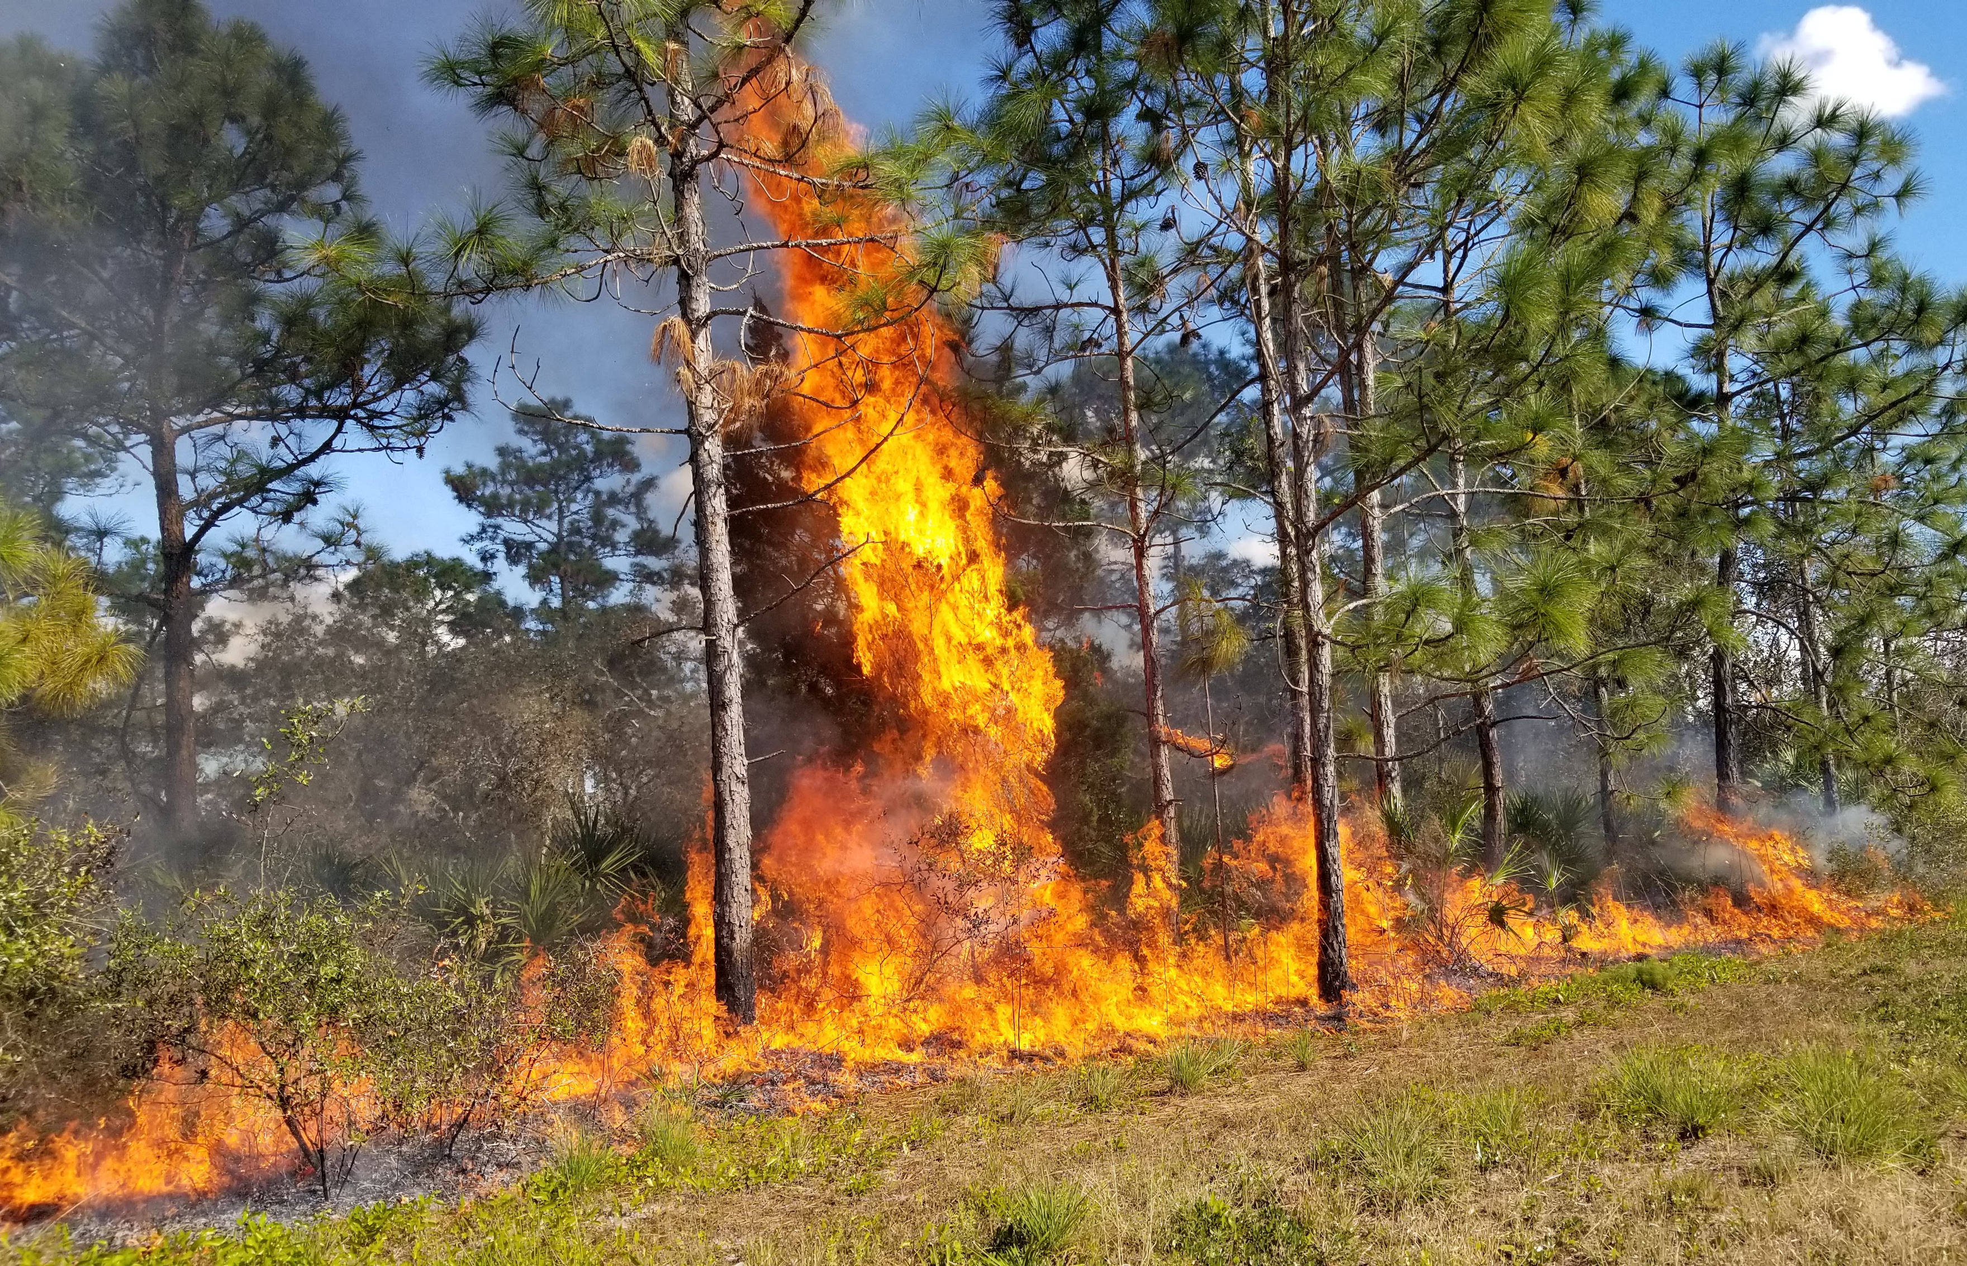
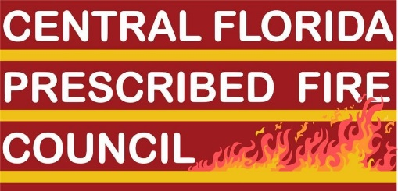

Dr. Patrick Bohlen, LNR Director
Brent Saulsbury, Biologist
October 1, 2021
Prescribed fire at the Wildland-Urban
Interface: the UCF experience

Slide 2
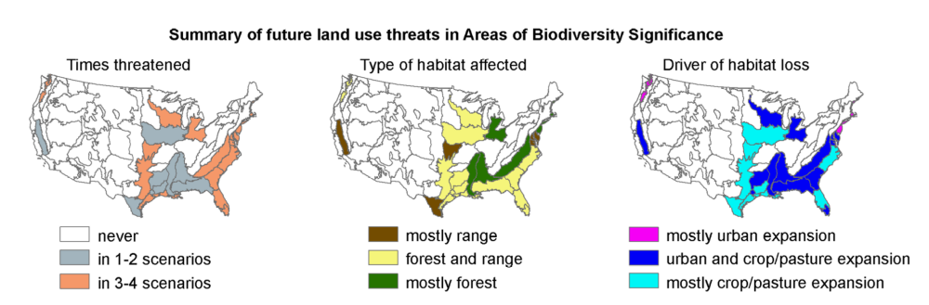
Summary of future lands use threats
in Areas of Biodiversity Significance
Significant Biodiversity Threats in Southeast US and Florida
Source: Martinuzzi et al. 2013. Ecosphere 4(5):58

Slide 3
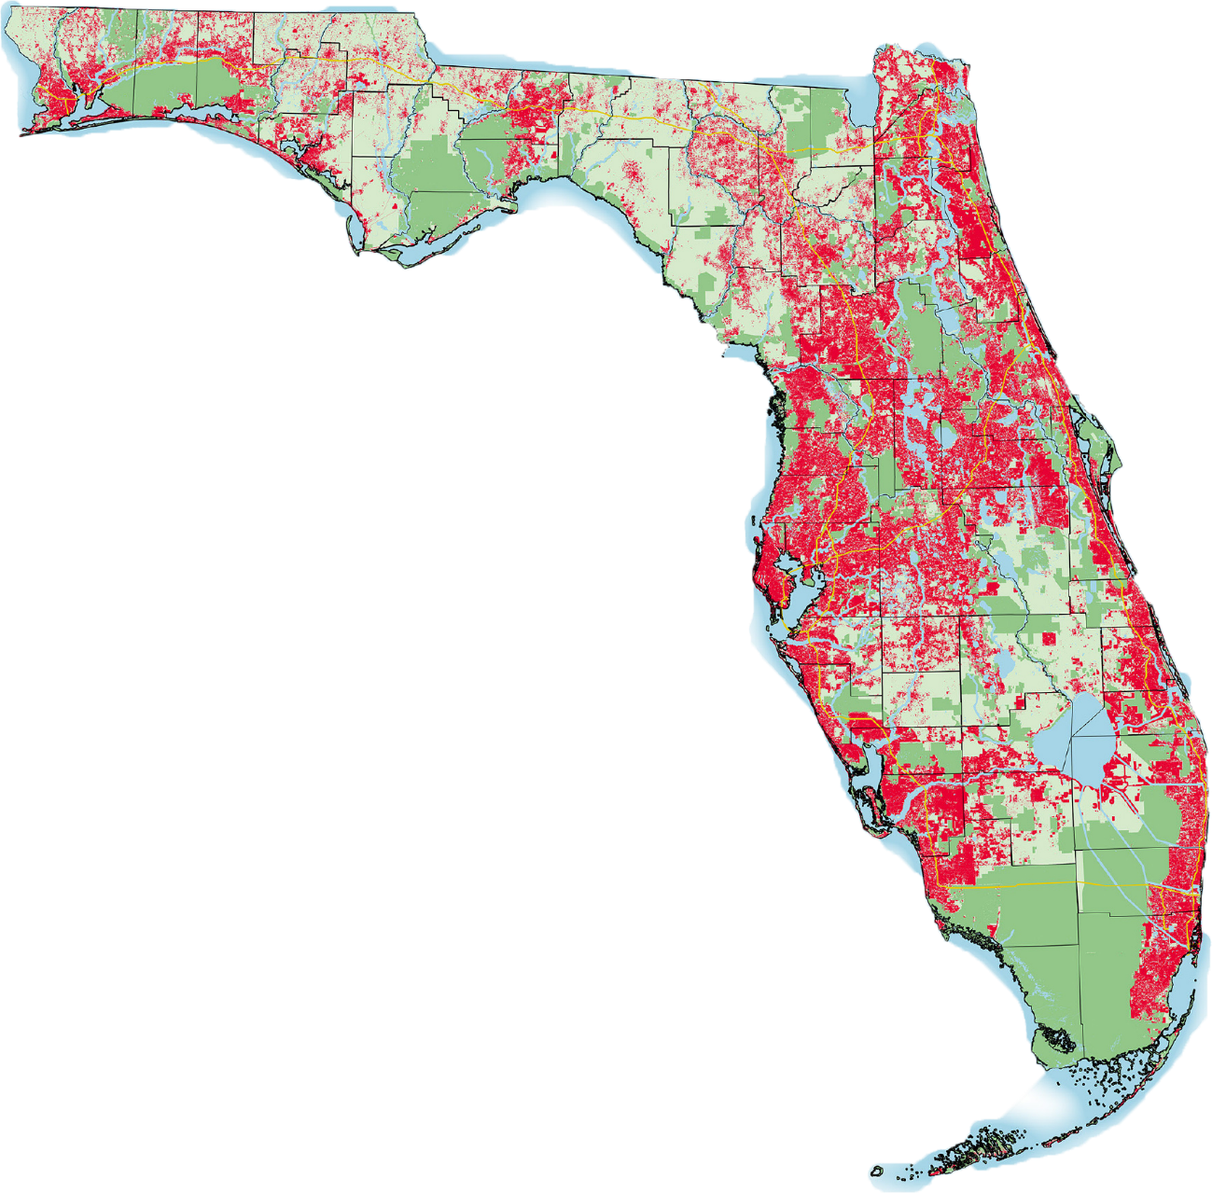
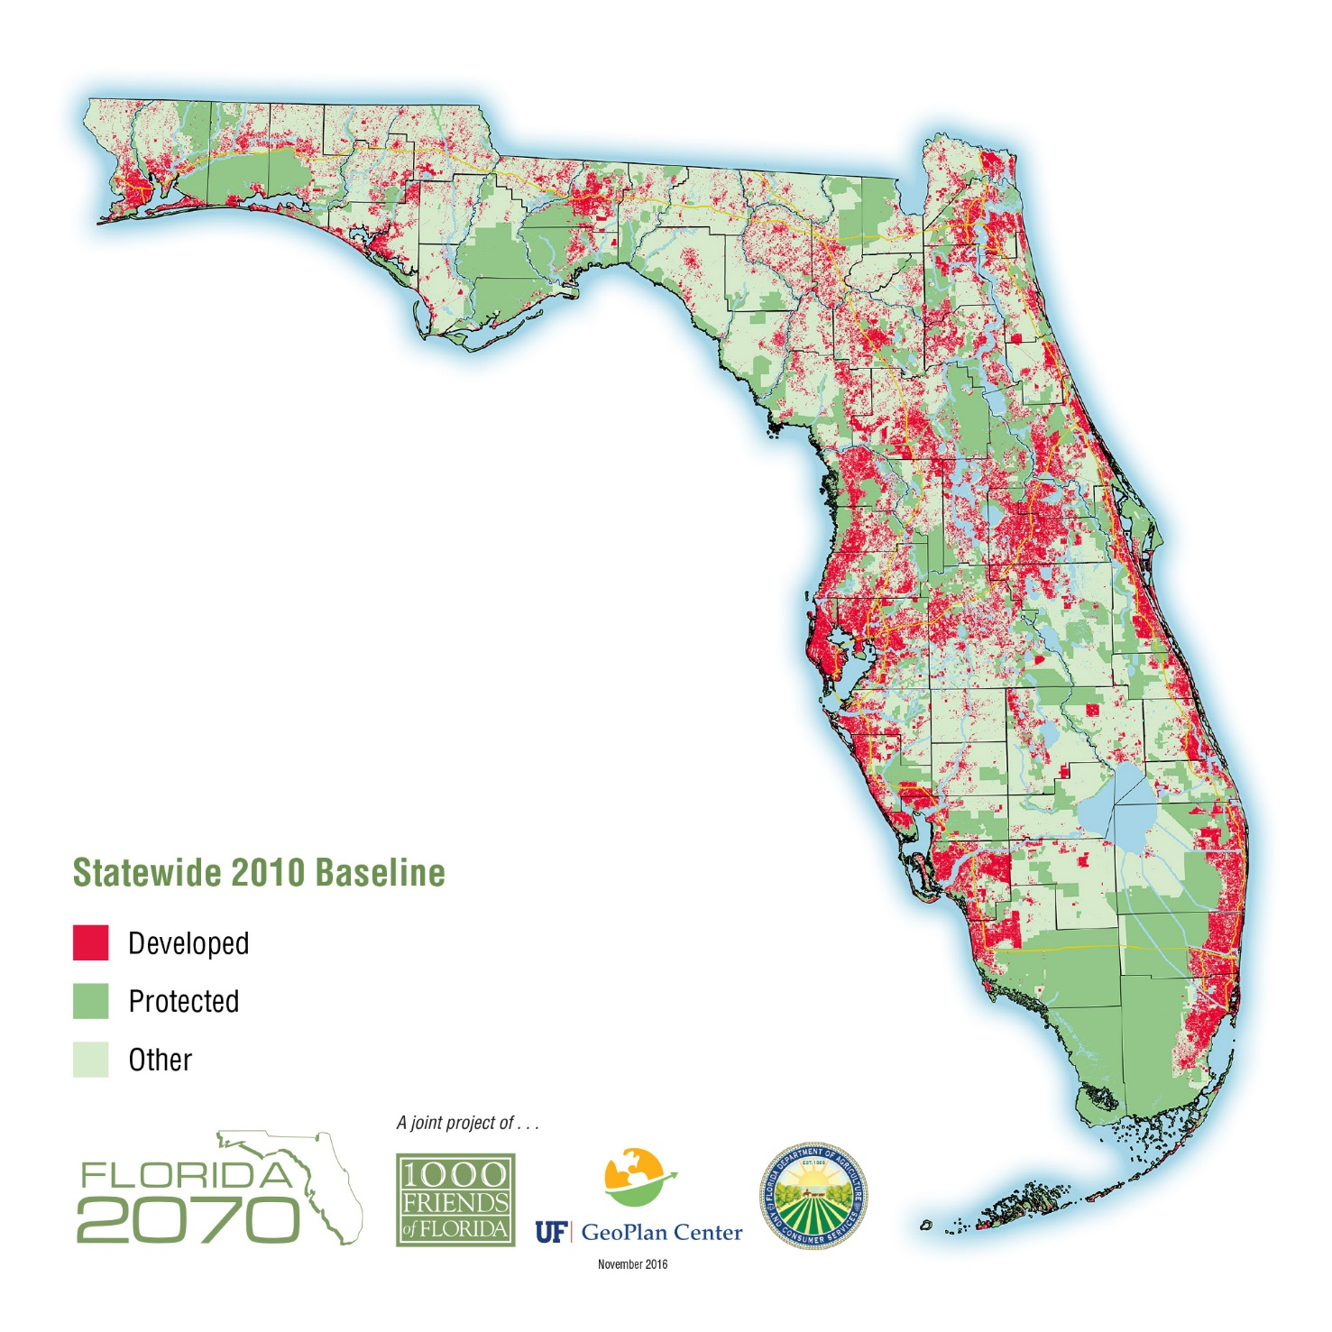
Florida urbanization
2070 Trend

Slide 4
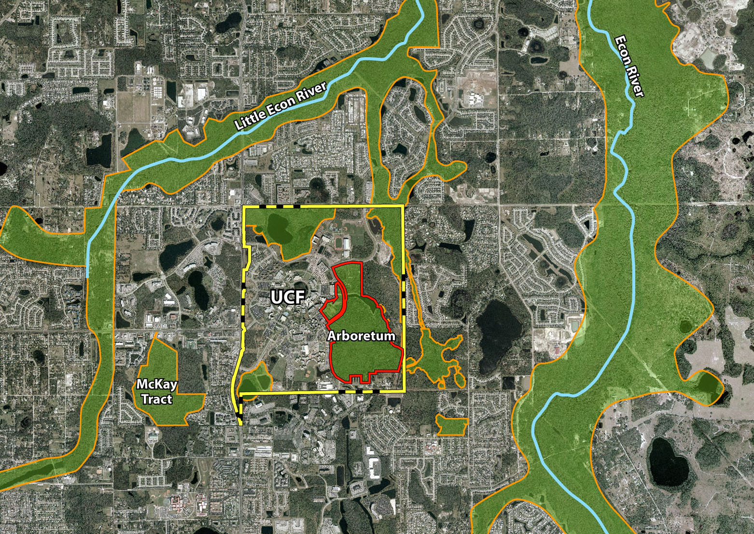
UCF fire program
regional context
Econ River Wilderness Area
Econ Sandhills
Conservation Area

Slide 5
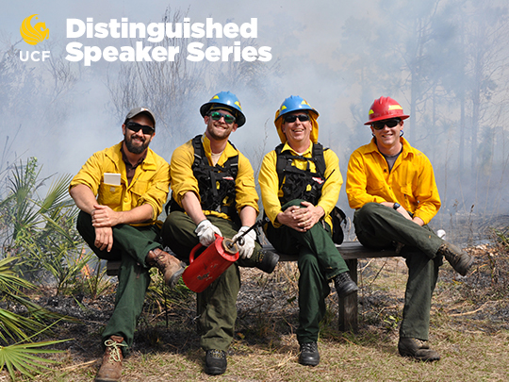
intrepid pioneers
burning at the wild-urban-interface

Slide 6
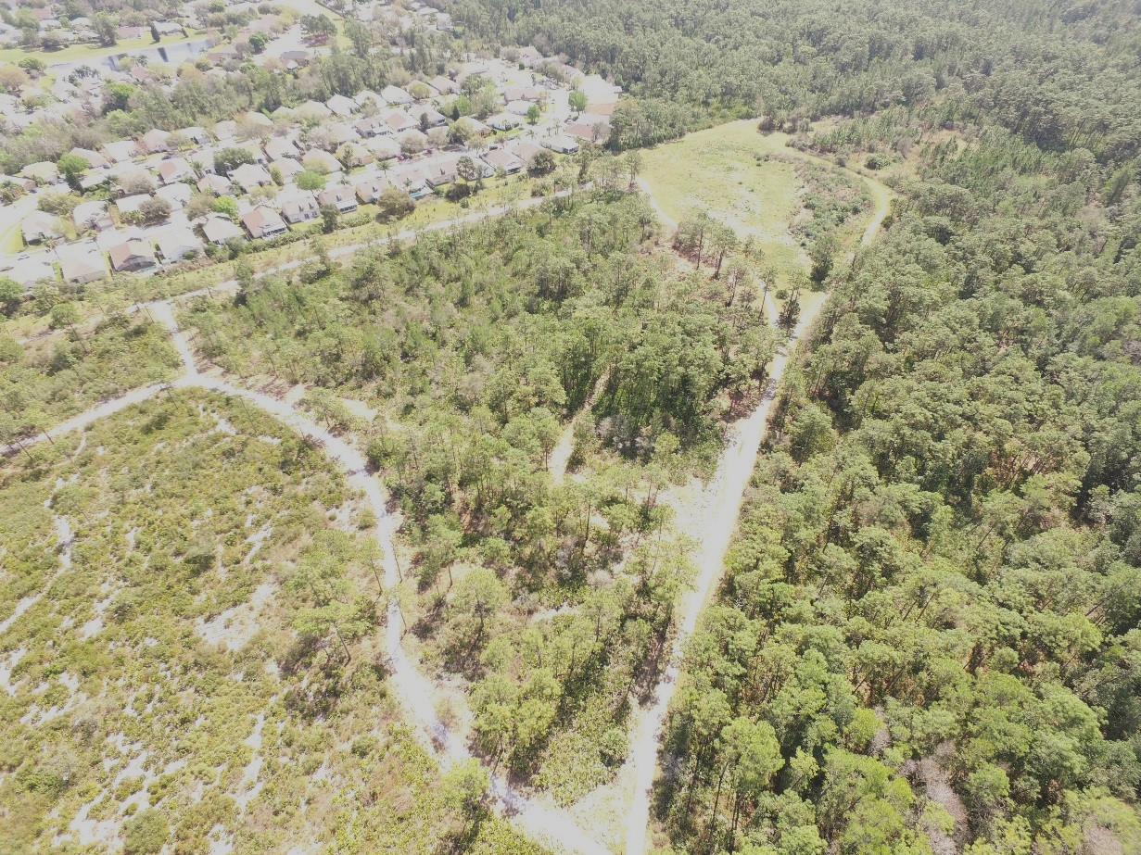
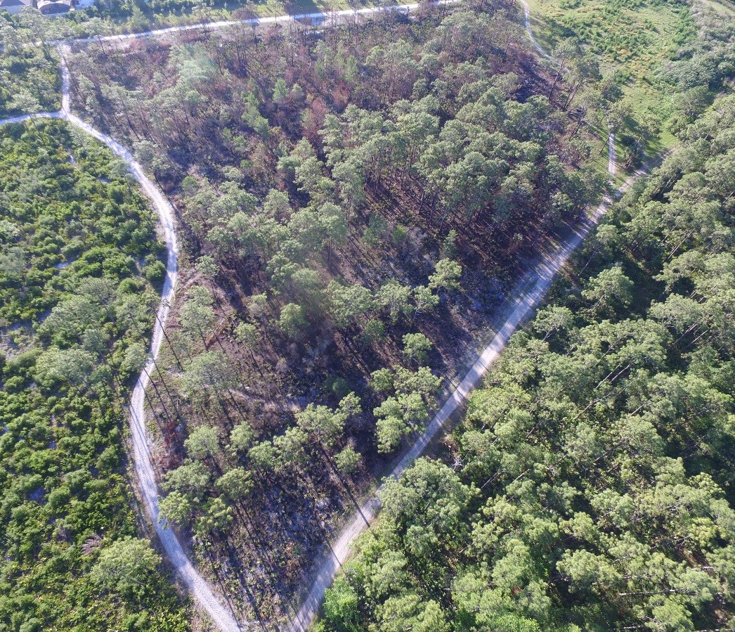
challenges of burning in urban areas
Unit 12C

Slide 7
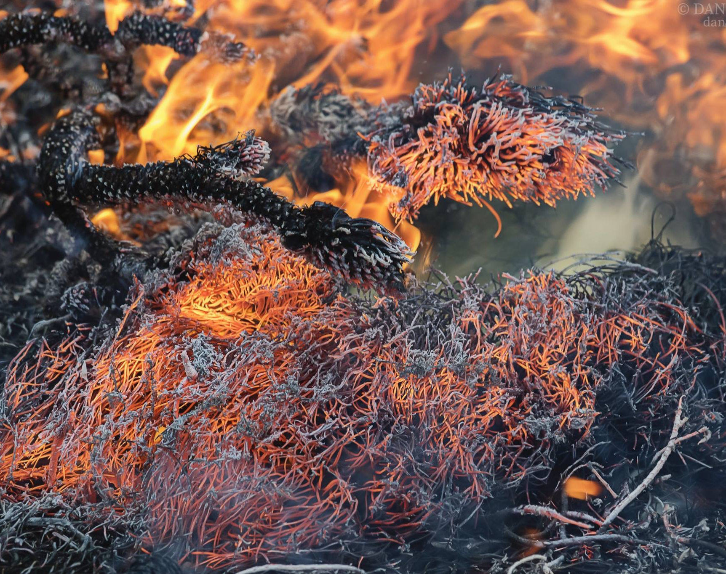
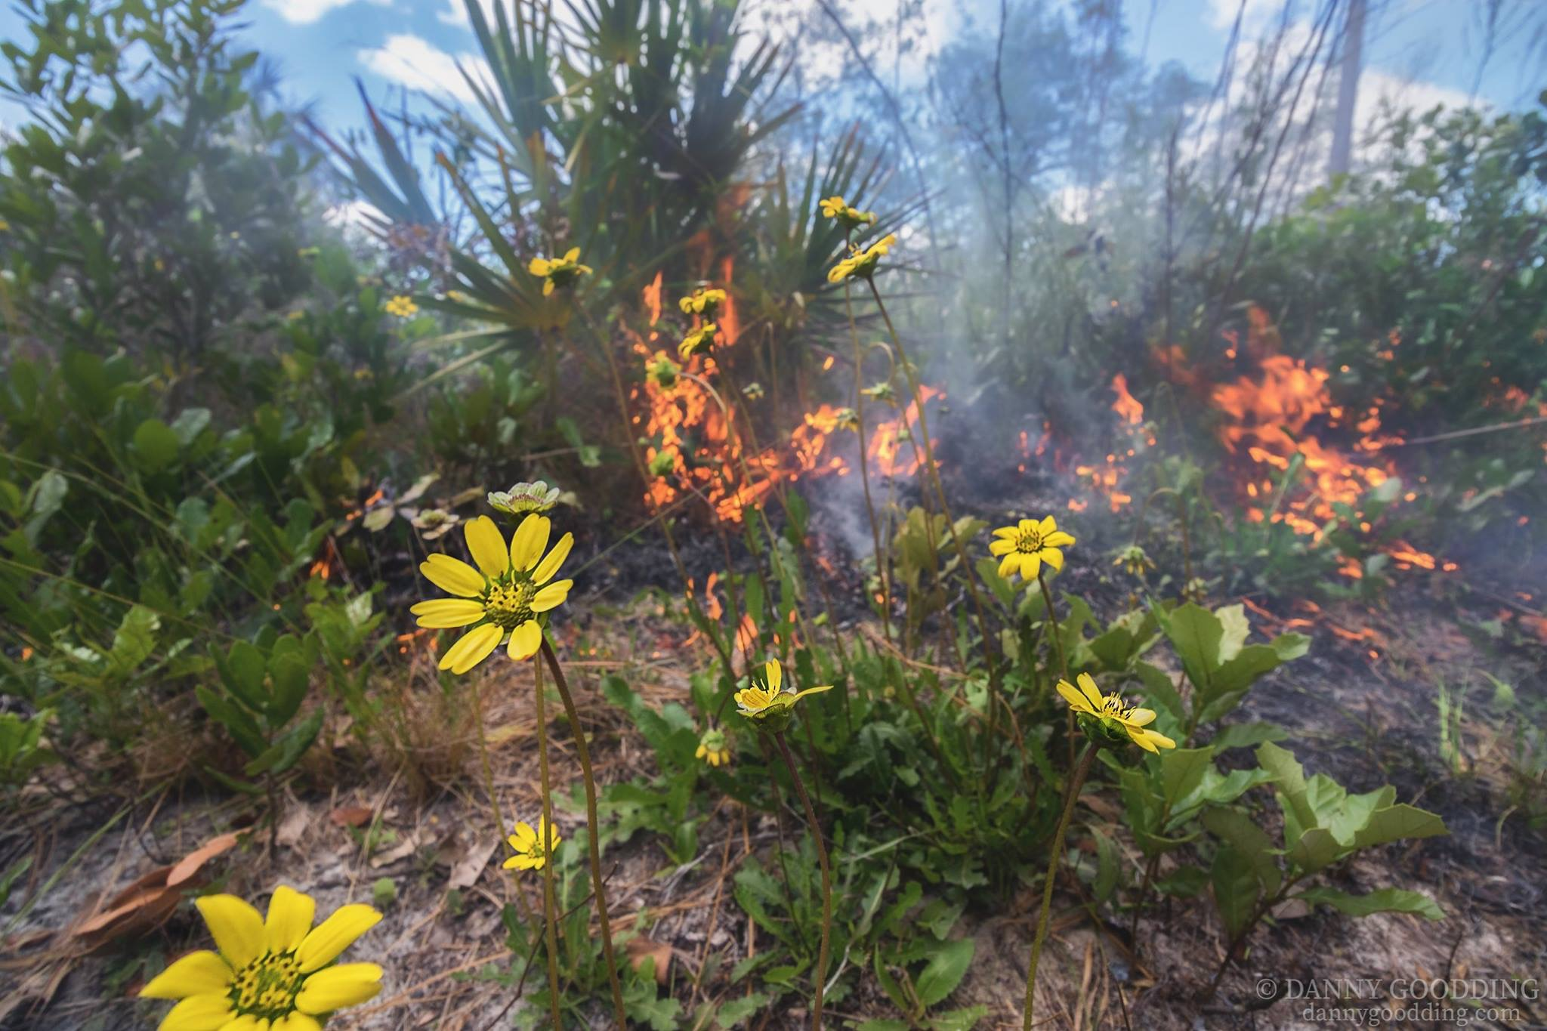
Importance of Fire Seasonality
Winter burns – fuel load reduction
Spring/Summer burns – best for biodiversity

Slide 9
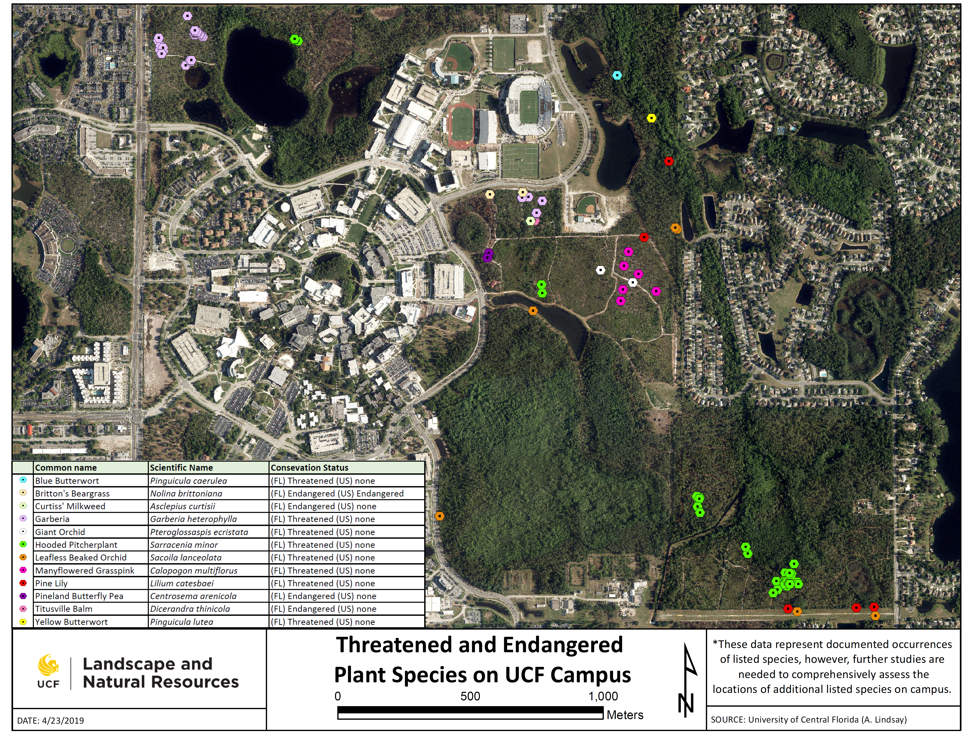
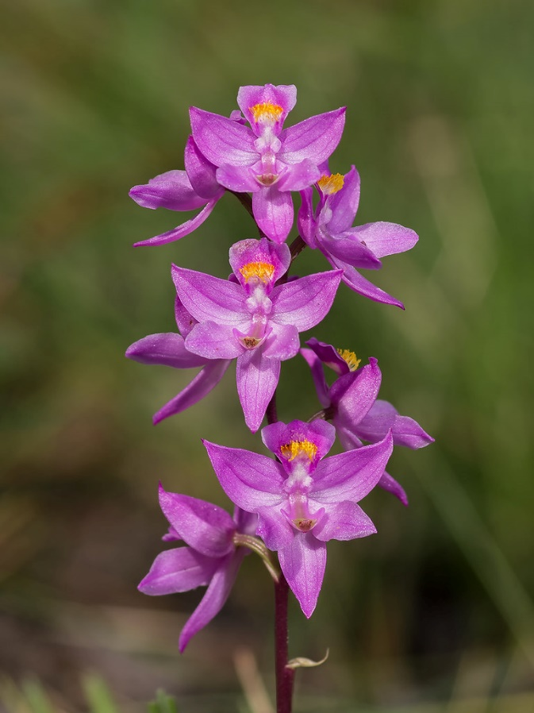

Slide 11
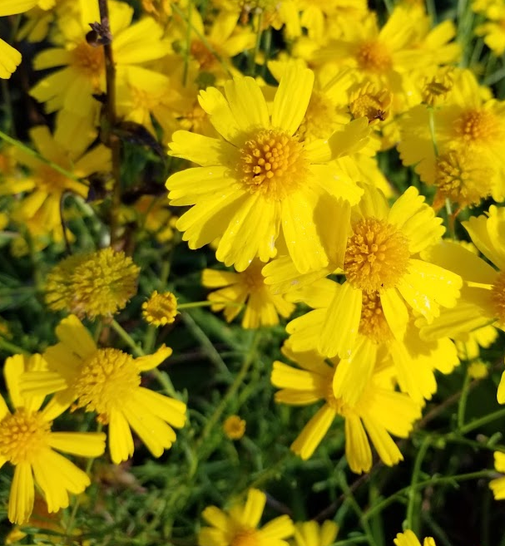
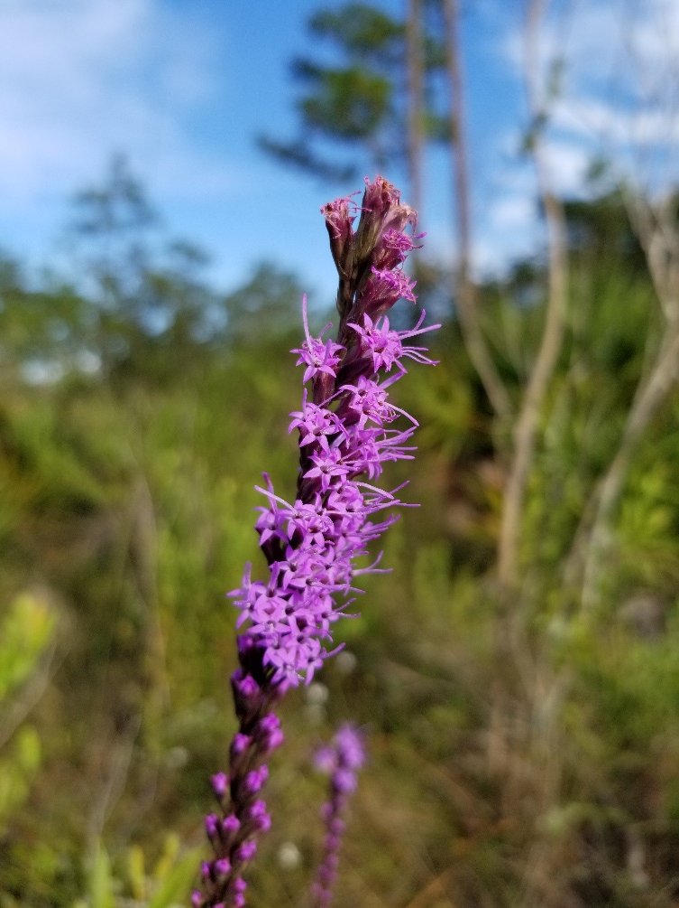
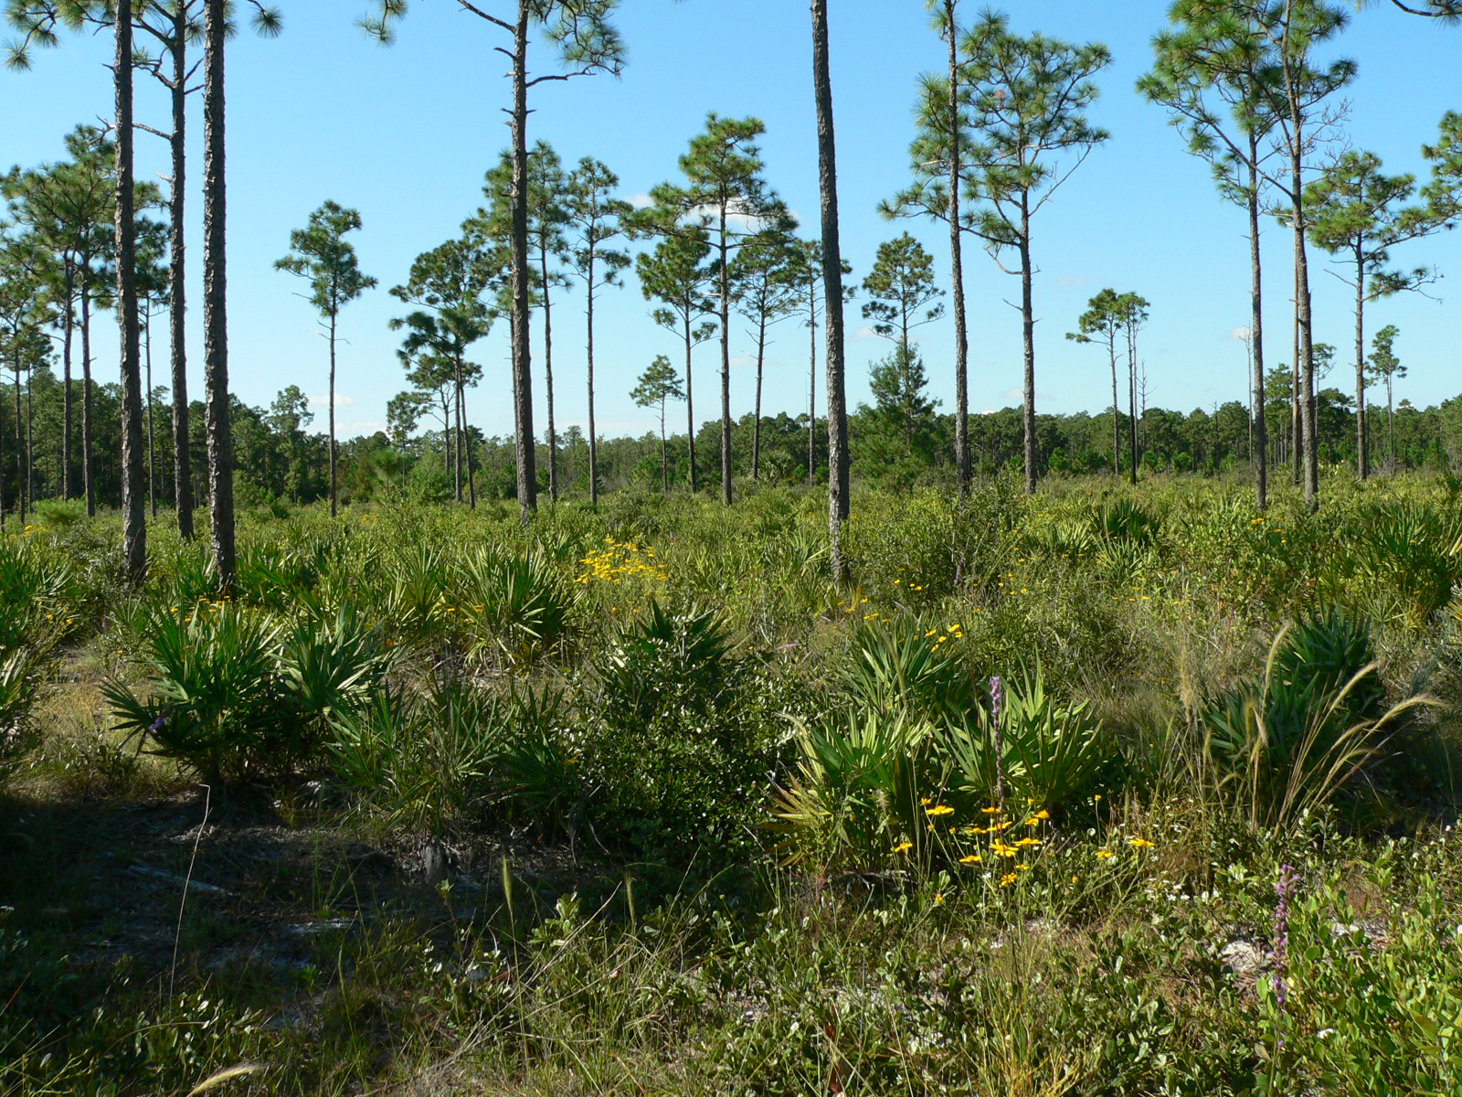
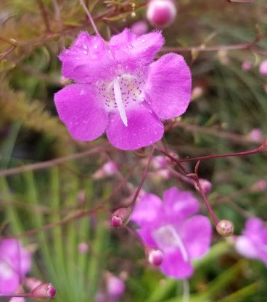
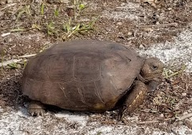
fire response at UCF

Slide 12
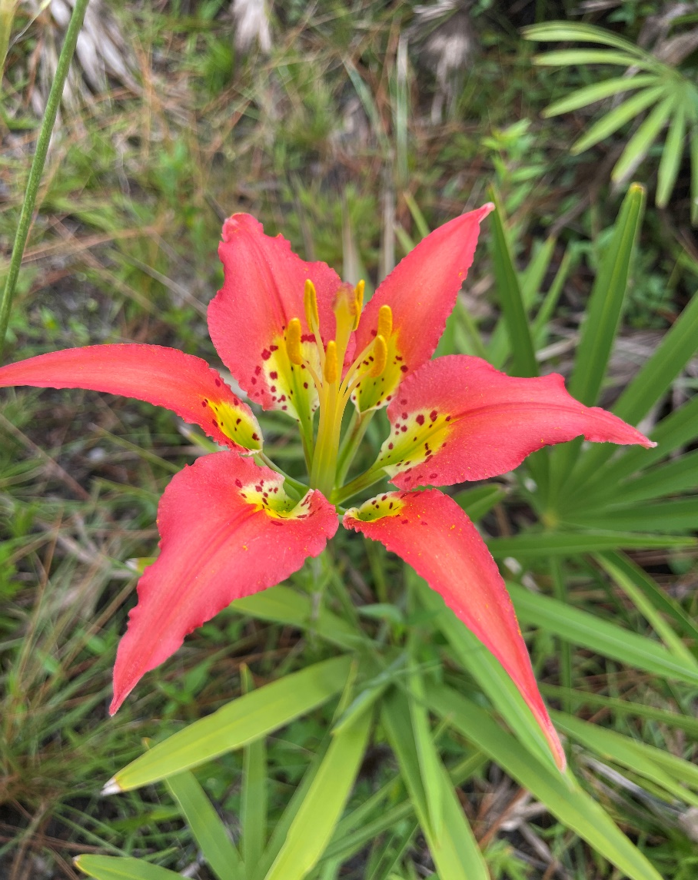
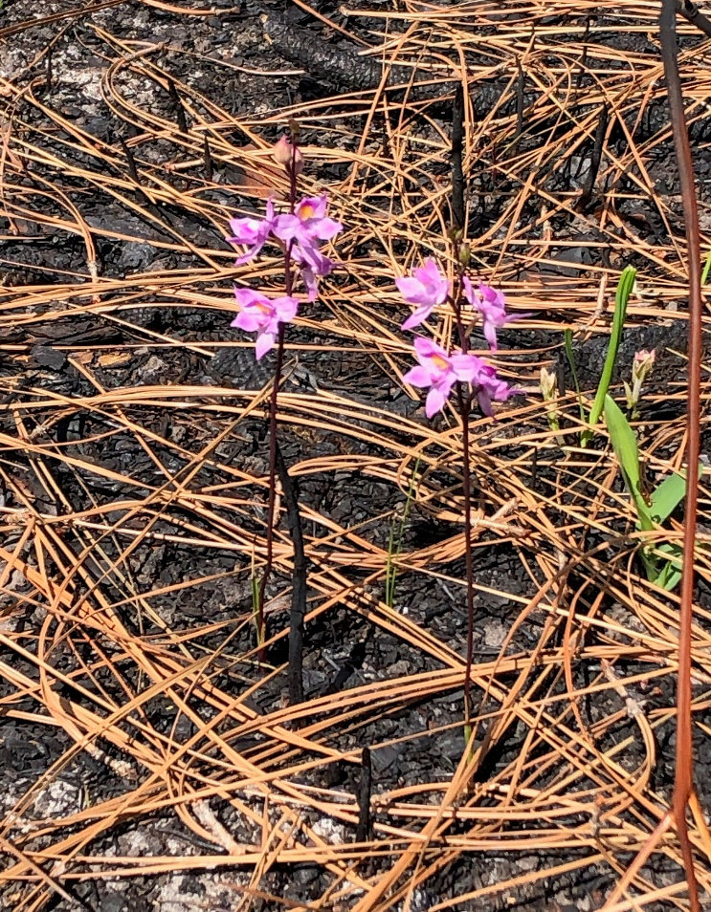
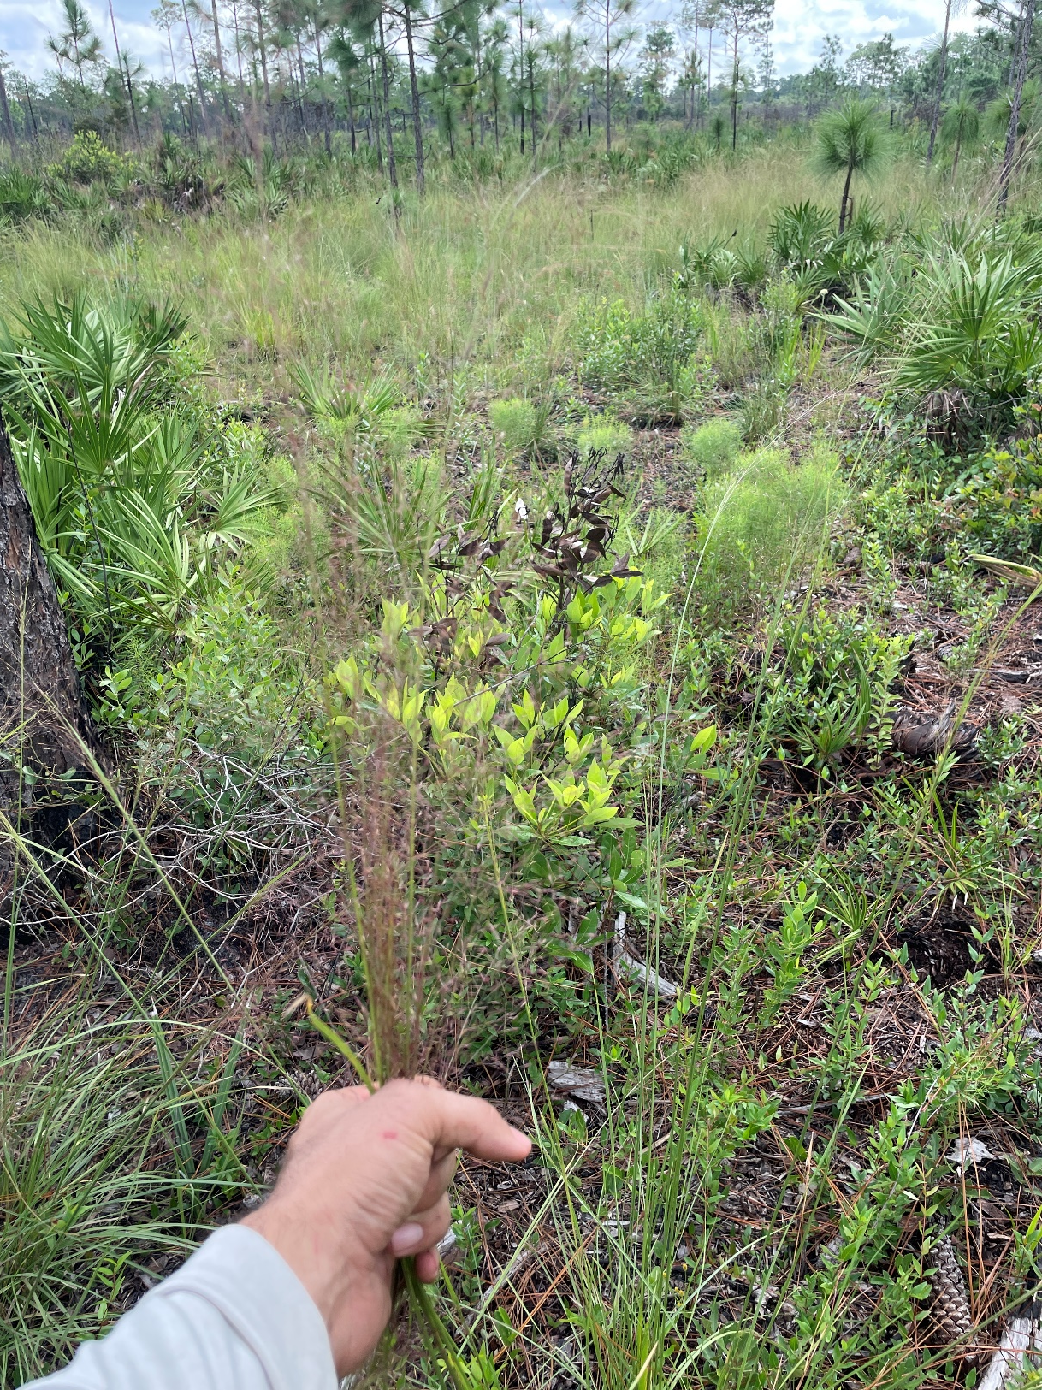
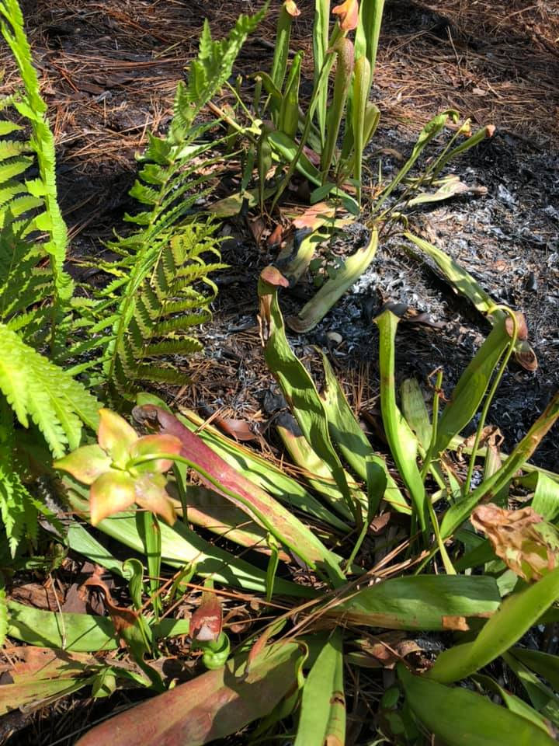
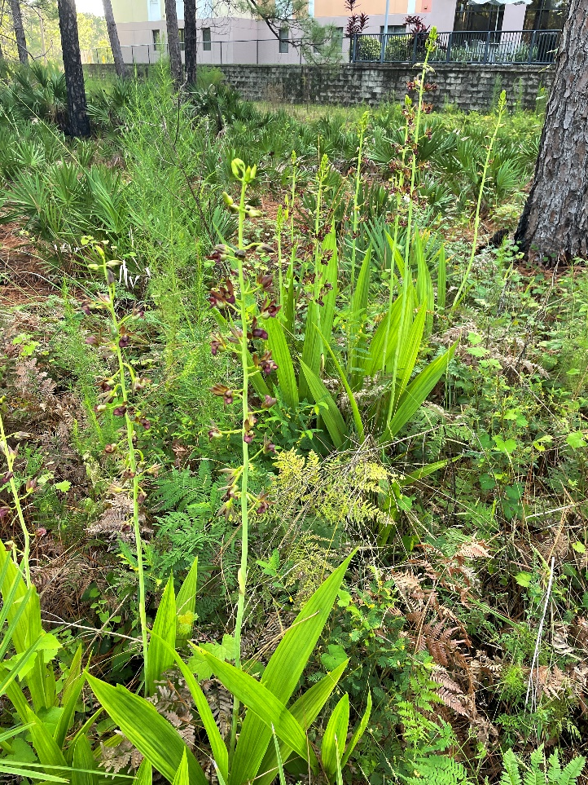
fire response at UCF

Slide 13
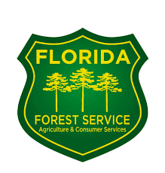
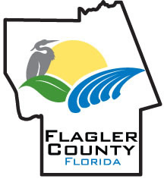

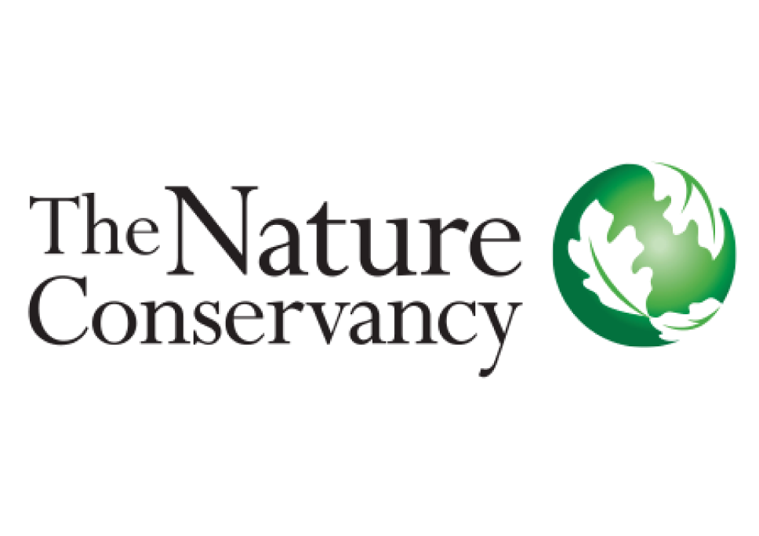

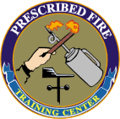
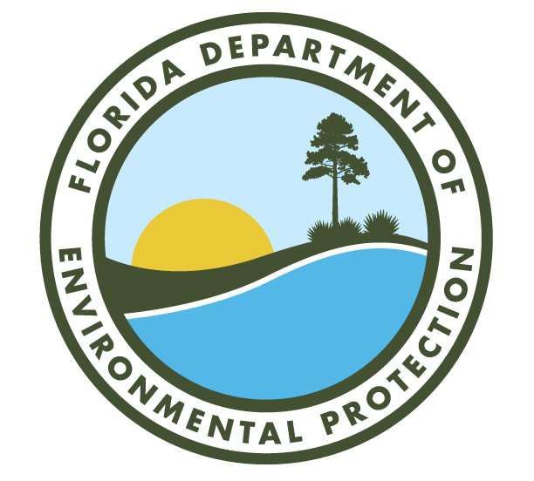

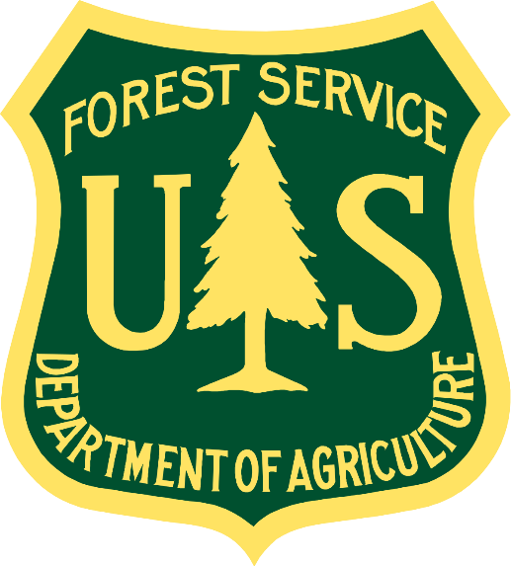
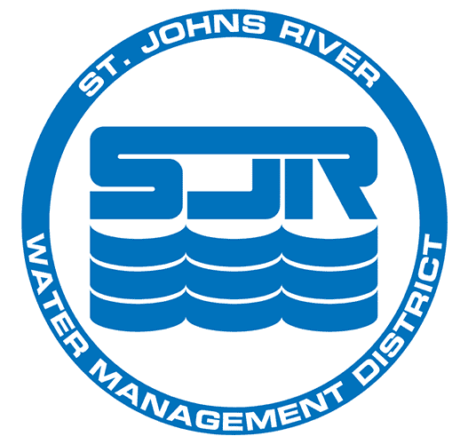


Slide 14
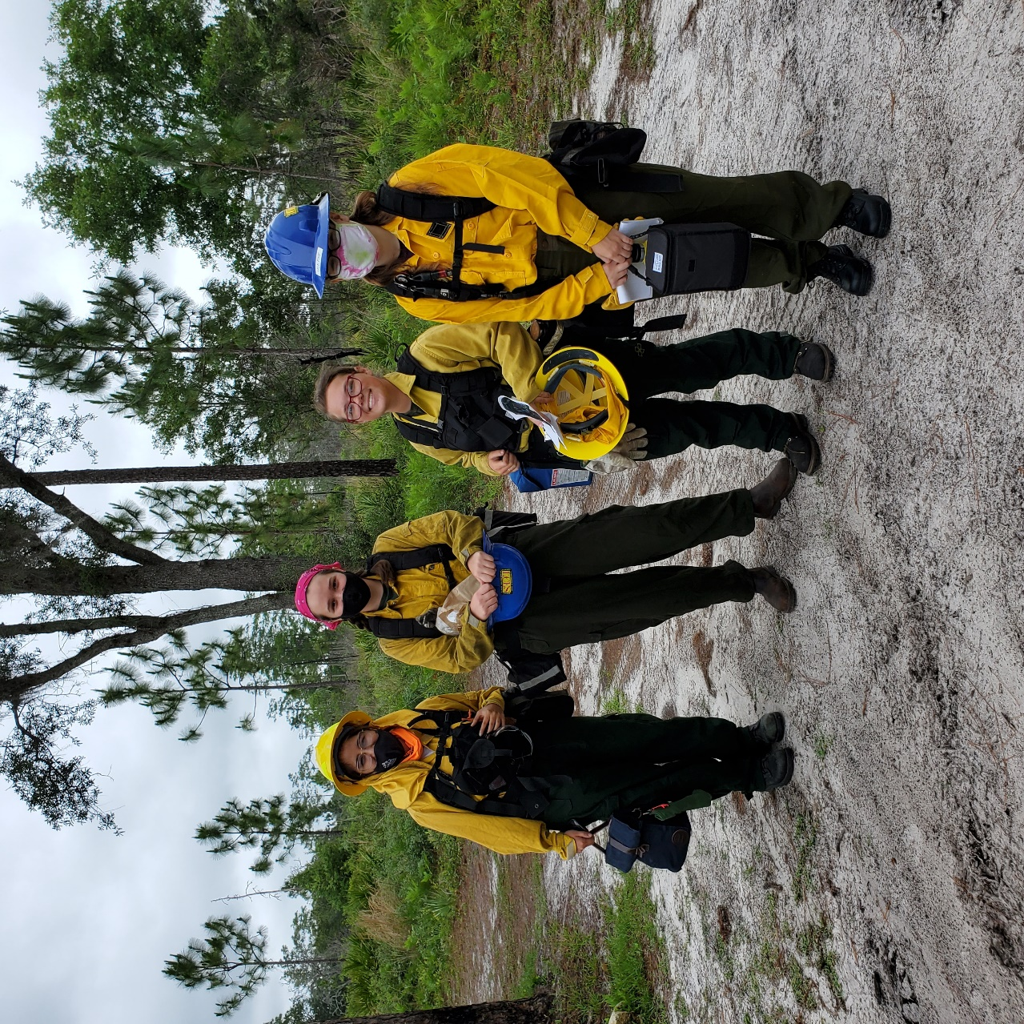
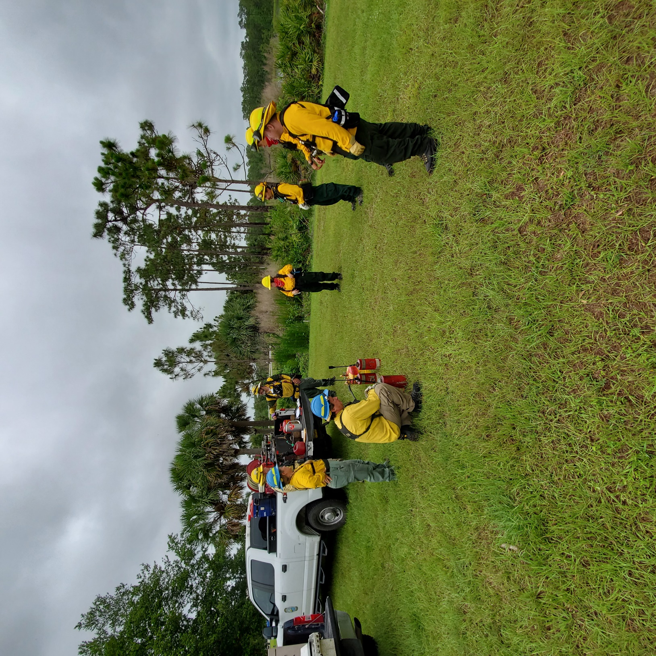
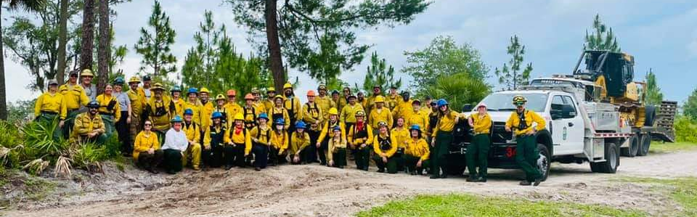

Slide 15
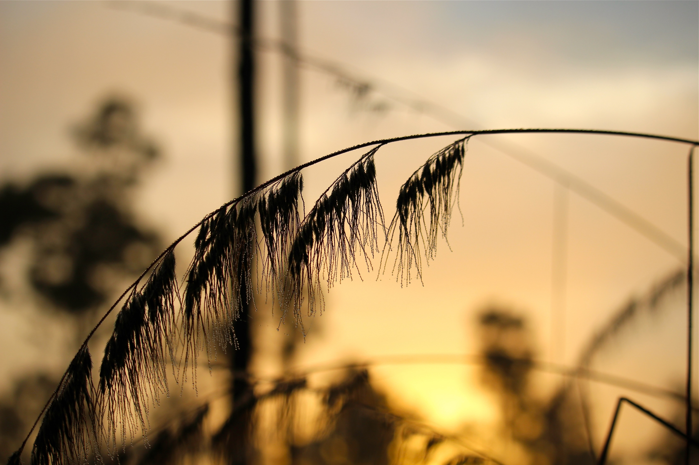
Thanks to all the Vital Connections that contribute to the success of our program!
Especially our staff!
Ray Jarrett
John Guziejka
Amanda Lindsay
Brent Saulsbury
Jennifer Elliott, Jack Wilson, Chris O’Hara, Jose Cruz, Kevin Hurst
And our students!
James Bardo
June Davison
Cheré Erickson
Vince Marcuzzi
Madison Schmidt
Andre Simoes
Juan Velasquez
Shannon Murphy, Adam Mirjar,

Slide 16
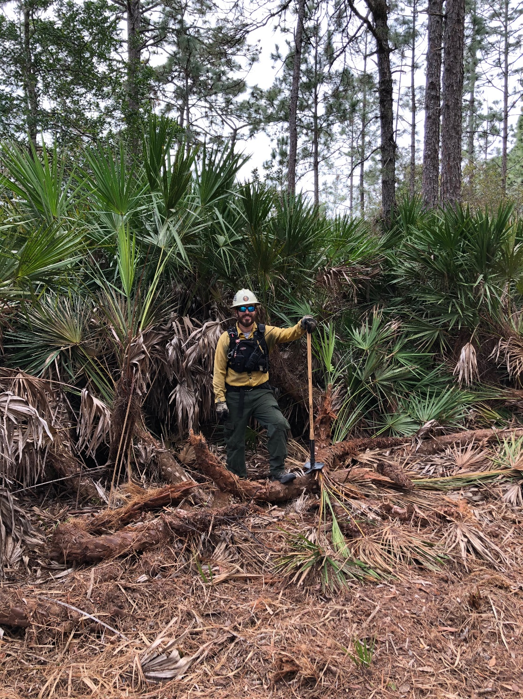
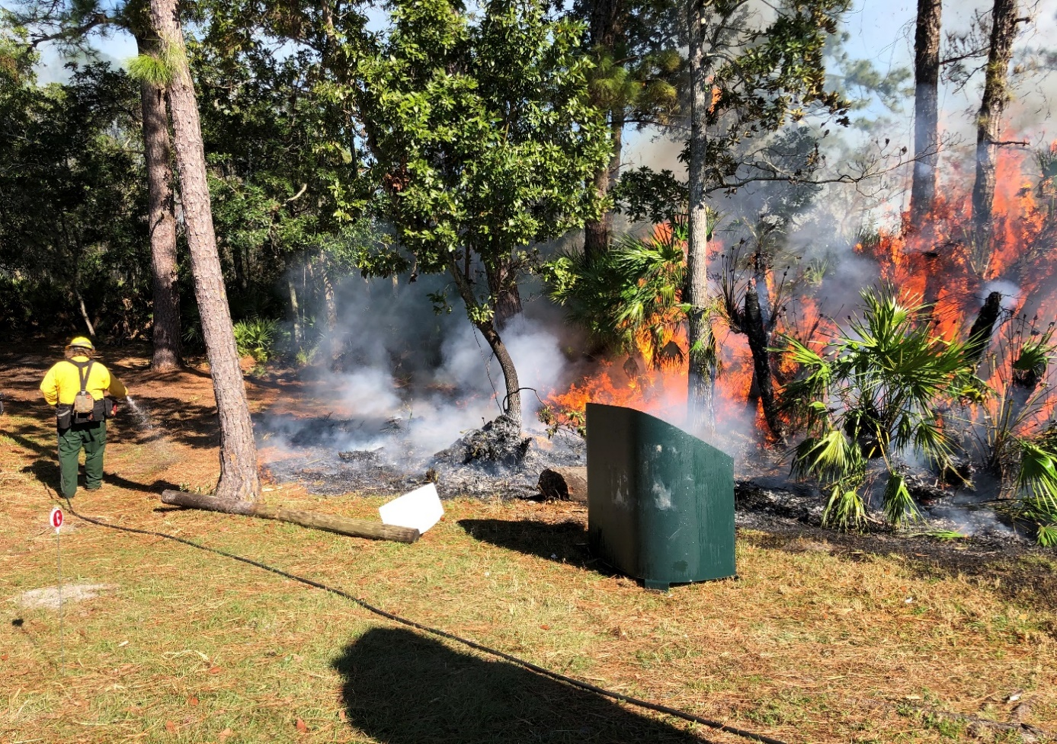
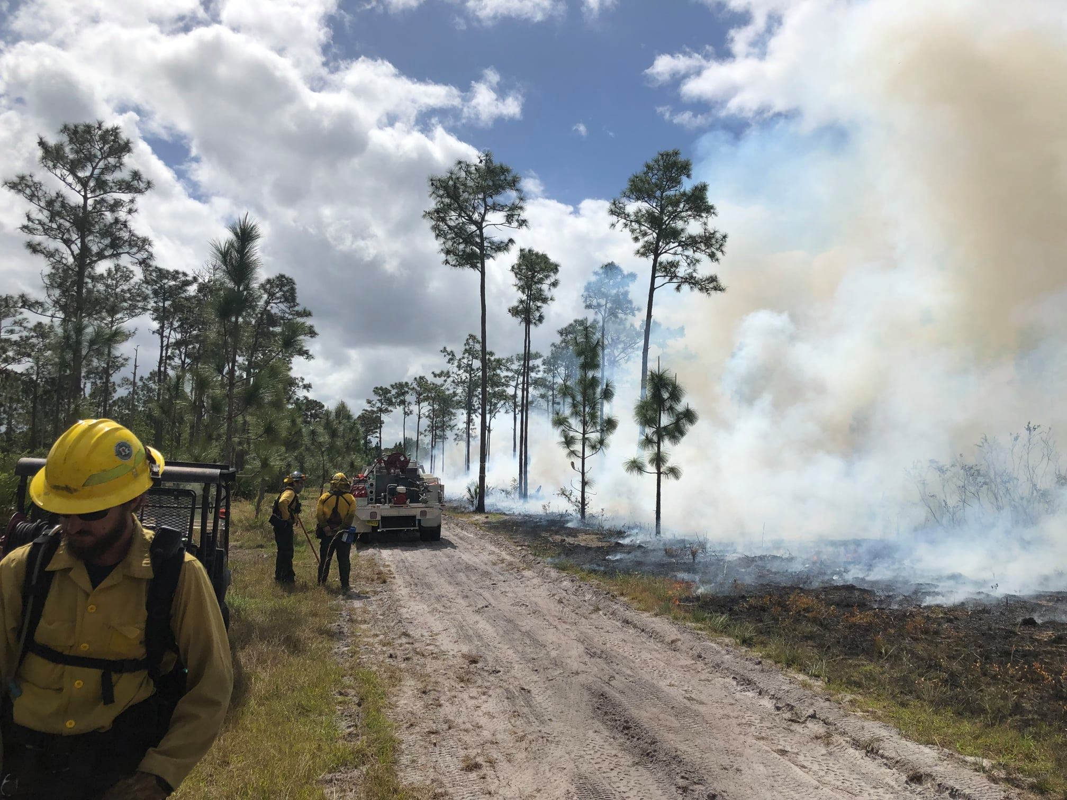
UCF’s Model for Reintroduction of fire in long, unburned pine flatwood ecosystems (Mesic, Scrubby, and Wet)
Notes:
The purpose of the rest of our presentation is to offer some guidance and recommendations for a reintroduction of prescribed fire into long, unburned ecosystems for mesic, scrubby, and wet flatwoods especially near urbanized communities. I know there are land managers and private landowners that have properties like you can see in these photos. These are areas where we know that prescribed fire is necessary to maintain that biodiversity and keep fuel loading, but it seems too challenging. This presentation is to offer some encouragement to others that it is very possible. Over the last 5 years, UCF has made great strides and also some lessons learned that I would like to share from our data over 4 years.

Slide 17
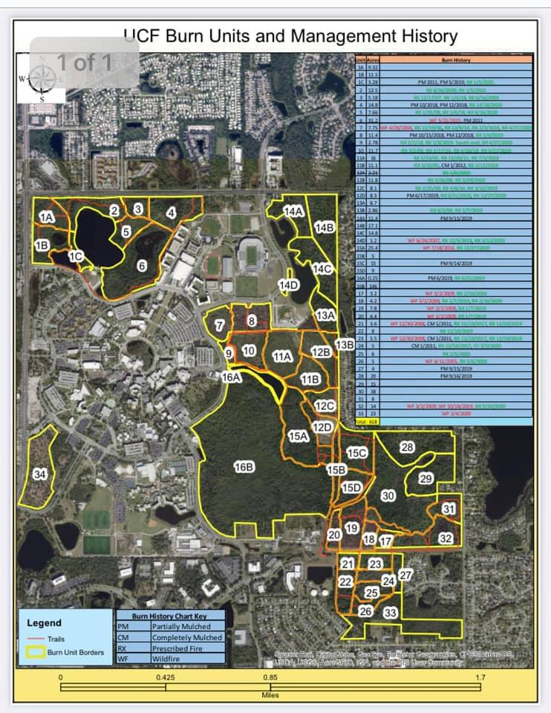
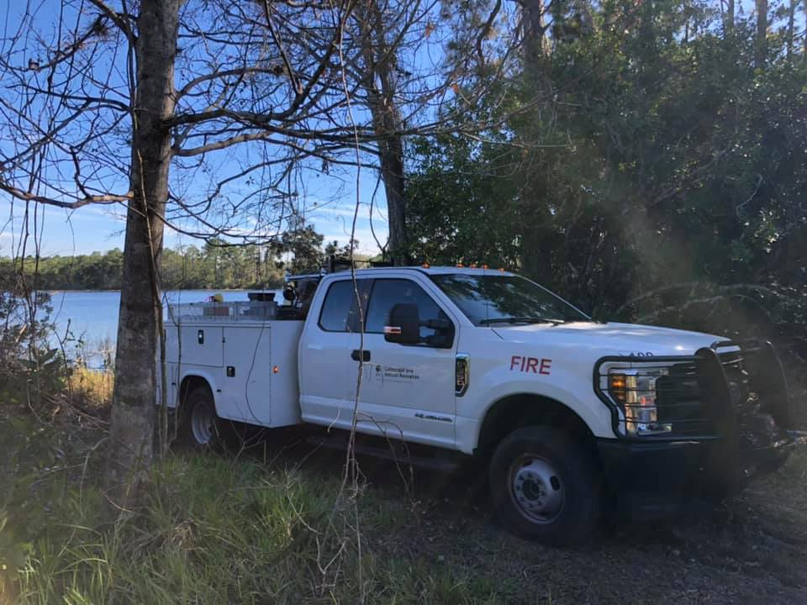
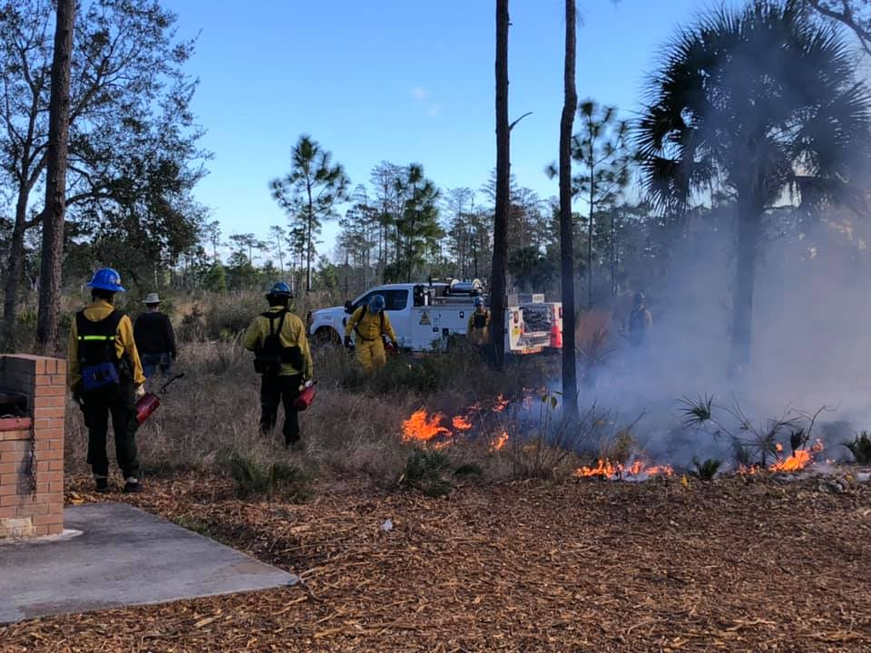
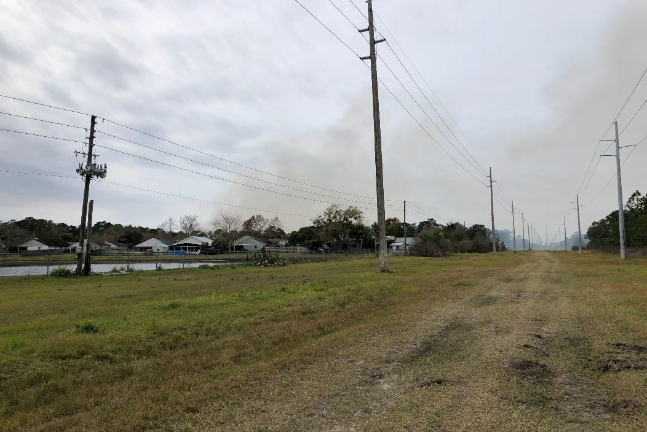
UCF’s Burn Unit Map
Notes:
This map shows where the prescribed burns in this study took place over that 4 year period. We have 34 unit management areas spread across four forest areas called Lake Claire, Arboretum and East Parcel and Mckay Tract. Each burn prescription was carefully reviewed and analyzed in their success by accomplished burn objectives regarding reduction of surface fuels, top killing hardwoods, ability to promote more grassy and shrub biodiversity, and keeping mature pine mortality under 20%. These introduction burns as you all know are very challenging to meet all resource management and public safety objectives in just one burn. Just being able to keep the burn inside the box and without complaints from the general public is a difficult objective alone. While we have been successful in manyy, some units did not recover well with % of pine mortality and we have some lessons to learn from this data.

Slide 18
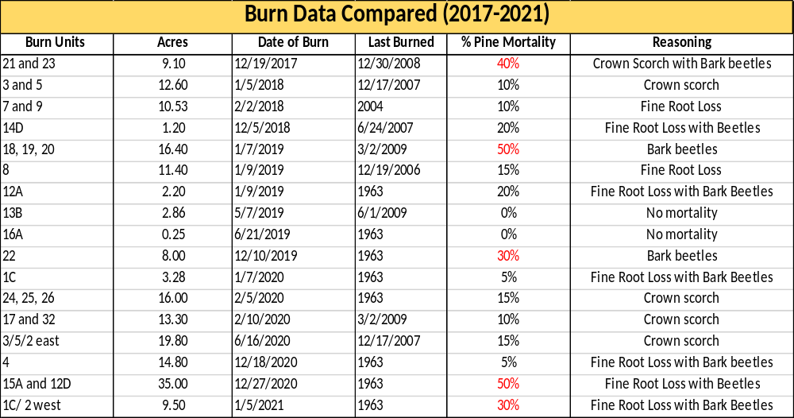
Lessons learned from ~4 years of burns on UCF campus
Notes:
These are the burn units at UCF in the last 4 years that I reviewed in this study that ranged from 10-50 years without a prescribed fire or wildfire. By participating on the burns and reviewing burn notes, conducting day of burn reports for fire effects, and post burn reviews 6 months after the burn I was able to estimate the % pine mortality for each unit as a measure for success and determine what contributed stressors led to that pine’s death. The units highlighted in Red resulted in some type of primary or secondary fire effect that led to mortality. There is plenty of research from Morgan Varner and others on this exact topic for the type of injuries that related to fire-caused stress as you can see from the photos taken on these ucf backlogged burns.

Slide 19
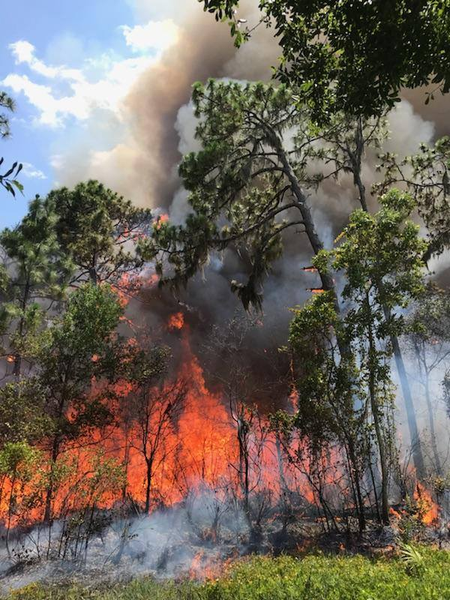
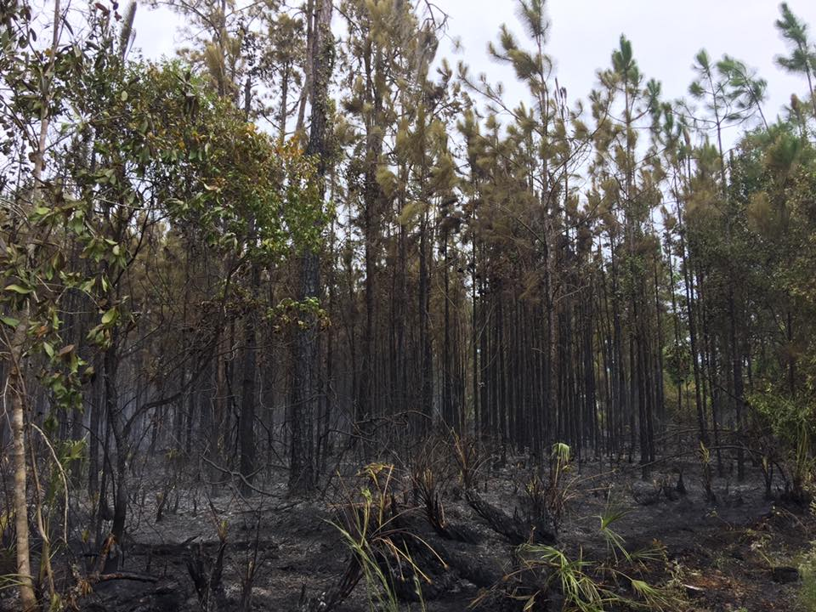
Crown Scorch/Meristem Damage – (Flaming effects)
Primary cause of mortality for East Parcel’s Units 24, 25,26
Notes:
Crown Scorch damage occurs when more than 80% of the canopy is burned at one time damaging the photosynthesis capabilities for the tree. Meristem injuriy on the tips of each pine branch is another common injuring for this type of flaming effect on the prescribed burn that can easily be observed by burn crew. This commonly happens when conditions become dryer, later in the day, and your surface fire becomes too intense with head/flanking fire during ignition.

Slide 20
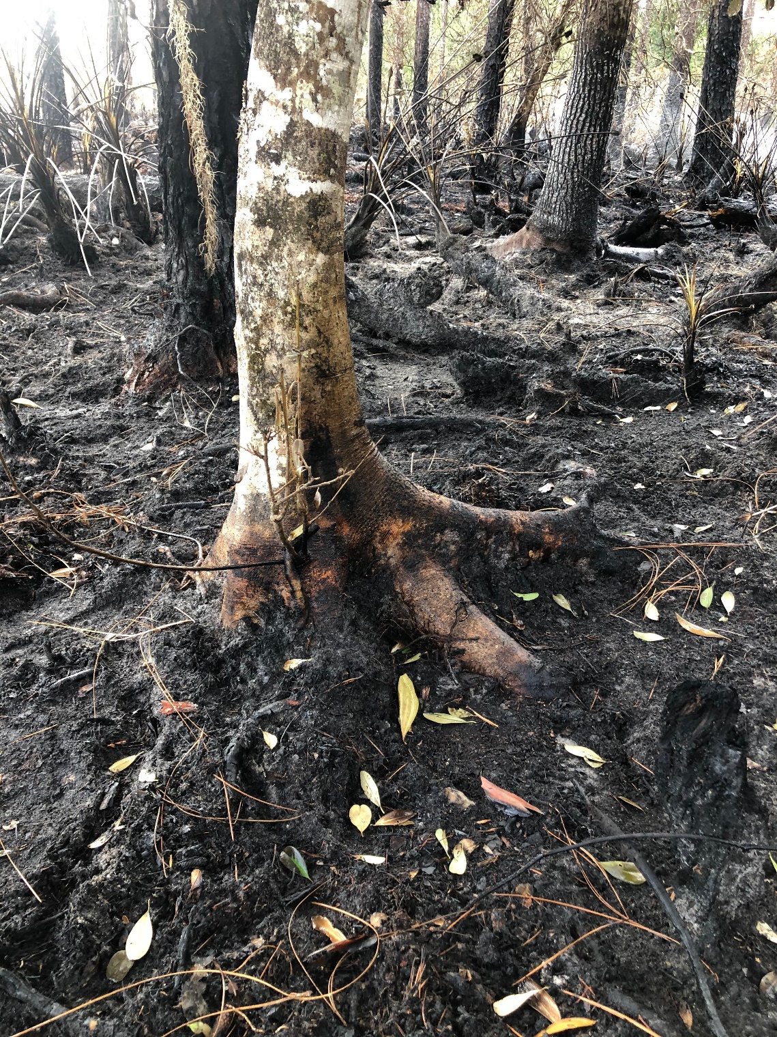
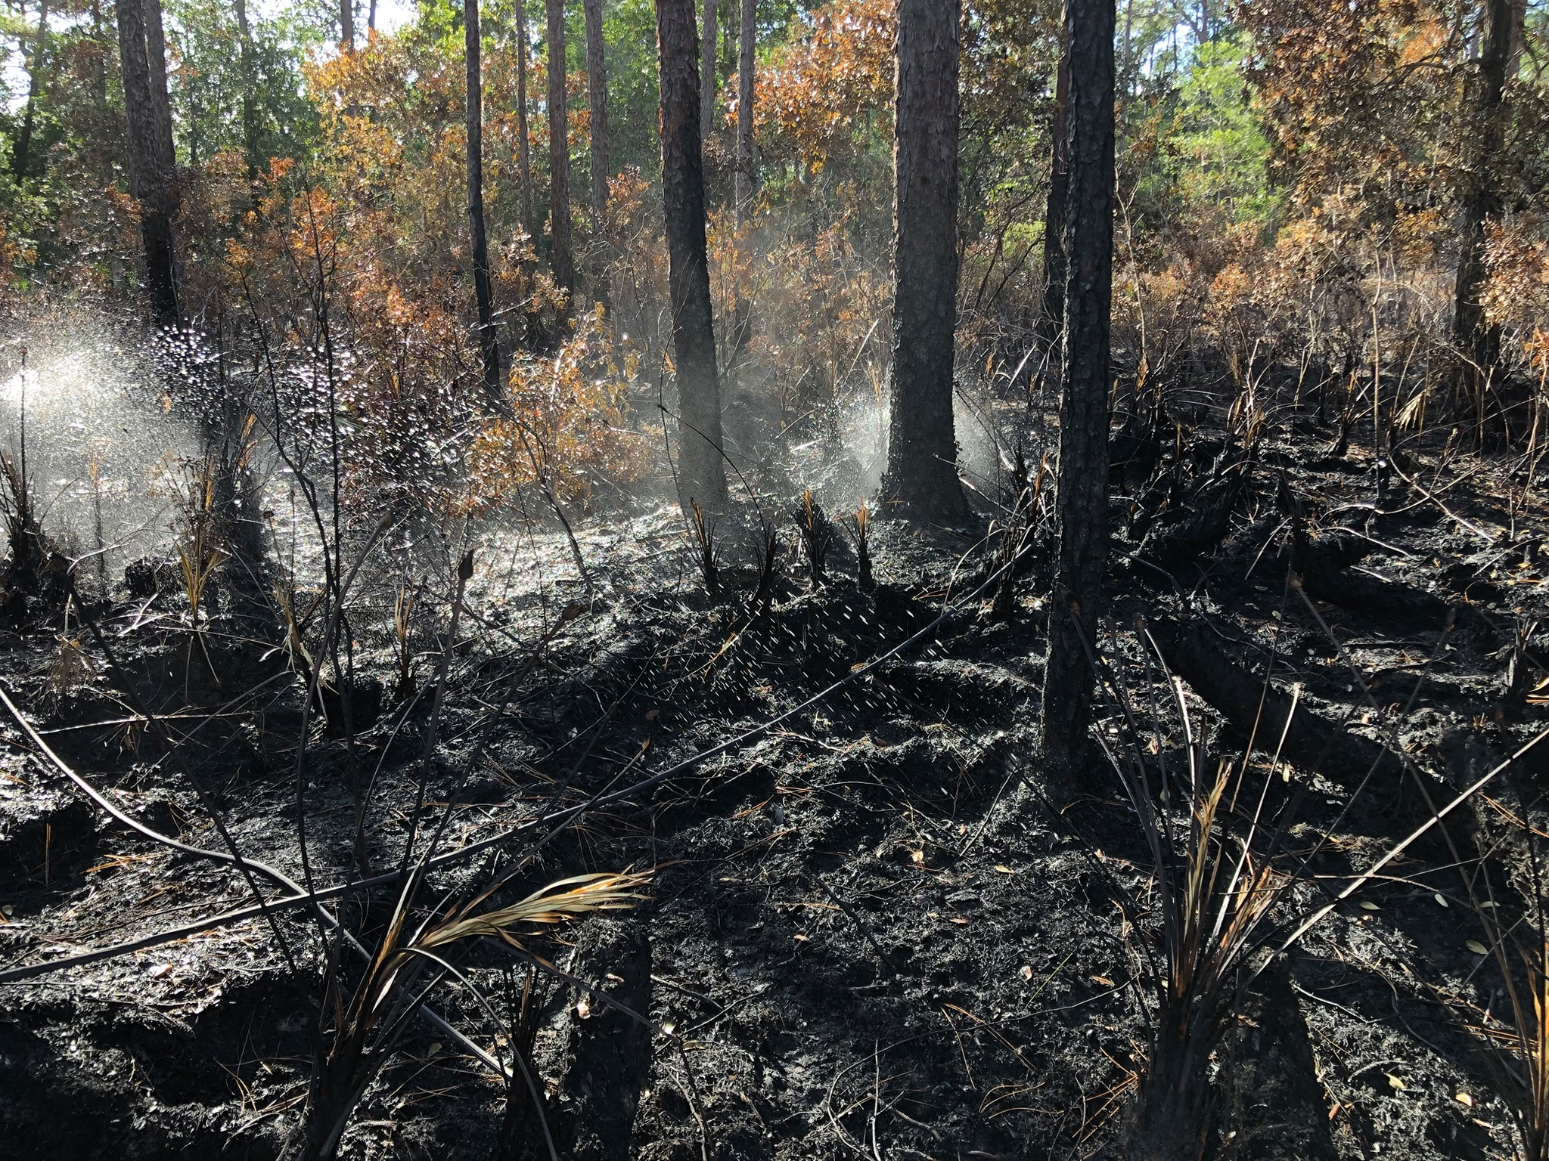
Stem Char/ Fine Root Loss leads to Tree Mortality (Smoldering fire effects)
-Arboretum’s Unit 12D and 15A
Notes:
The most common issue that leads to pine mortality as discussed in Morgan Varner and others 2009, is what we know as the smoldering fire effects that happens during mop up and can continue several days and weeks if weather is not favorable. Smoldering effects can kill trees via two ways and that is 1.) from cambium girdling from excessive heat around the entire trunk near the surface fuels, or 2.) through fine root loss in the organic soils. This is the number one stressor that leads to mortality.

Slide 21
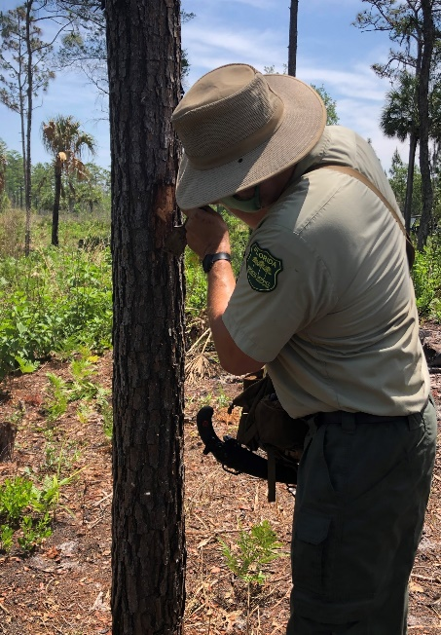
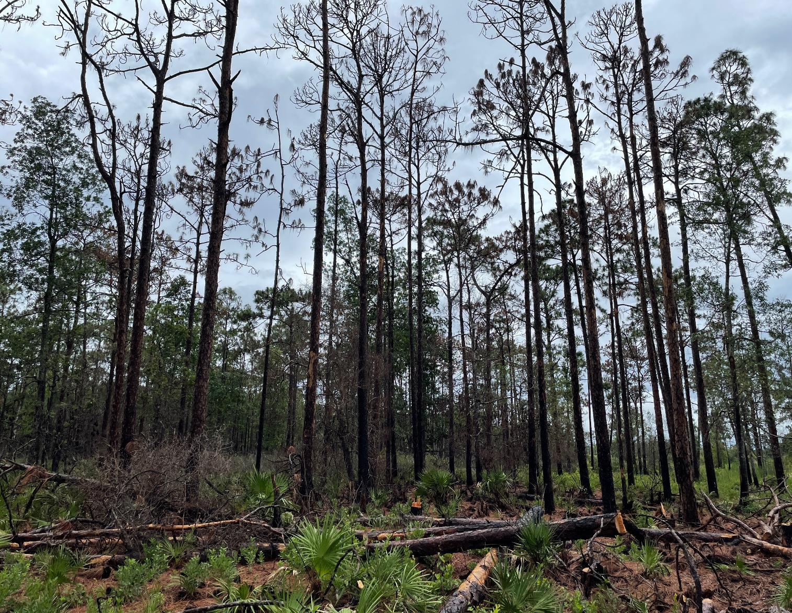
Bark Beetle Infestations
Secondary indirect effects (East Parcel’s Units 20,19,18)
Primary Bark Beetles (Eickwort, J. 2021)
Stress-responding (common, but require stressed host trees)
  Ips engraver beetles (3 spp.)
  Black turpentine beetle
Secondary Wood-borers (which infest dead/dying parts of trees) (Eickwort,J. 2021)
Sawyer beetles (Monochamus spp.)
Metallic wood-boring beetles (Buprestidae)
Ambrosia beetles (Scolytinae and Platypodinae)
Notes:
At UCF, we observed some unique areas that I determined that even with favorable weather and effective mopup and having 6 months to 1 year of what appeared to be healthy pines, trees started to succumb to bark beetles. I worked with Jeffrey Eickwort to survey and determine the exact species of these bark beetles to rule out any Southern Pine Beetle infestations and we determine that the primary beetles attacking stressed trees were common Ips and Black Turpentine beetles with secondary host beetles of sawyer and ambrosia beetles that killed the tree. These areas in the east parcel suffered primarily from secondary indirect effects rather than from first order effects.

Slide 22
UCF’s Fire Model for Backlogged Units
Fireline preparation is required before the burn.
Communication with all stakeholders.
Burning under the most “ideal” weather and fuel parameters for backlogged fuel types.
Keeping units smaller (~10-30 acres).
Burn these units in different tracts of forest and timing.
Assemble the best fireline crew and equipment day of the burn.
Special considerations and methodologies.
Notes:
So as a result, I reviewed the burn data for all these units, and want to offer a model for success in our future.
As with all burns, we need to prioritize safety as number one objective for all burns for firefighters and general public. This requires good prep with mechanical treatment.
Communication before the prescribed burn is very important to maintain good relationships with neighborhoods, our campus, and other fire and police departments.
Choosing the best weather and fuel conditions to reduce your pine mortality
Keep units small- This reduces bark beetle infestations for large tracts of land with stressed trees releasing pheromones to attract for insects.
Burn in various parts of your forest and different times of year to decrease your chances of beetle infestations and offer various burn weather conditions to ensure success.
Assembly the best and most experience crew for these challenging units. Our MOU partners have the best local knowledge, leadership and make an effective team when it comes to understanding fire effects, objectives, ICS and how to work together effectively under stressful situations
Consider using special methods such as raking back mulch, using sprinkers and class A foam for overcoming duff issues.

Slide 23
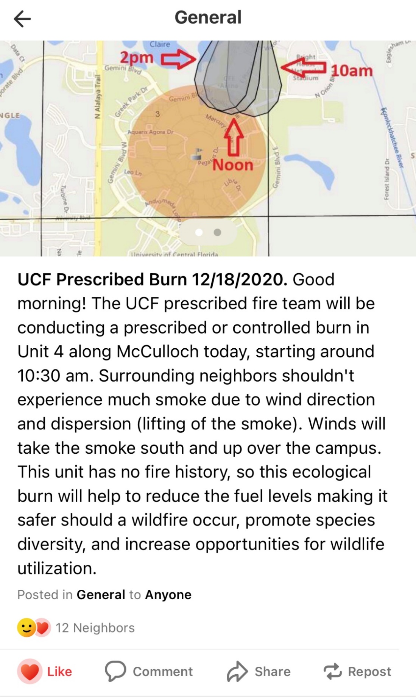
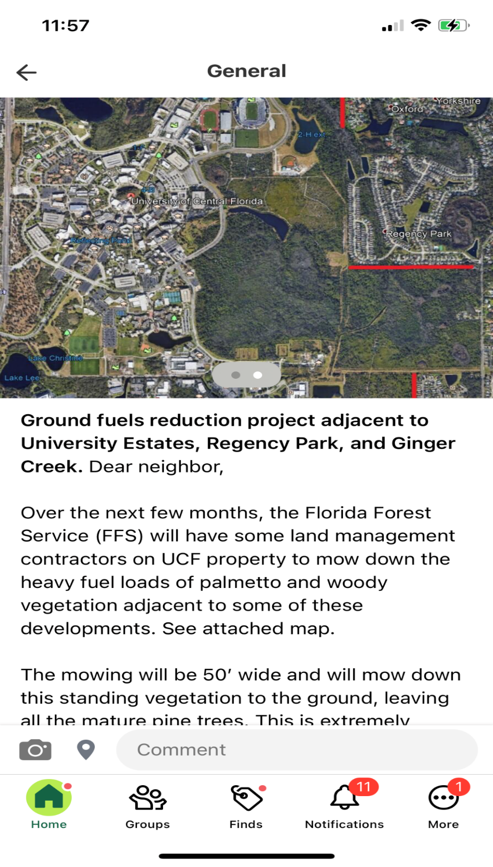





Use of Social Media to Communicate Effectively about the Burn Program
Notes:
Before every burn in the last 3 years, UCF has been using these social media platforms that allow for a quick notification system with all stakeholders, adjacent neighborhoods and student community about the prescribed burn that will be occurring. We use the Veoci app for emergency management operations and treat the prescribed burn like an incident so our Emergency Support Functions staff know about the process. UCF Arboretum uses facebook and Instagram to inform the students and trail users know about the prescribed burn. Next door app focuses on HOAs and neighborhoods that live near the prescribed burn areas. All these tools allow the general public know more about why, when, and where we are conducting the burns, and cuts down on 911 call volume for the process.

Slide 24




Notes:
While we do a good job about interpreting the process and purpose of prescribed burns, the public can sometimes ask questions and spread some media attention that you may or may not want to hear so you have to stay on top of apps like Next Door and Facebook. Here are some interesting posts over the last two years for Next door. We have noticed over the last 3 years, there are more likes and common knowledge about the purpose of controlled burns especially with what is happening out west being shared by neighbors, so that is a positive trend in Central Florida.

Slide 25


Fireline Preparation is a must
Ensures firefighter, campus, and public safety.
Reduces fireline intensity, and decreases likelihood of spot fires
Reduces pine mortality relating to crown scorch
Notes:
All our backlogged units received the same type of prep treatment and that is where we mulch down each side of the road at least 25 feet with a Cat 299D Skid Steer with mulching head. This takes that 6 foot tall palmetto and hardwood midstory down to the ground level and reduces the flame heights (crown scorch) and likelihood for spot fires to occur in adjacent units.

Slide 26



Slide 27




Notes:
While most landowners may don’t have the heavy piece of equipment like a skid steer or roller chopper, I highly recommend either renting or hiring a private contractor to conduct similar fuel treatments to knock back their overgrown fuels. They will see better results post burn. After these treatments are conducted 25-50 feet alongside all firebreaks, this allows you to use something like a john deere tractor with bushhog to maintain your firebreaks to make future burns and maintenance more less expensive and easier to prep.

Slide 28

Choosing ‘Ideal’ Weather and Fuel Conditions
Midflame Wind Speeds: 3-7 mph
Rh threshold values: 40-60%
Daytime Dispersion Index: 40-60
Days before burn greater than 0.5” rainfall: 3-4 days
Days after burn greater than 1” rainfall: 3 days or less
Consecutive nights Rh recovery >95%: 3 or more after burn
*KBDI threshold values: 90-200
Notes:
These are known and common recommendations that we all follow as prescribed burners but this particular data set is for an ideal weather and fuel conditions that pertains to backlogged units in flatwoods aimed at reducing pine mortality.
The take away from this “sweet spot for conditions” lies in 3 important control variables 1. ) Days before the burn with rainfall (3-4 days). This allows enough dampness in organic material to not cause excessive duff rings and extended mopup for safety concerns. Yet allows for some surface fuels and small amounts of duff to be consumed during the day of the burn.
The second weather factor is days following the burn with rain greater than 1” needs to occur 3 days or less post burn. This helps in mopup operations if needed, reduces soil temperatures and help stop addtional fine root damage for pines.
The 3rd most important factor is KBDI. Remember!!! KBDI has been documented as weakly correlated with organic moisture content, but serves as the primary tool for most Rx burners and the Florida Forest Service does a good job at maintaining accurate county averages to use from. Site specific KBDI would be more accurate than the county average. We learned from Morgan Varner when he presented here in 2019 that Dry duff consumption is responsible for overall tree mortality in most cases (Varner et al. 2007).
I have found success at burning between 90-200 KBDI in these fuel types because this still is a small correlation between organic duff moisture and fuel moistures within KDBI. Anything over 250 KDBI is a grey area without other variables helping you.
For even better results, using the Delmhorst BD-2100 Moisture Meter in trees sampled in burn unit captures a true and consistent value for moisture content. Any measure above 80% of duff will not burn. Lower 70% of moisture content for a reading is risky for mortality. Price tag is $400 dollars on amazon.

Slide 29
Special Applications for Success
Sprinkler kits and effective mop up day of burn.
Use of Class A foam during mop up can prevent “duff rings” from forming and can reduce post fire effects relating to tree mortality.
Raking of “duff build-up” for smaller units has been successful but time consuming (Varner et al, 2009)
  Thermal injuries to root and cambium reduced using this method.
  Carbohydrate reserves and fine roots are impacted greatly by smoldering post-fire effects in control groups.

Slide 30


Volunteer Opportunities- Raking back vegetation
Notes:
In unit 4A, we are able to use students needing volunteer hours to rake back historic duff buildup and mechanically treated areas so excessive mulch and duff rings would not be an issue for burn crews during mopup. These areas had only a 5 % mortality level with 50 years without fire next to the Tower Dorms and Arena.

Slide 31


Special Applications- Foam and Sprinklers
Notes:
We had some success with using Class A foam batched mixed in tanks during mop up for first and second operational days to stop duff rings from forming. Class A foam has become more environmentally friendly since the 90s, and works by cooling both the fire and roots with use of water, and smothering the fire with the foam blanket above fuels.
And also found success in having a sprinker kit handy to set up in a hoselay from a portable pump that ran for 3 hours on a tank full of gas. Just remember that for smoldering fire effects can take place hours after ignition, so kits are not always practical and take time to set up.

Slide 32
Conclusions…
The UCF’s model offers guidance for an ‘ideal threshold’ for weather, fuels, and fireline preparation to ensure your 1st Rx application can be successful.
2. By burning smaller acreages in these backlogged fuel types (~10-30 acres) during various times of year (primarily dormant season) and locations can help overcome the challenges of reintroduction of fire.
Notes:
1 Remember Days before Rain greater than 0.5” needs to occur between day 3-4, Days after Rain needs to be greater than 1” at least by Day 3 or less, and KBDI needs to be between 90-200. Fuels are complex and having multiple weather factors increases your odds for survival.
2. We found that we had better control of the objectives and smoke management for urban areas by burning small blocks and various times of year. Burning in the dormant season offers better predictability of rain forecast behind cold fronts. After speaking with Jeffrey Eickwort, bark beetle insects can be less active as compared to growing season. In some units, we have been able to get at least two dormant season burns completed, and now we are able to burn in the growing season to see full biodiversity effects of understory grasses and flowering plants taking place. You have deal with the fuel loading and public safety issue first!

Slide 33
Conclusions continued..
3. There may be additional stressors for pine survival as a result of bark beetle populations (~indirect fire effects) or a resiliency measurement that need further investigation (Slack et al. 2016, Shearman et al. 2019, Varner et al. 2007).
How can land managers create stands of more resilient pines in future?
“
“A smooth sea never made a skillful sailor”– African Proverb
Notes:
3. The results of 75 years of fire exclusion policies and growing urban communities are making prescribed burning even more challenging that ever before. Fire exclusion policies have create the situation where pines are less resilient even under normal fireline intensities experienced during a prescribed burn (Slack et al. 2016, Shearman et al. 2019, Varner et al. 2007).
How can we measure a pine’s resilency factor by judging the tree in the field by its appearance and its internal ability? That needs to be investigated. Is pine resiliency a measure of carbohydrate reserves, ability to pitch out, thickness of bark, etc.
What if by have more urban developments with diminishing natural lands, we are increasing the populations of bark beetles and other insect pests that only feed on yellow pine species. These two topics will require more investigation by researchers.
Lastly, pine mortality is not always a bad thing for some agencies when looking at historical stand acreages for mesic and wet flatwoods and comparing them to what they look like today. This may serve as a reset button back to these levels and tackle a growing fuel problem to make future burns even more successful. For any landowner that is worried about loosing trees during a prescribed burn or wildfire, one suggest can be to conduct single tree harvest that is not going to cause excessive soil compaction and disturbance to remaining trees or conduct a salvage logging operation on impacted trees.
I hope our presentation offers some guidance for a model for reintroduction of fire in these long, backlogged units and can make your burn more successful. Every burn counts in Florida regardless of the acreage. These high wildland urban interface burns are especially important for public relations because they set the precedent that good fires prevent bad ones, and are essential to maintain our remaining natural lands. Thank for listening.

Slide 34


Questions and Comments
Dr. Patrick Bohlen, Director of Landscape and Natural Resources
Patrick.Bohlen@ucf.edu
Brent Saulsbury, Biologist and Burn Manager
Brent.Saulsbury@ucf.edu, 209-628-2133
Go Knights, charge on!

