Slide 1
Landowner Cost Share Programs
Will Liner – December 16, 2022

Slide 2
What We’re Going to Cover
The Florida Forest Service Cooperative Forestry Assistance Section
Sequestering Carbon and Protecting Florida Land Program (Carbon Program)
Southern Pine Beetle Assistance and Prevention Program (SPB Program)

Slide 3
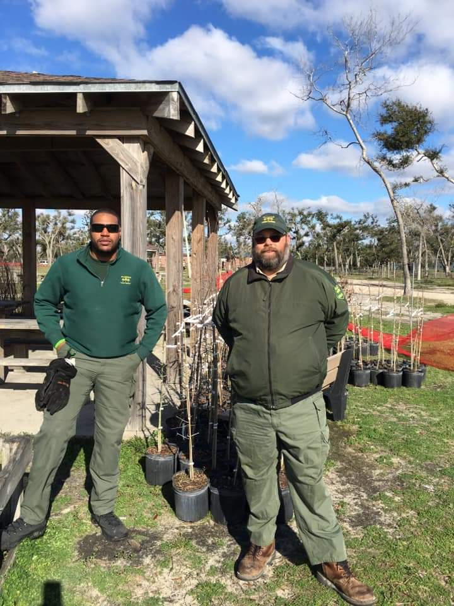
FFS Cooperative Forestry Assistance Section
3 Regional Coordinators
38 County Foresters
Urban and Community Forestry Program Manager
Conservation Programs Manager
CFA Supervisor

Slide 4
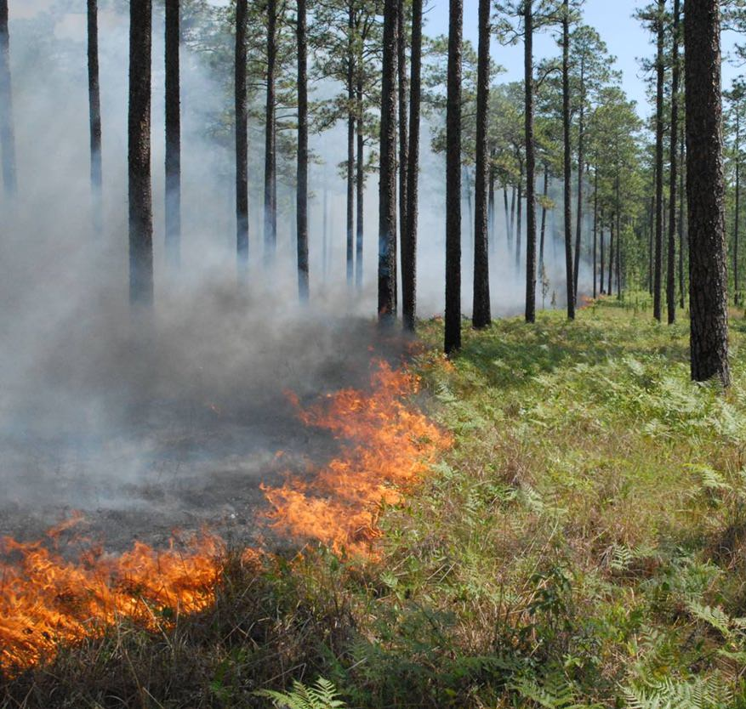
Carbon Program Overview
State Funded
Started in 2021
NIPL, County / Local Gov, non-profit
20 – 250 practice acres
Max payment: $118,387.50

Slide 5
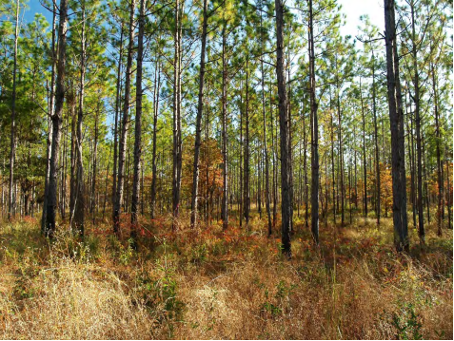
Carbon Program – Practices
Payments for:
  Seedlings
  Planting
  Site Preparation
    Burning
    Mechanical
    Chemical

Slide 6
Carbon Program – Selection Criteria
First score based on Planting Density (TPA)
  751 – 807 (10)
  701 – 750 (8)
  651 – 700 (6)
  605 – 650 (4)
Second score based on Practices to be Funded
  Seedlings and Planting (10)
  Seedlings, Planting, Site Prep (4)
  Site Prep only (2)
NEW THIS YEAR

Slide 7
Carbon Program – Practice Rates
Prescribed Burning Site Prep - $30/acre
Mechanical Site Prep - $150/acre
Chemical Site Prep - $112.50/acre
Planting - $60/acre
Containerized Pine Seedlings - $150/1000
Bareroot Seedlings - $60/1000
Can stack these together

Slide 8
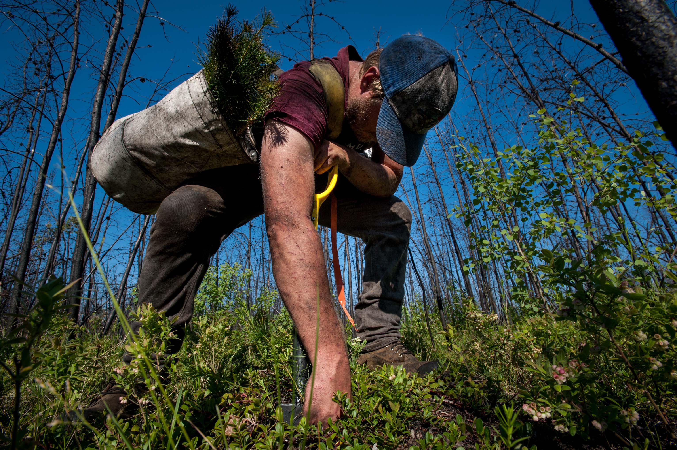
Carbon Program 2021 Outcome
169 Applications
  Requesting over $4 million
95 selected for funding
  $2 million
6,876.14 acres for planting

Slide 9
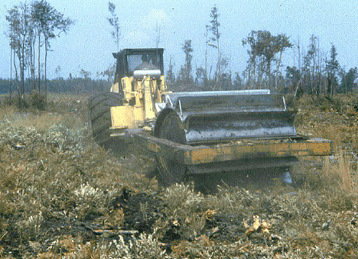
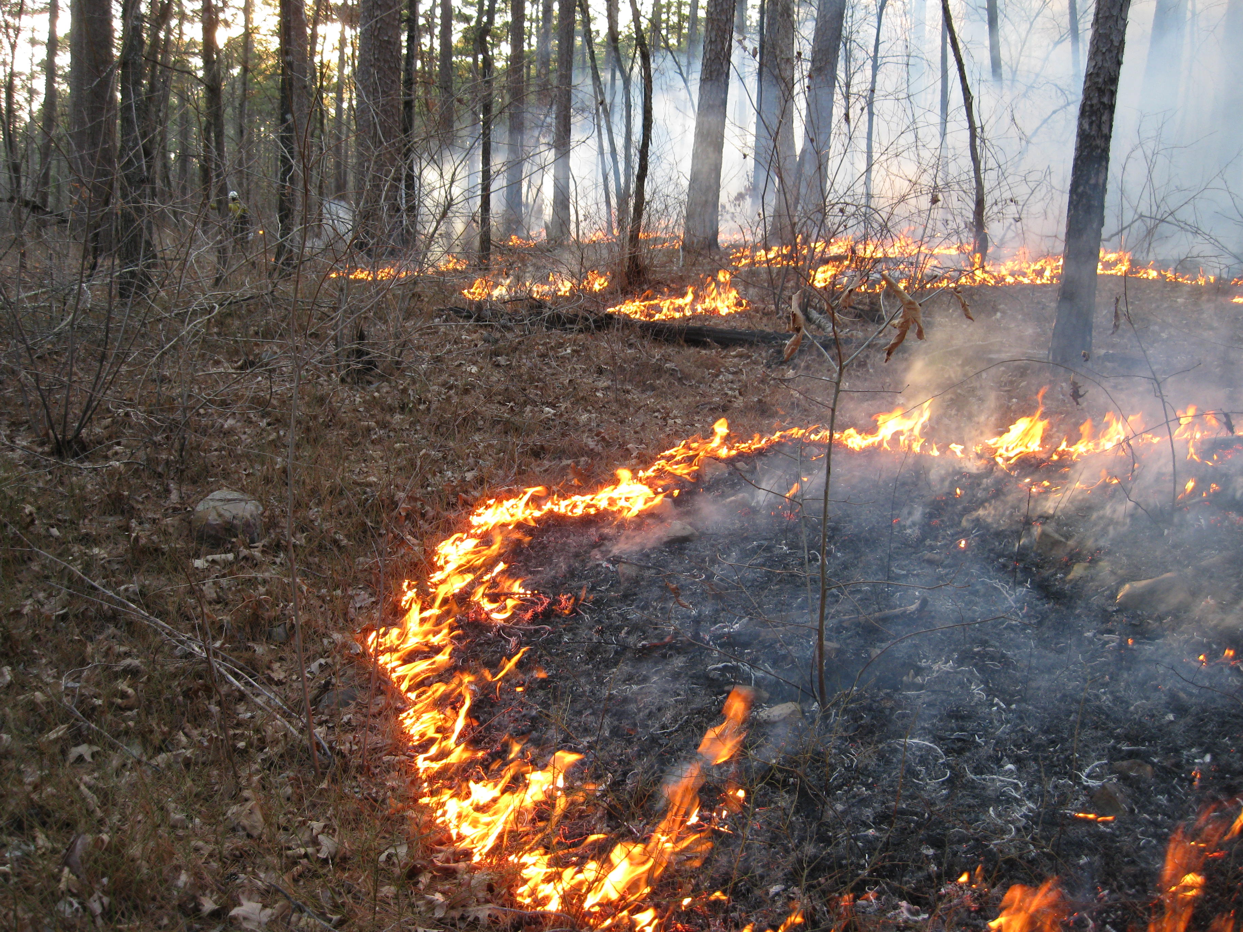
Carbon Program 2022 Outcome
254 Applicants
  Requesting $5.9 million
238 selected for funding
  Approximately $5 million

Slide 10

Carbon Program into the Future
Depends on next year’s budget from Legislature
Potentially about $3 million for 2023
Short-term contracts
Seedling supply

Slide 11

SPB Program Overview
Federally Funded
Started in 2003
Private Landowners
  Minimum of 10 acres
  $10,000 maximum payment
Only for northern 44 counties

Slide 12
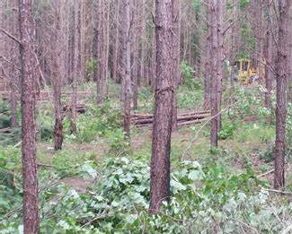
SPB – Practices
First Pulpwood thinning
  Minimum of 5 acres
Seedling Establishment
Prescribed Burning
Mechanical Underbrush Treatment

Slide 13
SPB – Selection Criteria
First score based on practice type:
  Thinning
    Loblolly of Shortleaf – 30 points
    Other pine species – 15 points
  Seedling Establishment – 20 points
  Prescribed Burning – 20 points
  Mechanical Underbrush – 15 points

Slide 14
SPB – Selection Criteria Cont’d
Second score based on previous funding:
  Not signed up during previous 2 years – 20 points
  Not signed up during previous year – 10 points
  Signed up previous year– 0 points
Third score based on management plan:
  Current Tree Farm or Forest Stewardship plan – 15 points
  Consultant prepared plan – 10 points
  No plan – 0 points

Slide 15
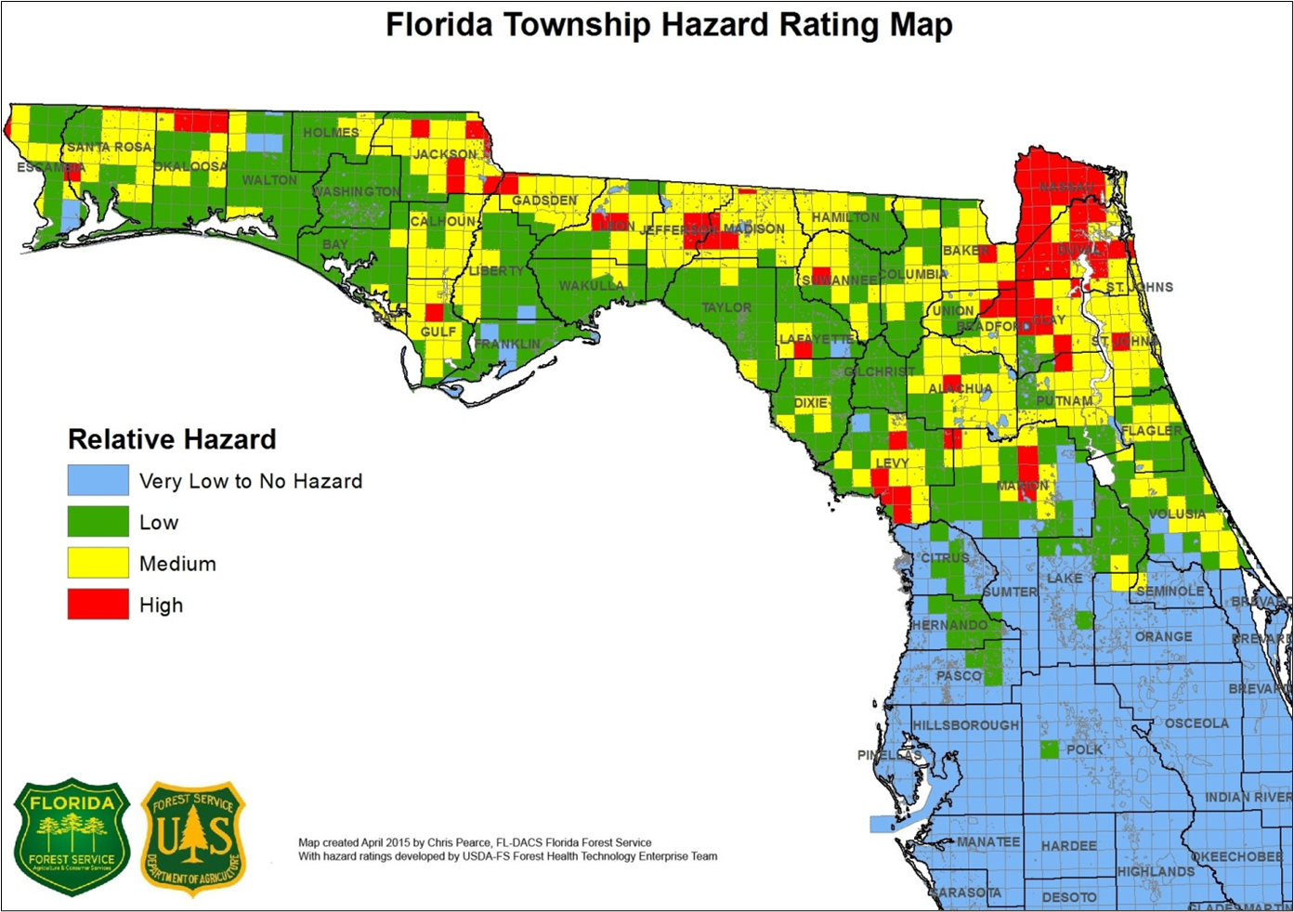
SPB Selection Criteria Cont’d
Fourth Score based on SPB Hazard Score
  High – 15 points
  Medium – 10 points
  Low – 5 points
  Very Low – 0 points

Slide 16
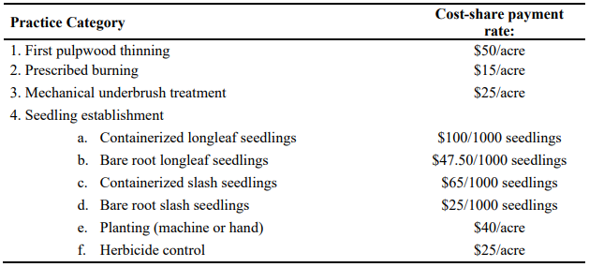
SPB – Practice Rates

Slide 17
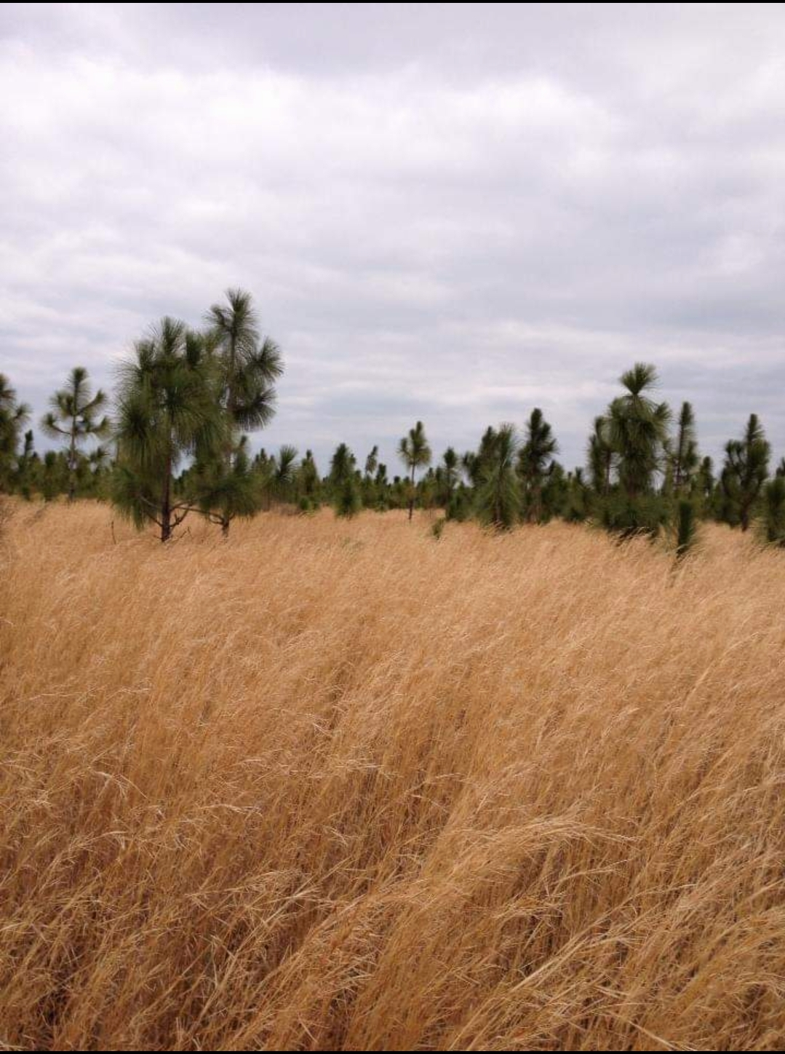
Questions?
Will Liner
Cooperative Forestry Assistance Supervisor
William.Liner@FDACS.gov
850-681-5881

