Slide 1
Engaging the Public in Prescribed Fire
Ludie Bond
Wildfire Mitigation Specialist/
Public Information Officer

Slide 2
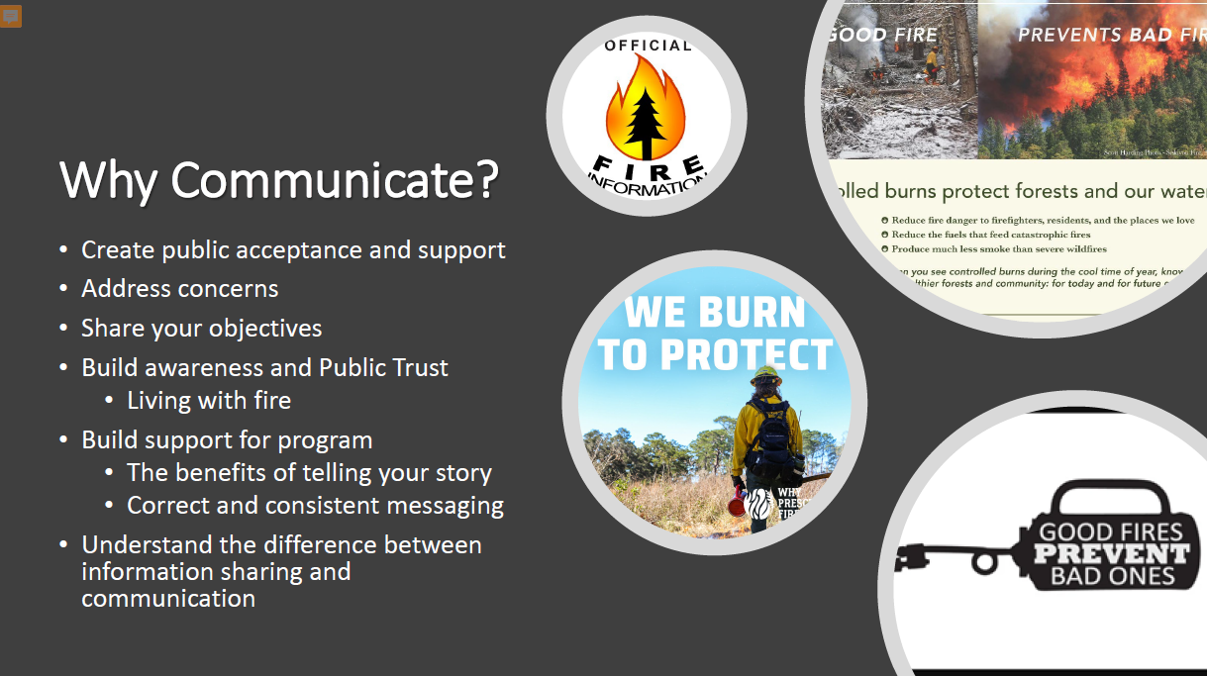

Slide 3
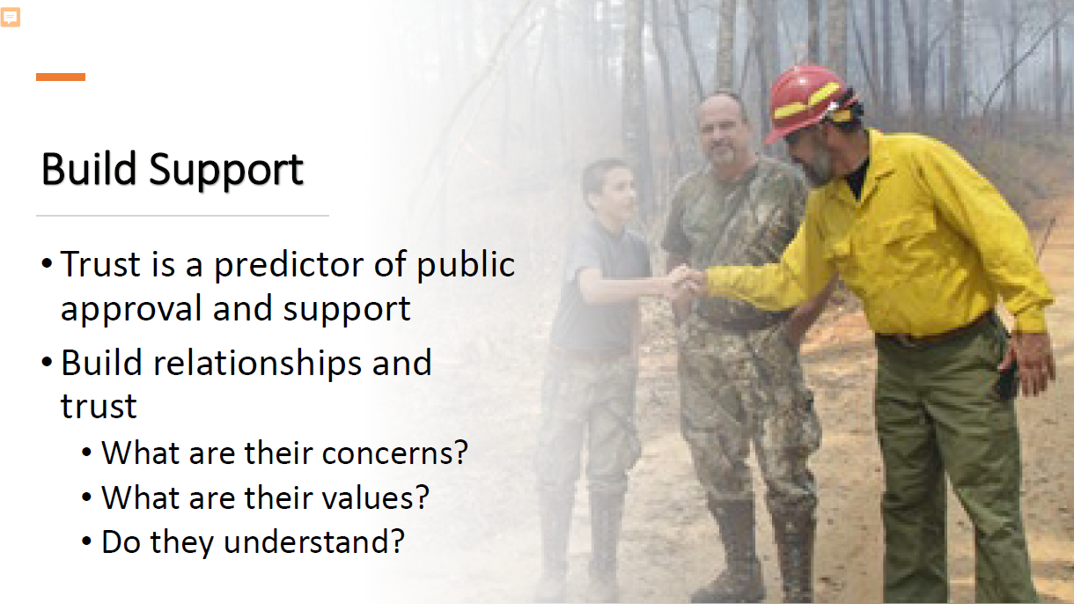

Slide 4
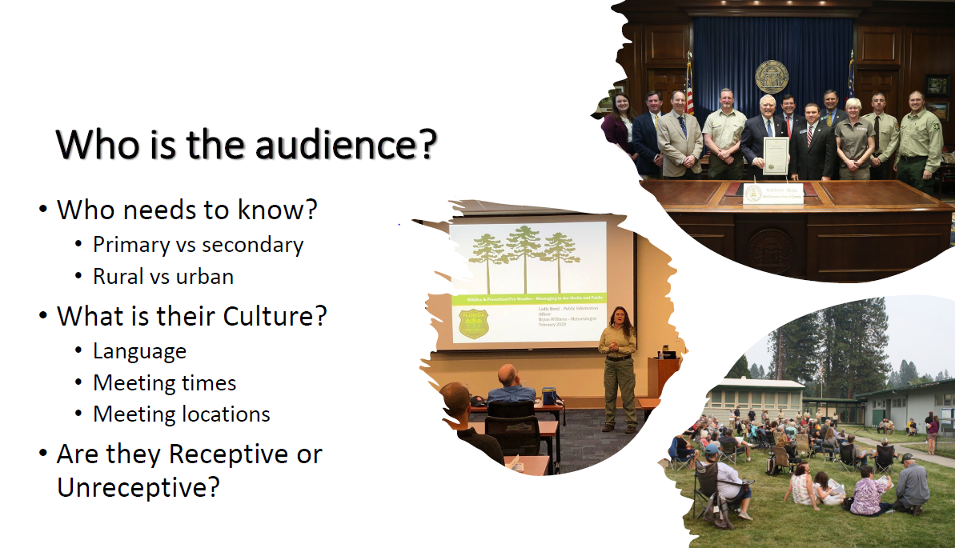

Slide 5
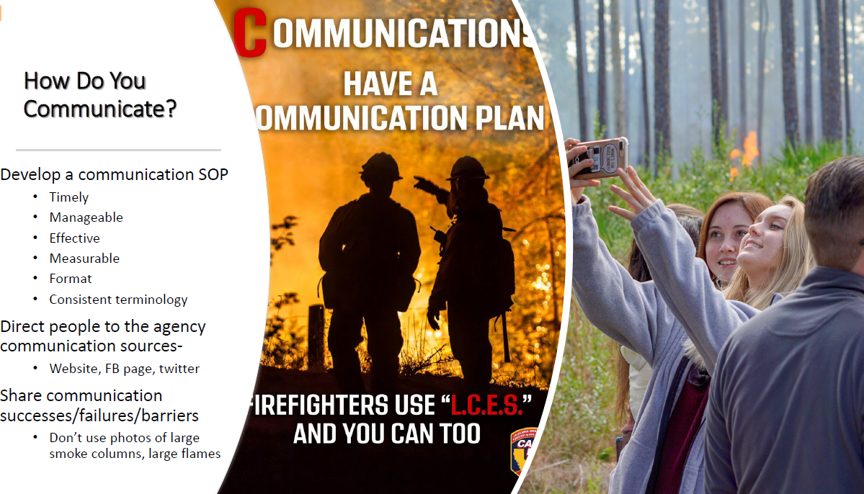

Slide 6
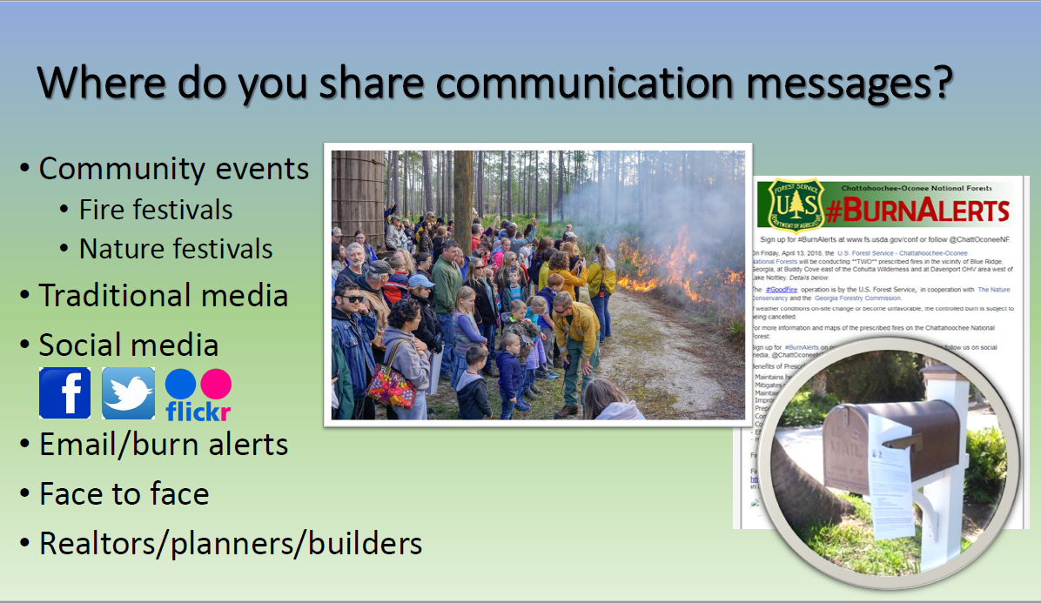

Slide 7
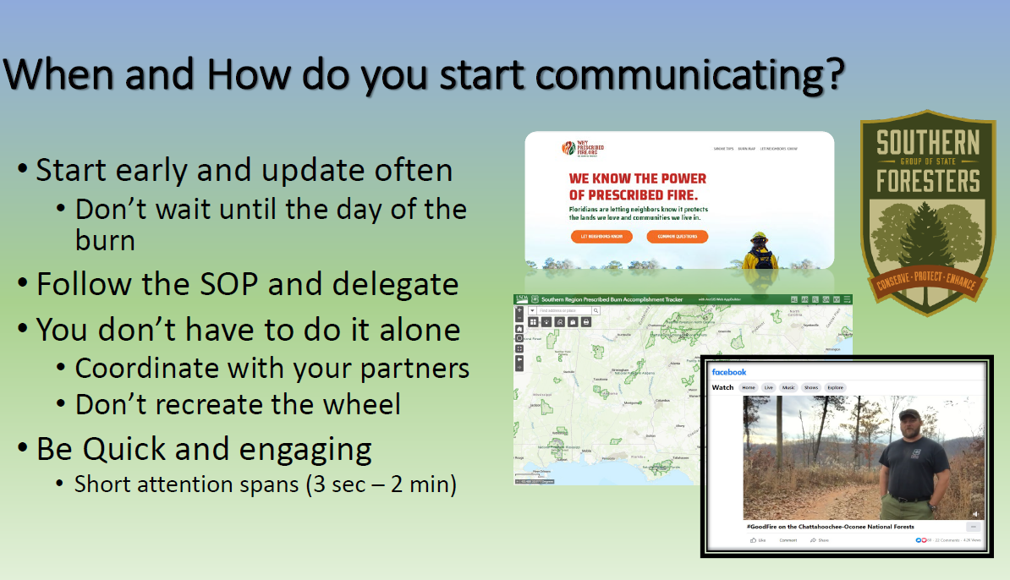

Slide 8
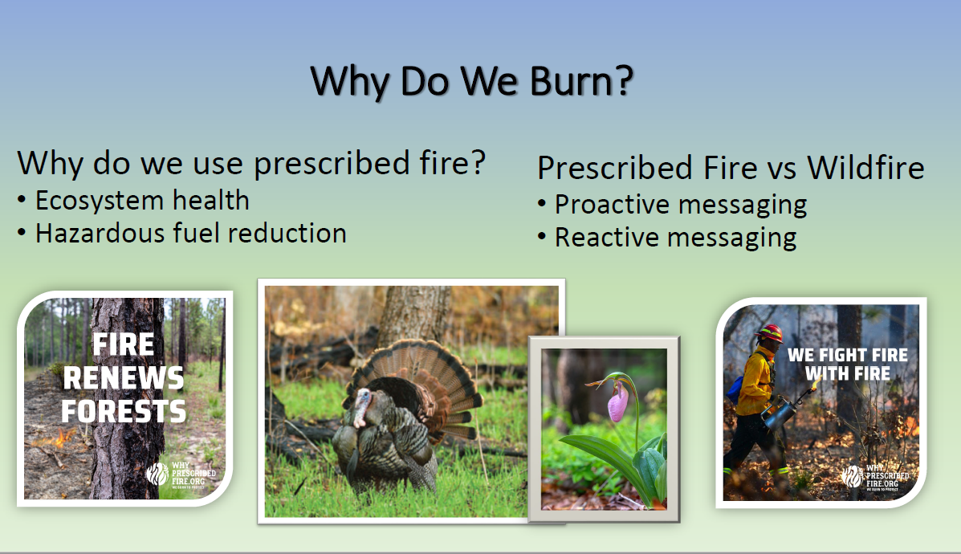

Slide 9
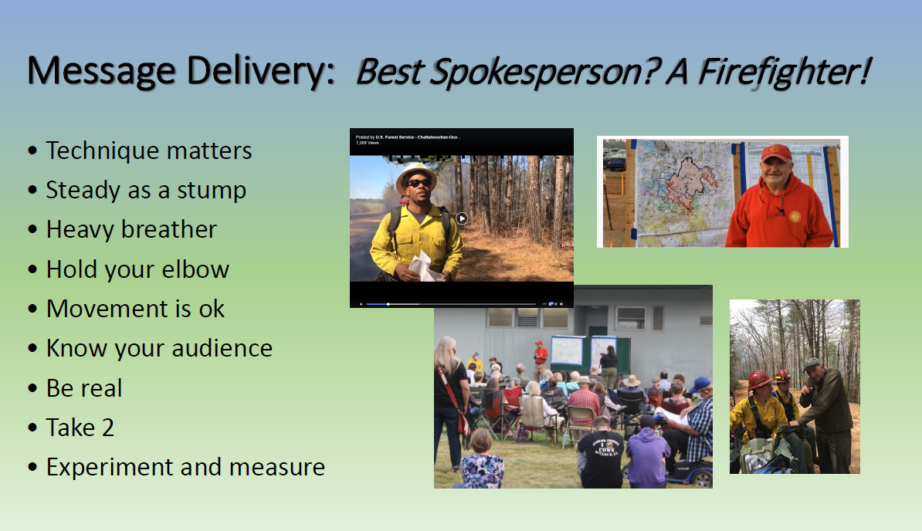

Slide 10
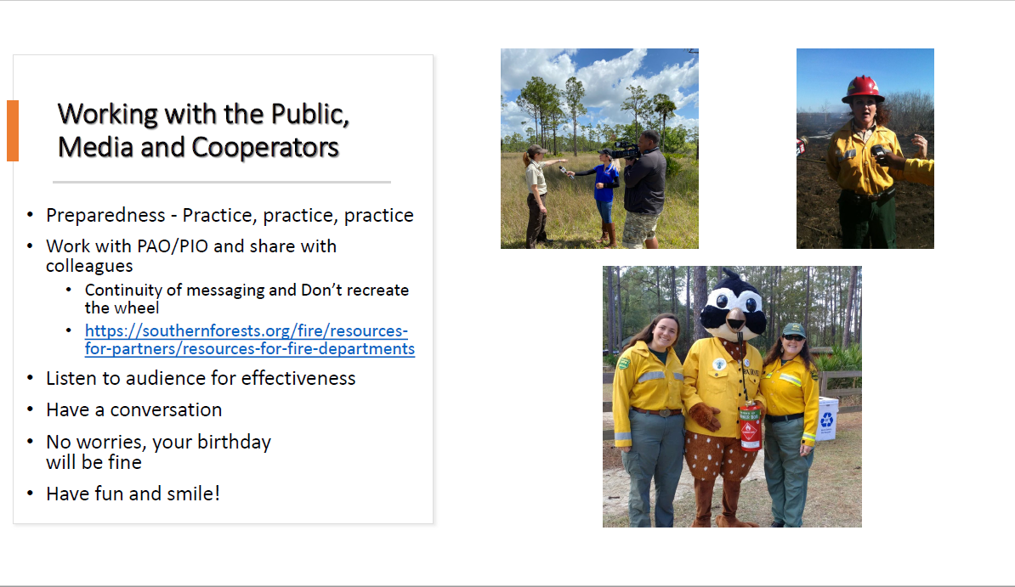

Slide 11
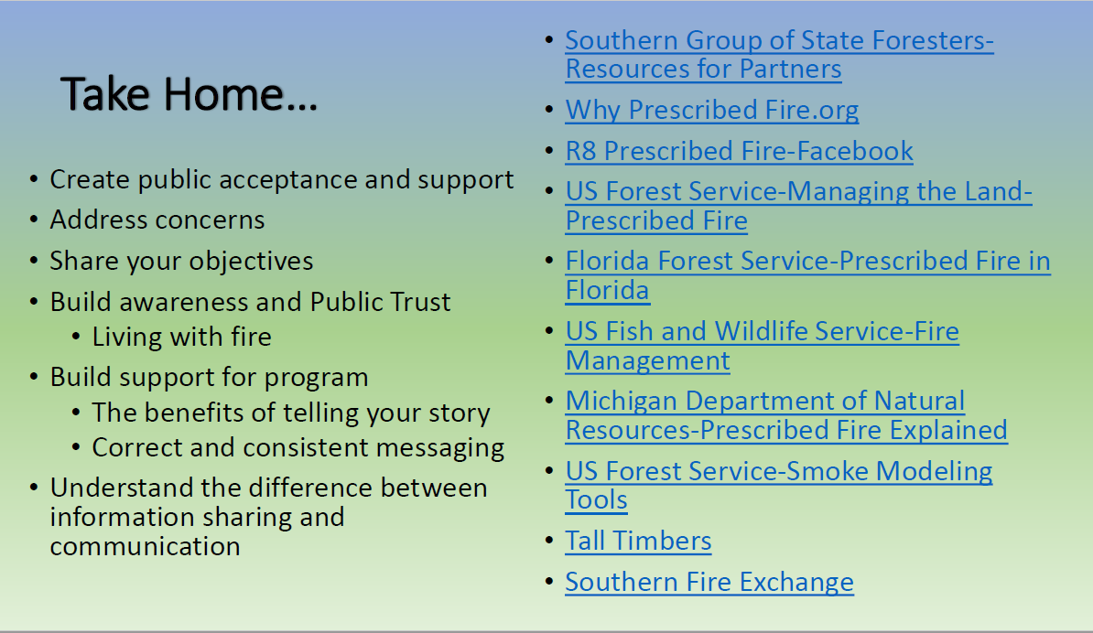

Slide 12
Ludie Bond
Florida Forest Service
352-258-6084
Ludie.Bond@FDACS.gov

