Slide 1

FFS Update – Fall 2022
Central Florida Prescribed Fire Council Meeting 12/16/2022
John Saddler
Prescribed Fire Manager

Slide 2
FFS Update
Good Year for Burning
Upcoming Training
Prescribed Fire Enhancement Program
Why Prescribed Fire?
Prescribed Burn Planner
Burner Review

Slide 3
Authorized Prescribed Burn Acres By F/Y
(Million Acres)
Notes:
2020/2021 was a little higher than last year.
Considering the wet winter and COVID-19 I think we did pretty good.

Slide 4
2022-23 CPBMT Course Schedule
Jacksonville: December 5-9, 2022
Bradenton: December 12-16, 2022
Welaka: December 12-16, 2022
West Palm Beach: January 9-13, 2023
Tallahassee: January 23-27, 2023
Brooksville: February 6-10, 2023
Apopka: February 20-24, 2023

Slide 5
Prescribed Fire Enhancement Program
Funding to Enhance Rx Burning
  Extra funds this year
  Most projects will be funded
Notes:
Seventh year for the program.
Over the years this has been a very successful program that has helped get more quality prescribed fire acres across the state.
Increased funding this year with a late start
2.6 million in proposals
-Mostly mechanical fuel reduction and fireline installation.

Slide 6

Why Prescribed Fire?
Prescribed Fire Messaging Campaign
  Statewide Campaign – 3 years
  Working With Tall Timbers
  Year 4?
Notes:
New Messaging Campaign to promote the use of prescribed fire.

Slide 7





Prescribed Burn Planner
RxBurnPlanner.com
Notes:
The Southern Group of State Foresters, in coordination with Florida Forest Service, Florida Park Service, Texas A&M Forest Service and Tall Timbers. Developed the Prescribed Burn Planner to help burners track burn units and monitor weather conditions.

Slide 8
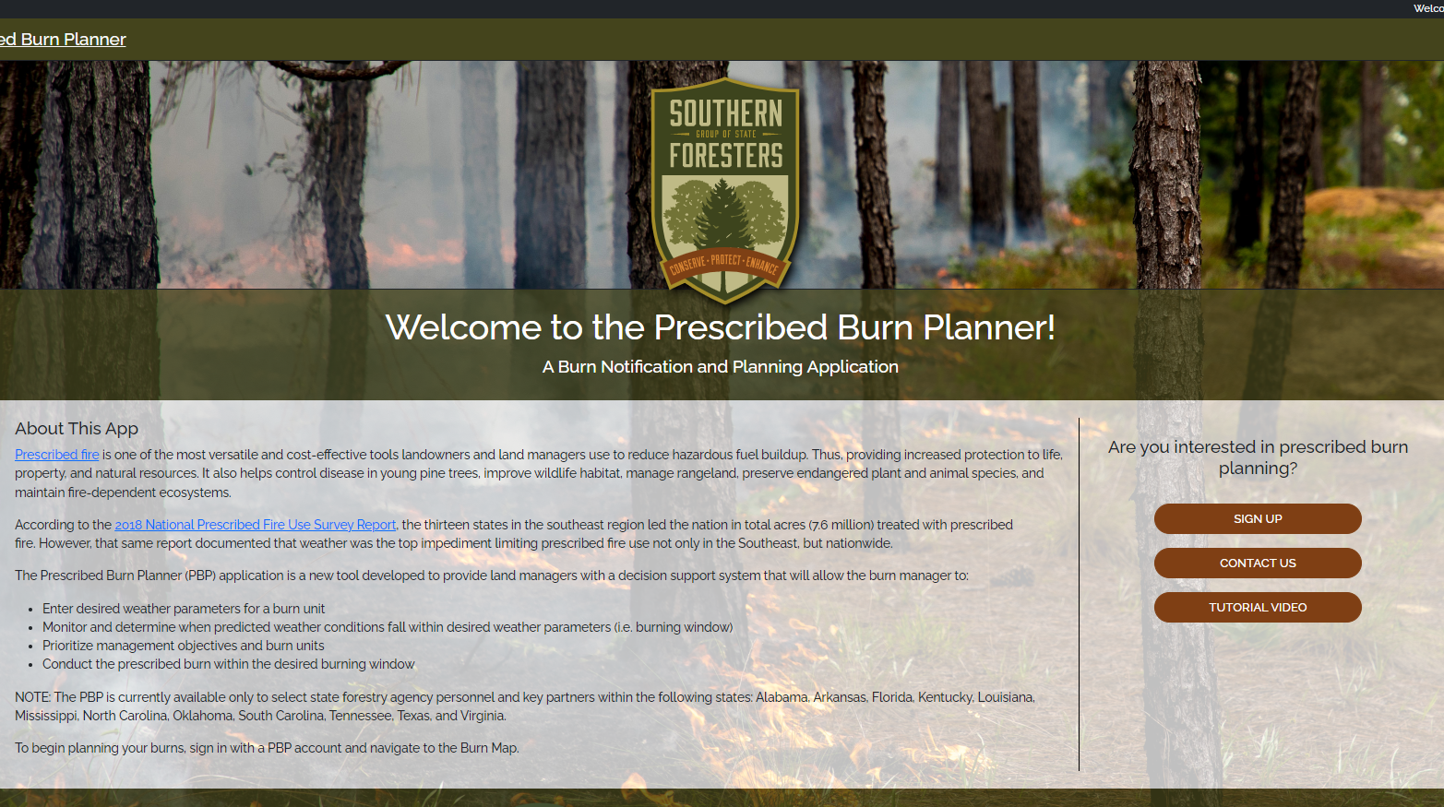
Prescribed Burn Planner

Slide 9
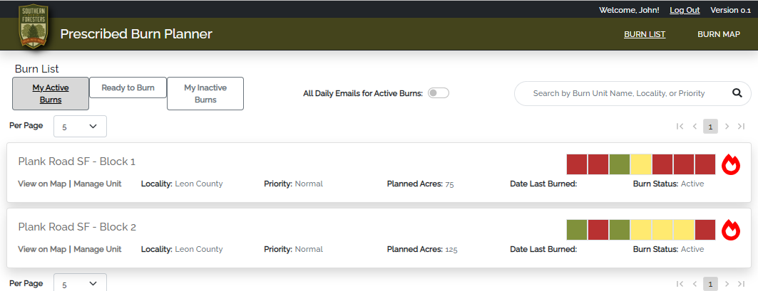
Prescribed Burn Planner

Slide 10
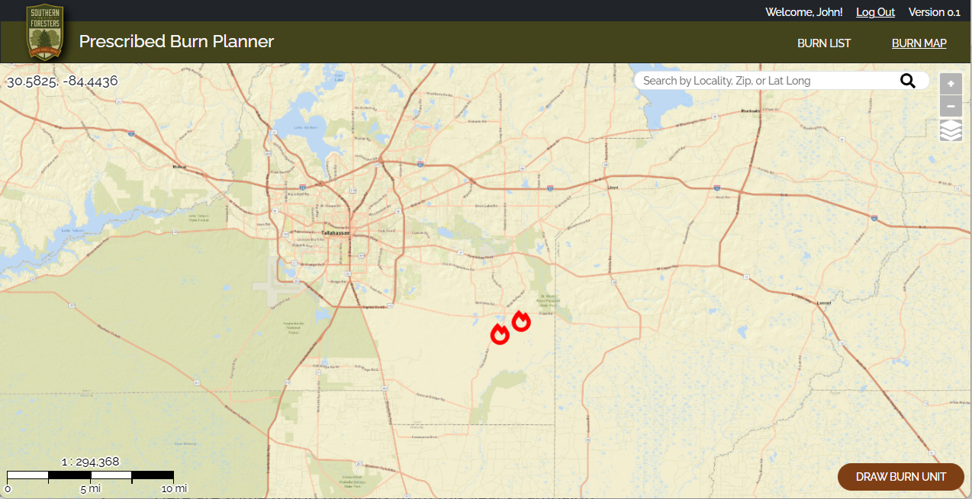
Prescribed Burn Planner

Slide 11
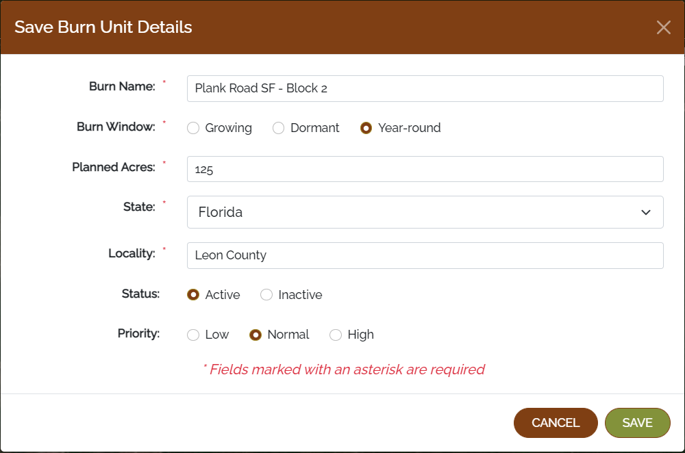
Prescribed Burn Planner

Slide 12
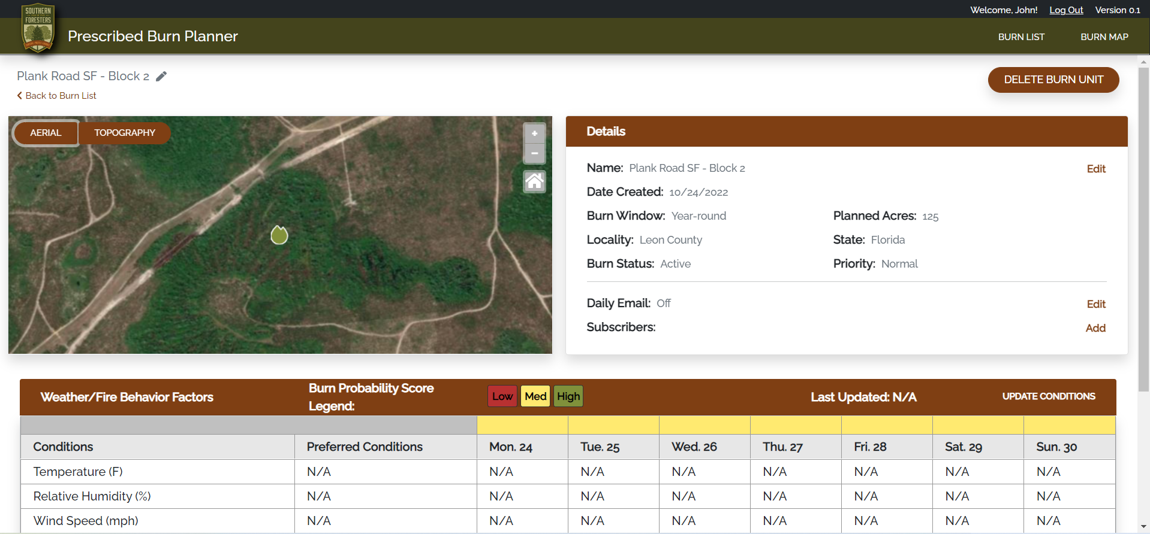
Prescribed Burn Planner

Slide 13
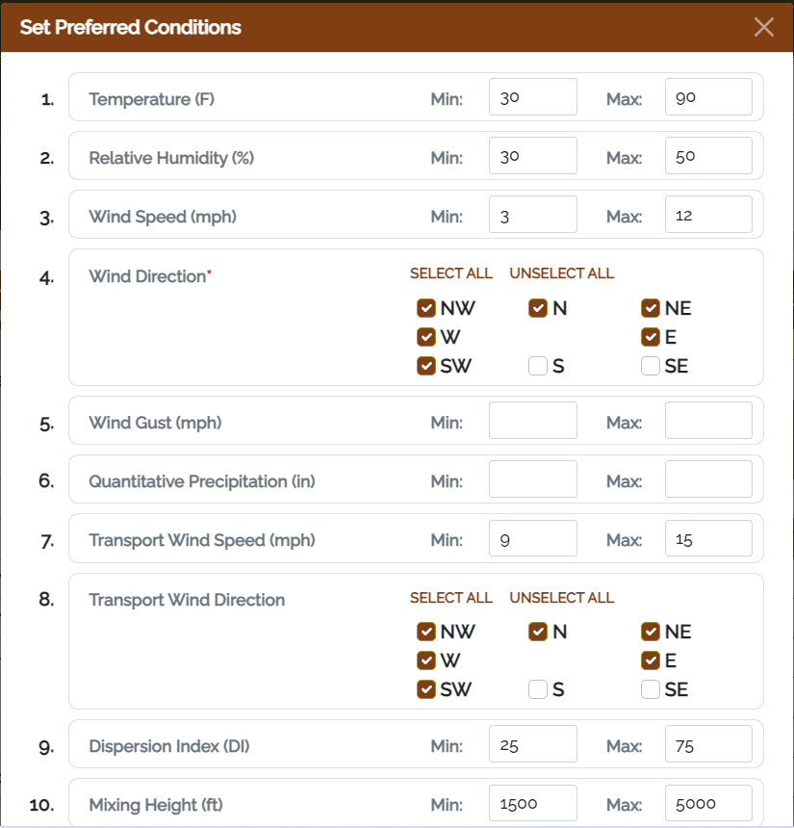
Prescribed Burn Planner

Slide 14
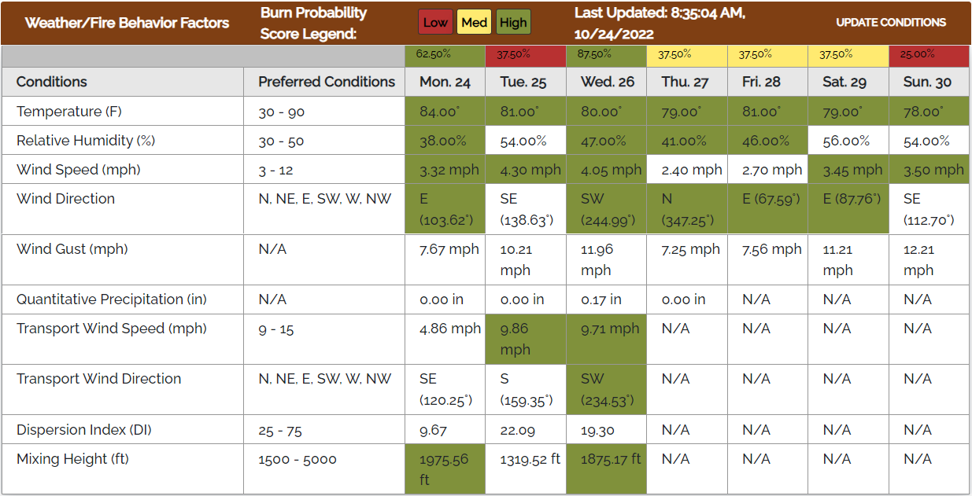
Prescribed Burn Planner

Slide 15
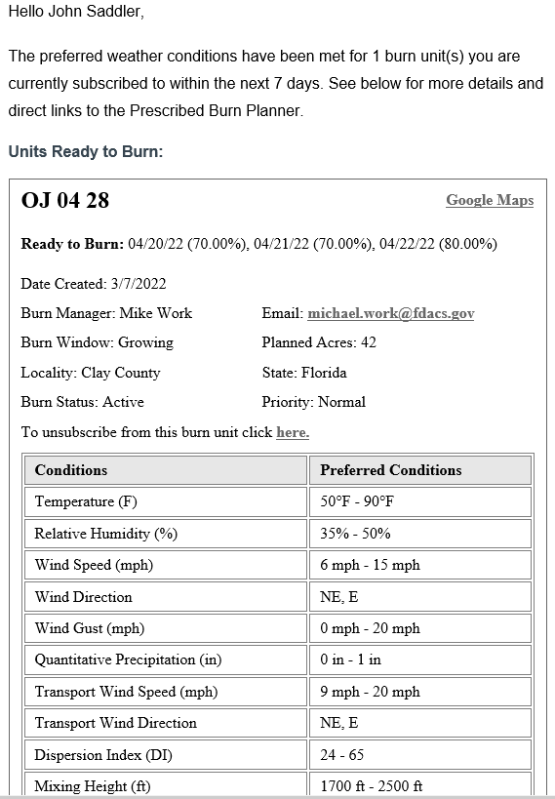
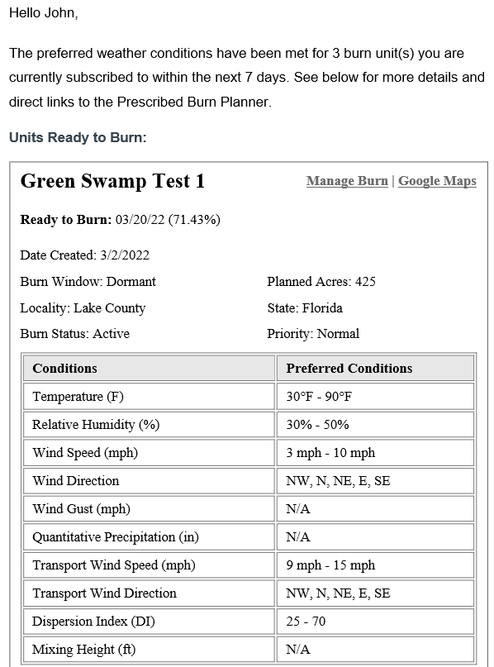

Slide 16
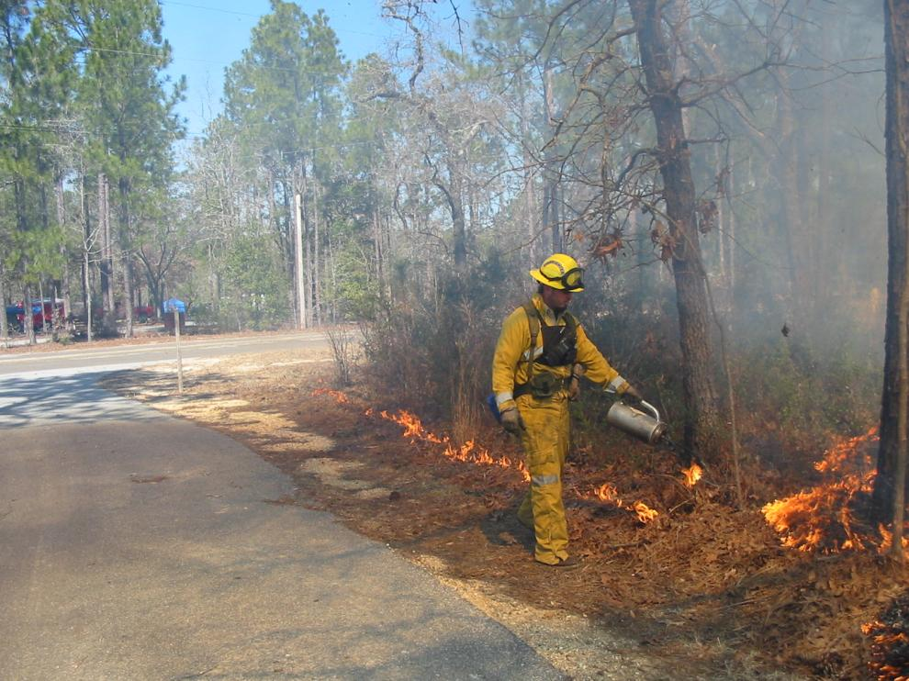
Burner Review

Slide 17
Burner Status Letters
Mailed or E-Mailed at the end of January
  Green = Status good beyond end of year
  Yellow = Status will expire at end of year
Keep your contact information current
  Used to send letters
  Add Email to your account
Let the Duty Officer know that you are doing a certified burn
  WebOBA system requires this
Notes:
We will be emailing status updates to those that have an email associated with their account. If you want to get email status update, log into WebOBA and add your email address.

Slide 18
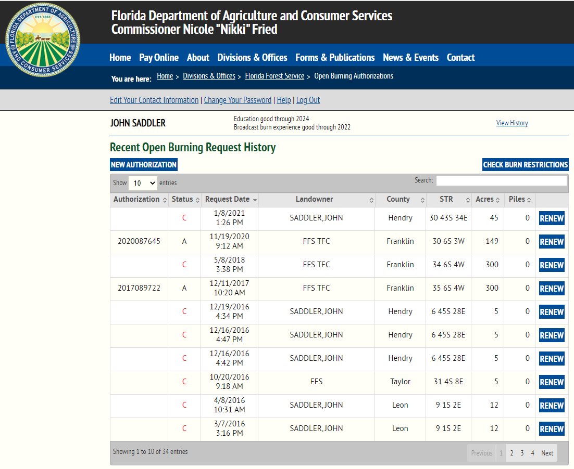
Web-OBA
Notes:
We encourage the use of WebOBA.
If you use WebOBA make sure to have an email address in your contact information. When your request is processed you should get an email with either your authorization number or notification (and reason) for a denied request.

Slide 19
Check Your Status

Slide 20
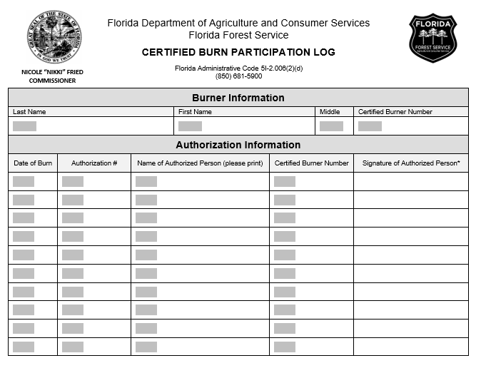
Burn Participation Log
Notes:
If you mainly participate in burns, you can use the attached form to submit your burn activity. Please be sure to fill in all the fields when submitting your information.

Slide 21
Things to Remember
Your prescription is a legal document
  Make sure information is complete
  Make sure information is correct
  Signature with date
  Add authorization number
  Take it to the burn
  Keep it in your files for future use
  Tell us you are doing a certified burn

Slide 22



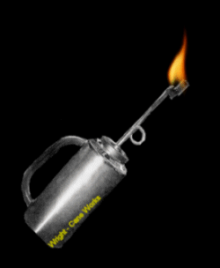
Questions?
Contact
John Saddler
850-681-5928
John.Saddler@FDACS.gov

