Slide 1

CFPFC Meeting
December 16, 2022
John Pendergrast
National Weather Service - Melbourne, FL

Slide 2
Discussion on selected topics:
Smoke and AQ
Current Conditions
Outlook for upcoming Dry season
Q&A…

Slide 3
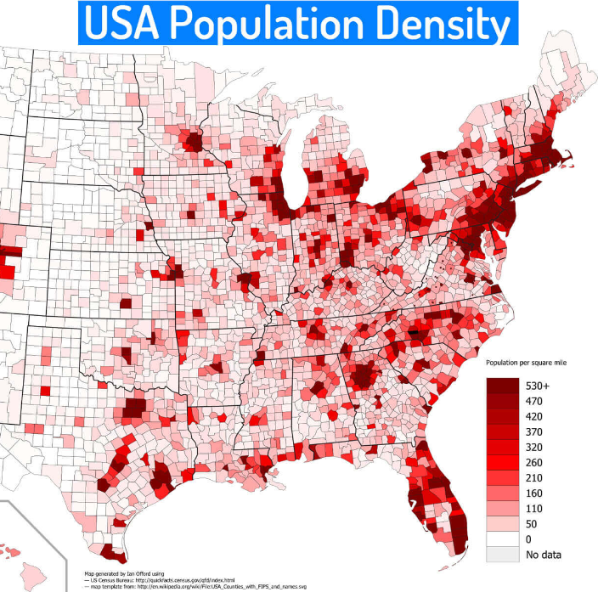
California (Pop: 39,613,493)
Texas (Pop: 29,730,311)
Florida (Pop: 21,944,577)
New York (Pop: 19,299,981)
World Population Review 2022

Slide 4
Where does Florida Rank ???

Slide 5
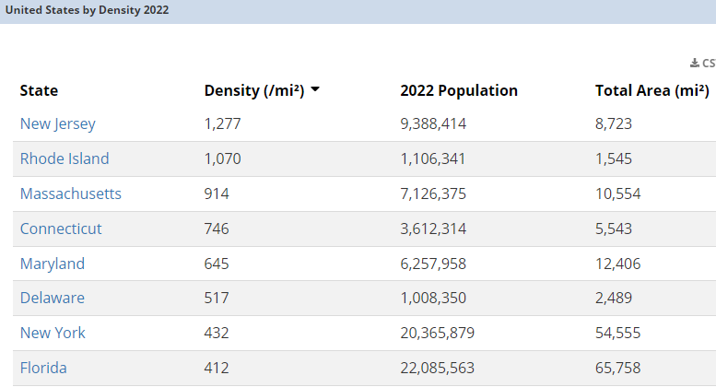
World Population Review 2022
Notes:
Florida first state outside of the Northeast corridor… How many of these states above Fl have strong prescribed burning programs?

Slide 6
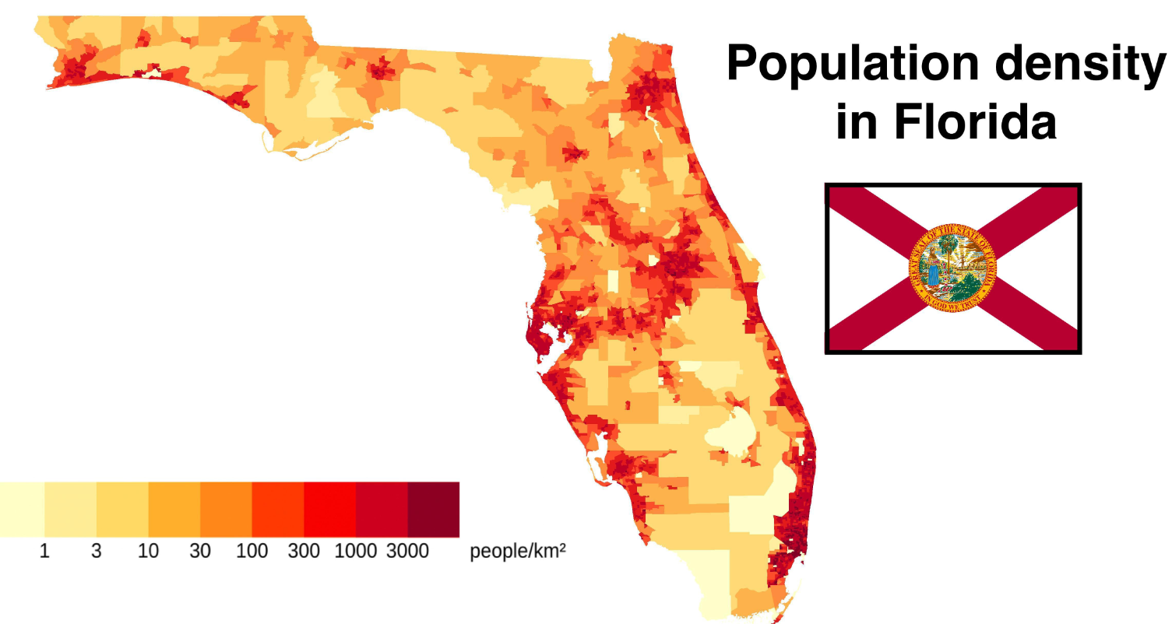

Slide 7
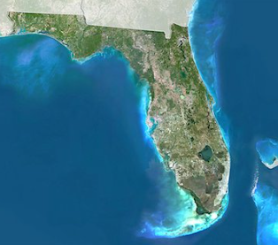
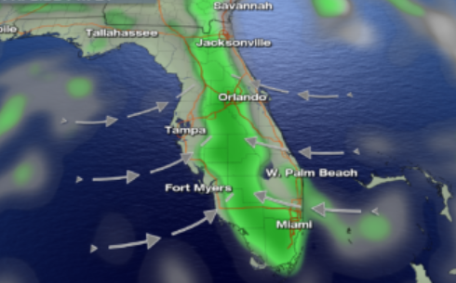
Notes:
Because we are a peninsula surrounded by water dispersion tends to be good most days. Due to seabreezes.

Slide 8
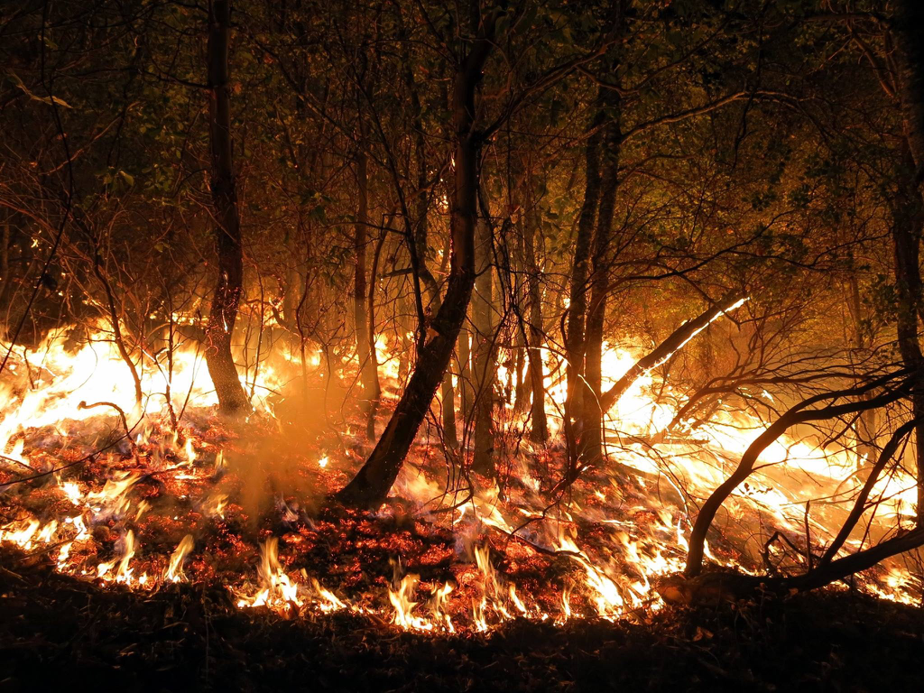
In Regards to Smoke…
NO_{x}
CO
2
VOCs
Particulate Matter
CO
PAH
Notes:
Fire personnel and ecologists consider three things when trying to predict fire behavior on the landscape – topography (fire likes to go uphill), fuel (how much stuff is available to burn), and weather (will it be hot , dry and windy?)
So due to fire exclusion and climate change – we may be more likely to see extreme fire behavior and activity on the landscape. Which means more wildfire smoke in our environment – As a wildfire burns, different compounds are released in the smoke, such as carbon monoxide, carbon dioxide, hydrocarbons, particulate matter (PM), benzene, acrolein, and aldehydes.
In addition to workers suppressing a wildland fire – firefighters and response personnel. There is growing concern for outdoor workers and their exposures. Past research has shown that smoke effects are not only localized to communities near large fires but can extend long distances and affect larger urban areas. Outdoor workers that may be at risk for exposure to smoke include: agricultural workers, landscapers, utility workers, construction workers, park personnel.

Slide 9
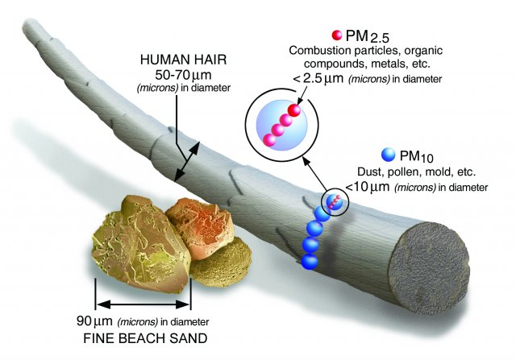

Slide 10
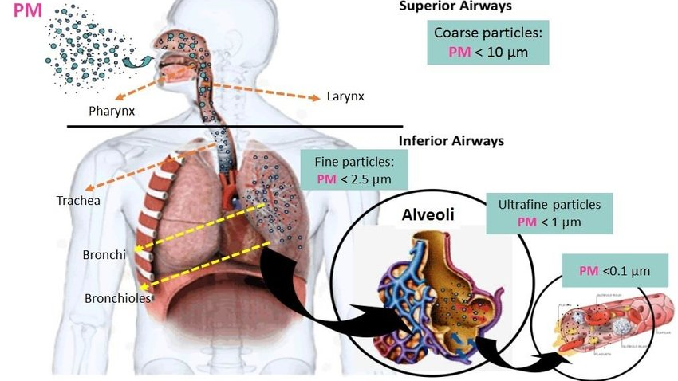

Slide 11
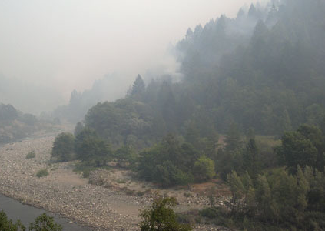
Sensitive Populations
People with Chronic Diseases
  Asthma and other lung diseases
  Cardiovascular disease
Lifestages and populations
  Children
  Older adults
  Pregnancy
People with Higher Exposures
  Outdoor workers
Notes:
There are people who may be more sensitive to the short and long term effects of smoke.
People with chronic diseases, including those with asthma and other lung disease, those with cardiovascular disease - exposure to smoke may trigger severe reactions
Folks who are young, old and pregnant may be more susceptible to exposure to smoke.
Children are still developing their lungs, they are often more active - which means they breath in more air. And because they have a lower bodyweight - they have a higher dose of smoke.
Older adults are more likely to have pre-existing health conditions, and may have weakened defensive mechanisms for their bodies to handle exposure to smoke.
Pregnant women tend to have increased breathing rate - which may lead to a higher dose of smoke. Depending on the development of their baby, the baby may be sensitive to exposure. There is some evidence of exposure to smoke and lower birth weight and pre-term birth.
Additionally people who work outdoors may be susceptible to higher exposures and may perform work that causes increased breathing at times.

Slide 12
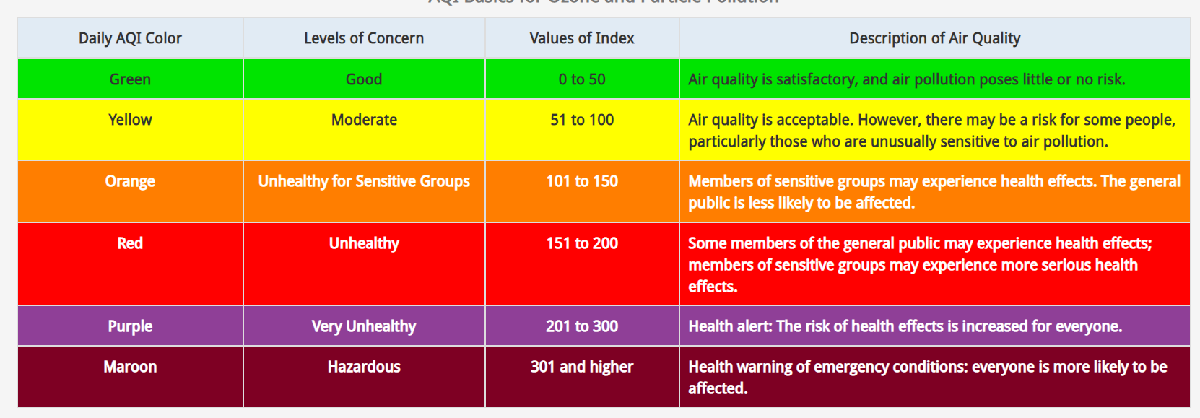
EPA AQI
Notes:
The Air Quality Index is a guide for reporting daily air quality. It uses colors and numbers to show how clean or polluted the air is. EPA uses the Air Quality Index to report particulate matter pollution. EPA has established national standards to protect people’s health from exposure to PM.

Slide 13
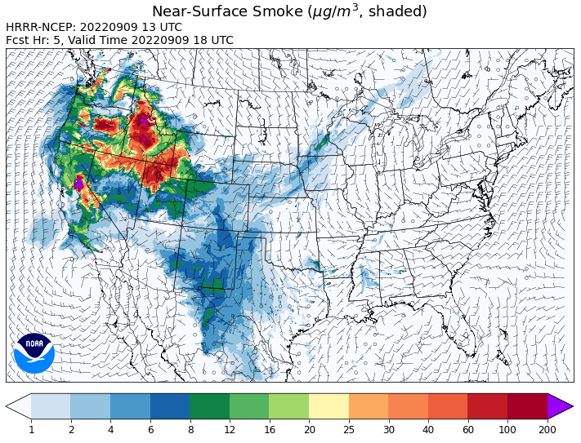
Deceiving!

Slide 14
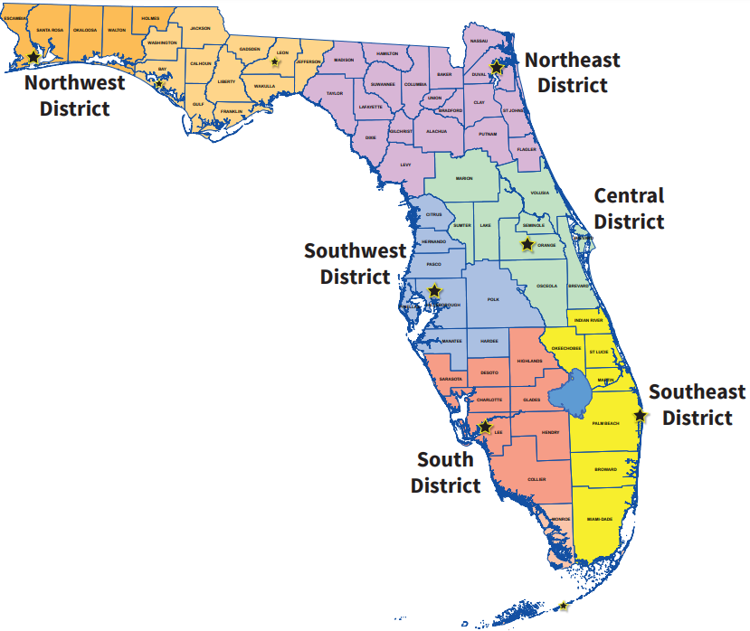
Florida DEP
District Offices

Slide 15
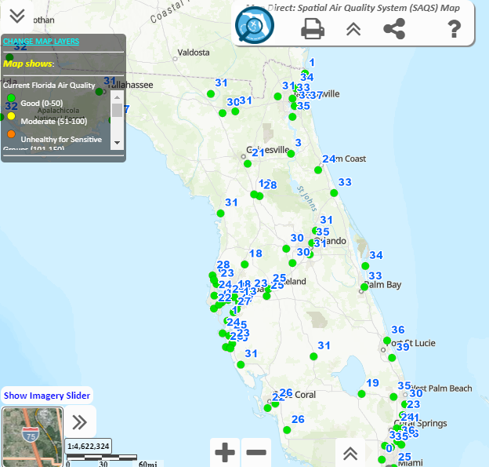
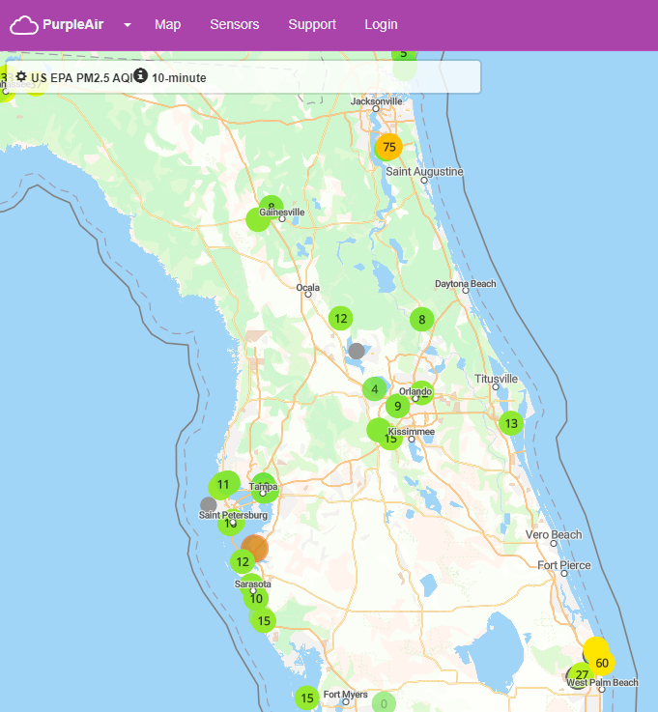
Florida DEP
(SAQS)
Spatial Air Quality System
PurpleAir
citizen monitoring

Slide 16
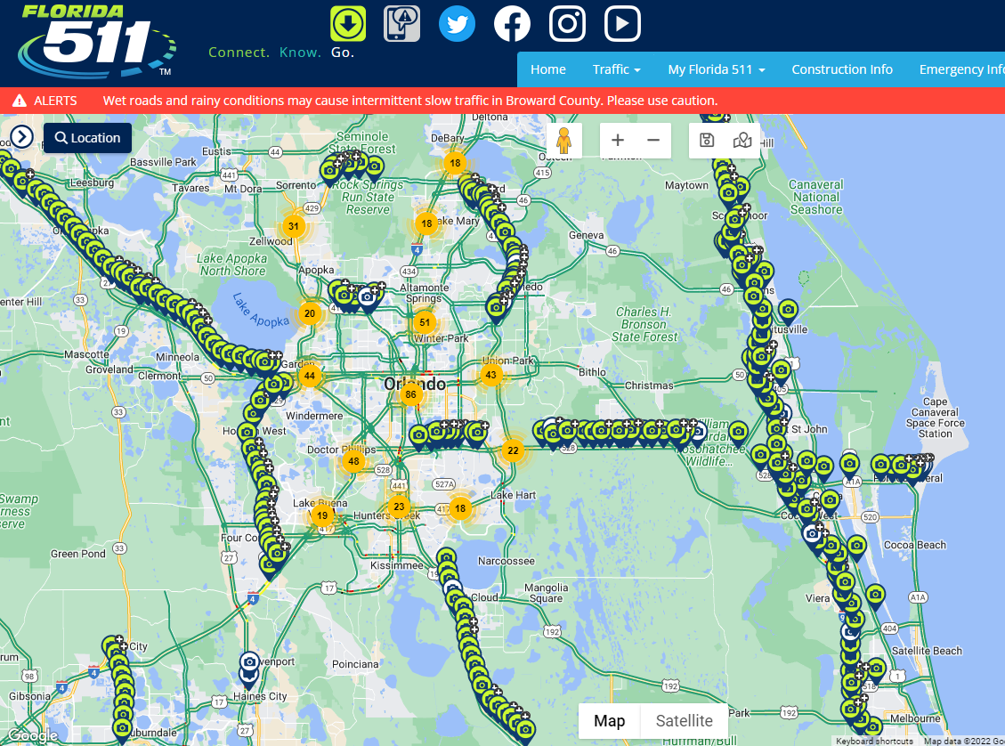
Florida 511 highway cameras

Slide 17
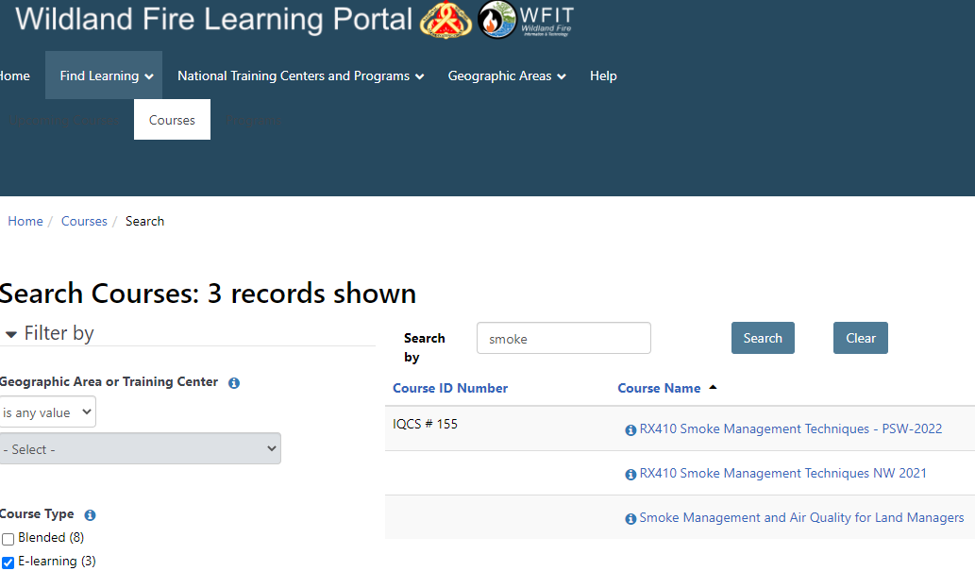


Slide 18
Discussion on selected topics:
Current Conditions
Outlook for remainder of Dry season
Q&A…

Slide 19
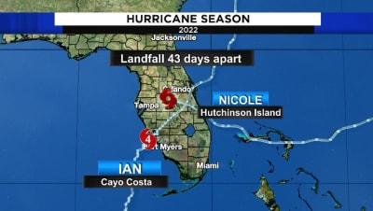
Ian and Incole

Slide 20
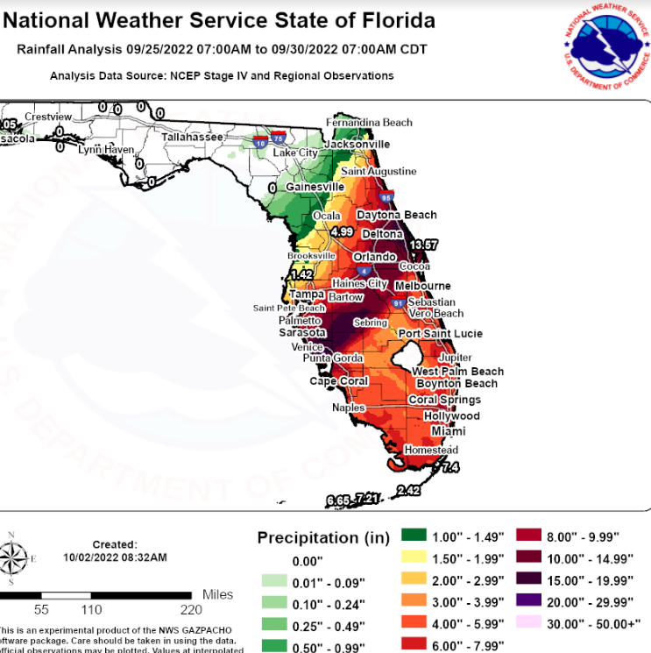
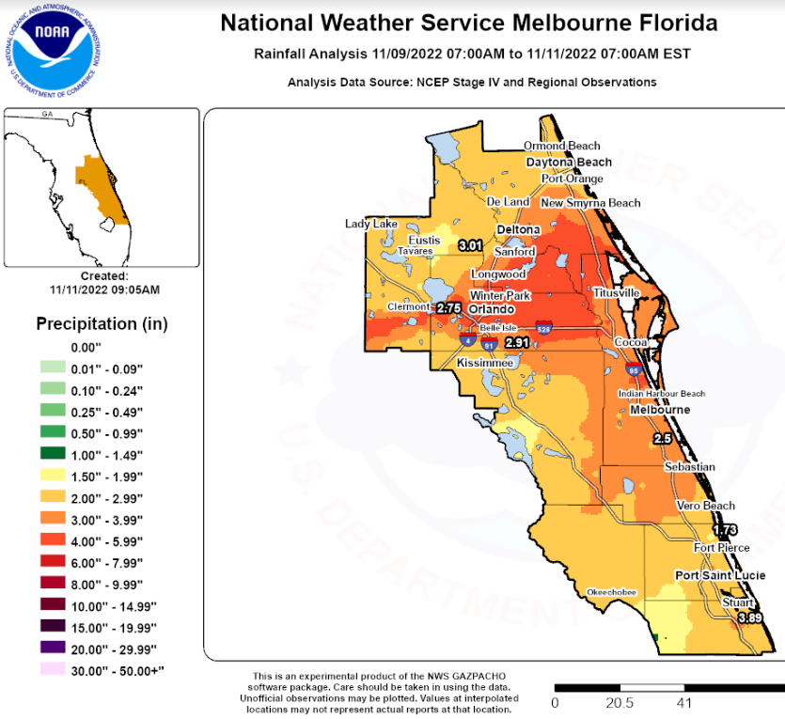
Nicole
Ian

Slide 21
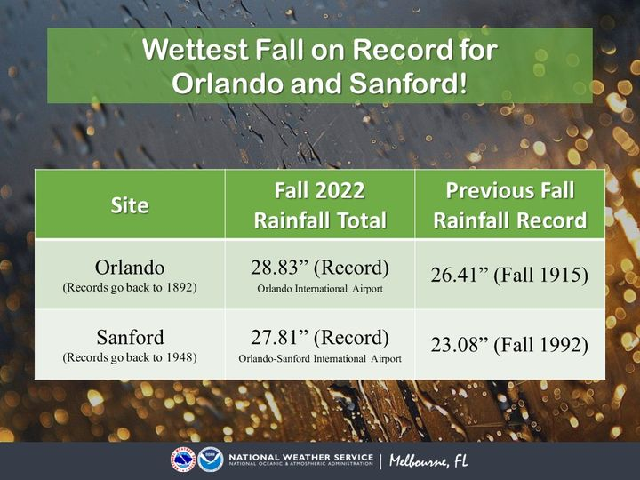
Wettest Autumn Orlando/Sanford
Notes:
As we are into the dry season, rainfall totals are above normal over the past 90 days across the peninsula from heavy rain events in late Summer.

Slide 22
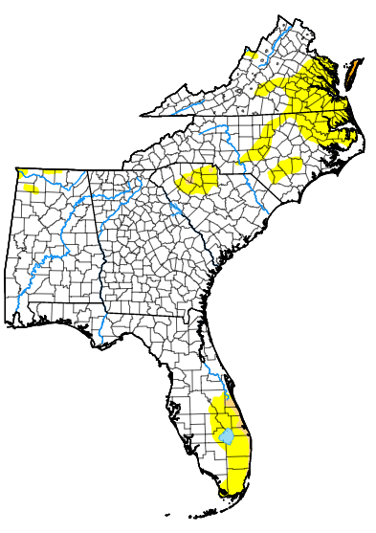
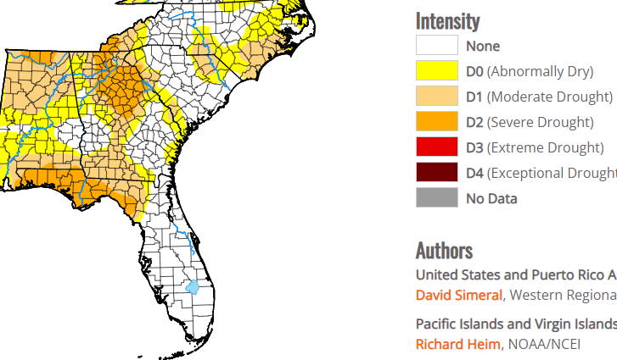
2022 September –vs– 2022 December

Slide 23
2023 Winter/Spring Outlook
12/4/22
John Pendergrast
National Weather Service Melbourne

Slide 24
Why ENSO and Florida Dry Season?
Projected ENSO conditions are a large component of the Florida seasonal rain and temperature forecasts.

Slide 25
Historical El Niño and La Niña Episodes Based on the ONI computed using ERSST.v5
Recent Pacific warm (red) and cold (blue) periods based on a threshold of +/- 0.5 ºC for the Oceanic Nino Index (ONI) [3 month running mean of ERSST.v5 SST anomalies in the Nino 3.4 region (5N-5S, 120-170W)]. For historical purposes, periods of below and above normal SSTs are colored in blue and red when the threshold is met for a minimum of 5 consecutive over-lapping seasons.
The ONI is one measure of the El Niño-Southern Oscillation, and other indices can confirm whether features consistent with a coupled ocean-atmosphere phenomenon accompanied these periods. The complete table going back to DJF 1950 can be found here.
Year | DJF | JFM | FMA | MAM | AMJ | MJJ | JJA | JAS | ASO | SON | OND | NDJ
2010 | 1.5 | 1.2 | 0.8 | 0.4 | -0.2 | -0.7 | -1.0 | -1.3 | -1.6 | -1.6 | -1.6 | -1.6
2011 | -1.4 | -1.2 | -0.9 | -0.7 | -0.6 | -0.4 | -0.5 | -0.6 | -0.8 | -1.0 | -1.1 | -1.0
2012 | -0.9 | -0.7 | -0.6 | -0.5 | -0.3 | 0.0 | 0.2 | 0.4 | 0.4 | 0.3 | 0.1 | -0.2
2013 | -0.4 | -0.4 | -0.3 | -0.3 | -0.4 | -0.4 | -0.4 | -0.3 | -0.3 | -0.2 | -0.2 | -0.3
2014 | -0.4 | -0.5 | -0.3 | 0.0 | 0.2 | 0.2 | 0.0 | 0.1 | 0.2 | 0.5 | 0.6 | 0.7
2015 | 0.5 | 0.5 | 0.5 | 0.7 | 0.9 | 1.2 | 1.5 | 1.9 | 2.2 | 2.4 | 2.6 | 2.6
2016 | 2.5 | 2.1 | 1.6 | 0.9 | 0.4 | -0.1 | -0.4 | -0.5 | -0.6 | -0.7 | -0.7 | -0.6
2017 | -0.3 | -0.2 | 0.1 | 0.2 | 0.3 | 0.3 | 0.1 | -0.1 | -0.4 | -0.7 | -0.8 | -1.0
2018 | -0.9 | -0.9 | -0.7 | -0.5 | -0.2 | 0.0 | 0.1 | 0.2 | 0.5 | 0.8 | 0.9 | 0.8
2019 | 0.7 | 0.7 | 0.7 | 0.7 | 0.5 | 0.5 | 0.3 | 0.1 | 0.2 | 0.3 | 0.5 | 0.5
2020 | 0.5 | 0.5 | 0.4 | 0.2 | -0.1 | -0.3 | -0.4 | -0.6 | -0.9 | -1.2 | -1.3 | -1.2
2021 | -1.0 | -0.9 | -0.8 | -0.7 | -0.5 | -0.4 | -0.4 | -0.5 | -0.7 | -0.8 | -1.0 | -1.0
2022 | -1.0 | -0.9 | -1.0 | -1.1 | -1.0 | -0.9 | -0.8 | -0.9 | -1.0 | -1.0

Slide 26
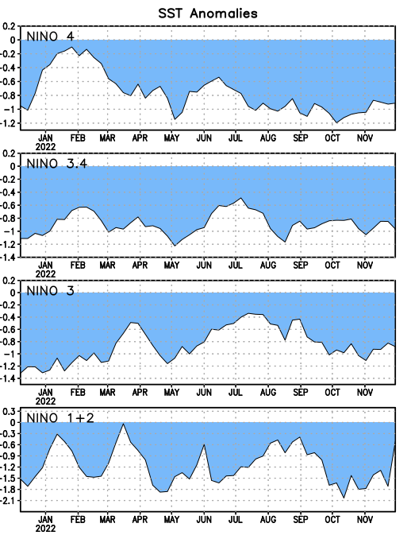
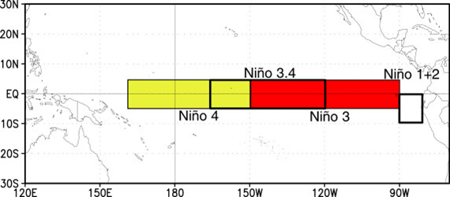
Niño Region SST Departures (ºC) Recent Evolution
The latest weekly SST departures are:
Niño 4
-0.9ºC
Niño 3.4
-1.0ºC
Niño 3
-0.9ºC
Niño 1+2
-0.5ºC

Slide 27
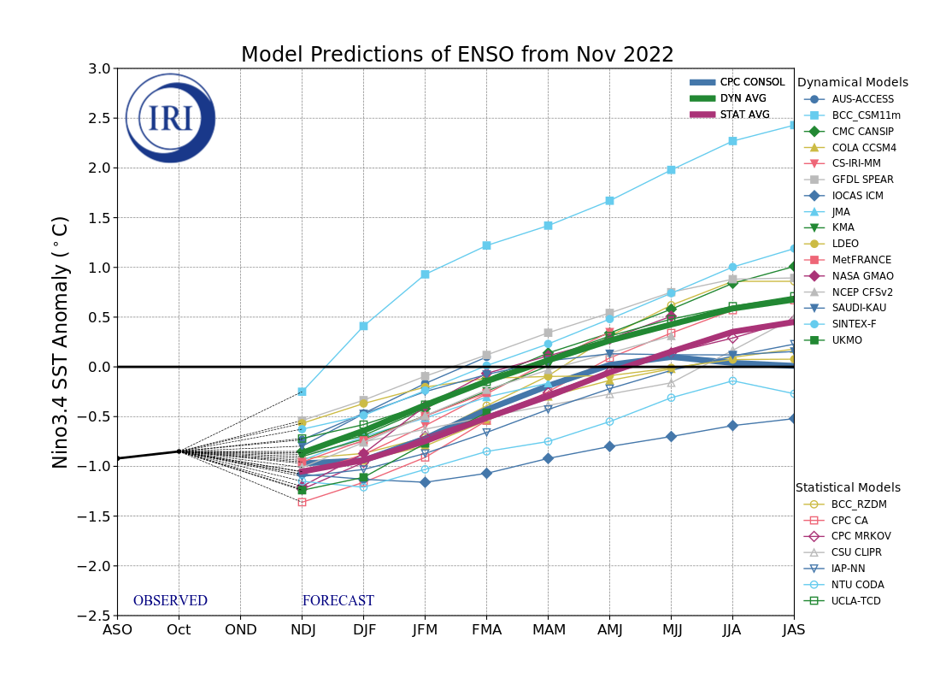
IRI Pacific Niño 3.4 SST Model Outlook
According to the dynamical model average (green thick line), La Nina is expected to persist into the Northern Hemisphere winter 2022-23 and then transition to ENSO-neutral in January-March 2023. For the statistical model average (red thick line), the transition to ENSO-neutral is around February-April 2023.
Figure provided by the International Research Institute (IRI) for Climate and Society (updated 18 November 2022).

Slide 28
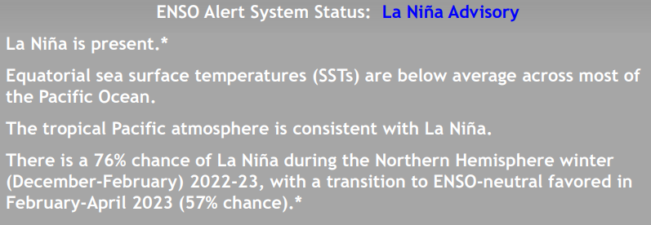
Summary
La Niña is expected to continue into the winter, with equal chances of La Niña and ENSO-neutral during January-March 2023. In February-April 2023, there is a 71% chance of ENSO-neutral.

Slide 29
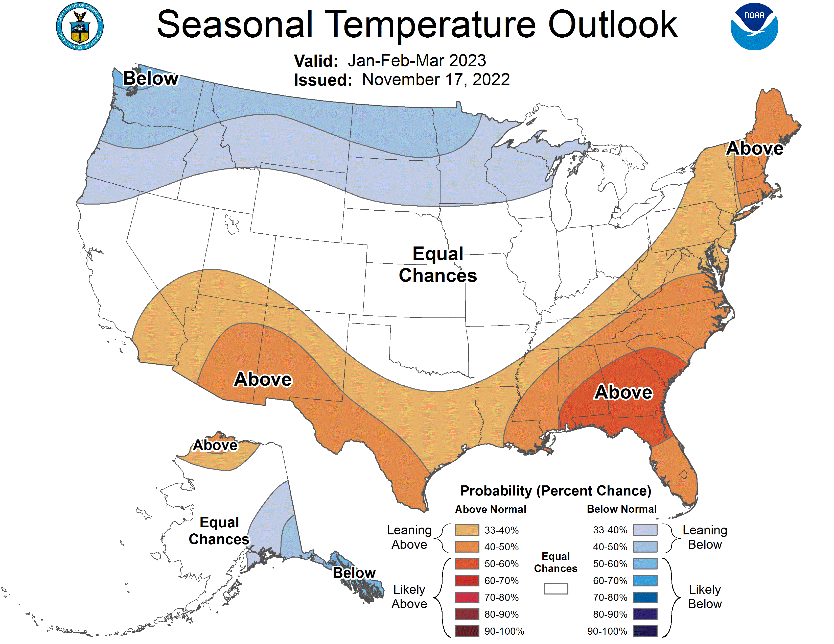
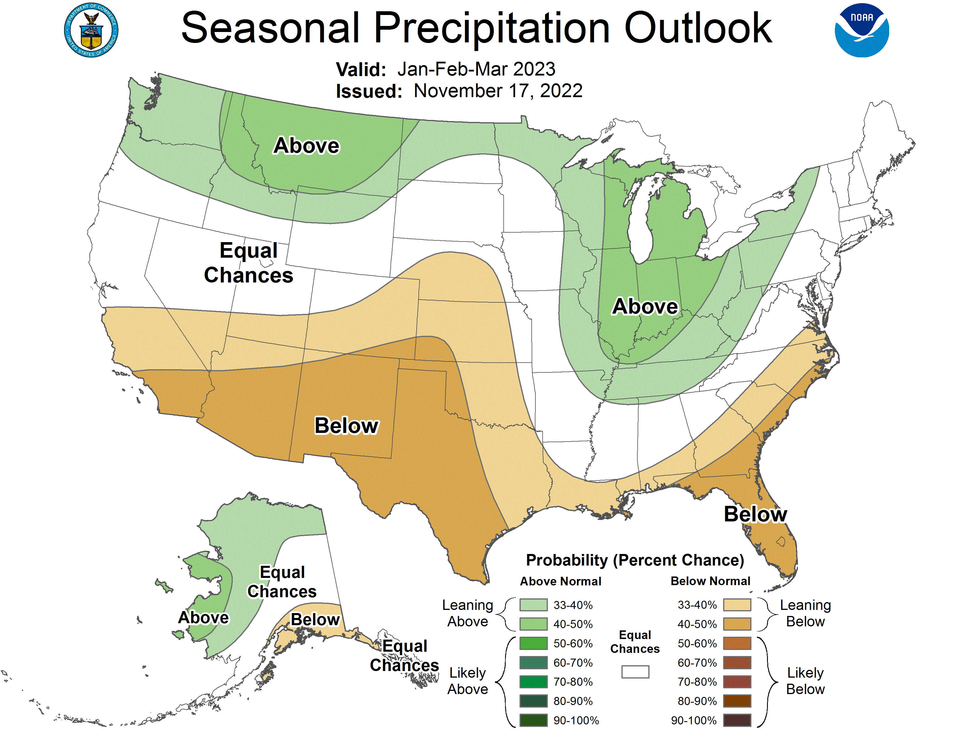
NOAA Forecast Jan-Mar
CPC Rainfall Forecast (JFM):
40-50% chance of below normal precipitation FL

Slide 30
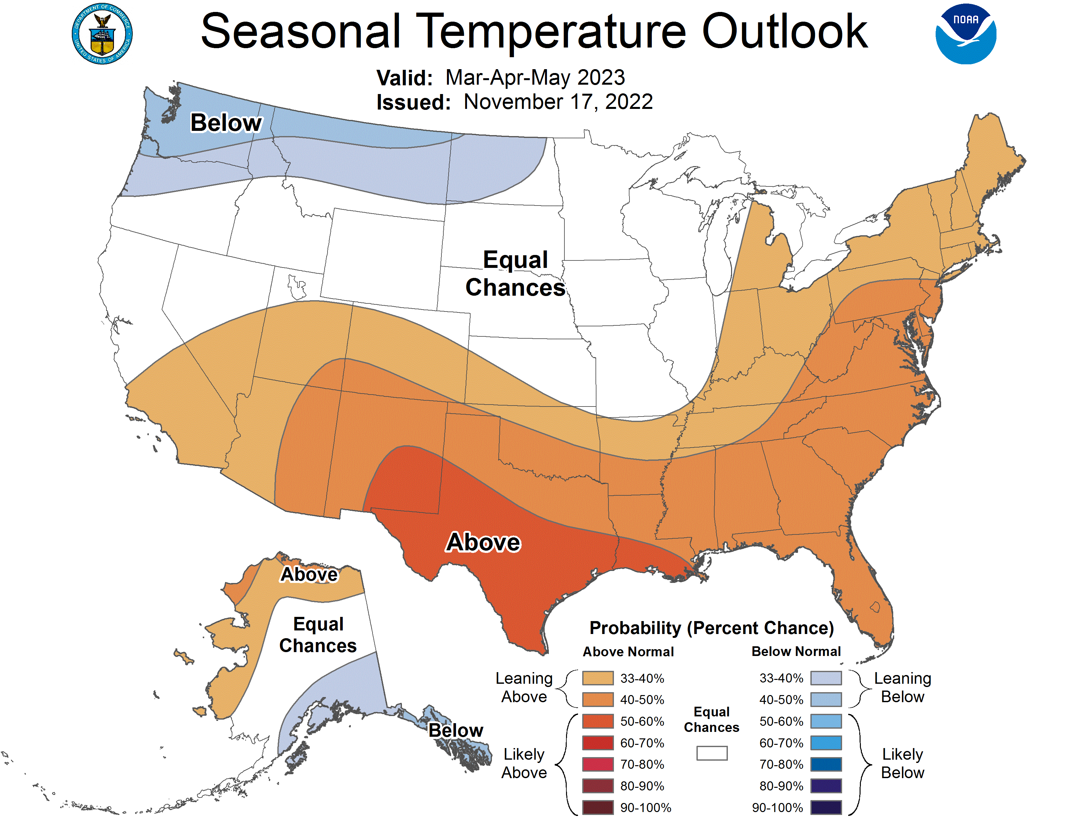
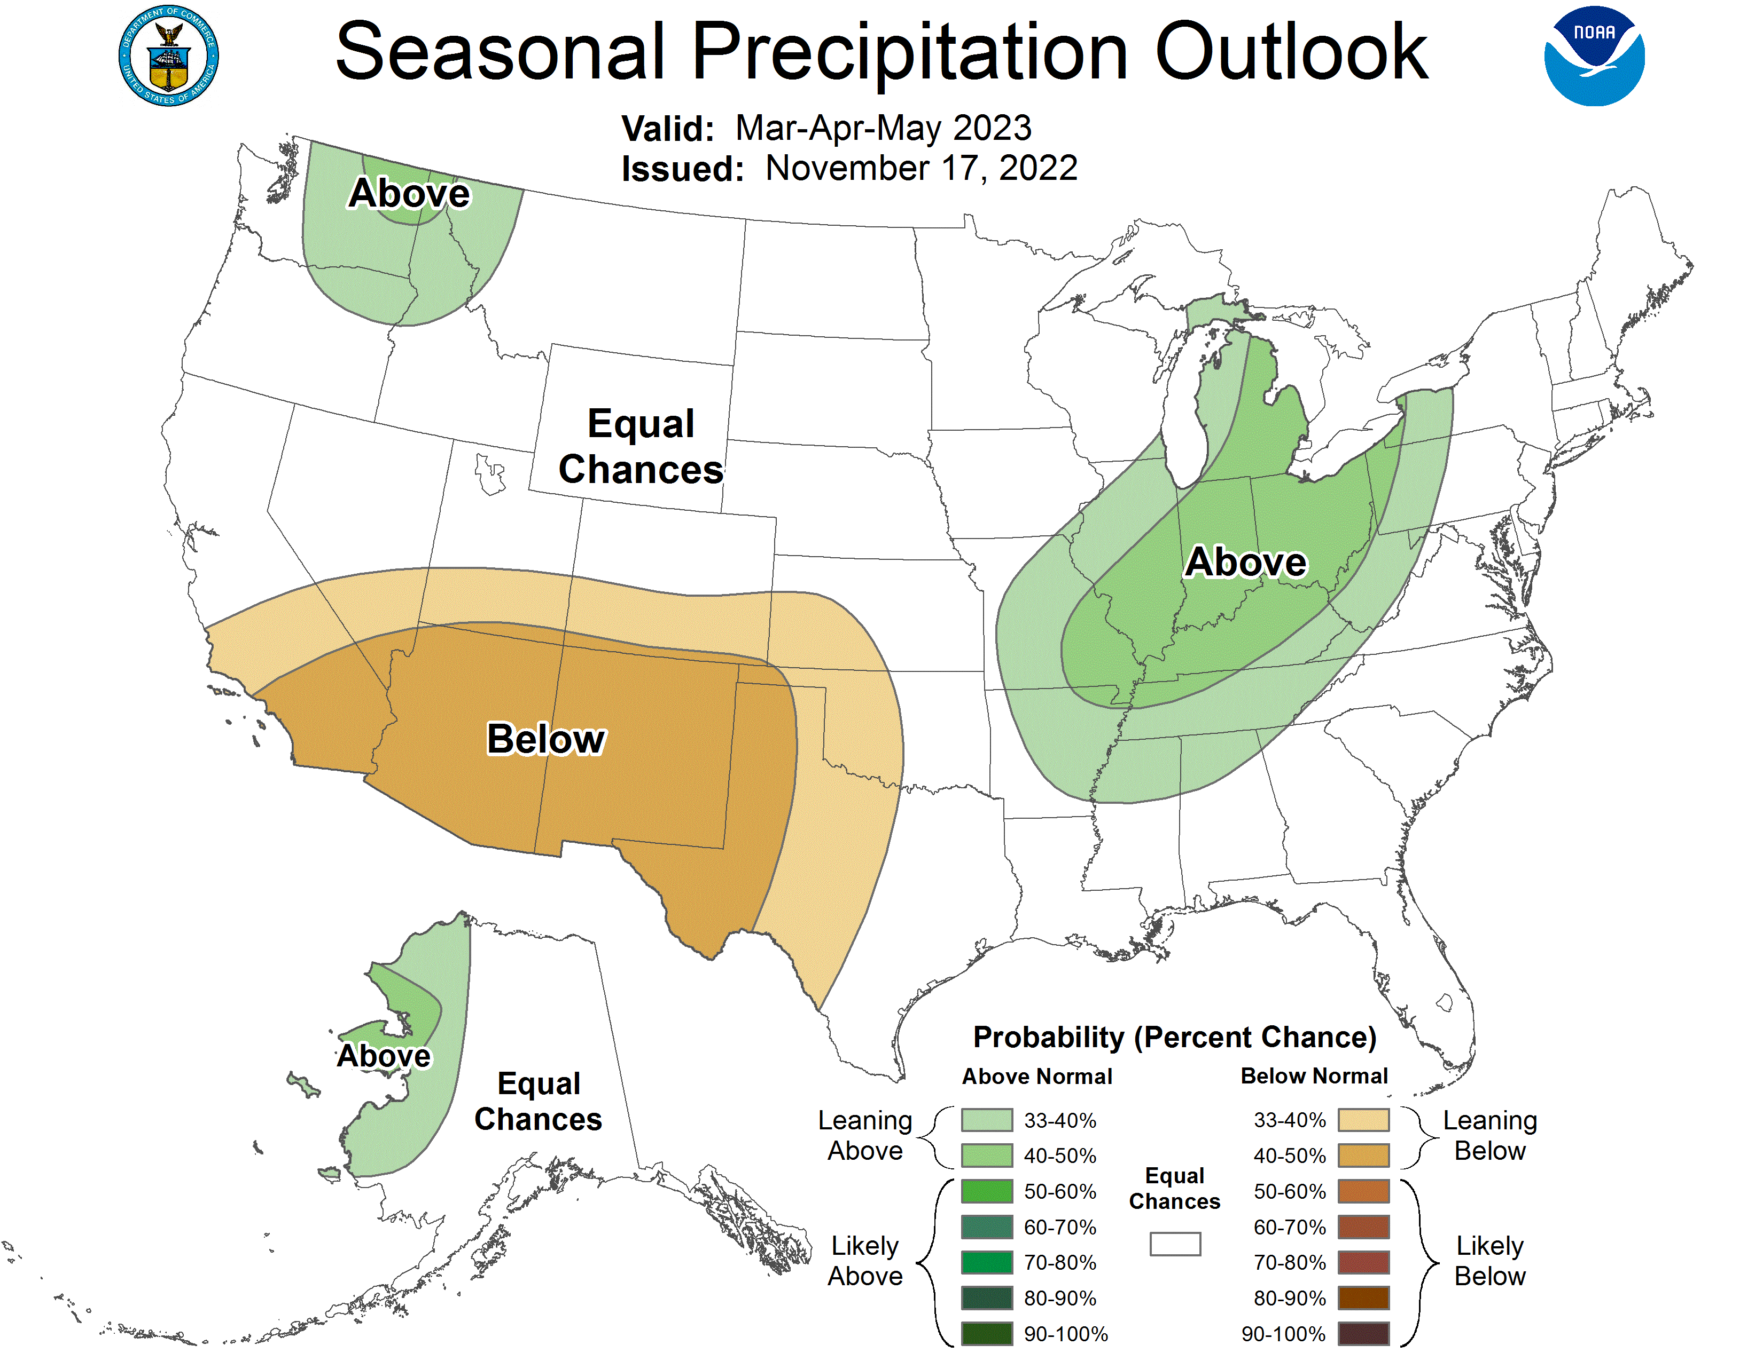
NOAA Forecast Mar-May
CPC Rainfall Forecast (MAM):
Equal chance of below/above normal rain

Slide 31
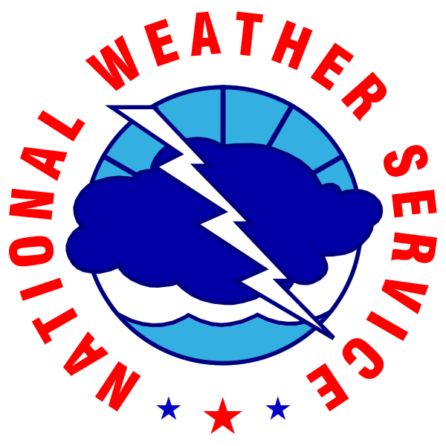
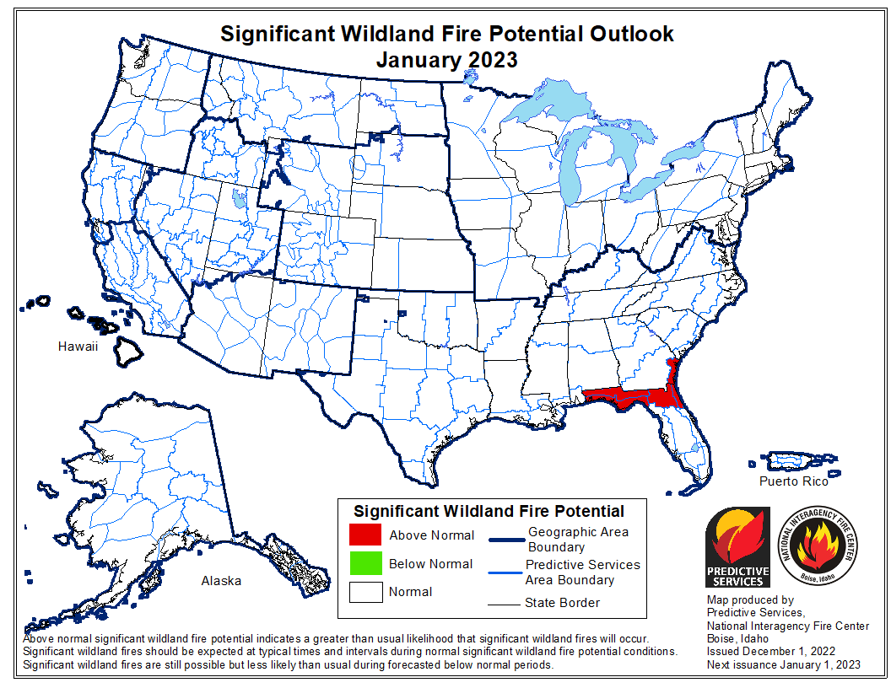
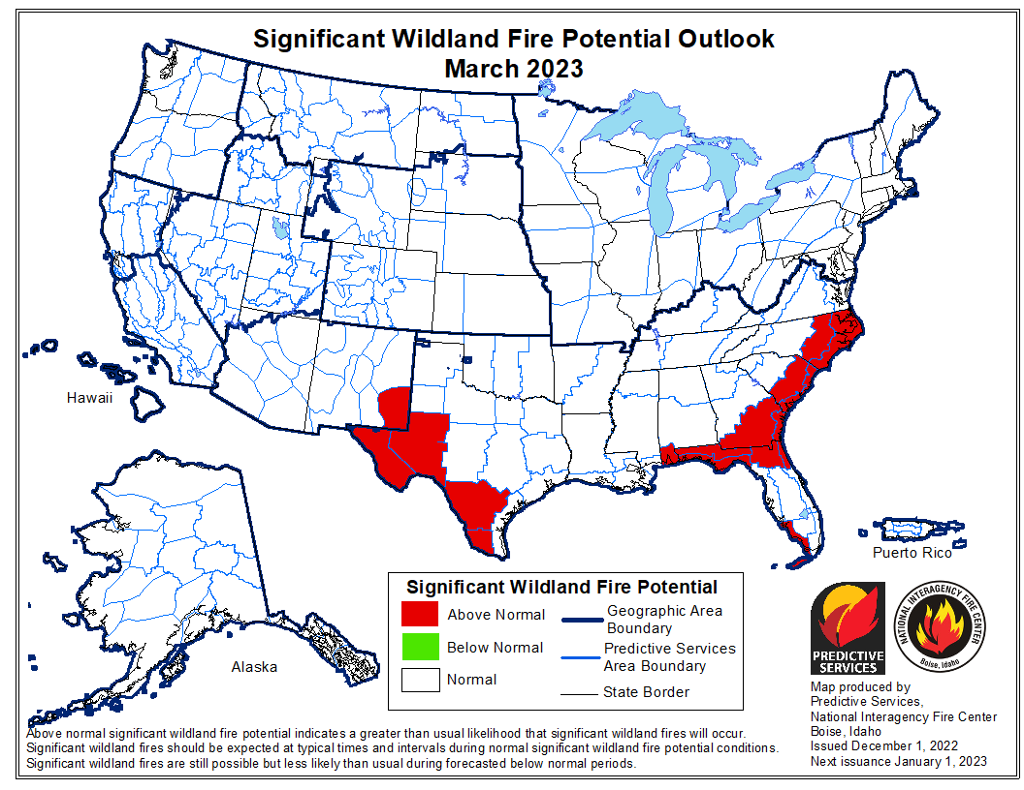
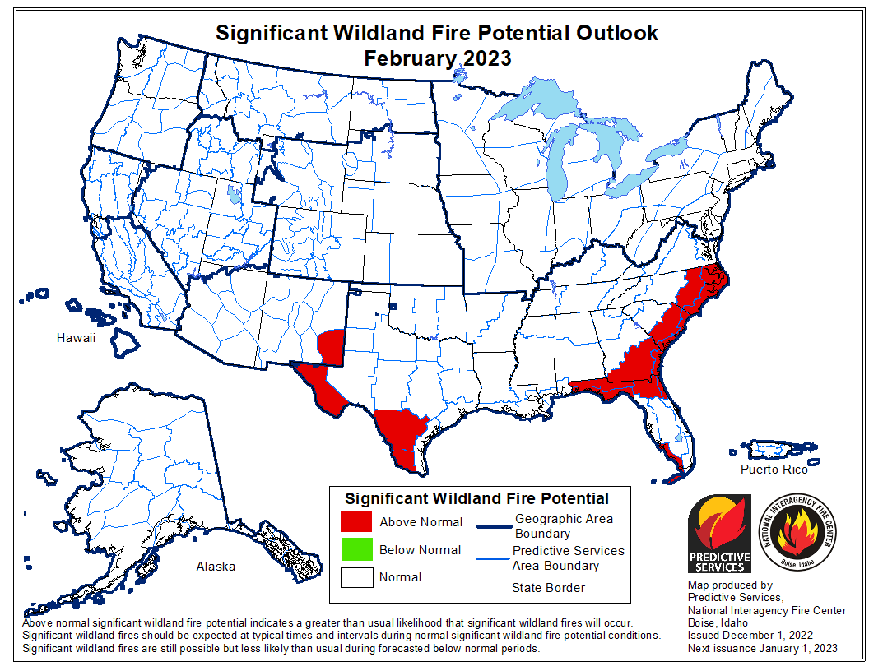
Wildland Fire Outlook Jan-Mar 2023
https://www.predictiveservices.nifc.gov/outlooks/outlooks.htm
Mar 2023
Jan 2023
Feb 2023

Slide 32
Questions ?????????
John.pendergrast@noaa.gov

