Slide 1
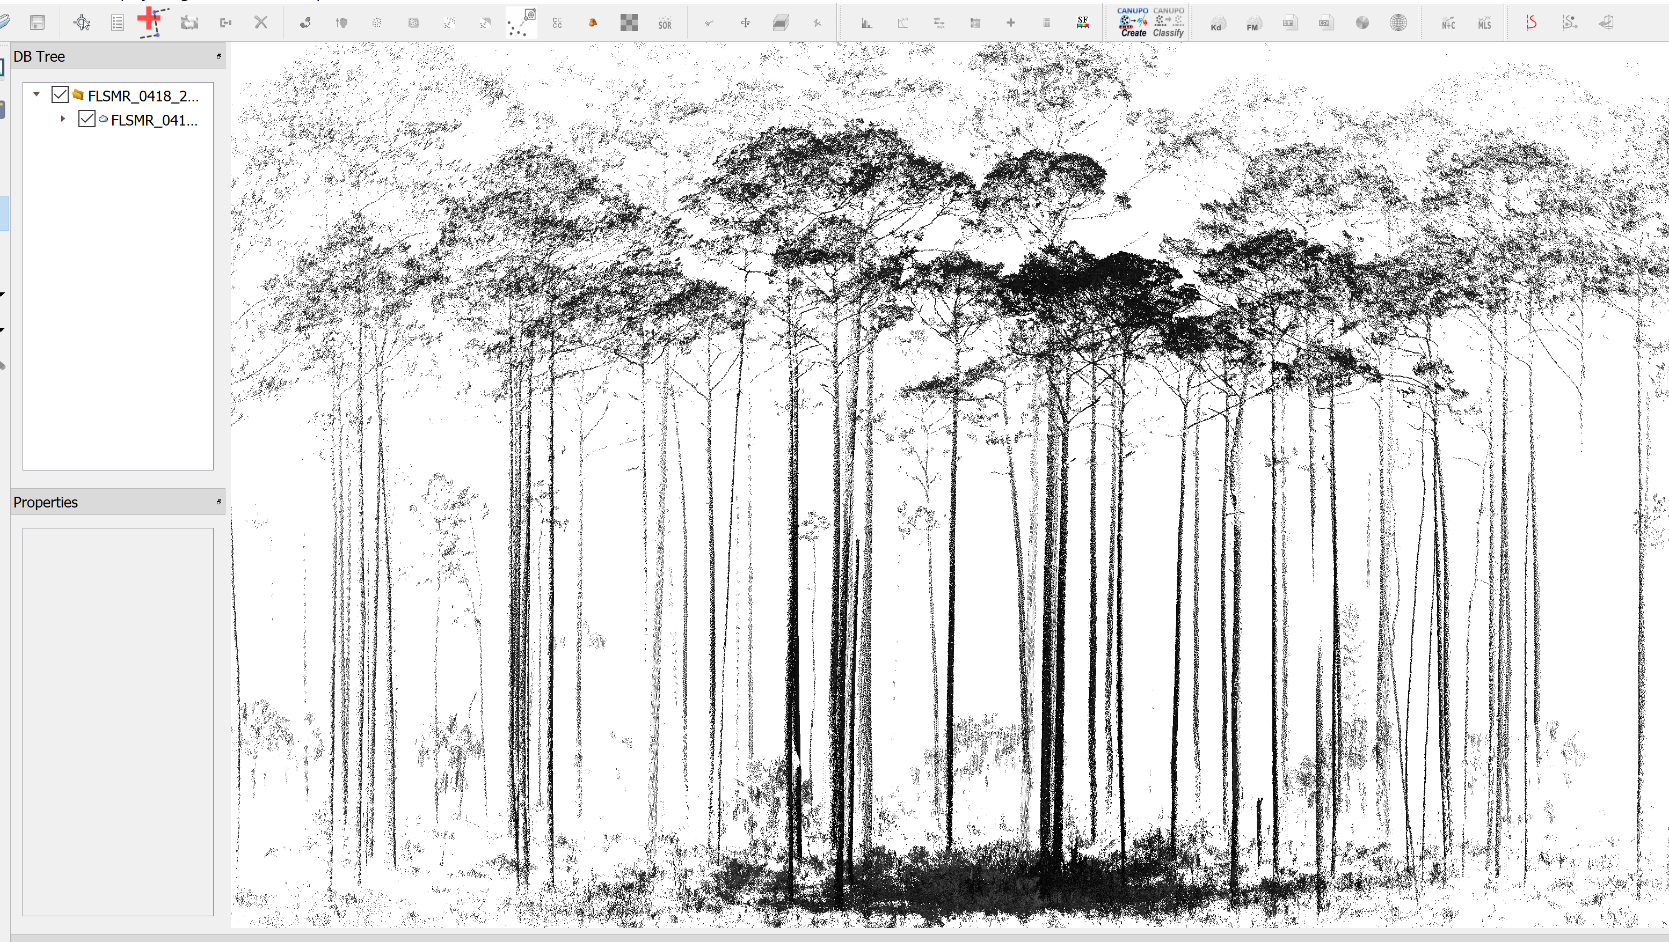
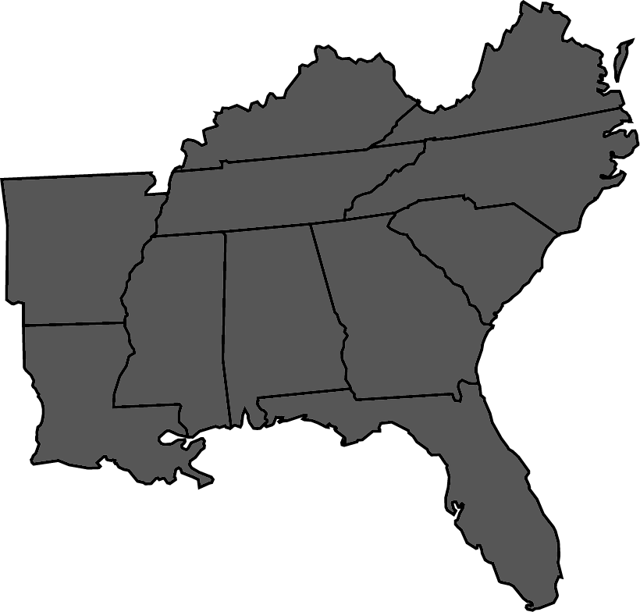
Utilizing Terrestrial LiDAR in Ecosystem Monitoring in the Southeast U.S
Emily Link
USFWS Region 4 Fire Ecologist

Slide 2
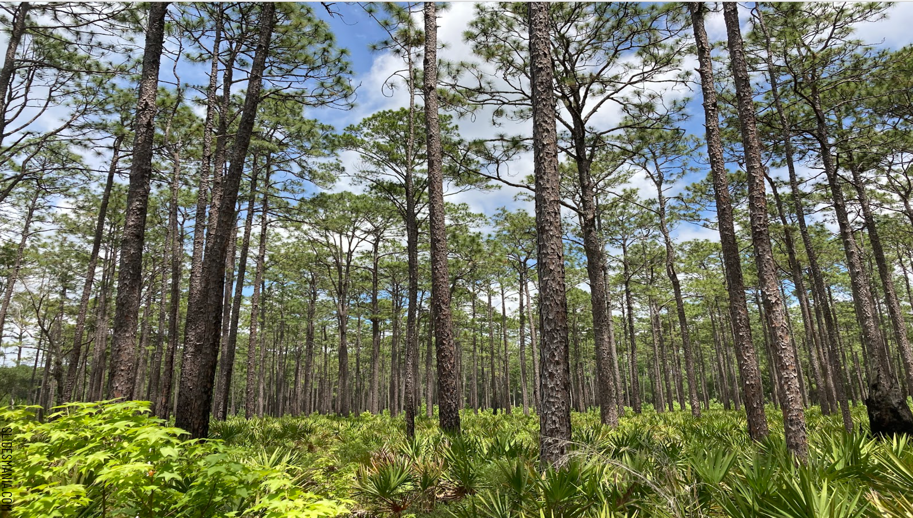
USFWS Mission:
working with others to conserve, protect, and enhance fish, wildlife, plants, and their habitats for the continuing benefit of the American people
Evaluate and document management efforts for conserving and enhancing habitat
Increase understanding of current and desired conditions to make informed resource management decisions

Slide 3
Why monitor?
Accountability and transparency between the public and managers
Evidence for funding allocation needs
Understanding fuels for predicting fire behavior and assessing risk
What should ecosystem objectives be and are they being met?

Slide 4
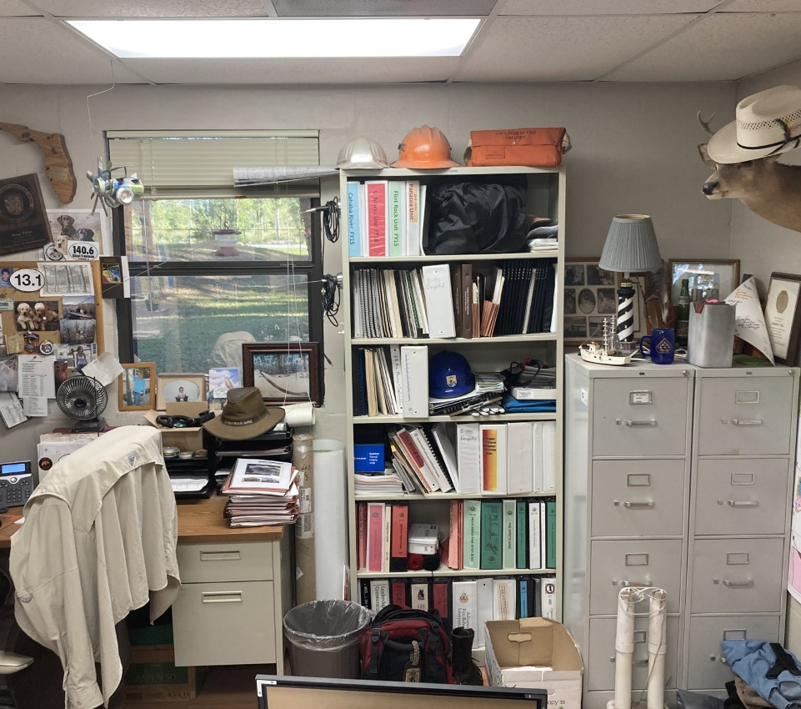
Why is this project necessary:
Data accessibility
Data is collected and then not analyzed
Data and results are buried in cabinets or unorganized computer system
Analysis results are not in an accessible format

Slide 5
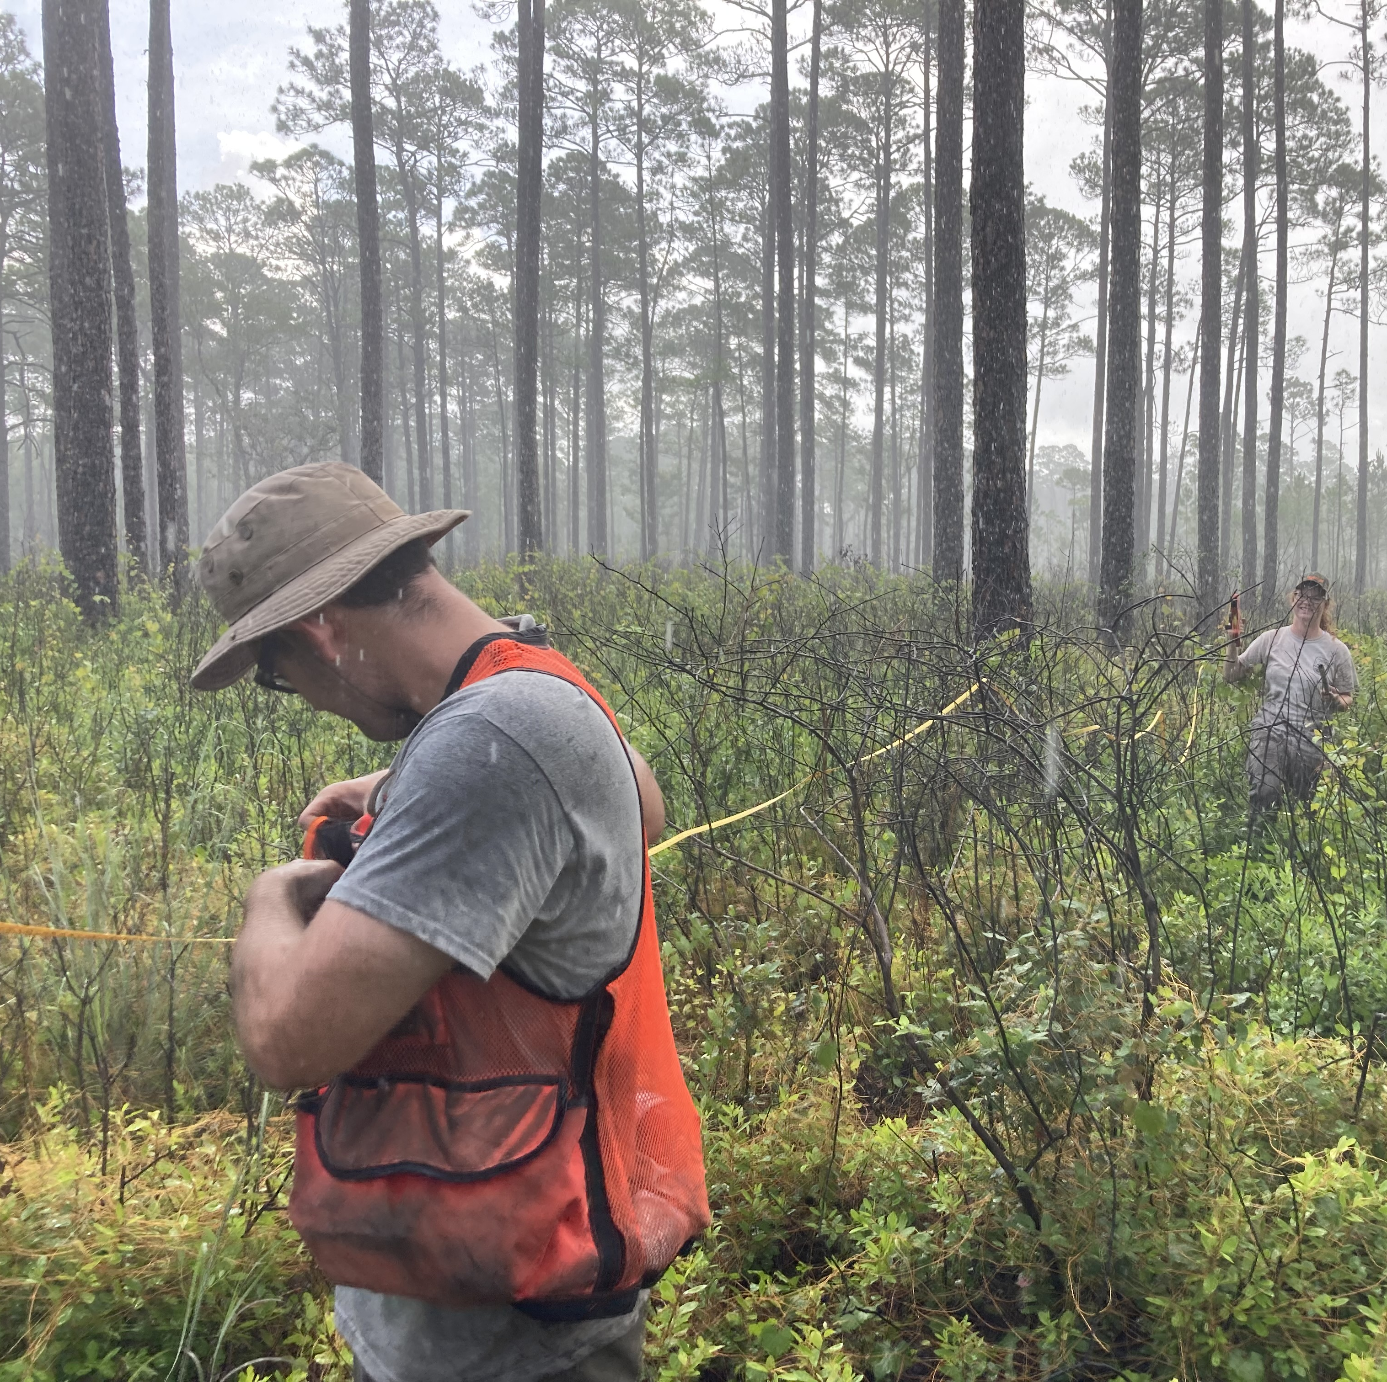
Why is this project necessary:
Staffing needs
Multiple people (biologist/forester/etc) take time and resources to visit the same forest stand to collect different data
Many organizations are lacking in resources and staff for monitoring
Long-term commitment

Slide 6
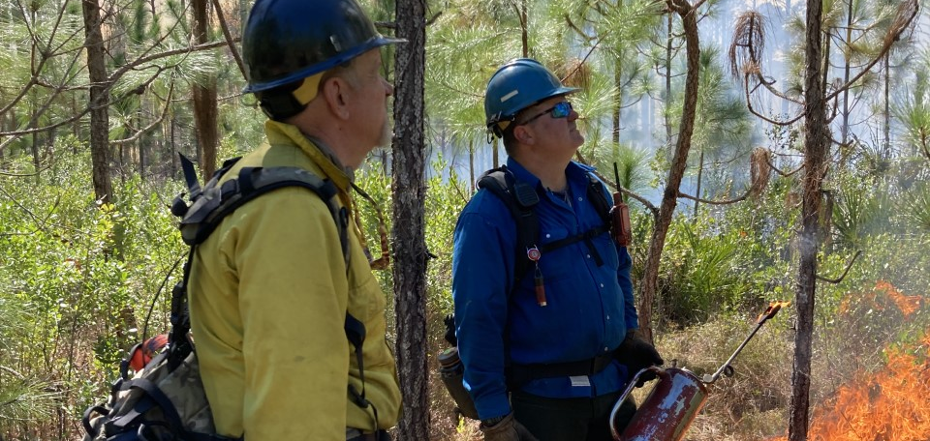
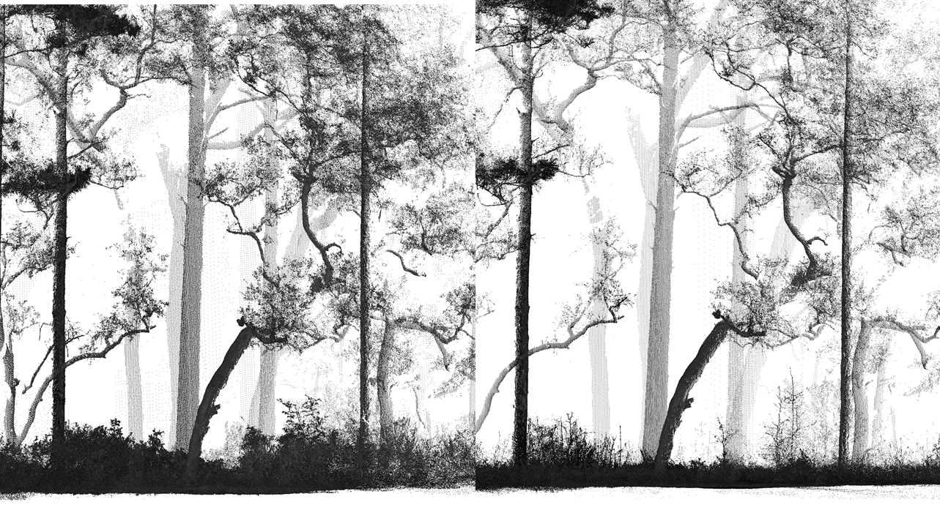
Why is this project necessary:
Communication
Deliver habitat measurements and empirical evidence to justify treatments
Evidence for individuals unfamiliar with fire effects
as to why treatment is necessary,
both visual data and metrics with a single scan

Slide 7
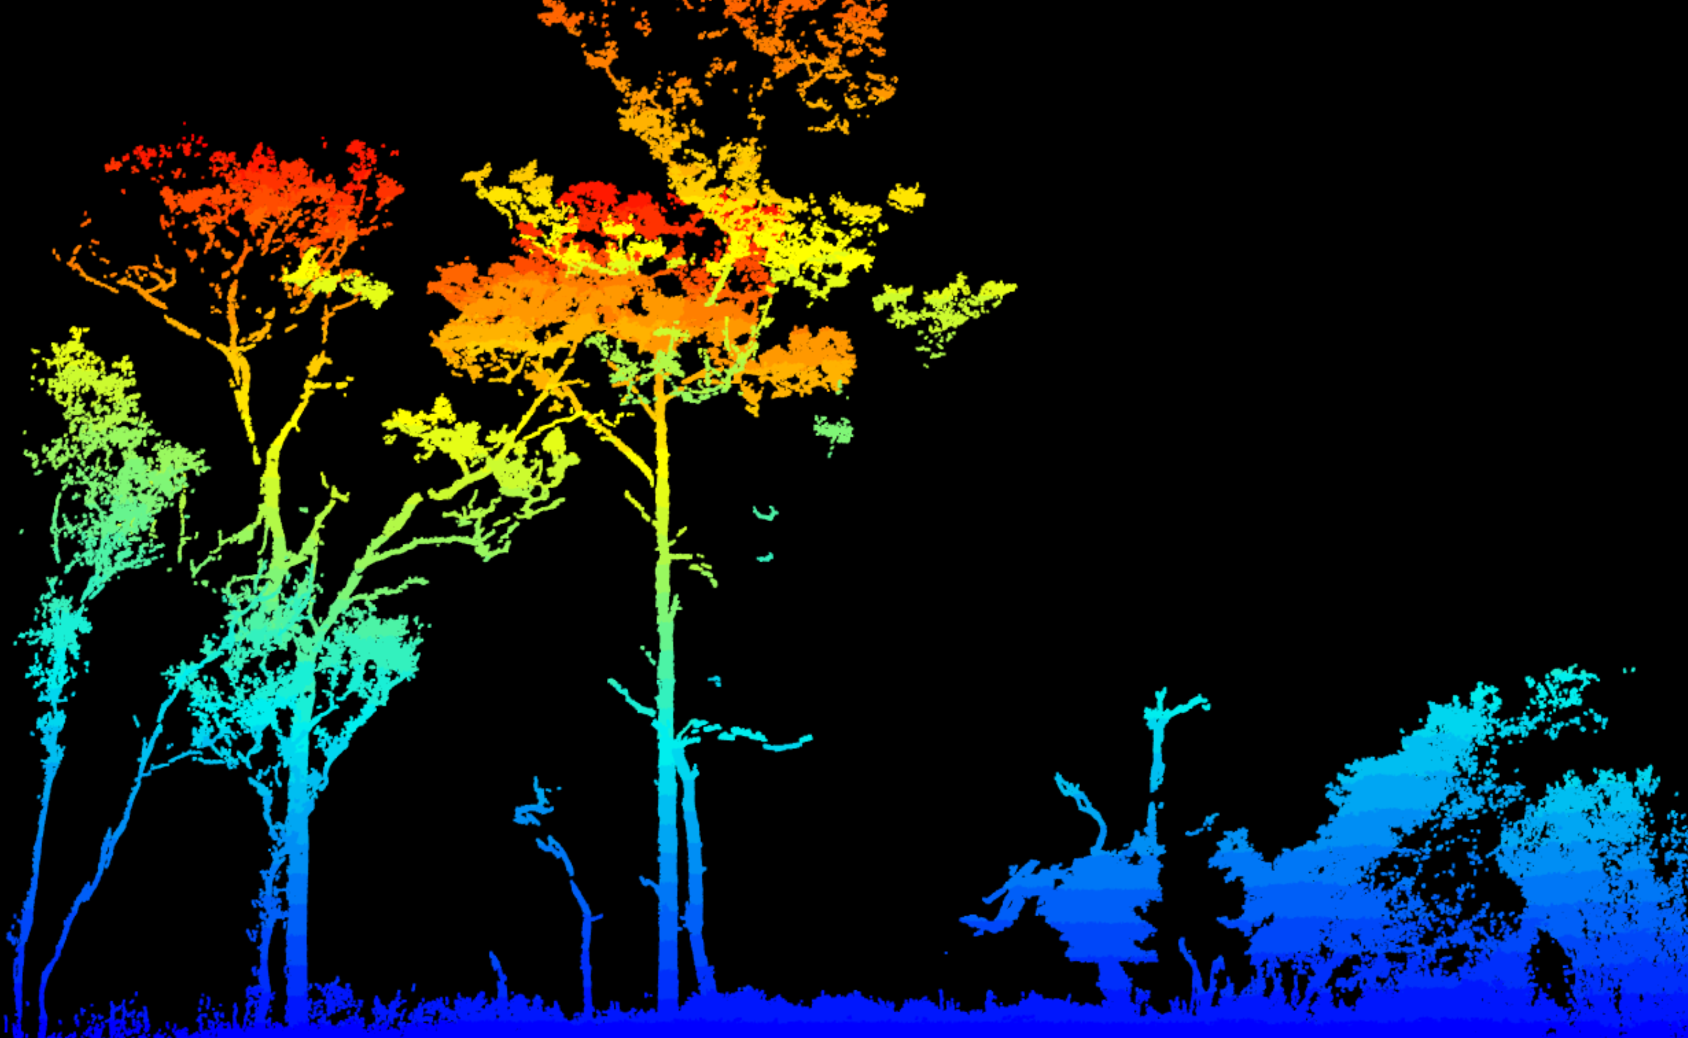
What is LiDAR?
LiDAR - a remote sensing method used to examine the surface of the Earth.
Terrestrial LiDAR - Provides 3D measurements of the forest structure
Point cloud - set of data points that represent an object or space

Slide 8
The Objective of the Terrestrial LiDAR Project
Develop a repeatable, rapid, and cost-effective means of monitoring ecosystem structure
Measure ecosystem response to fuel treatments and vegetative change using Terrestrial LiDAR
Assess long-term impacts of treatments on the integrity of traditional lands and resilience of ecosystems
Provide land managers with decision-making tools based on empirical evidence
Standardize the monitoring process and language across agencies

Slide 9
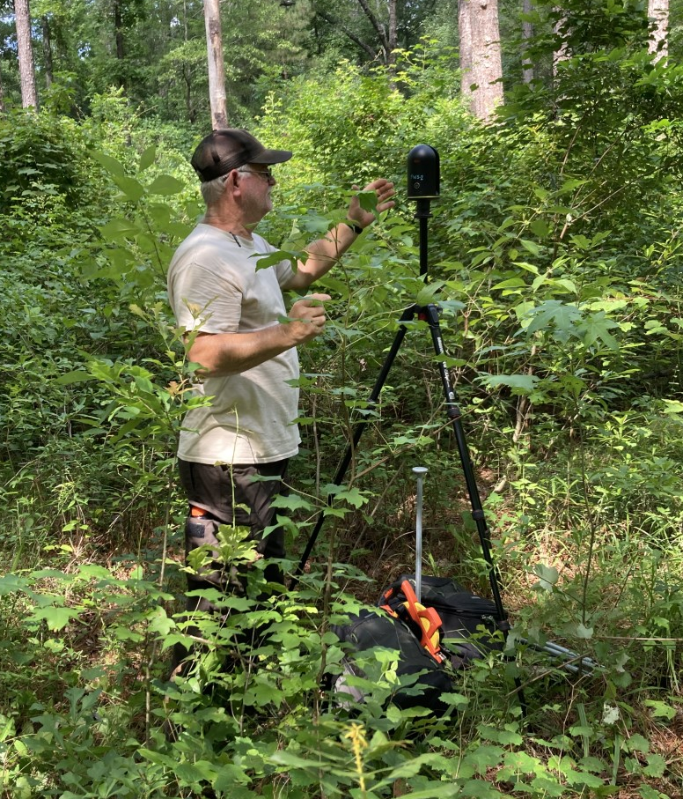
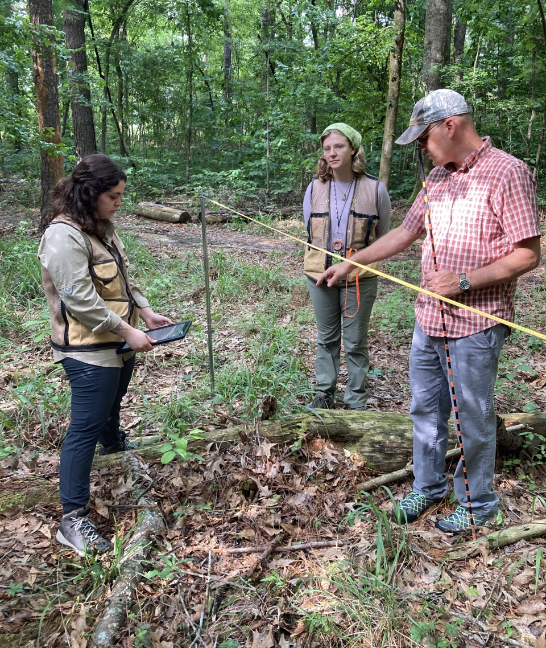
Why is Terrestrial LiDAR an effective tool?
Cost-effective
Minimal training
Removes human error
Removes bias
Measure multiple metrics at once
“Revisit” scans once analysis improves

Slide 10
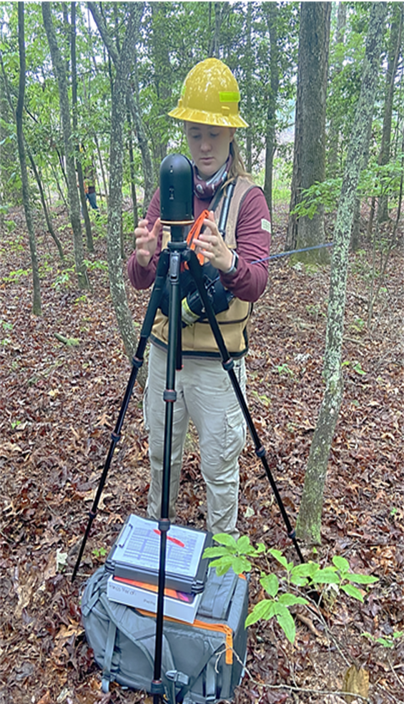
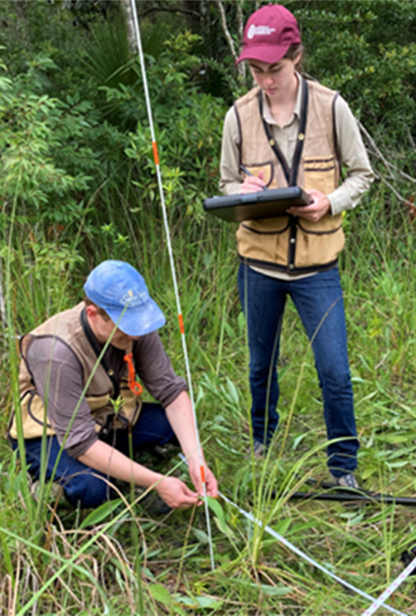
What does the protocol entail?
l
Tier 1
Scan
Plot Location Data
10-Factor Prism
Tier 2
Scan
Plot Location Data
10-Factor Prism
Fuel Point Intercept Sampling
Coarse Woody Debris
Fuelbed and O Horizon Depth
Overstory: Species and Count

Slide 11
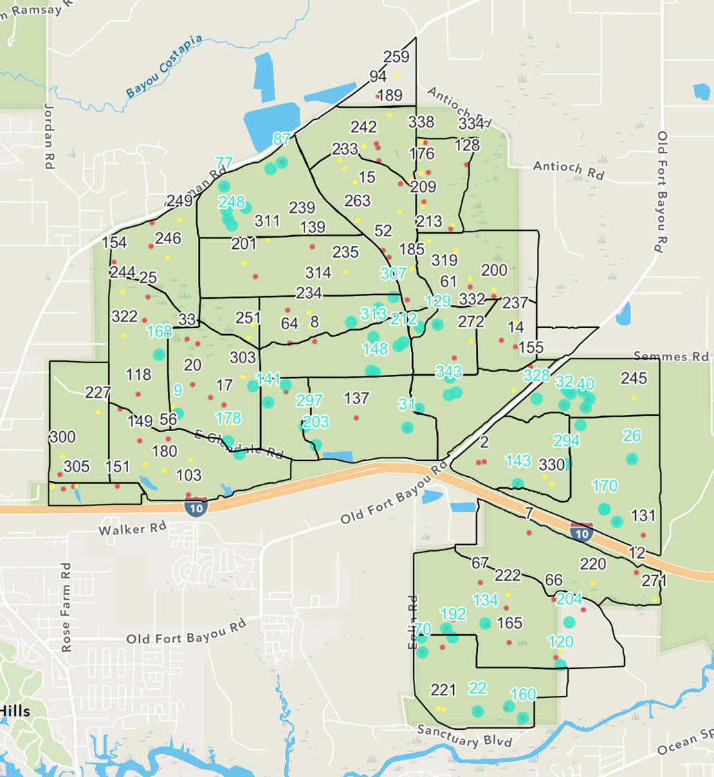
Current Spatial Design
Randomly generated plot locations
Historic/permanent plots
Minimum is 1 plot per management unit less than 500 acres

Slide 12
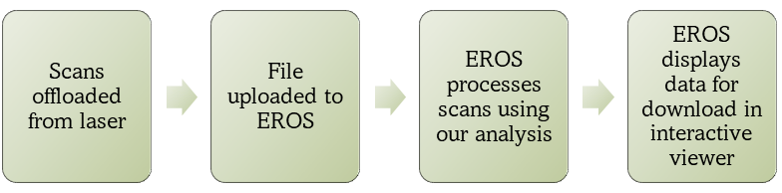
What does technician do with the data?
In the field:
Field Maps -> navigation and GPS coordinates
Survey123 -> recording vegetation data
In the office:
1. Offload scan from laser
2. Convert file types (takes approximately 2 minutes per scan)
3. Upload to EROS – USGS Earth Resources Observation and Science

Slide 13
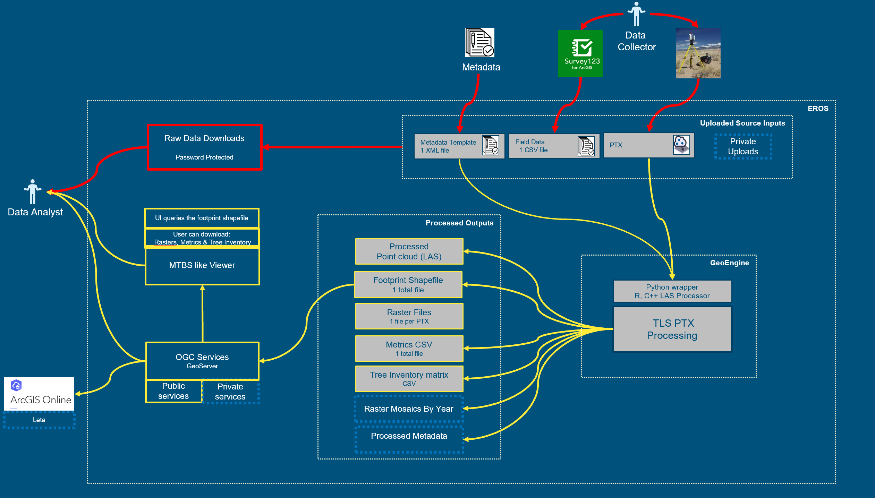
What happens with data after upload?
EROS
-processes the point clouds using script from our research team
-stores original cloud and any related data
-provides database to access data
*required training to use system and upload data*

Slide 14
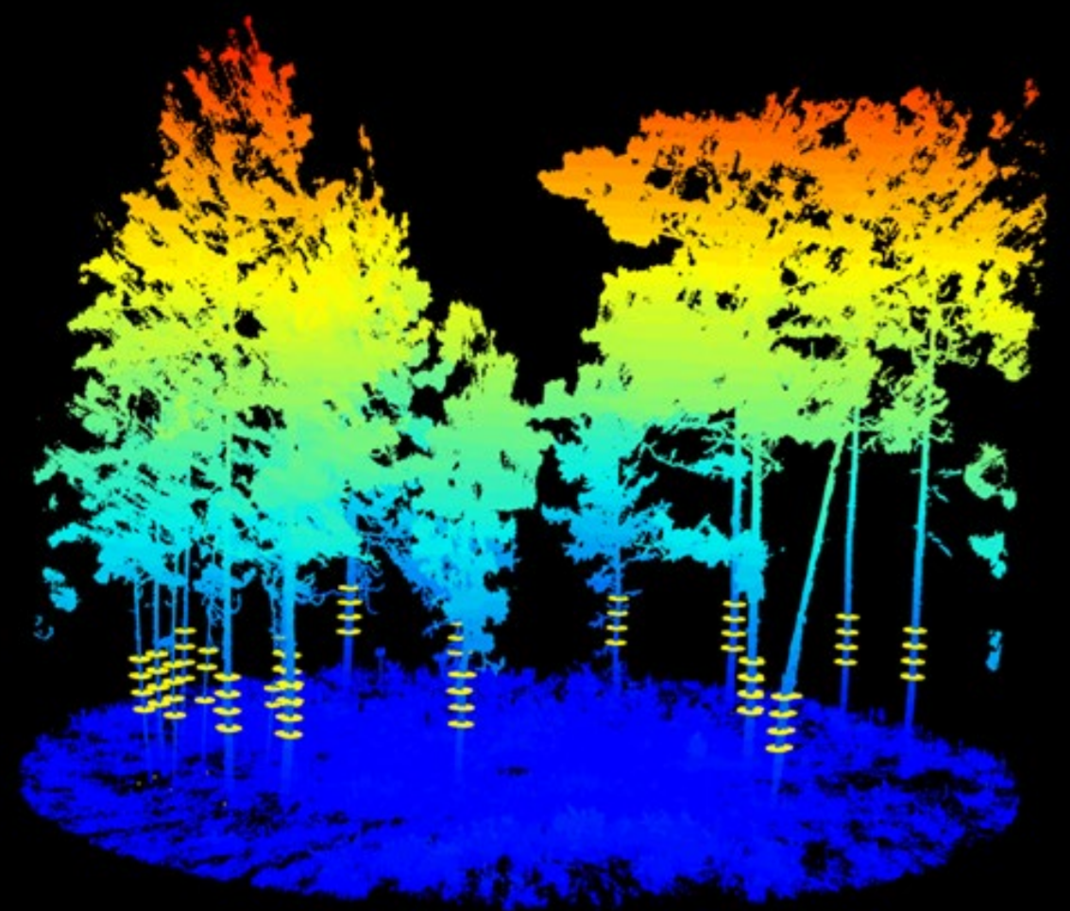
What metrics result from processing?
Biomass
Tree Count
Basal Area: total, pine, hardwood
Mean DBH
Mean Fuel Bed Height
Litter Depth
Grass Cover (%)
Shrub Cover (%)
Forb Cover (%)
Needle Cover (%)
Canopy Heights: max, min, mean
Canopy Cover, Canopy Bulk Density,
Gap Fraction
Fine and Coarse Woody Debris

Slide 15
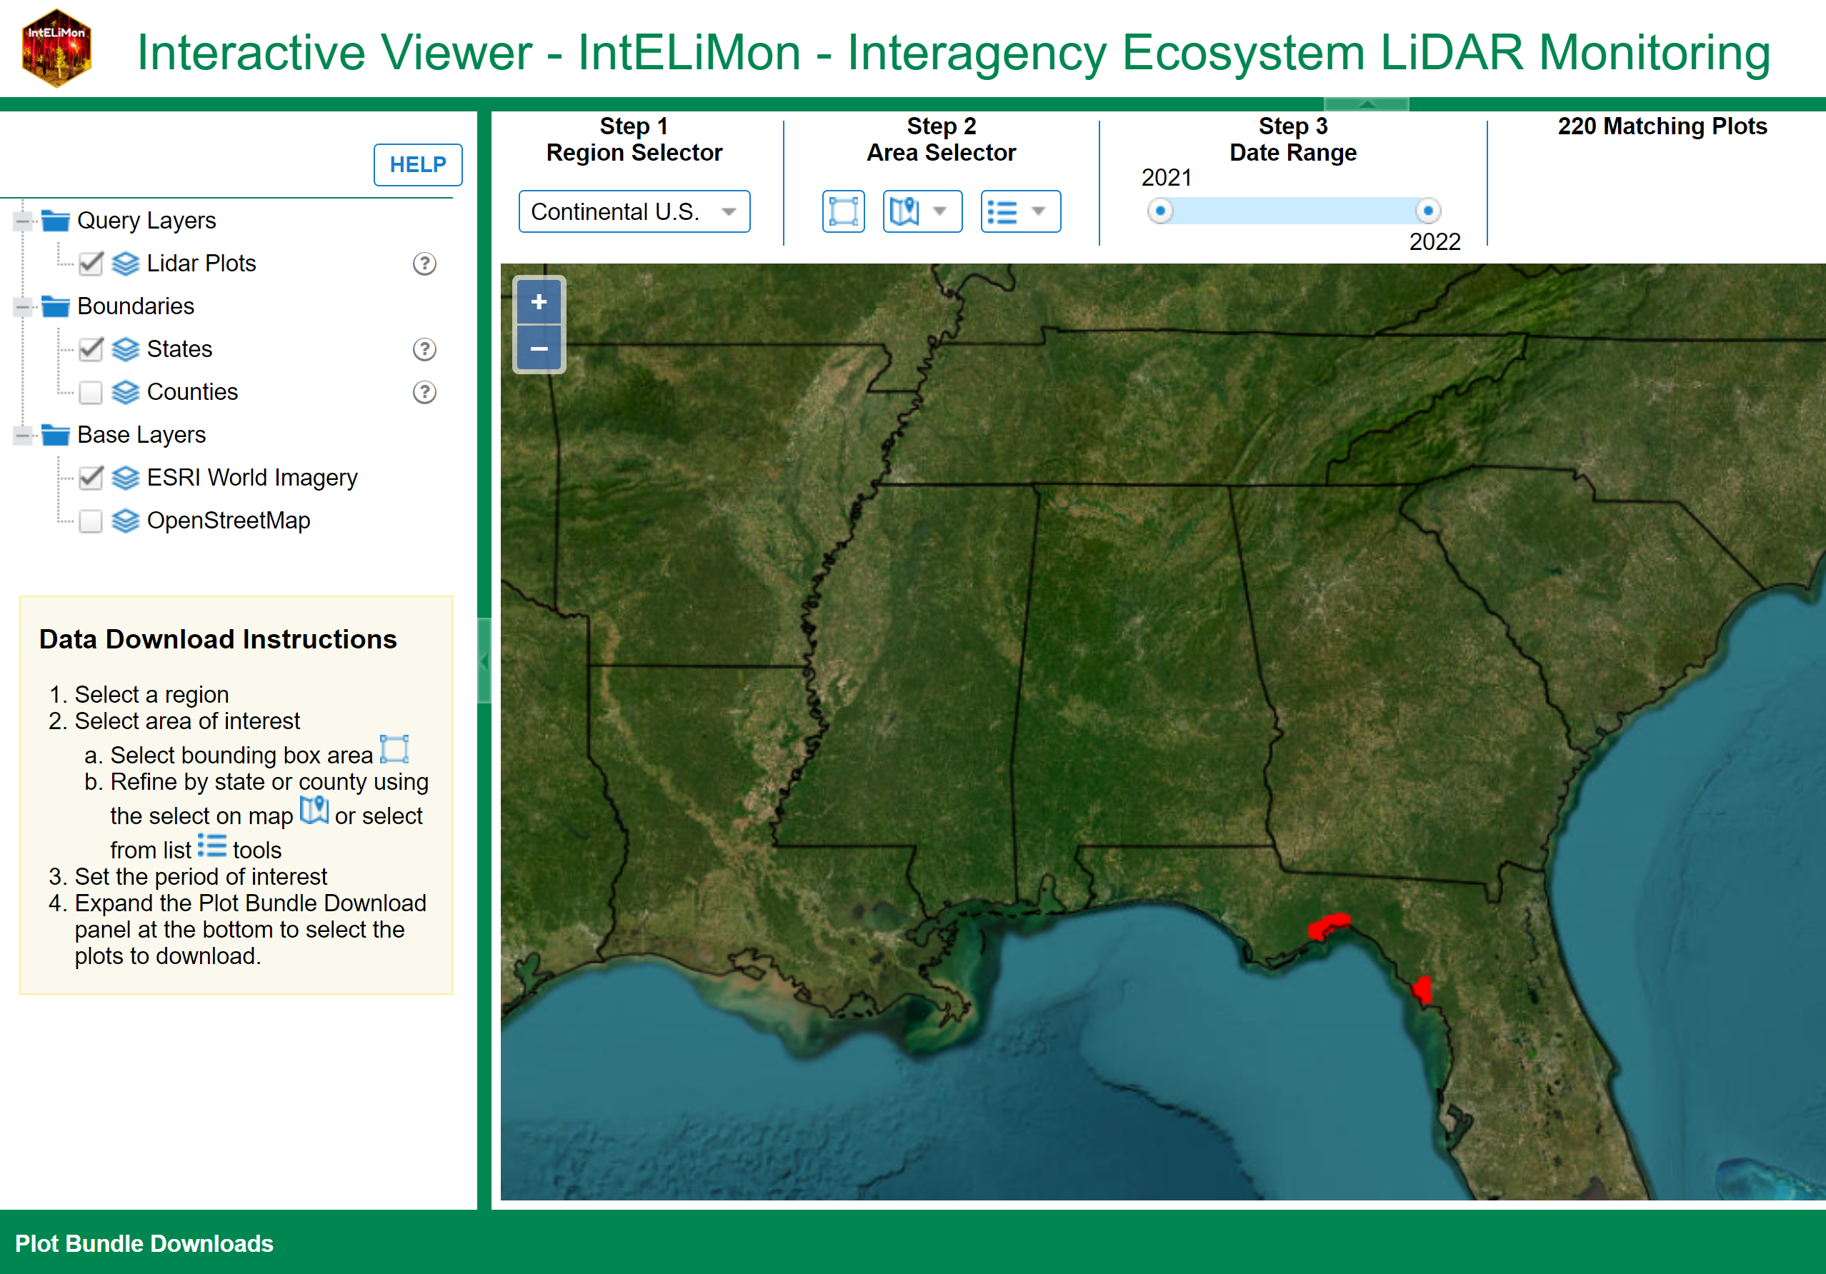
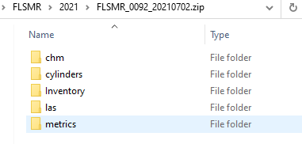
How Can Staff Access the Data?
Downloading raw data
Our team manages help
account

Slide 16
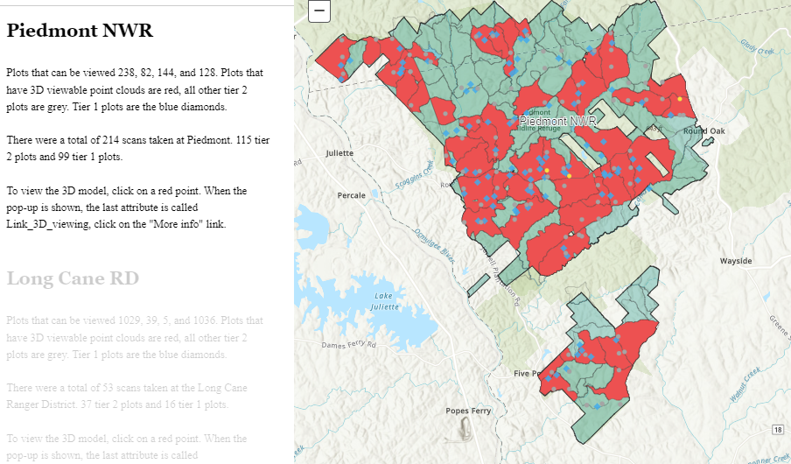
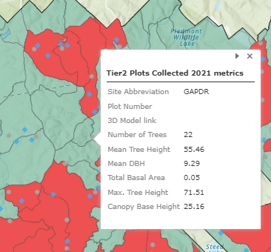
How Can Staff Access the Data?
Database for Managers

Slide 17
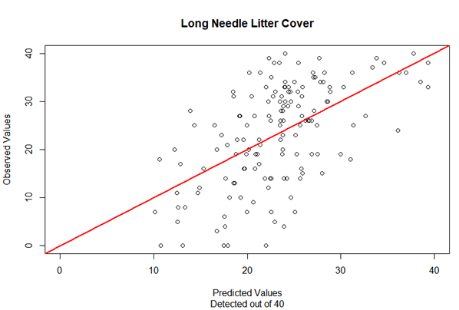
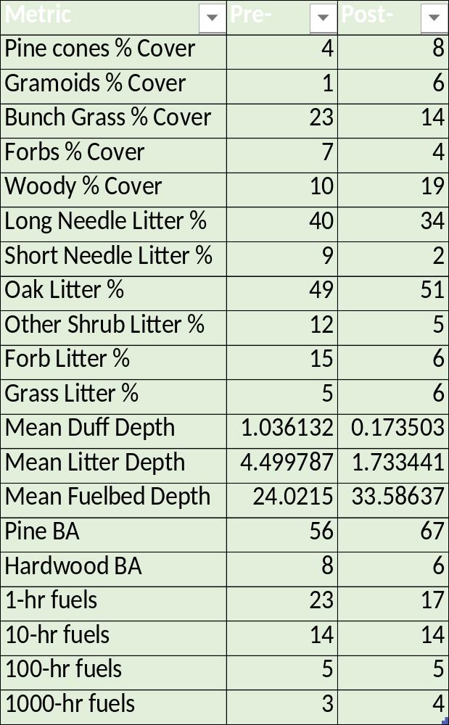
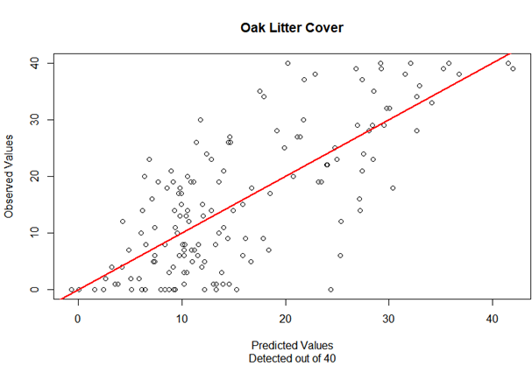
Linear models are used to determine relationships between physical data and point cloud predictions

Slide 18
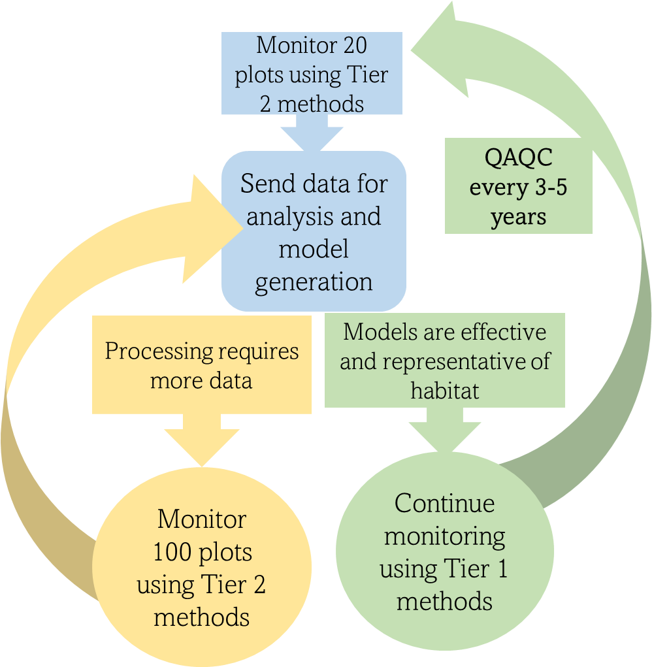
To create models to predict metrics, a large enough sample size of tier 2 plots must be collected.

Slide 19
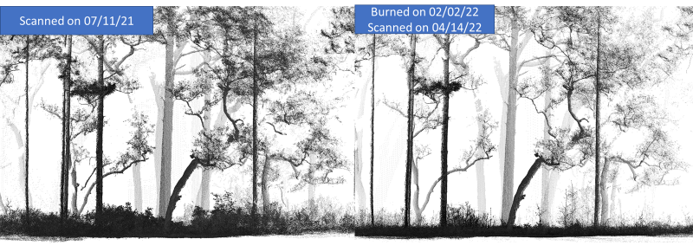
How Can the Data be used?
Measure habitat structure and quantify change from management treatments

Slide 20
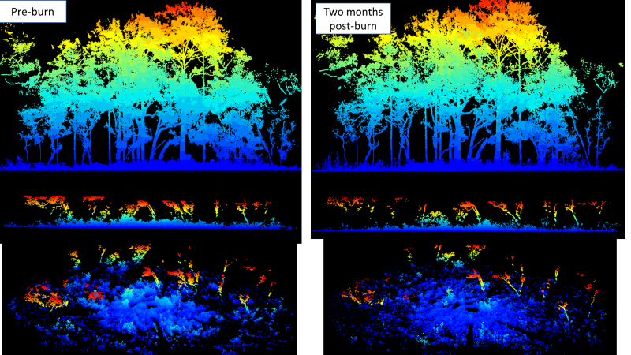
What Will Happen With the Data?

Slide 21
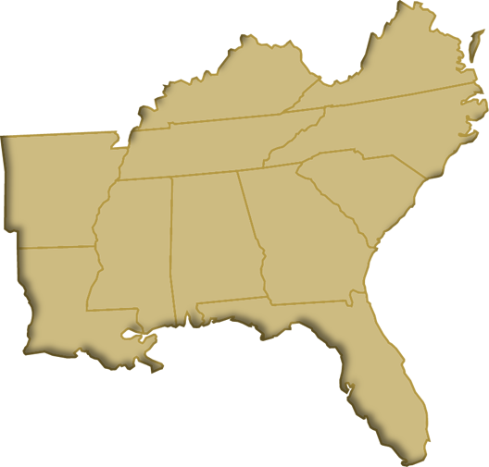
TLS is currently implemented…
8 Refuges, 1 National Forest, 1020 plots and counting
Bon Secour NWR: 8
Grand Bay NWR: 22
Lower Suwannee NWR: 20
Mississippi Sandhill Crane NWR:110
Piedmont NWR: 274
Sam D. Hamilton Noxubee NWR: 137
St. Marks NWR: 209
St. Vincent NWR: 10
Sumter/Francis Marion NF: 230

Slide 22
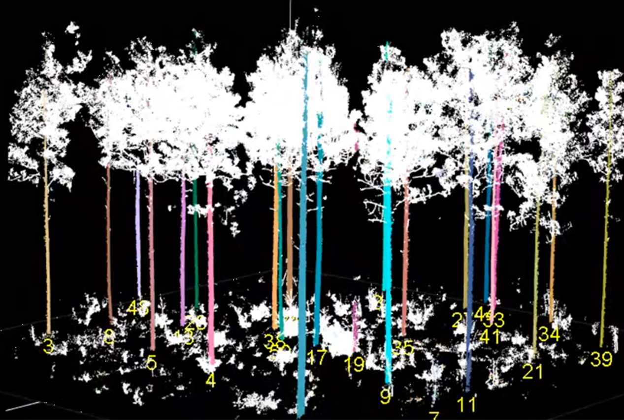

Applications - Forestry
Tree count
Accurate basal area: total, pine, hardwood
Timber volume
Limitation: snags

Slide 23
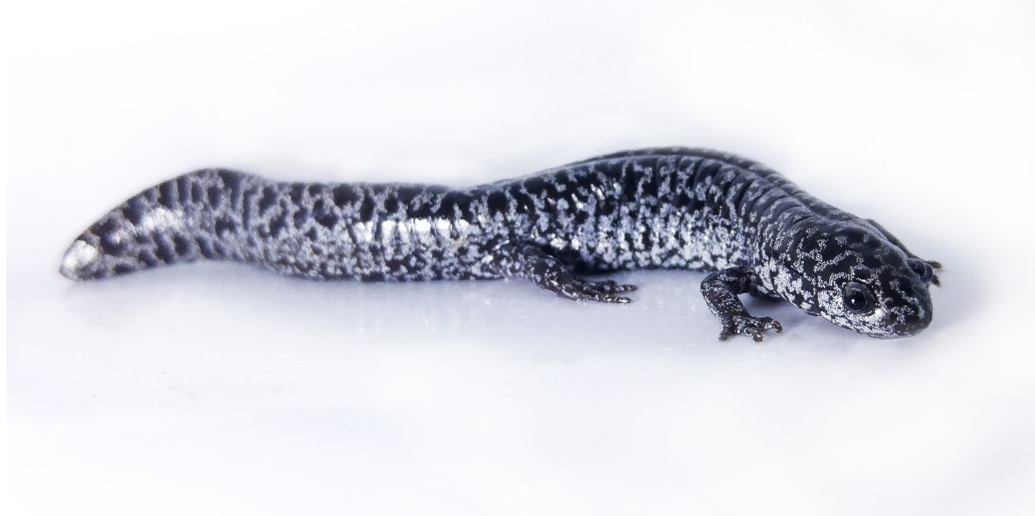
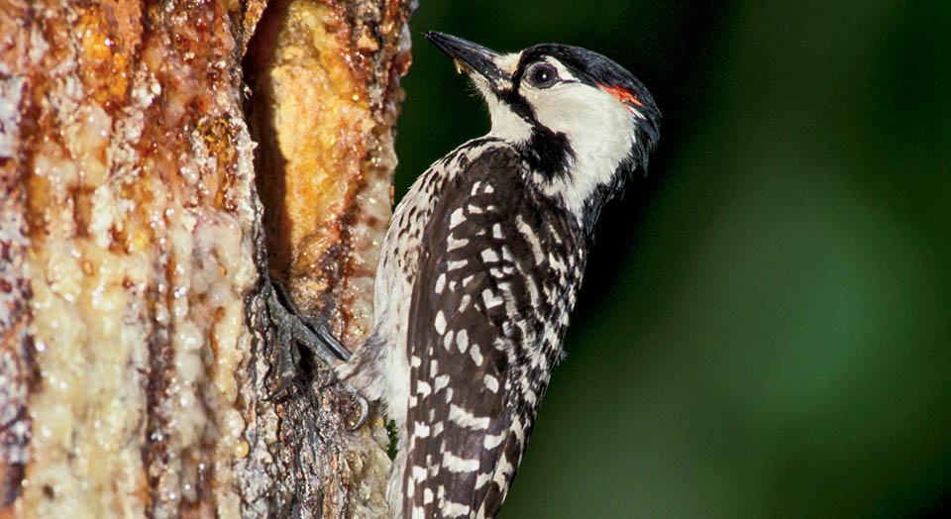
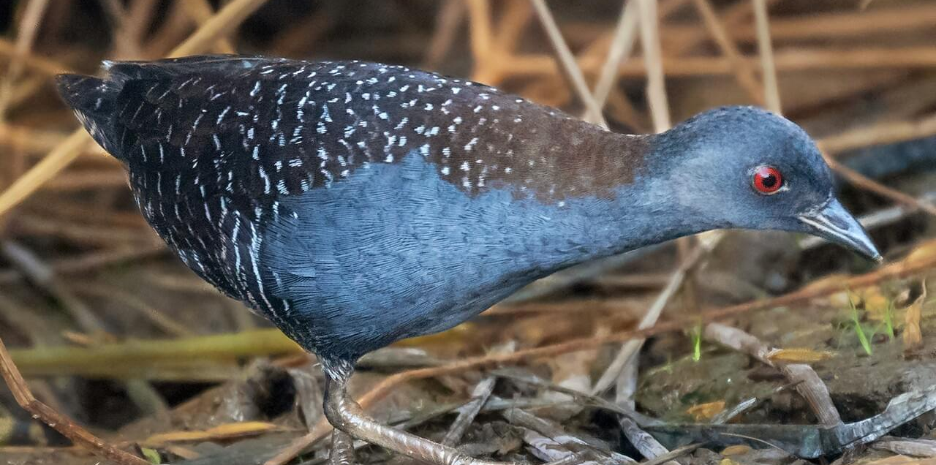
Applications - Biology
St. Marks National Wildlife Refuge
  Frosted flatwood salamander (threatened)
  Black rail (threatened)
  Red-cockaded woodpecker (endangered)
Piedmont National Wildlife Refuge
  Bird richness and habitat structure
  Red-cockaded woodpecker (endangered)
Evaluate critical habitat
Document restoration projects
Identify areas of potential use or for translocation

Slide 24
Questions?
Thank you to anyone who has helped to make this project possible and has contributed to the collection or analysis of data. Special thanks to Scott Pokswinski (New Mexico Consortium) for his dedication to the success of the TLS program.
Contact: emily_link@fws.gov

