Slide 1
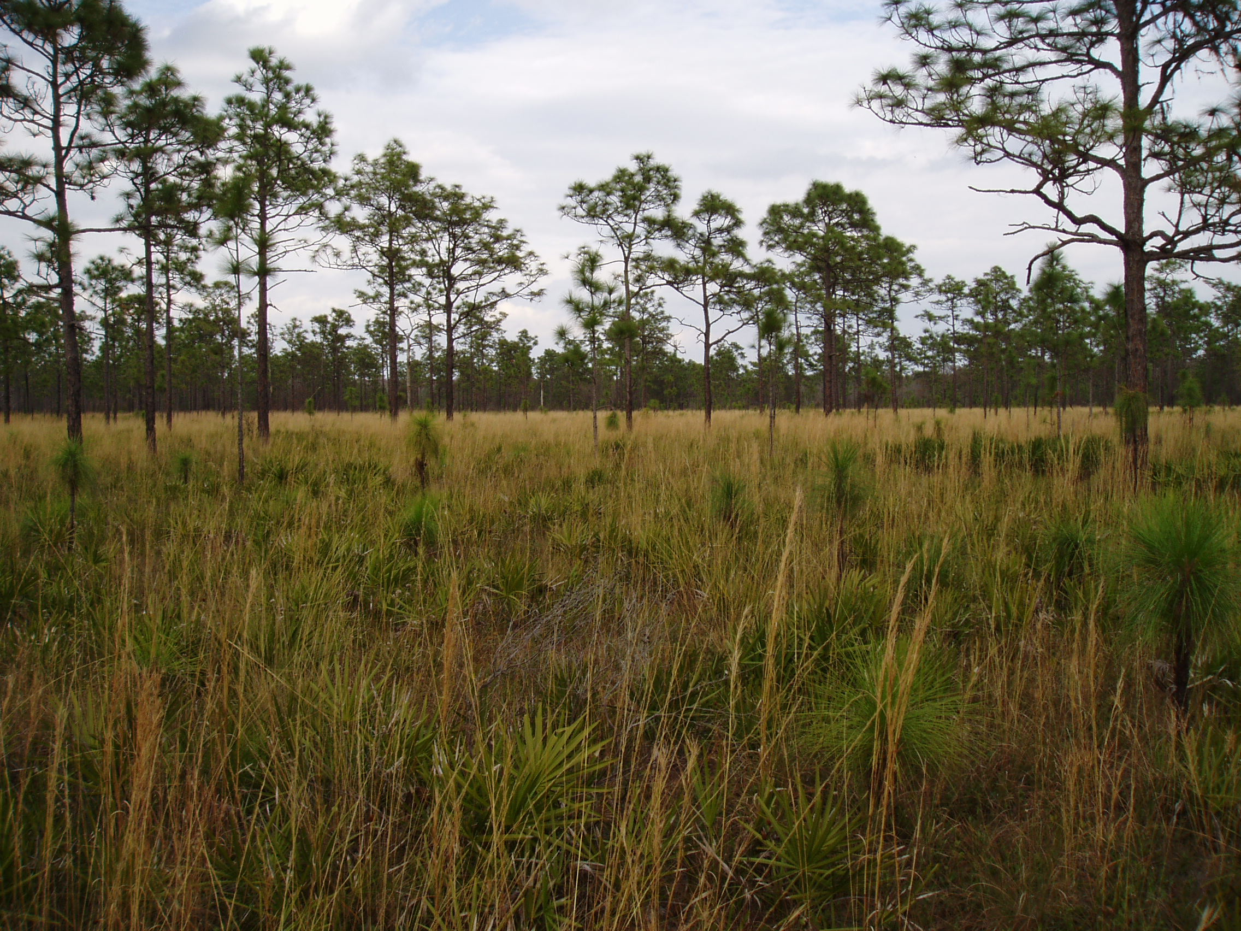
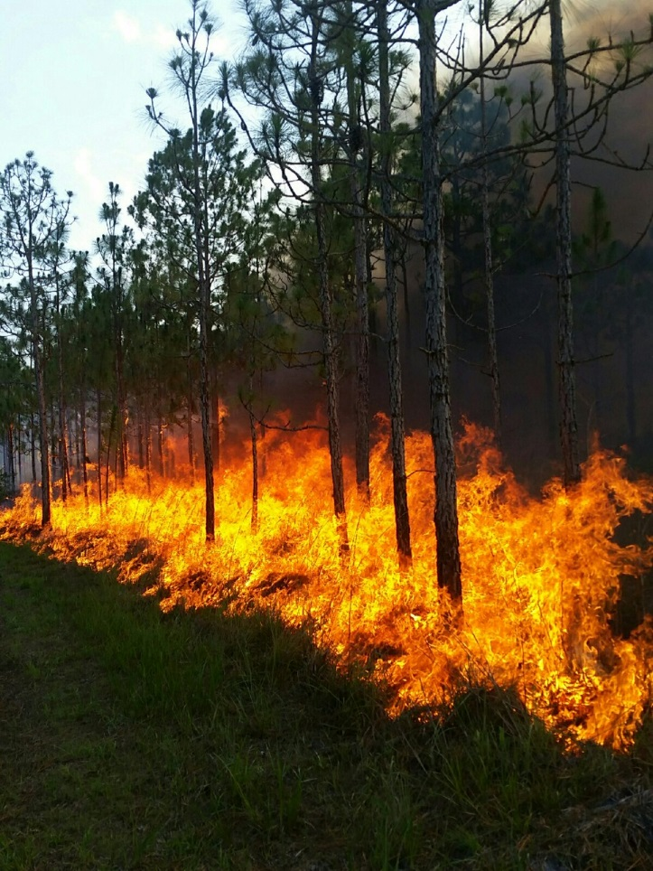

Central Florida Prescribed Fire Council Annual Meeting
October 4th, 2019

Slide 2













Thanks to Our Vendors and Sponsors:

Slide 3
Are you an artist or a graphic designer? Do you know someone who is?
We are looking for ideas to enhance our logo.
Have an idea for next years meeting or know a good presenter?
Please let us know.
- Photo contest
- Equipment garage sale/swap
A big thanks to all of the CFPFC officers and steering committee
members for organizing the meeting and making it happen

Slide 4
Have you heard? We are having a raffle!
You can purchase 1 ticket for $3
2 tickets for $5
or 5 tickets for $10
New Chainsaw
Tickets to Kennedy Space Center
Tickets to Brevard Zoo
Various items from Wildland Warehouse and TNC
and more!!!!!!!

Slide 5
A big thank you to David Hogrefe and Evan Hall for busting the CFPFC right into 2019
WEBSITE:
CFPFC.org
FACEBOOK PAGE:
CENTRAL FLORIDA PRESCRIBED FIRE COUNCIL

