Slide 1
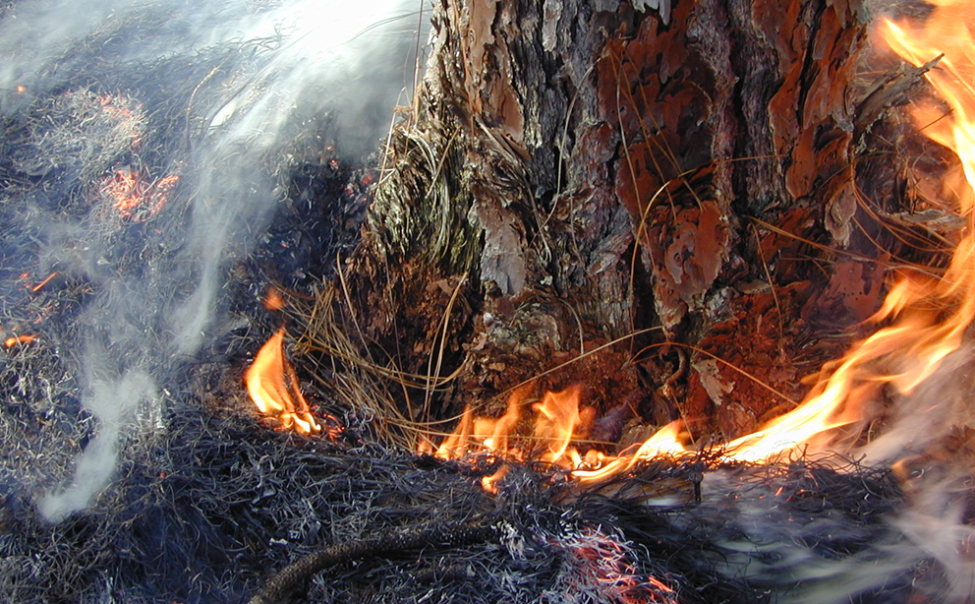
Understanding duff fires and pine mortality
Dr. J. Morgan Varner
Tall Timbers Research Station

Slide 2
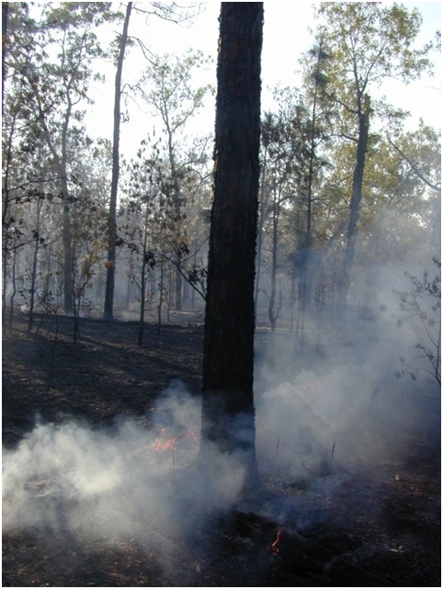






Collaborators and Funding
Collaborators:
Kevin Hiers, Tall Timbers Research Station
Jack Putz & Doria Gordon, Univ. of Florida
Jesse Kreye, Penn State Univ.
John Kush & Ralph Meldahl, Auburn University
Joe O’Brien & Dale Wade, USDA-FS SRS (Athens)
Leda Kobziar, Univ. of Idaho
Eamon Engber & Lenya Quinn-Davidson, Humboldt State University Fire Lab
Bob Mitchell, Jones Research Center at Ichauway
James Furman & Brett Williams, Eglin AFB
Steve Coates & Andy Rappe, Ordway-Swisher Biological Station
Roger Ottmar & Bob Vihnanek, Pacific Wildland Fire Sci. Lab (Seattle)
Many at Eglin AFB and Ft. Gordon (GA)
The Nature Conservancy of Florida & Georgia

Slide 3
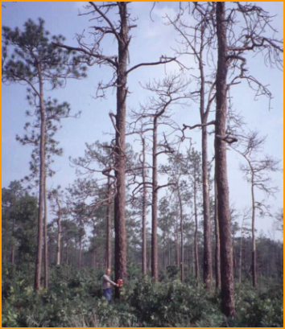
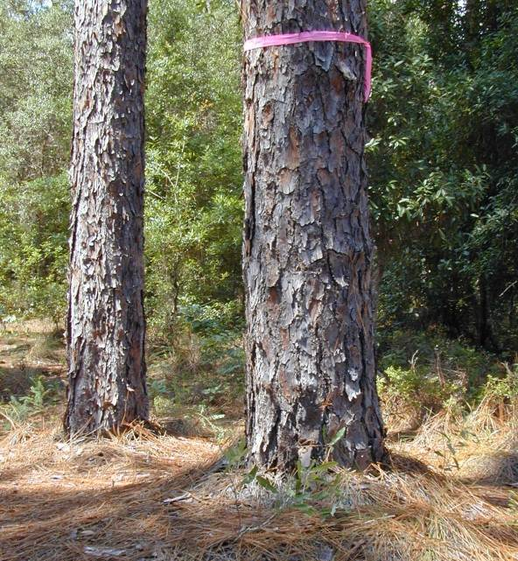
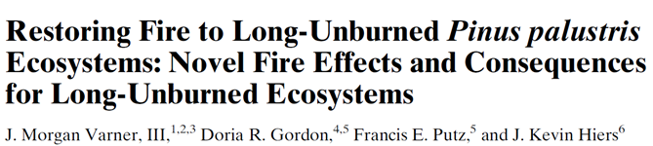
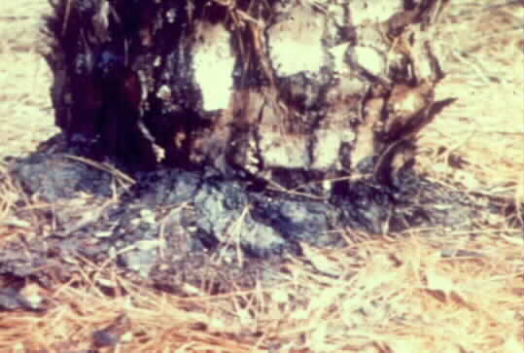
Contemporary Longleaf Pinelands
Varner et al. 2005 Restoration Ecology
Fire exclusion across ½ of area (Outcalt 2000)
  Results of exclusion:
    Structural changes
    Compositional shifts
    Fauna extirpation
    Advent of forest floor
Reintroduction linked to:
    Heavy overstory mortality
    Long-duration soil heating
    Persistent noxious smoke

Slide 4
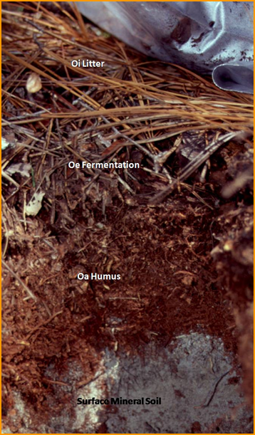
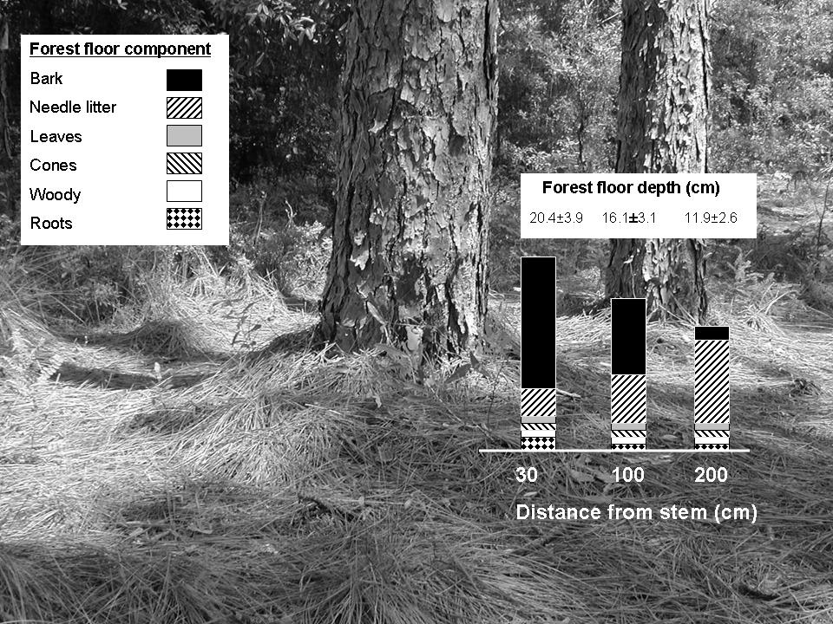

What changed?
“DUFF”
Deep mounds, dominated by bark slough

Slide 5
Management Conundrum:
How to reduce duff
while maintaining large, old pines
Retain large, old trees Reduce duff
High survival = residual duff hazard Consume duff = high mortality

Slide 6
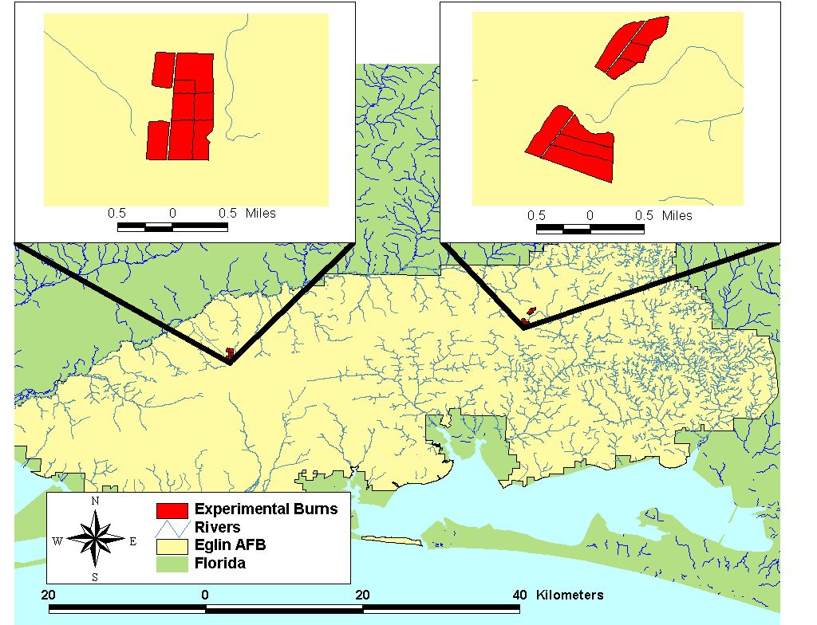
Operational scale Rx fire experiment:
Eglin Air Force Base, FL
4 treatments × 4 reps (>25 ac)
  No burn
  Wet duff (115% mc)
  Moist duff (85% mc)
  Dry duff (55% mc)
Injury surveyed within 3 wks
Mortality surveyed every 6 mo for 2 yrs

Slide 7
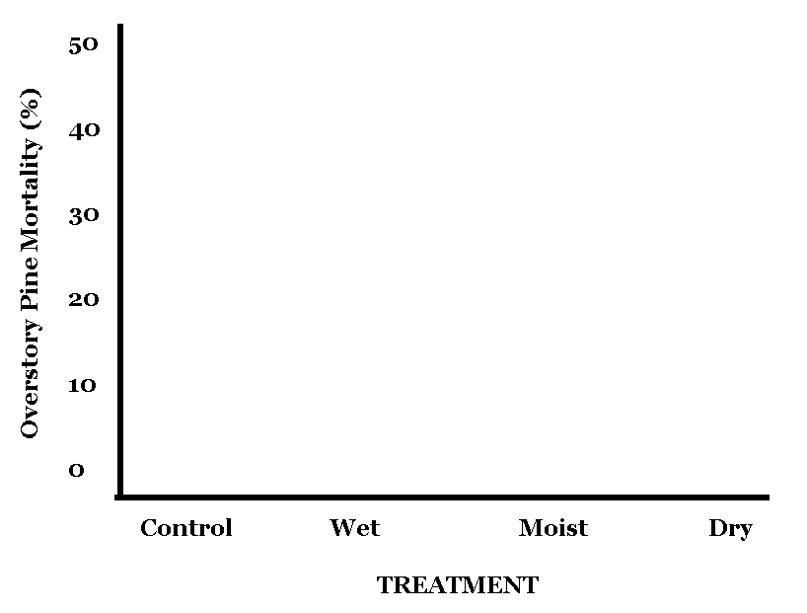
Post-fire pine mortality: Year 1

Slide 8
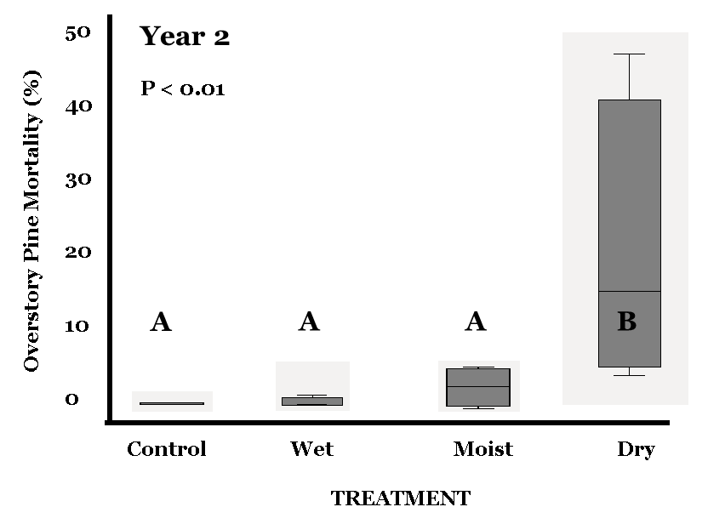
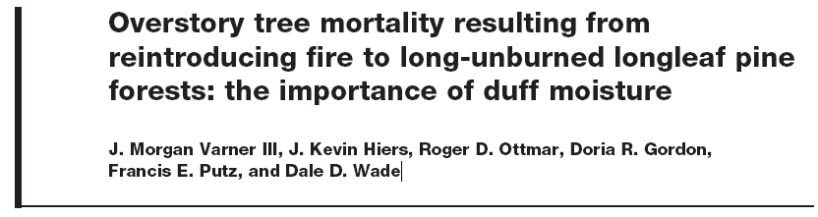
Post-fire pine mortality: Year 2
Mortality delayed 18-24 months
Mortality peaked in dry burns
Mortality in unburned not different from moist & wet

Slide 9
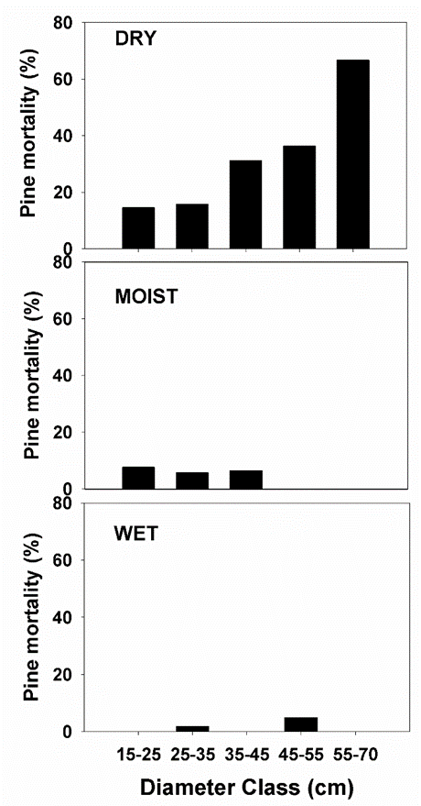
Which pines died?
Varner et al. 2007 Can. J. For. Res.
Dead DBH > Live DBH*
Pines < 16” DBH= 19% mortality
Pines > 16” DBH= 53% mortality
Crown scorch also important

Slide 10
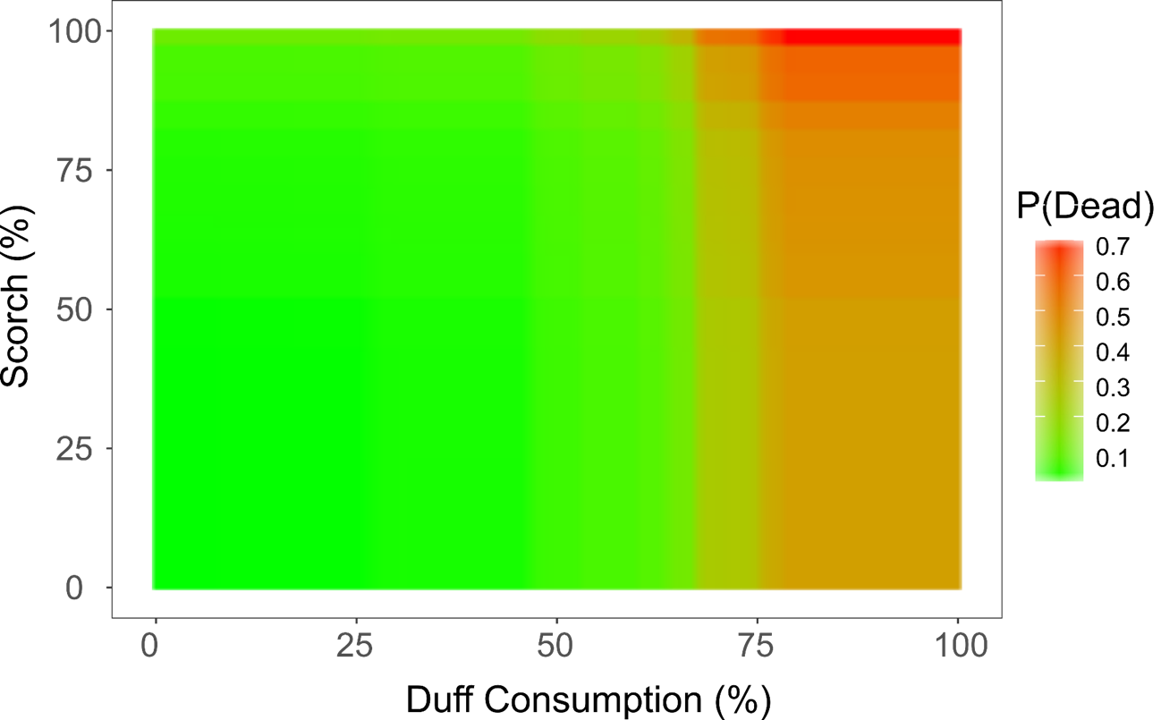
Which more important: duff or scorch?
Shearman et al. Ecological Modeling (In review).

Slide 11
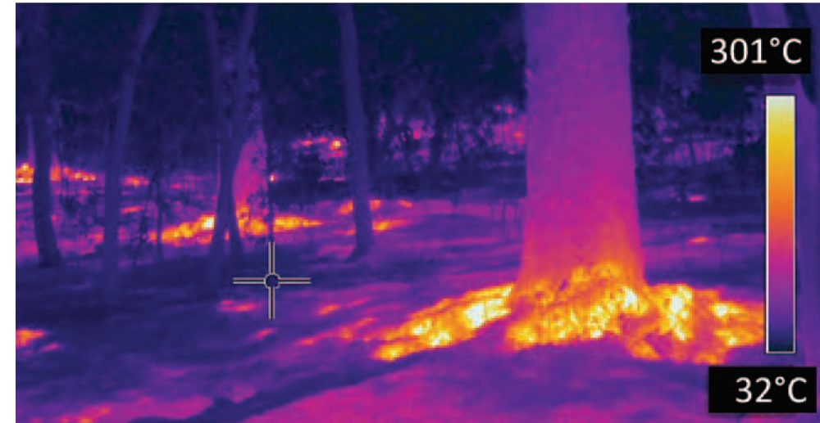

Slide 12
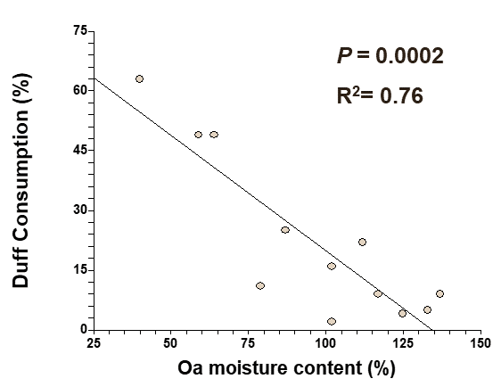
What drives duff consumption?
Varner et al. 2007 Can. J. For. Res.
Lower duff moisture drives consumption.

Slide 13
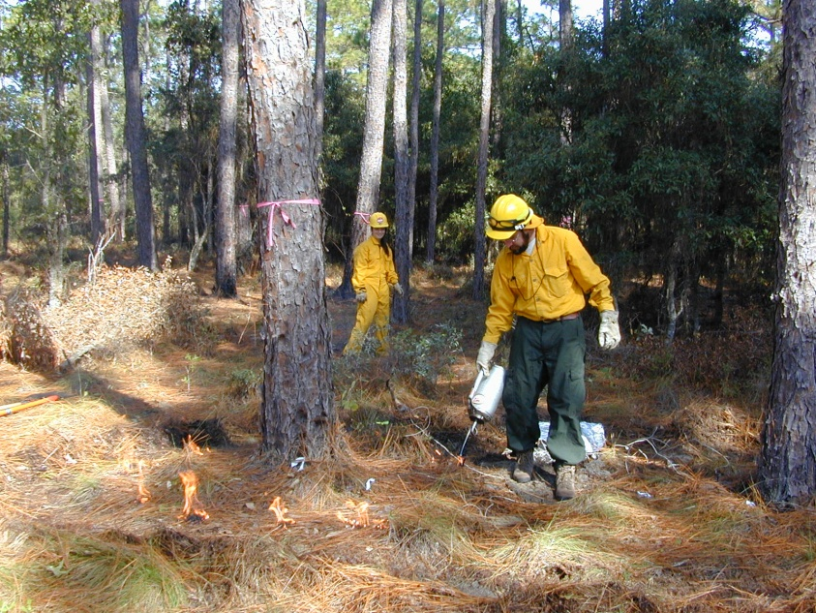
What makes these pines die?
Ordway-Swisher Biological Station, FL
Long-unburned (37 yrs)
Pinus palustris-Aristida-Quercus
Deep forest floor
Experiment: 4 treatments×20 trees
  “injury” treatments
    ROOT
    STEM
    ROOT + STEM
    CONTROL (×2)

Slide 14
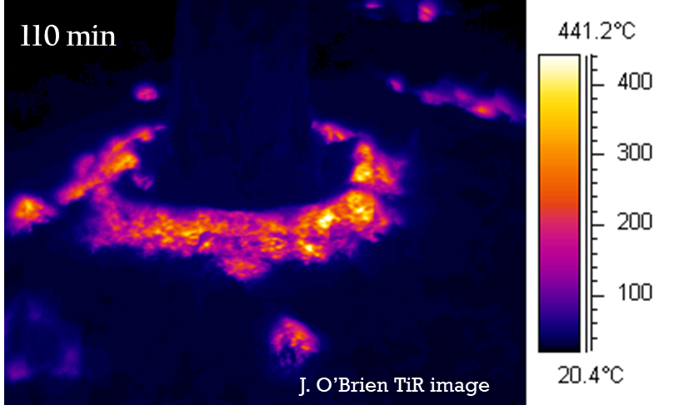
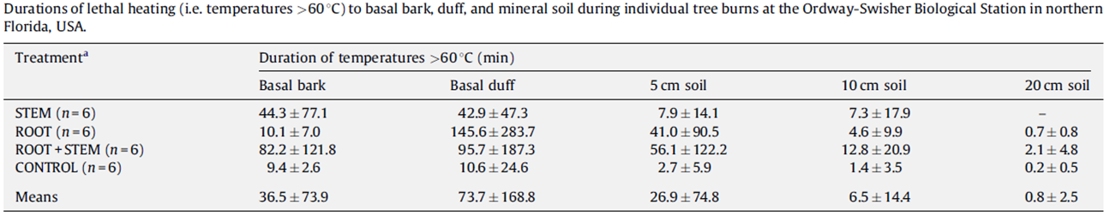
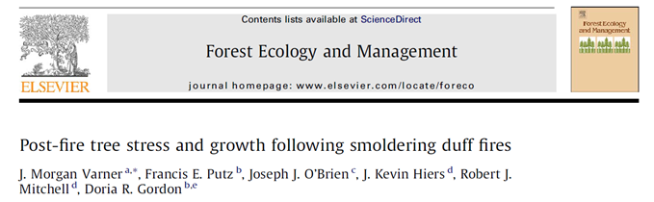
Patterns of heating during fires
25% of all burns recorded lethal temperatures (<140F) at 8” depths
At 4” deep, averaged 6 minutes of lethal heating
Varner et al. 2009 Forest Ecol & Management

Slide 15
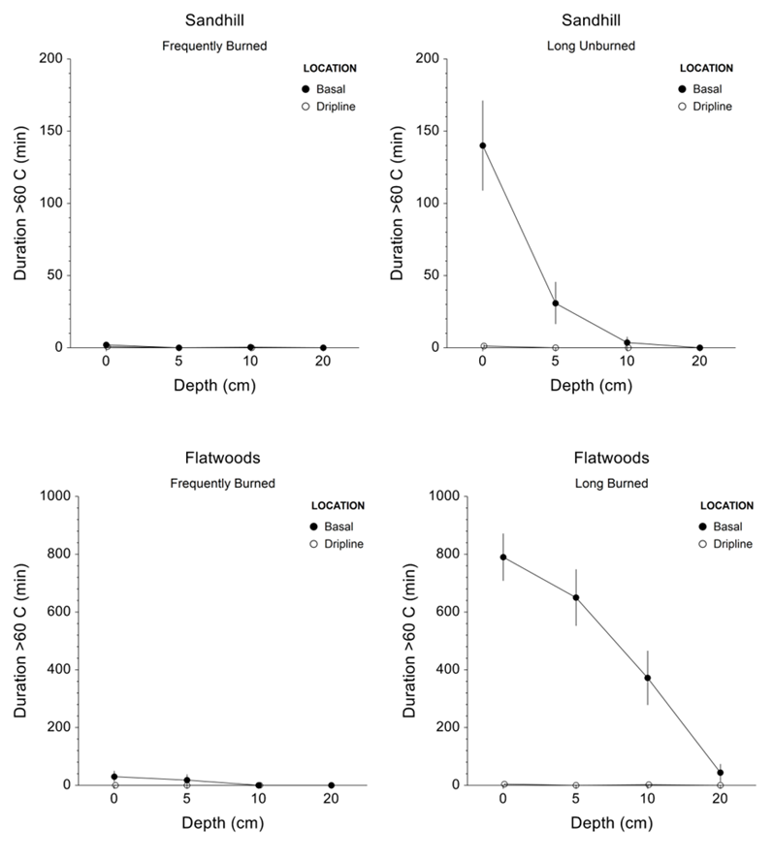
Heating during fires: what about flatwoods?
Sandhills:
~2 minutes of lethal heating at 4”
Flatwoods:
~6 HOURS of lethal heating at 4”
Kreye et al. Forest Science (In review)

Slide 16
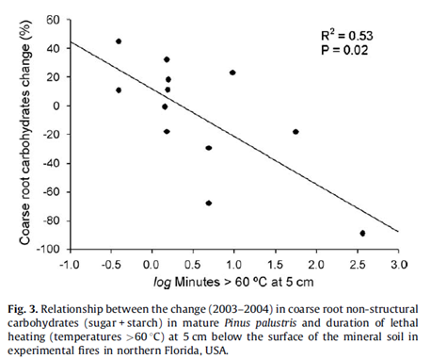
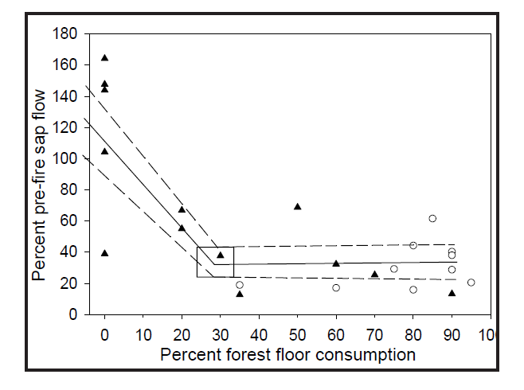
Trees get stressed via root injury
O’Brien et al. 2010 Fire Ecology
Varner et al. 2009 Forest Ecol. & Mgmt
Pines sensitive to duff consumption & soil heating
Declines in root starch
Reductions in sap flow
Reductions in leaf N
Reductions in latewood growth

Slide 17
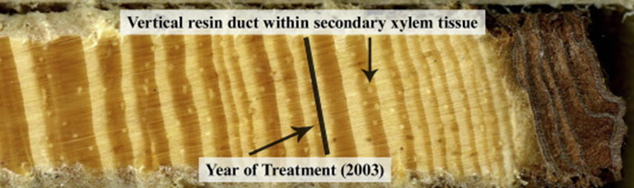
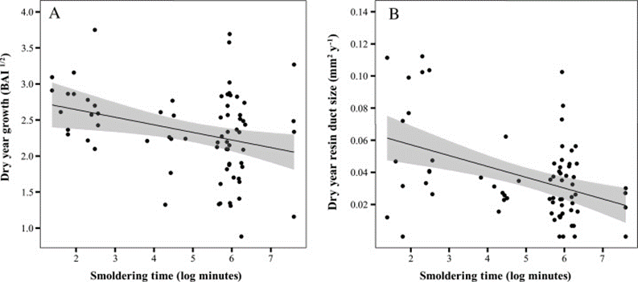
Stress endures for a decade
Slack et al. 2016 Forest Ecol. & Mgmt
Pines had reduced resin defense
Pines had slower growth during droughts as many as 10 years post-burn

Slide 18
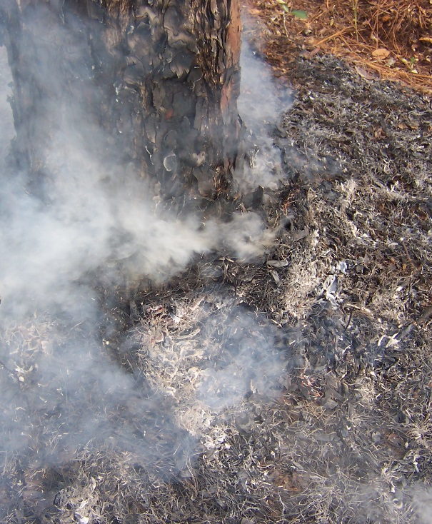
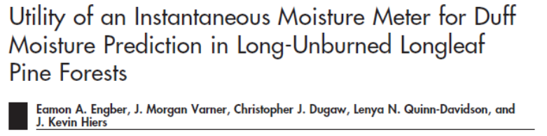
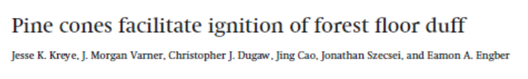
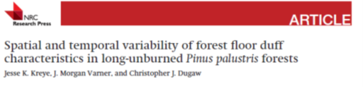
How to manage duff consumption?
Duff consumption a function of MOISTURE, but…
Burning following rainfall
Small and large scale approaches
“Peeling the onion”

Slide 19
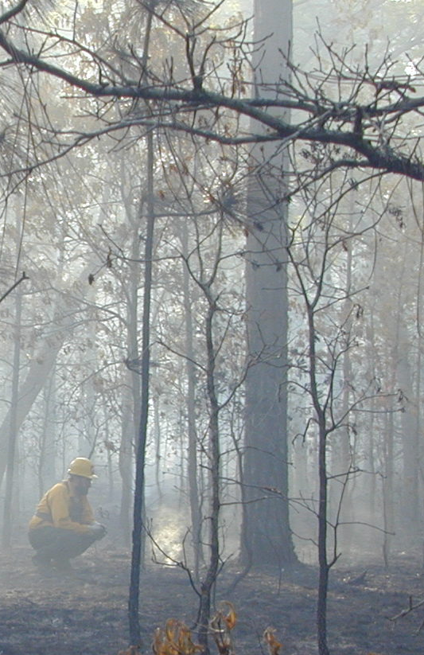

Advent of forest floor is a major threat
Duff-fire caused mortality a serious issue
  Pine stress & mortality
Duff consumption is key
  Linked to moisture
Much to learn…

Slide 20
How have you been successful?

Slide 21
What are the patterns in large pine mortality?

Slide 22
