Slide 1

FFS Update – Fall 2019
Central Florida Prescribed Fire Council Meeting 10/42019
John Saddler
Prescribed Fire Manager

Slide 2
FFS Update
Changes to Rx Burning
Splendid Year for Burning
Upcoming Training
Prescribed Fire Enhancement Program
Backyard Air Quality Monitors
Burner Review

Slide 3
Changes To Rx Burning
fiResponse
  New Dispatch System – Primarily for Wildfire
  Public maps will include P-burn locations
New Smoke Plume
  HYSPLIT vs. V-Smoke
  WRF (Warf) vs. MM5
Air Quality Index (AQI)
  AirNow.gov

Slide 4
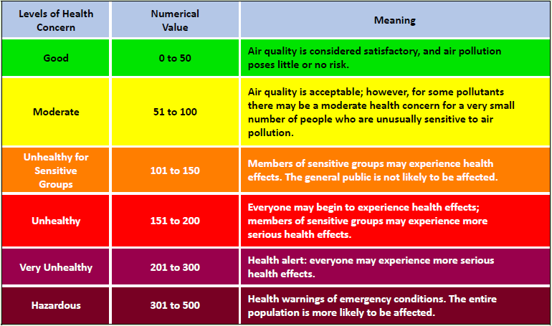
Air Quality Index (AQI)

Slide 5
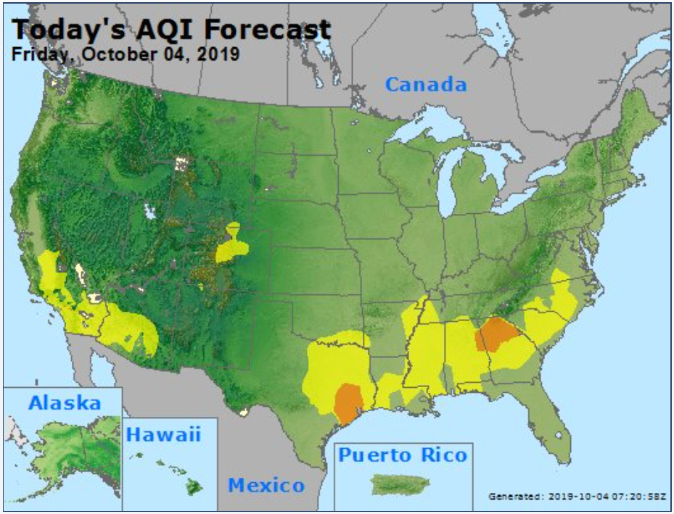
AirNow.gov AQI Forecast

Slide 6
Authorized Prescribed Burn Acres By F/Y
(Million Acres)

Slide 7
2019-20 CPBMT Courses
Brooksville: Sept. 30-Oct. 3, 2019
Chipley: November 13-15, 2019
Tallahassee: December 2-4, 2019
Jacksonville: December 3-5, 2019
Ft. Myers: January 21-23, 2020
West Palm : January 27-30, 2020
Apopka: February 3-6, 2020

Slide 8
Prescribed Fire Enhancement Program
One Million Dollars to Enhance Rx Burning
  Florida Fish and Wildlife
  Florida Park Service
  Northwest Florida Water Management
  Suwannee River Water Management
  St. Johns River Water Management
  Southwest Florida Water Management District
  South Florida Water Management District

Slide 9
Prescribed Fire Enhancement Program
Prescribed Fire Messaging Campaign
  Statewide Campaign
  Working With Tall Timbers
  Multi-agency Partners Wanted

Slide 10
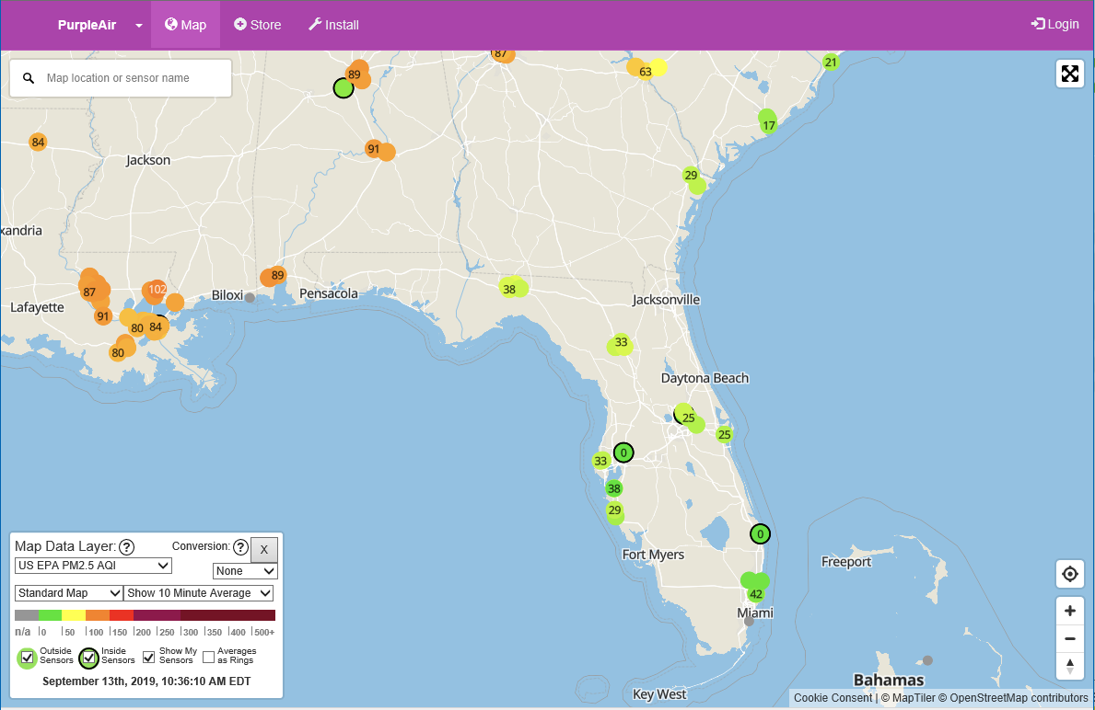
Backyard Air Monitors

Slide 11
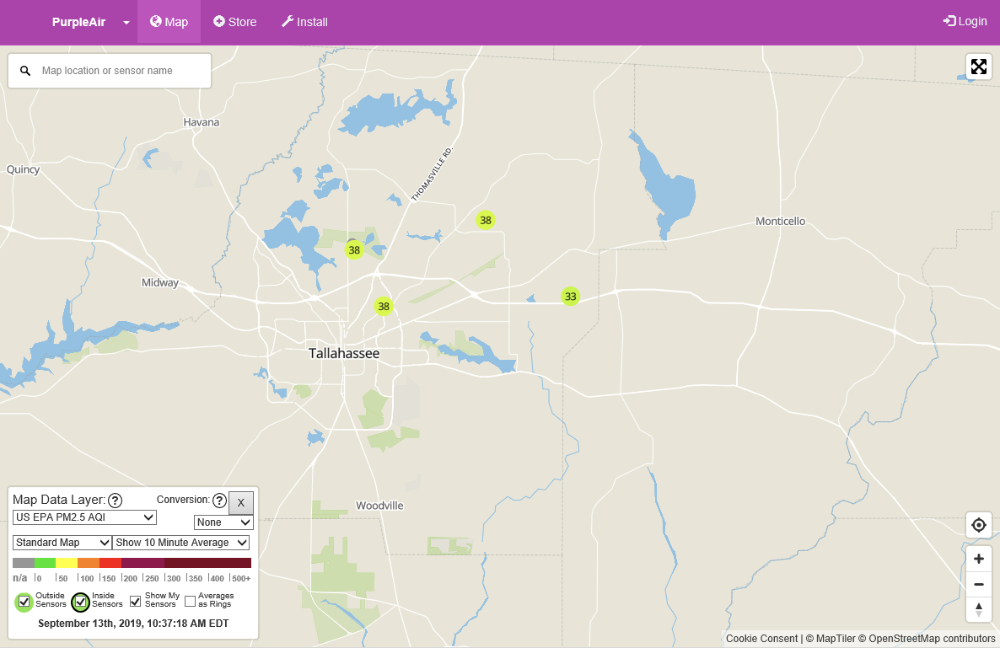
Backyard Air Monitors

Slide 12
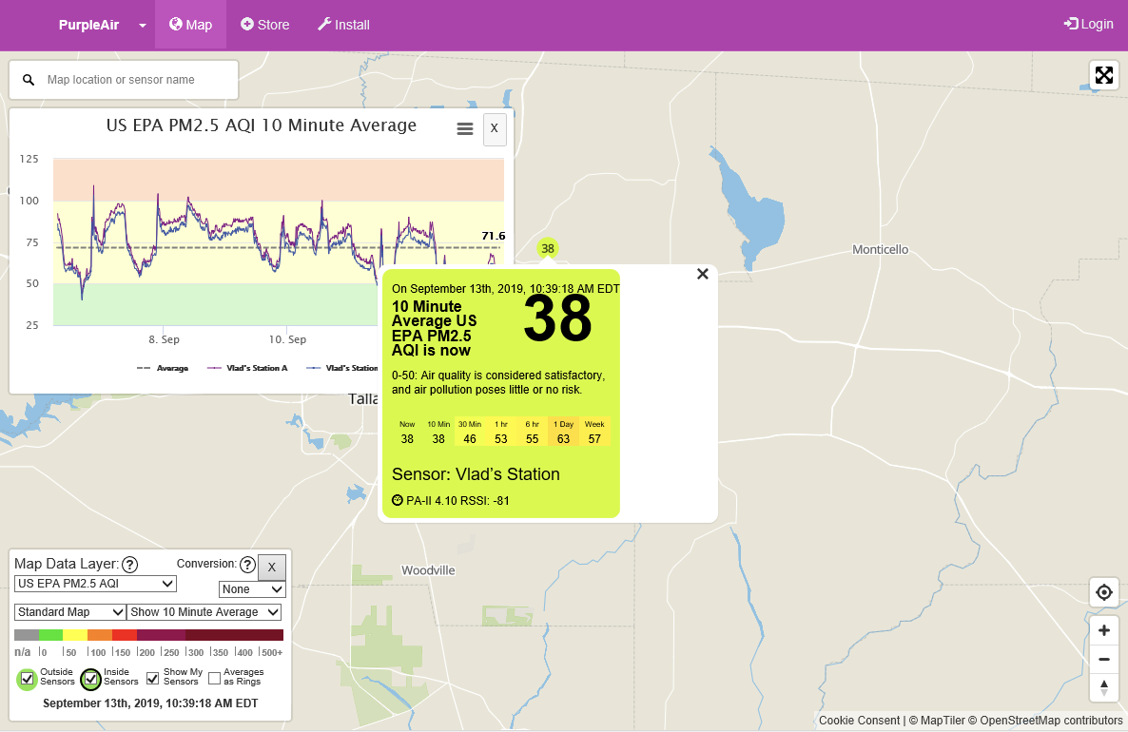
Backyard Air Monitors

Slide 13
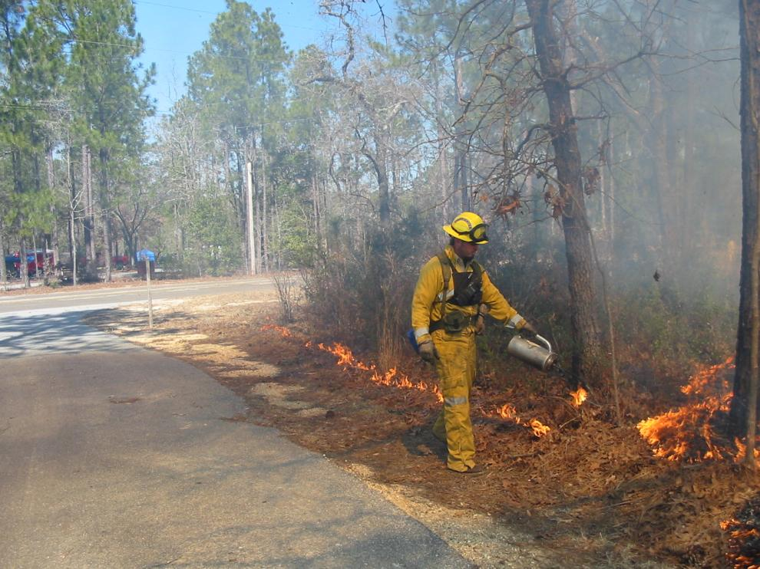
Burner Review

Slide 14
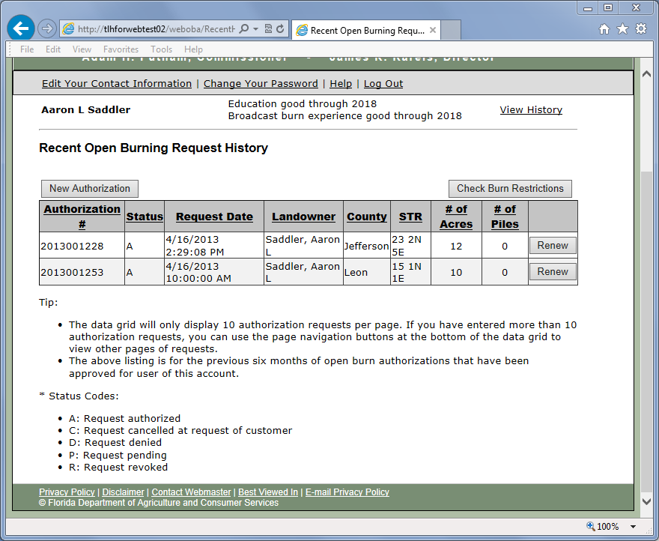
Check Your Status

Slide 15
Burner Status Letters
Mailed at the end of January
  Green = Status good beyond end of year
  Yellow = Status will expire at end of year
Keep your contact information current
  Used to send letters
Let the Duty Officer know that you are doing a certified burn
  WebOBA system requires this

Slide 16
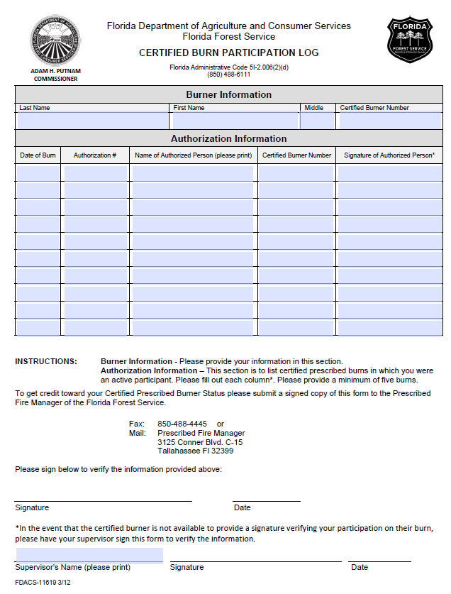
Burn Participation Log

Slide 17
Things to Remember
Your prescription is a legal document
  Make sure information is complete
  Make sure information is correct
  Signature with date
  Add authorization number
  Take it to the burn
  Keep it in your files for future use
  Tell us you are doing a certified burn

Slide 18
Other Items
New Email for FFS
  FreshFromFlorida.com
  FDACS.gov
Smokey is 75
We are all in this together!

Slide 19





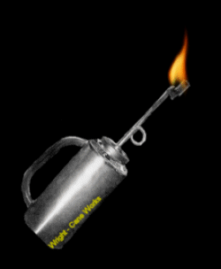
Questions?
Contact
John Saddler
850-681-5928
John.Saddler@FDACS.gov

