Slide 1
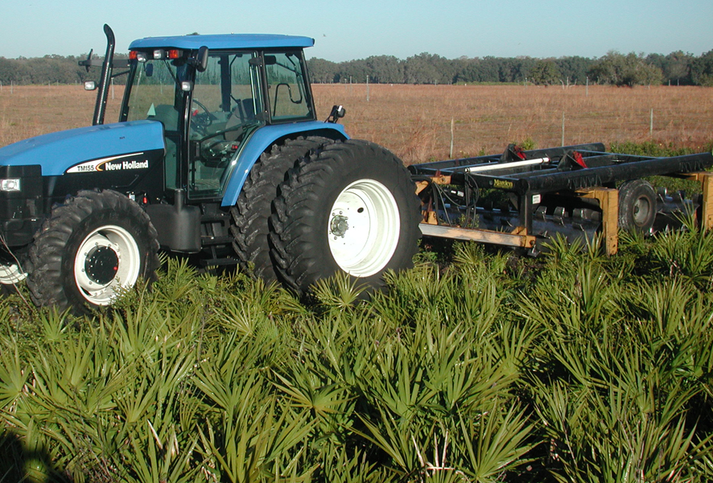
Rx for
Restoration
Roller-chop
with Rx Fire
Paula Benshoff
Robert Dye
Jean Huffman

Slide 2
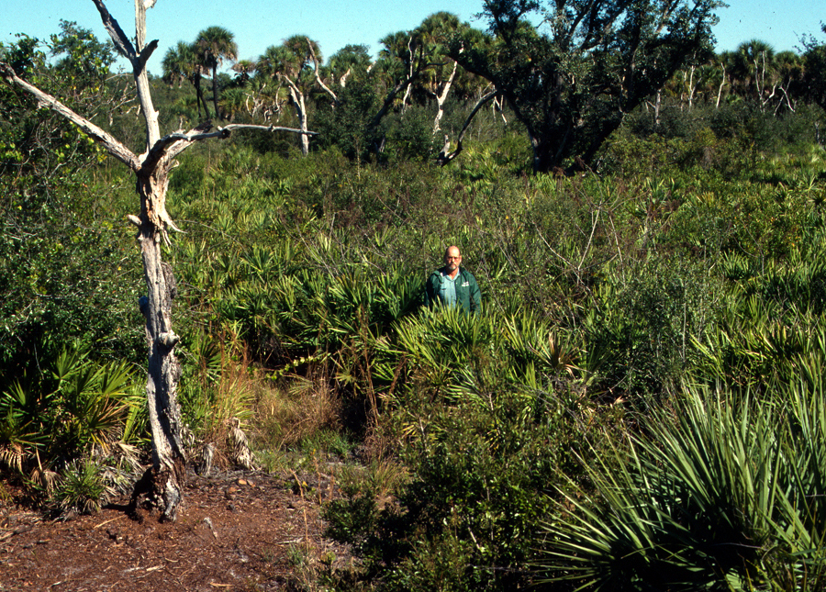
Notes:
Three decades ago, the three of us happened to come together at one of the most fire-excluded public lands in the state.

Slide 3
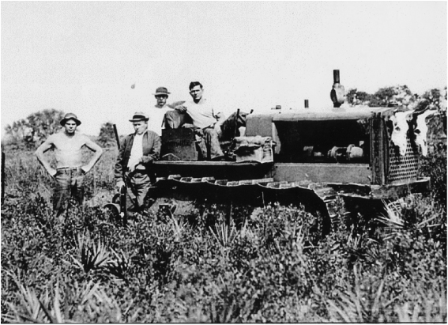
Notes:
Myakka River State Park was acquired in the 1930s, then manned by the Civilian Conservation Corps, 50 energetic young men with a passion for fire suppression.

Slide 4
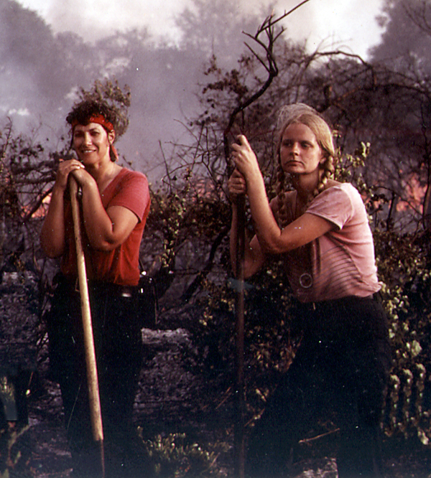
(Yes, this was ALL our PPE in 1981.)
Notes:
By the time I hired on as a ranger, the park service had begun “control burns” but only in the winter. Forest rangers were still burning with backing fires and the roller chopper was primarily used to convert native range to bahia grass or for site prep for planted pines.

Slide 5
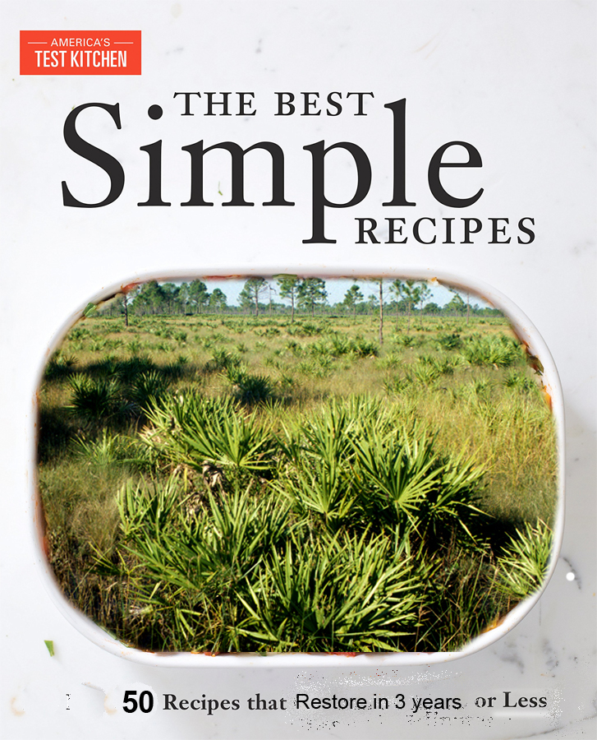
Weather
Site History
Equipment Operators
Micro elevation variation
Species Composition
Notes:
Land Management is not a simple process. There is no one-size-fits all recipe. There are too many variables: weather—before and after treatment, site history, equipment operators, micro variation in elevation, species composition, and so many more. Even the few roller chopping studies that are out there are insufficient to provide exact formulas. There are too many variables they did not consider.

Slide 6
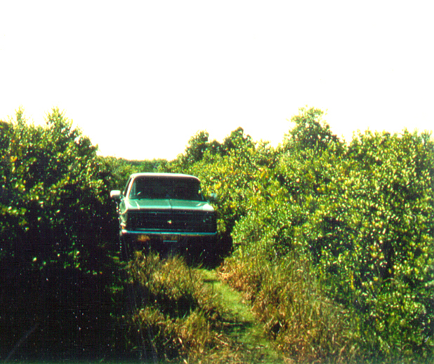
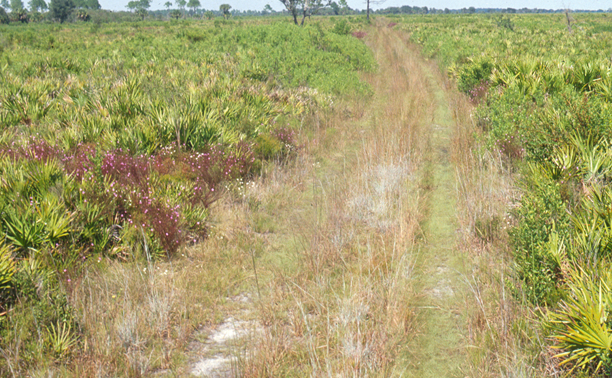
Deer Prairie Lane 1984
Deer Prairie Lane
2003
Notes:
So we don’t claim to have all the answers. But over the years we have tried many variations in Rx fire and mechanical treatment. So we are here today to share our story so you don’t have to re-invent the wheel or perhaps ruin the land you want to restore. So here’s the story:

Slide 7
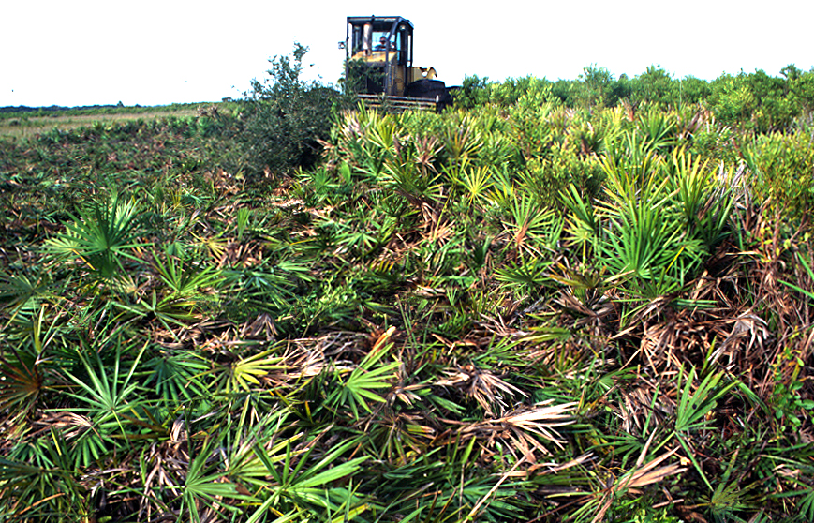
In the beginning…
Notes:
Restoration roller-chopping was first introduced into Florida State Parks in the late 1980s to treat extremely long unburned prairies and flatwoods. By that time the decades of fire exclusion had produced a near monoculture of palmetto cover,

Slide 8
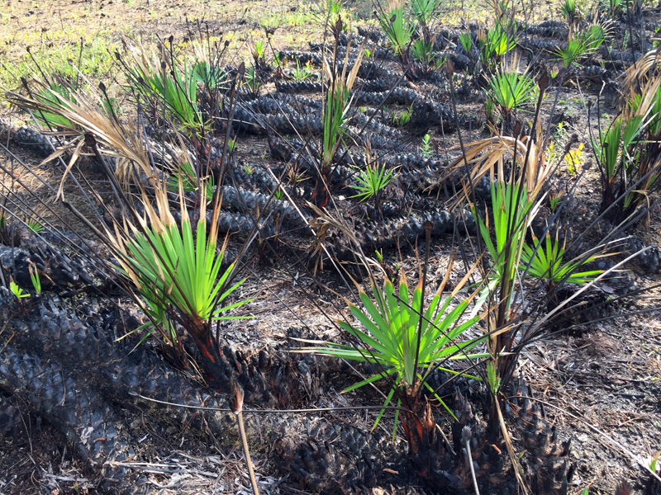
Notes:
with woody trunks often covering the ground’s surface.
After a few burn cycles we realized this condition could not be remedied with fire because fire would not carry at a natural burn frequent enough.. The thick woody stems snaking along the ground, sometimes called gator-back palmettos, are uncommon in fire maintained prairies and flatwoods

Slide 9
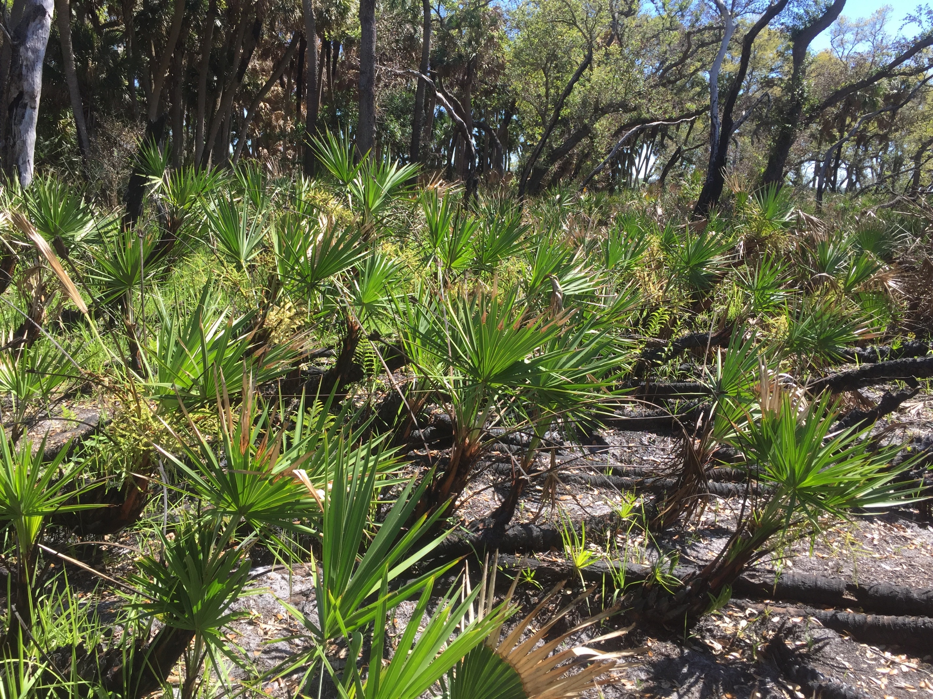
Notes:
. So the theory was that if we could remove them, it would clear the way for a better diversity of grass, forbs and low shrubs.

Slide 10
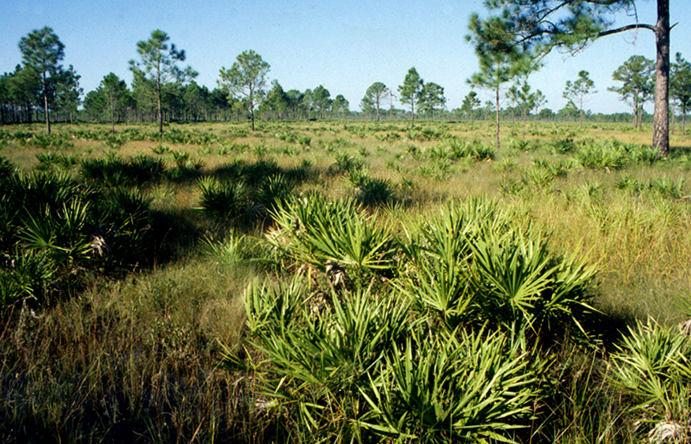
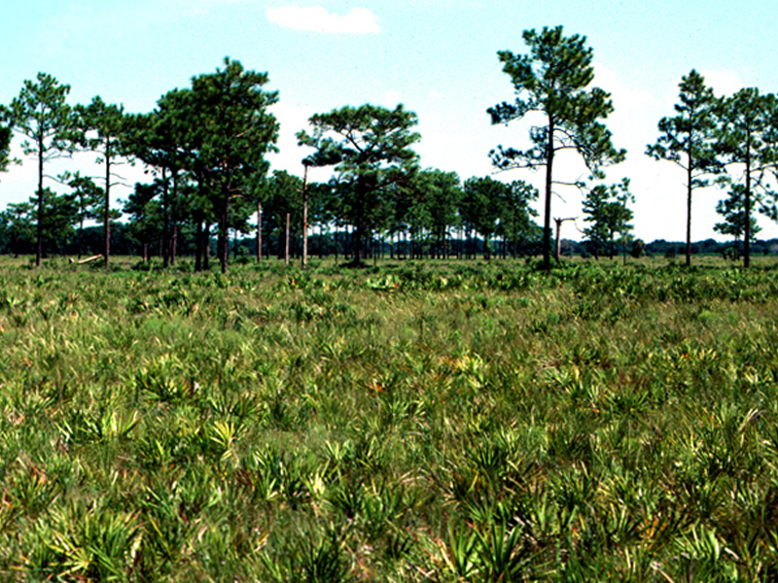
Cecil Webb Wildlife Management Area
Roller Chopped Flatwoods
Cecil M. Webb Wildlife Management Area
Rusty Pot Ranch - Manatee County
Notes:
In his quest to find a solution, the park manager discovered that Larry Campbell at Cecil Webb Wildlife Management Area was using a roller chopper to enhance quail habitat. He found that a local cattle rancher chopping without totally eradicating native groundcover. The result was the decision to experiment with roller chopping. It took a lot of convincing and many field trips, but finally Park Service upper management gave permission to try it out at MRSP.

Slide 11
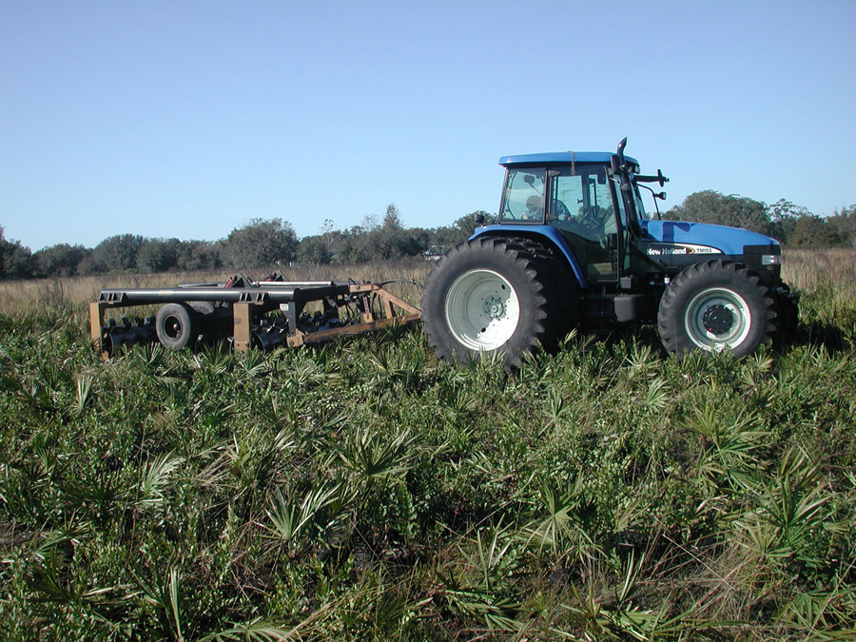
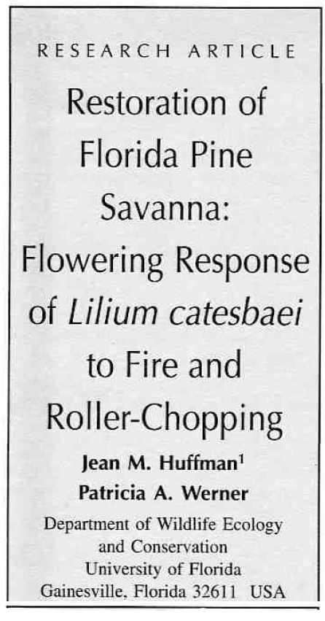
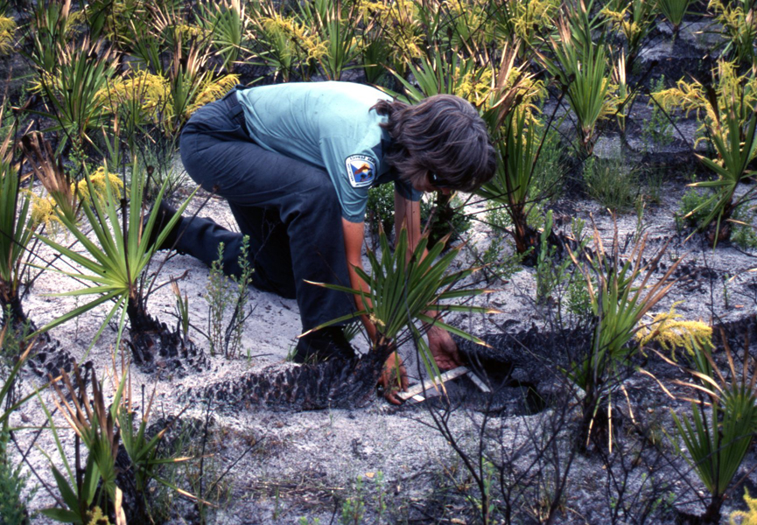
What is Restoration Roller-chopping?
Notes:
After much experimenting, trials, monitoring and documentation, a methodology was defined and named “restoration roller chopping.”

Slide 12
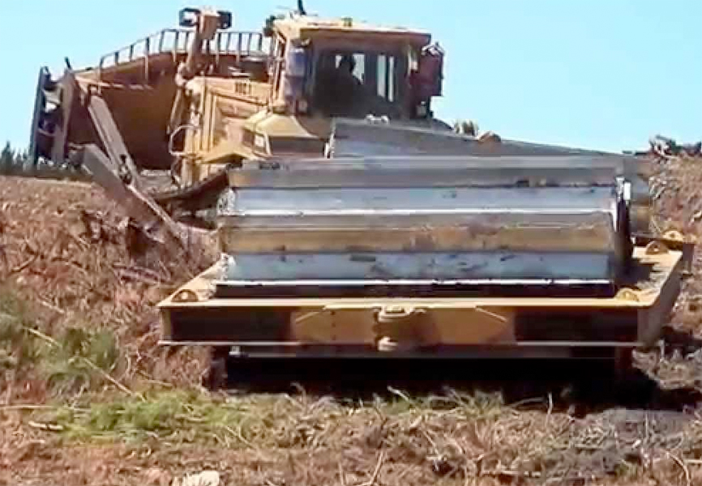
Traditional = Siviculture &
Range Mgmt
Roller-chopping destroys native groundcover
Notes:
Restoration roller-chopping differs significantly from other types of roller-chopping methods, such as forestry, site clearing, agricultural and pasture roller-chopping.
Other types of roller-chopping are infamous for destroying native groundcover. The same risk exists for this process if it is misapplied by land managers lacking an understanding of how, when and where to use it.

Slide 13
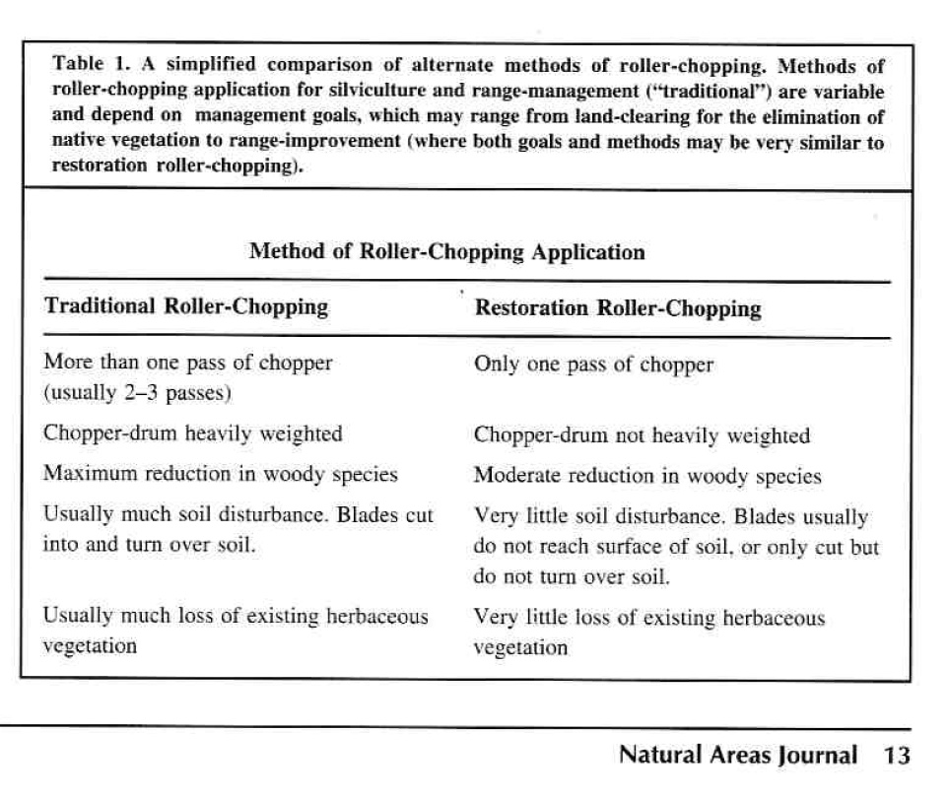
What is Restoration Roller-chopping?

Slide 14
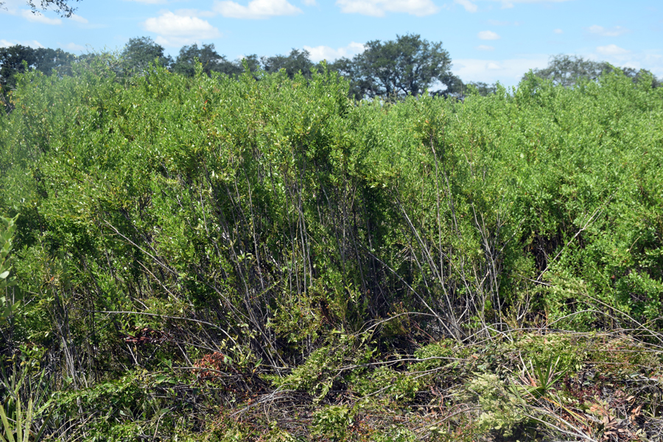
To chop or not to chop….
Rx=Repetition of lightning season burns
Notes:
Roller chopping is not the answer to all restoration challenges. For example, it is not the best tool to reduce shrub cover. Some common flatwoods shrub, produce suckers when cut, which results in an increase in woody vegetation. Gallberry is particularly known for this, especially when paired with winter burns. Repetition of frequent lightning season burns is the best rx to reduce shrubs.

Slide 15
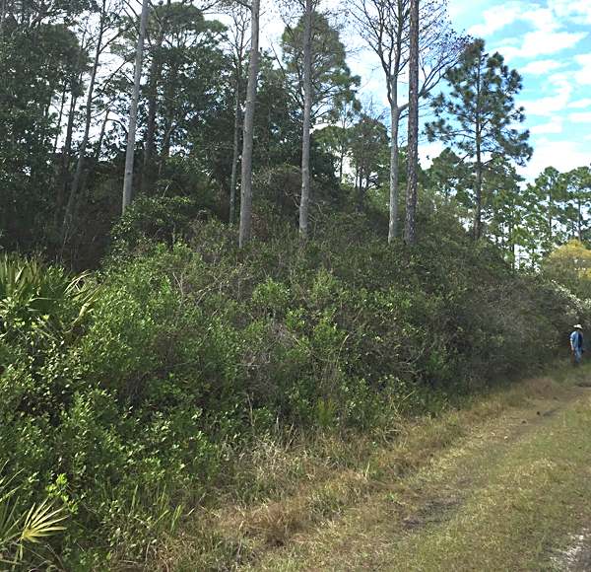
St. Joe Buffer Preserve
Notes:
Here is an example. The park biologist at Myakka eventually moved to North Florida and took over the management of St. Joe Buffer Preserve. The flatwoods were in pretty rough condition when I visited her there.

Slide 16
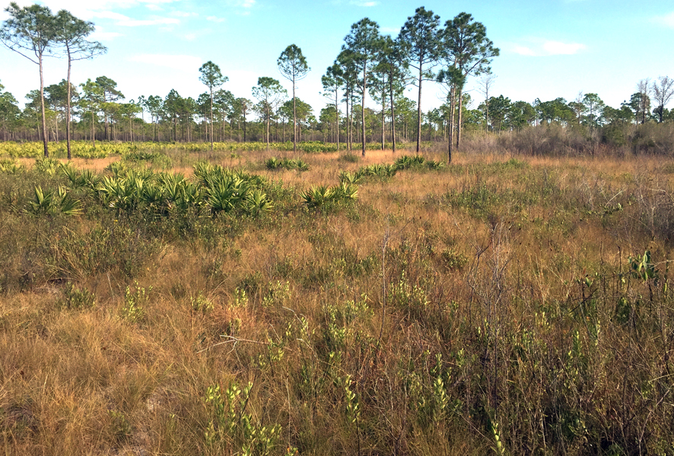
Notes:
But when I visited a decade later, I found an amazing transformation.

Slide 17
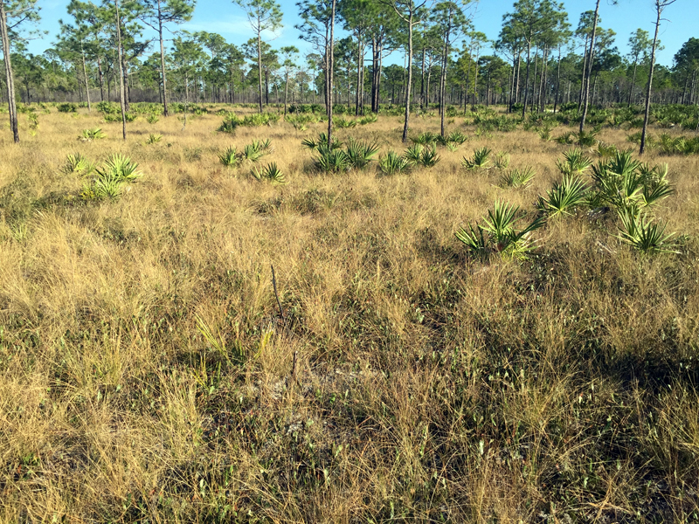
Notes:
The restoration was accomplished complete with frequent lightning season burns.

Slide 18
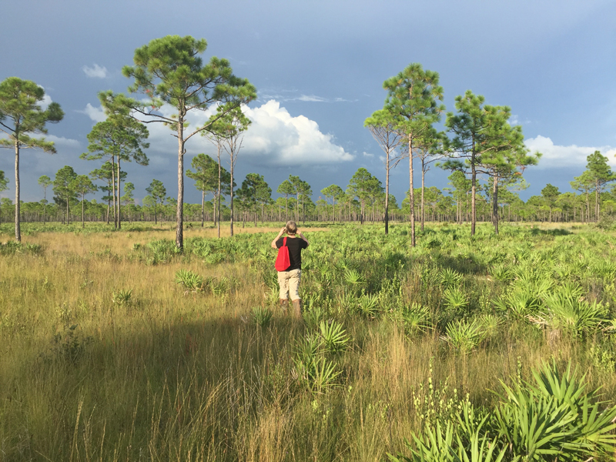
Notes:
I asked her what she thought the difference was between restoring Myakka River and restoring St.Joe.

Slide 19
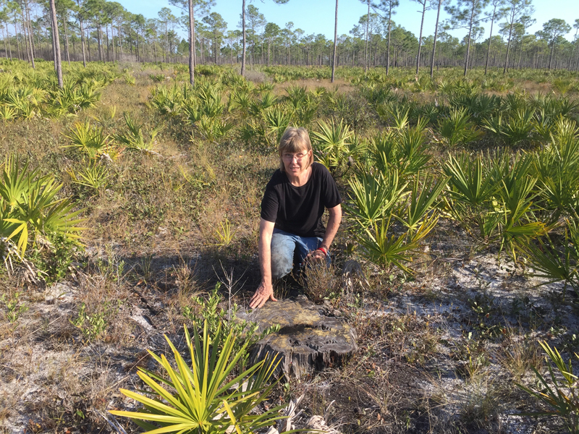
Notes:
Her opinion was that palmetto dominated flatwoods and prairies that have only experienced a decade or two of fire-exclusion can often be restored with frequent lightning-season burns

Slide 20
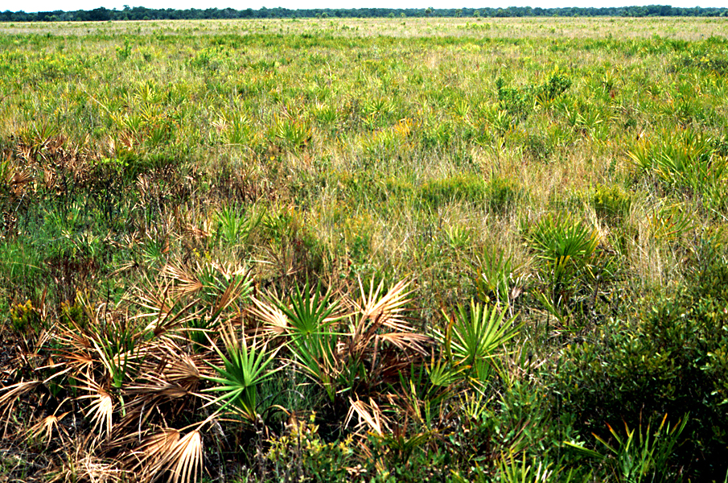
6 months post chop
Notes:
The goal of restoration chopping is not to remove palmetto

Slide 21
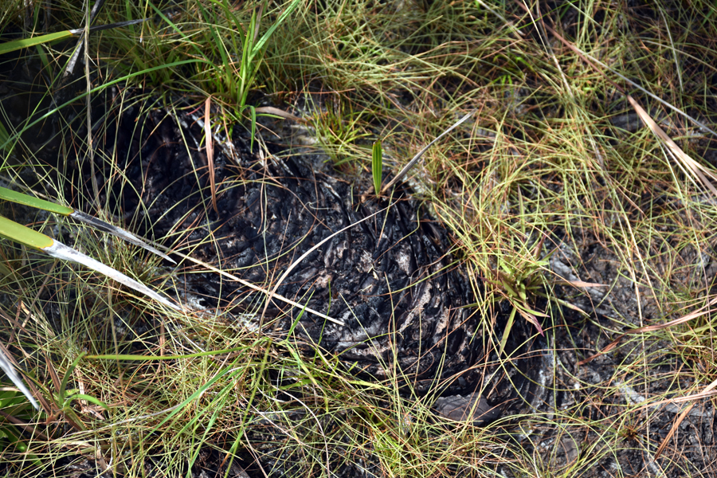
Notes:
but rather to encourage herbaceous plants by decreasing cover of palmetto trunks.

Slide 22
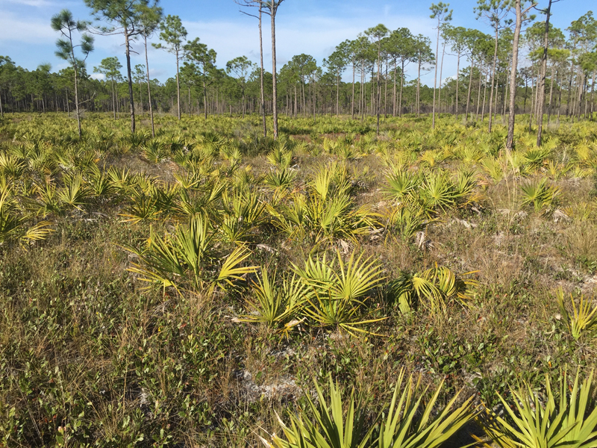
Notes:
The optimum target % cover will vary depending upon the habitat, but should not be consistent.

Slide 23
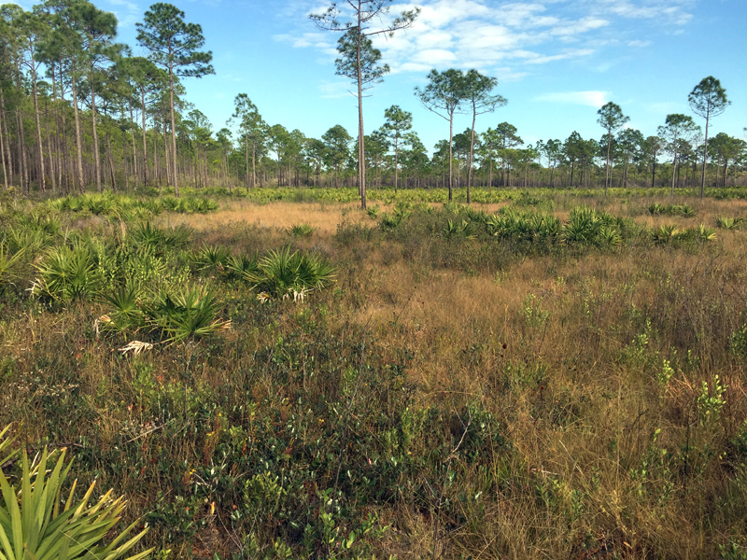
Notes:
Naturally, you would find a mosaic of densities, satisfying the needs of all animals

Slide 24
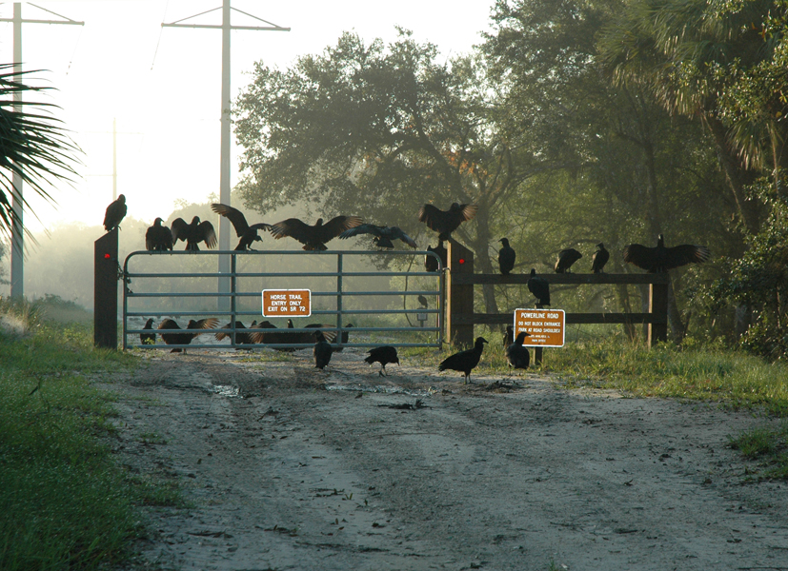
To chop or not to chop….
Notes:
, including black bears, turkey vultures and black vultures who require palmetto thickets

Slide 25
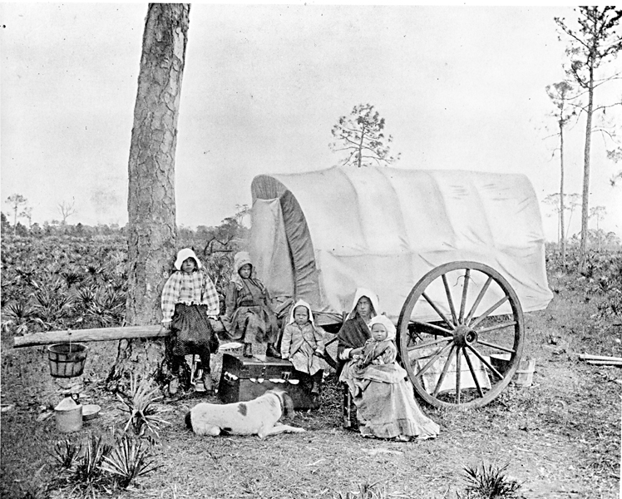
Palmetto Prairie
Notes:
The original name for dry prairie was palmetto prairies, which should provide a hint about their composition.

Slide 26
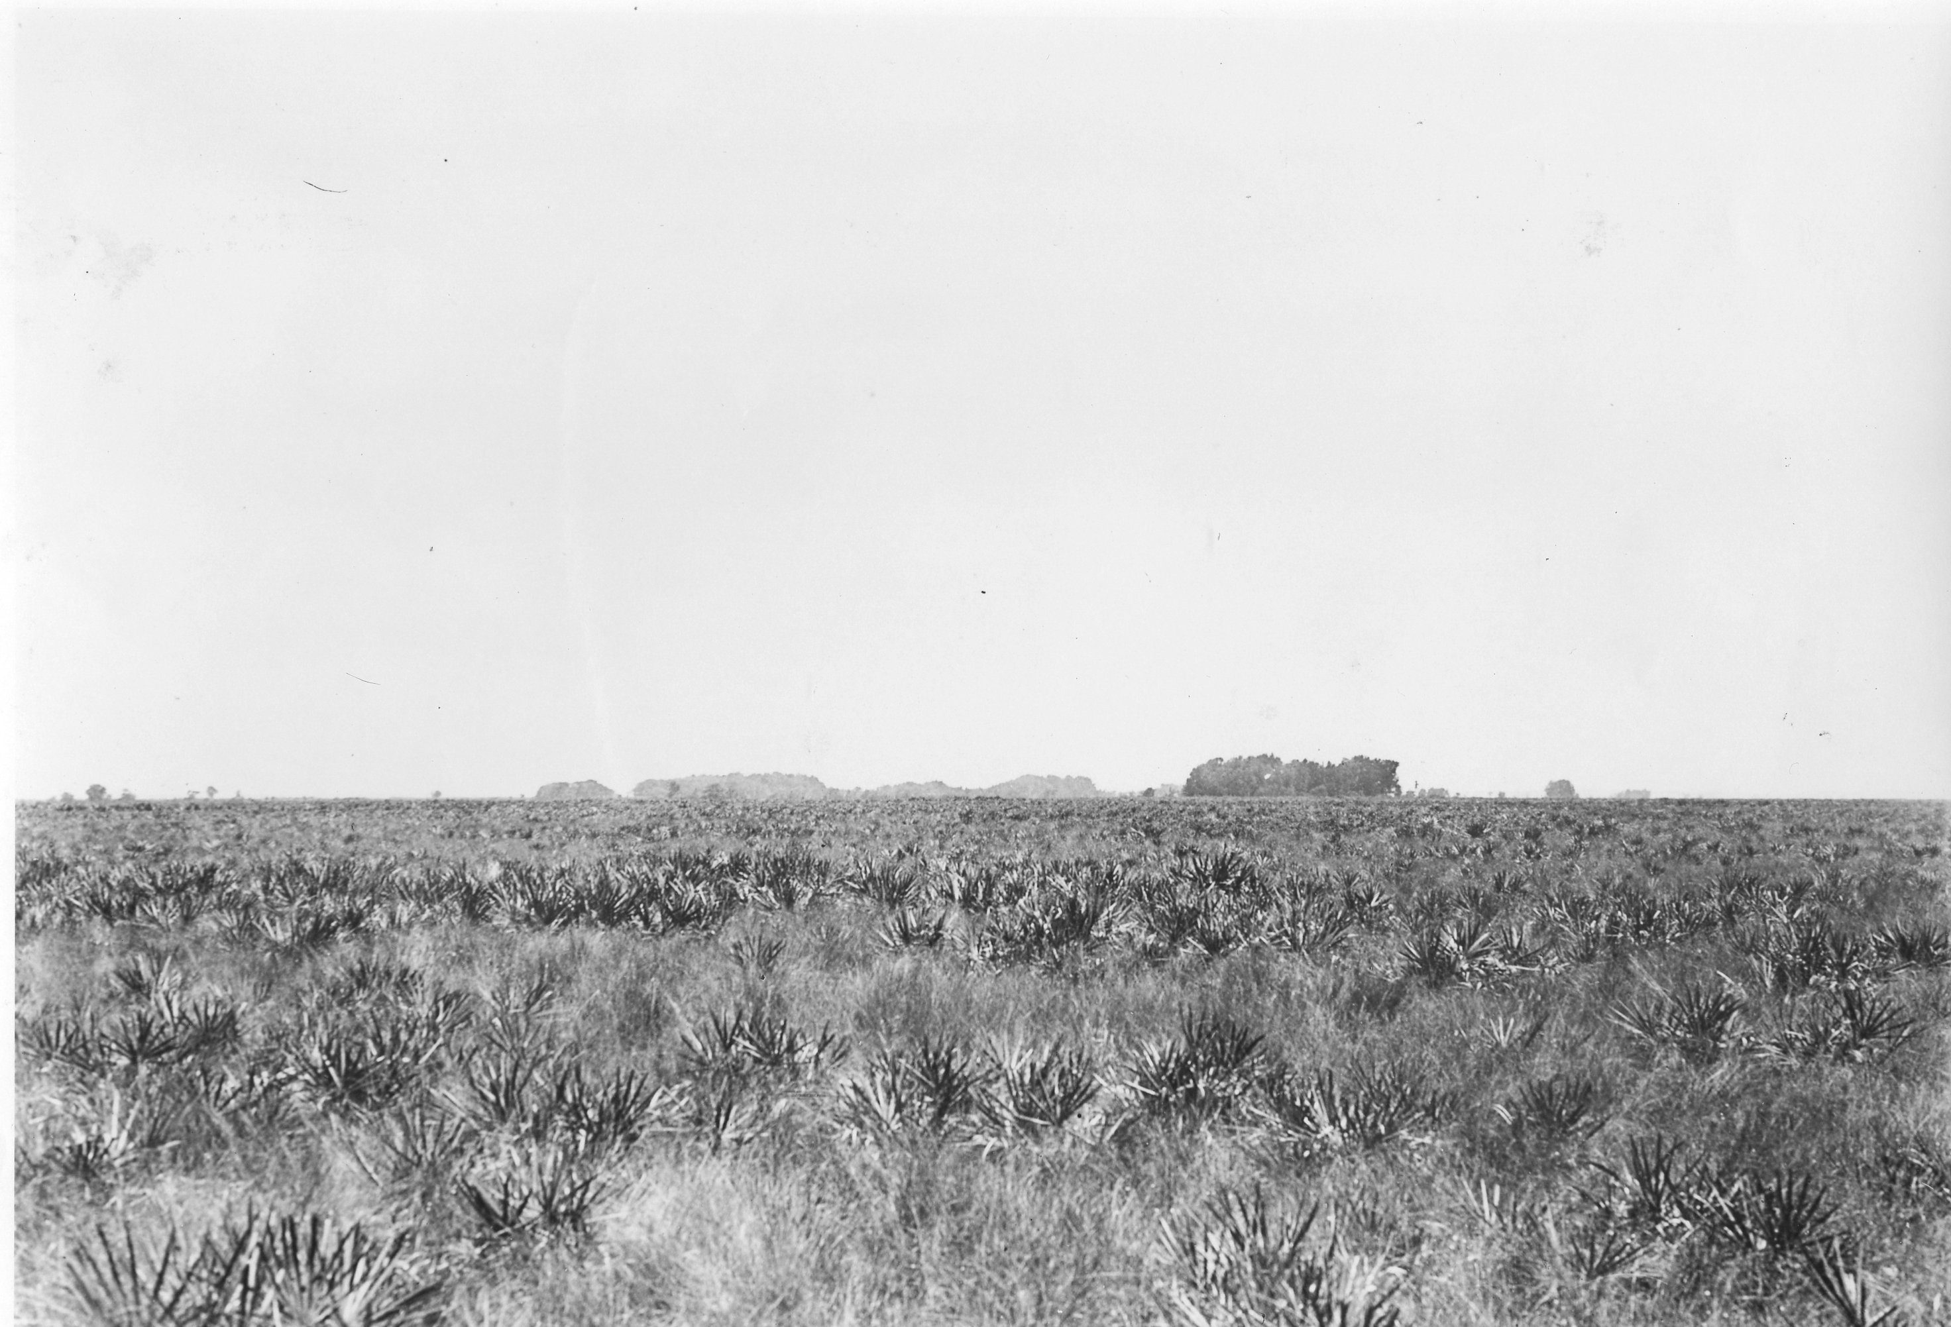
1927—Palmetto Prairie, Melbourne, FL
Notes:
Dry prairie and pine flatwoods share similar ground cover.

Slide 27
To chop or not to chop….
1. Have you researched site history?
1940s aerials—University of FL, ArGis
Original 1800s surveys
----Land Boundary Information System (LABINS)
Previous land managers
Current employees
Adjoining landowners
File cabinet
Burn databases
https://www.labins.org/survey_data/landrecords/landrecords.cfm
Notes:
When you are ready to make the decision of whether or not an area will benefit from roller chopping, I suggest asking yourself these three questions:
1. Have you researched the history of this property and have you documented that it has suffered from decades of fire exclusion?
(The first official survey of Florida was performed around 1824. The original survey notes and plats have been preserved and the Florida Department of Environmental Protection has made these General Land Office (GLO) Early Records available to the public in electronic format. )

Slide 28
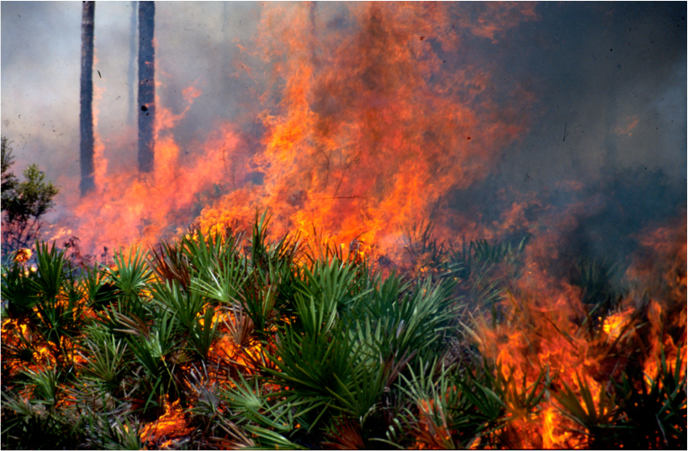
To chop or not to chop….
2. Have you applied fire at least twice within optimum burn return?
Notes:
2. Have you burned the area at least twice on a burn return of 2-3 years? You don’t know what you have until you have applied fire two or three times.

Slide 29
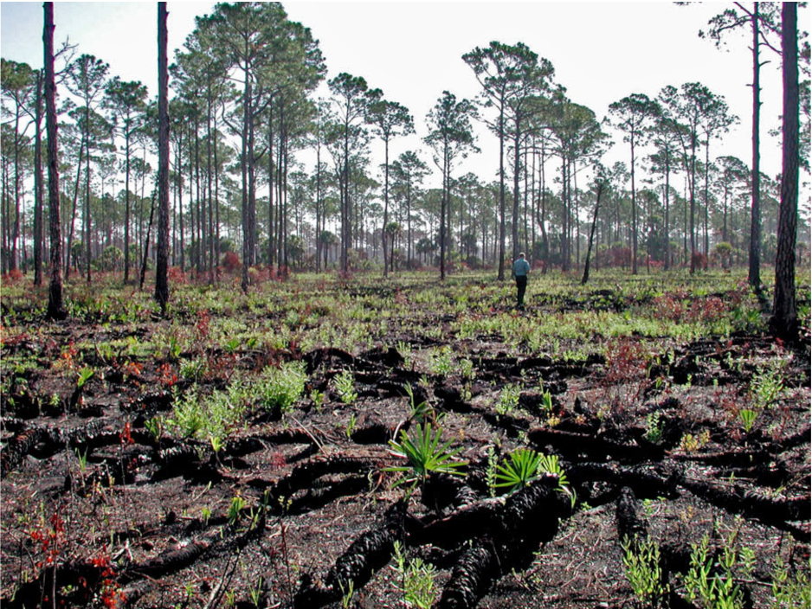
To chop or not to chop….
3. Still palmetto-dominated?
Notes:
At one to two years post burn can you describe the area as still dominated by saw palmetto and with thick trunks that prevent the growth of herbaceous plants and low shrubs? If you do not answer yes for each of the above questions, restoration roller chopping may not be the best restoration method for this property. Get more than one INFORMED opinion before deciding to roller chop.

Slide 30

When it’s time for a plan…
1. A good Rx by experienced practitioners
Notes:
Like Rx fire, you need a Rx, developed by knowledable land managers. (Note managers Is plural). Perhaps the main difference from writing a burn rx and a roller-chop Rx is the amount of irreparable harm you can do to native ground cover with a Roller-chop Rx.

Slide 31
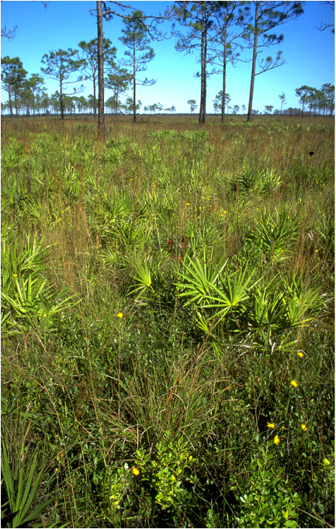
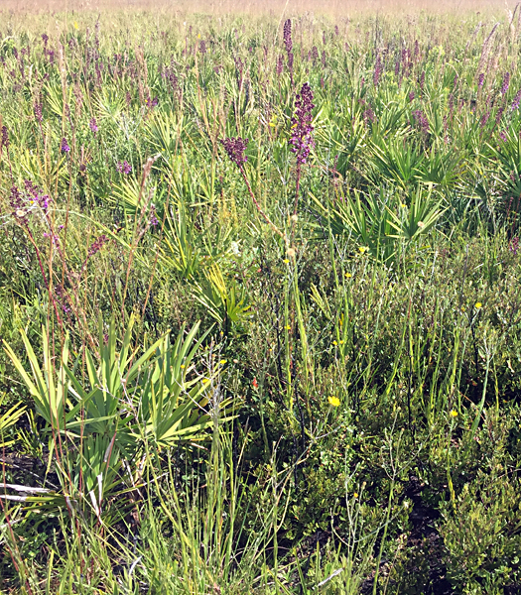
2. Select a reference site.
Notes:
When it’s time for a plan, begin by choosing a reference site. It is important to have a vision for what you want to achieve. Choose a site with similar elevation, hydrology, soil types. Be sure that whoever chooses the site has enough plant knowedge to recognize good-quality ground cover.

Slide 32
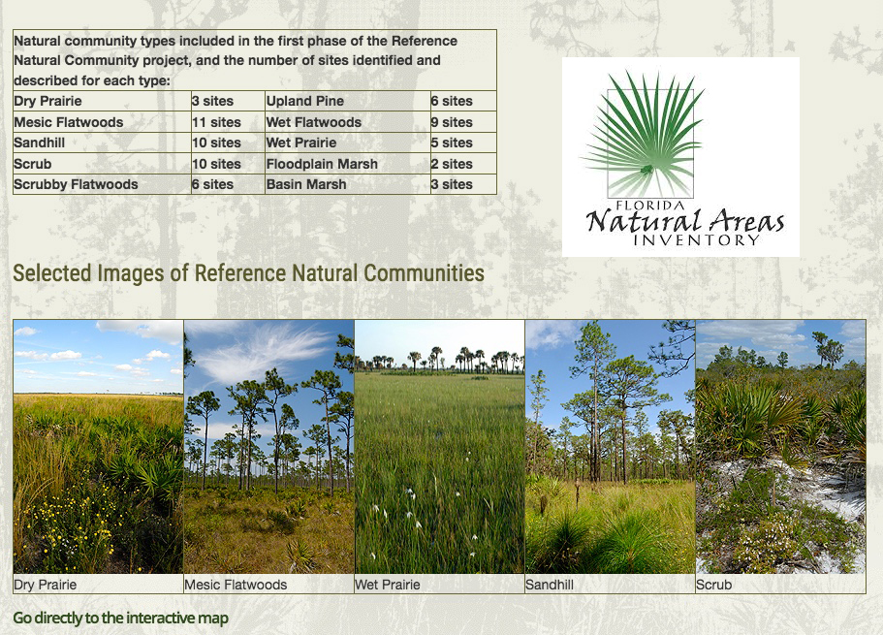
1. Select a reference site.
Notes:
c. FNAi lists reference sites for ten different natural communties. They also provide example of those communities in different parts of the state.

Slide 33
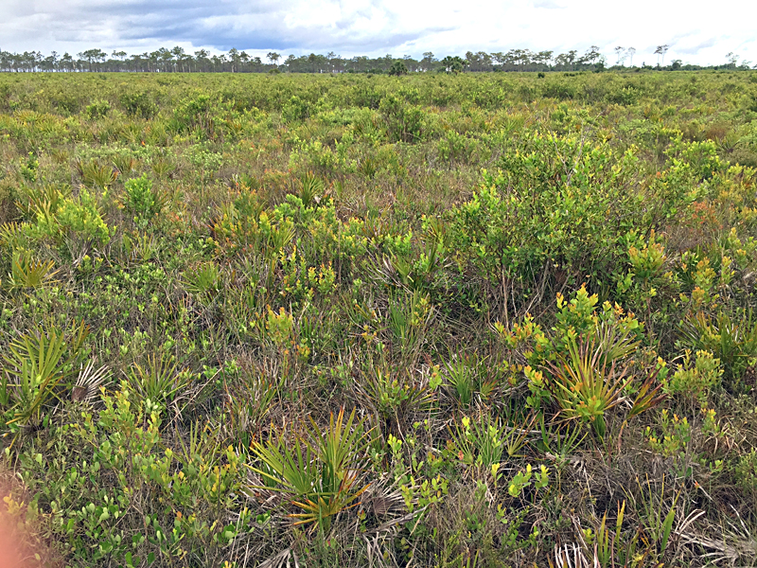
FNAI Reference site at Myakka River State Park.
Notes:
Here’s an example of a dry prairie site located in Myakka River State Park.

Slide 34
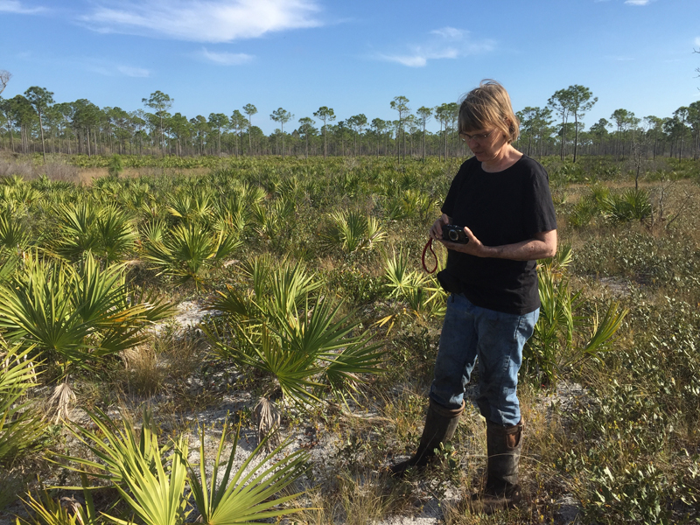

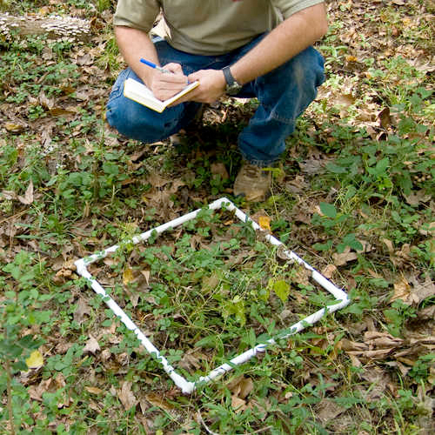

3. Establish monitoring protocols
Notes:
Establish monitoring protocols: photographs, vegetation transects, gps tracking, or however you plan to document detailed pre-chop site descriptions.

Slide 35
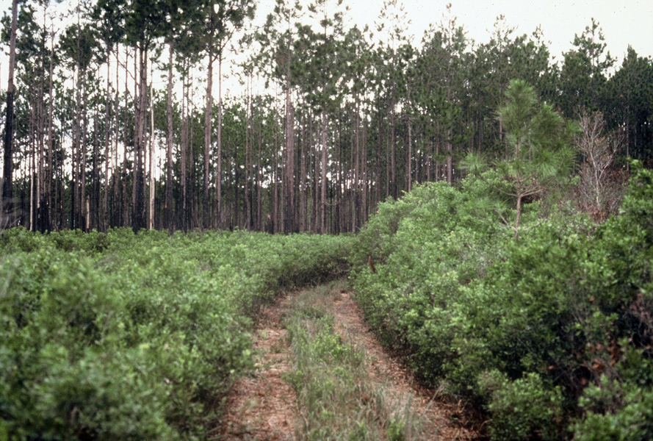
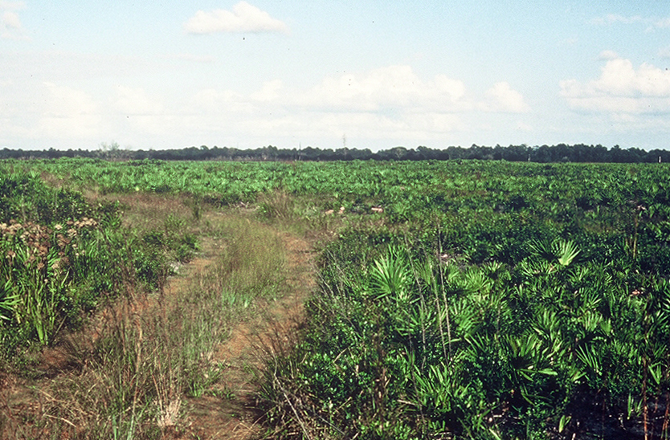
4. Evaluate/modify canopy density
Zone 5 prior to pine removal
Zone 5 after
pine removal
Notes:
When you are ready to choose the areas to chop, keep these suggestions in mind:
Prioritize areas that have significant seed source close by.
Look for zones with diversity resulting from mowed edges
Use flagging tape. Don’t just rely on maps
Consider planting plugs or distributing seed after chopping
Don’t chop large areas.

Slide 36
5. Select areas to be chopped
Don’t chop large areas.
Know your site history. Re-chopping previously
chopped areas can cause serious harm
Prioritize areas that have significant seed source close by.
Notes:
When you are ready to choose the areas to chop, keep these suggestions in mind:
Prioritize areas that have significant seed source close by.
Look for zones with diversity resulting from mowed edges
Use flagging tape. Don’t just rely on maps
Consider planting plugs or distributing seed after chopping
Don’t chop large areas.

Slide 37
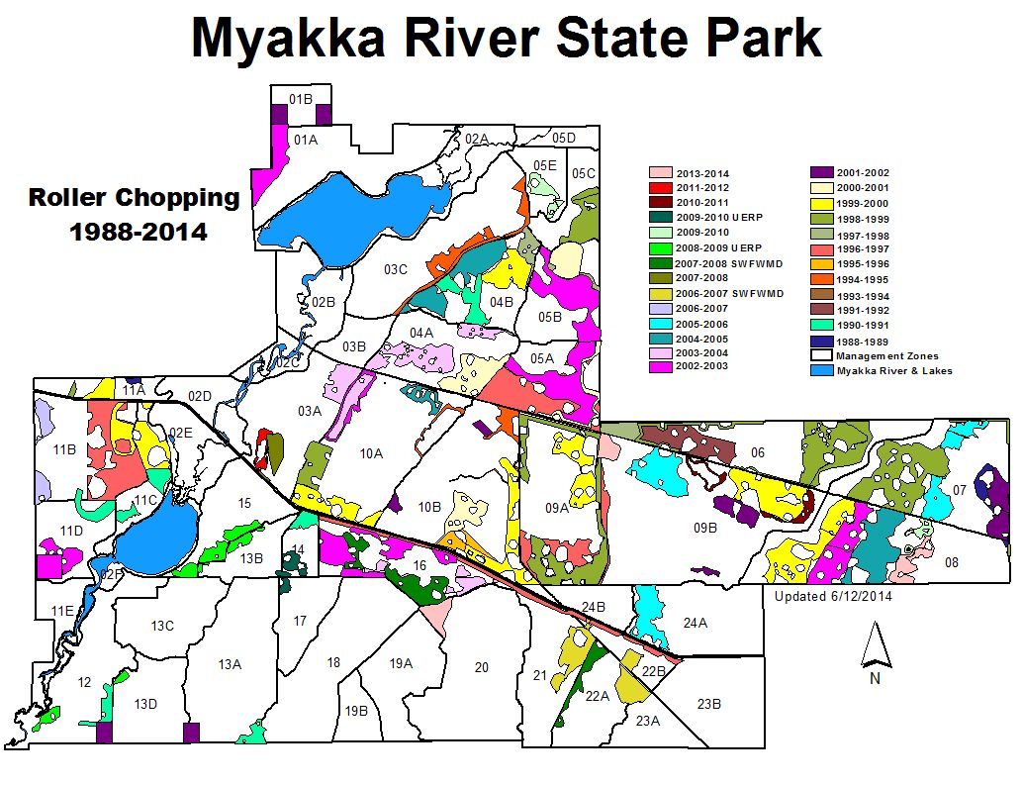
6. Keep good records!
Notes:
Here is an example of distribution of chopping at MRSP over 26 years. It also emphasizes the importance of keeping good records. You would not want a subsequent land manger to come in and re-chop areas that have been previously chopped.

Slide 38
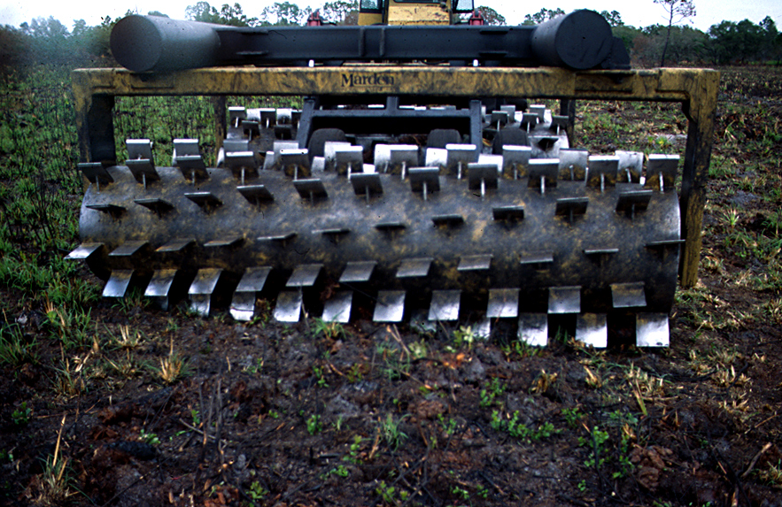
7. Choose the appropriate equipment for the site.
Notes:
4. Choose the appropriate equipment for the site; don’t use a heavier chopper than required for the job.

Slide 39
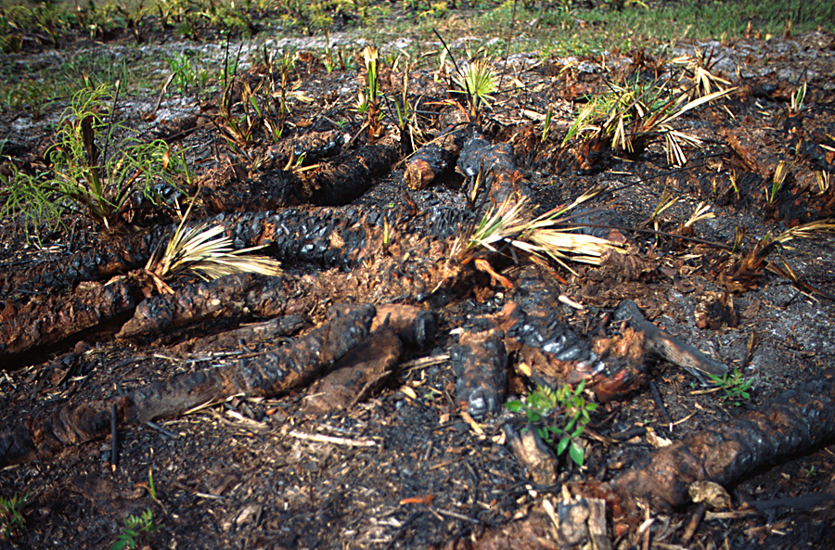
Chop & Burn or Burn & Chop?
Burn the area to be chopped less than 6 months pre-chop.
Notes:
5. Burn the area to be chopped less than 6 months prior to chopping—you don’t want to burn up your seedbank by putting the heat at the ground level rather than the shrub level.

Slide 40
Chop & Burn or Burn & Chop?
Prevents loss of seedbank with subsequent burns.
Prevents intense heat on soils, fungi and other micro-organisms.
Less residence time prevents extended smoldering.
Reduces risk of pine mortality due to smoldering duff.
Provides equipment operator with better view.
Notes:
5. Burn the area to be chopped less than 6 months prior to chopping—you don’t want to burn up your seedbank by putting the heat at the ground level rather than the shrub level.

Slide 41
When to Chop?
Growing-season chops are most effective.
Burn spring, then chop summer to best impact palmettos.
Chop when wet enough to get maximum palmetto trunk penetration, but not so wet as to cause wheel-slip or ground disturbance.
d. Chopping during dry times of the year won’t attain palmetto trunk penetration and it risks wiregrass destruction.

Slide 42
Choose your equipment operator carefully!
An ad posted on a Facebook Page:
“Does anyone need a job? Its operating a bulldozer for wildfire mitigation roller-chopping. Easy work. No skills necessary.”
Notes:
7. Choose your equipment operator with care.

Slide 43
Choose your equipment operator carefully!
1. Understands the difference between Restoration-roller-chopping and other types.
2. Can identify invasive plants from afar.
3. Is sensitive to animal sign such as gopher tortoises, burrowing owls,& ground-nesting birds.
4. Knows the capabilities of the equipment.
5. Can be relied upon to stop often to assess chopping effects and inspect equipment.
6. Can be relied upon to choose the best locations to leave unchopped for mosaic.
Notes:
(my interview with Lorna goes here.

Slide 44
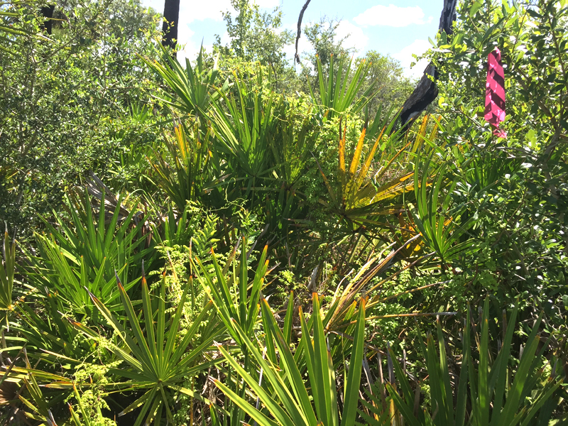
Finally: Roller-chopping 101
1. Be sure area is well marked. Don’t just rely on maps. Go out in field with contractors.
Notes:
.

Slide 45
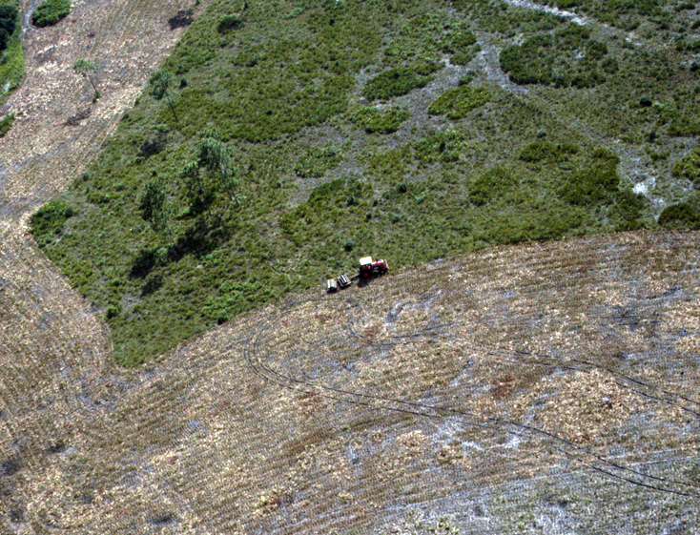
Finally: Roller-chopping 101
2. Carefully set your pattern so as not to double-chop.
Notes:
.

Slide 46
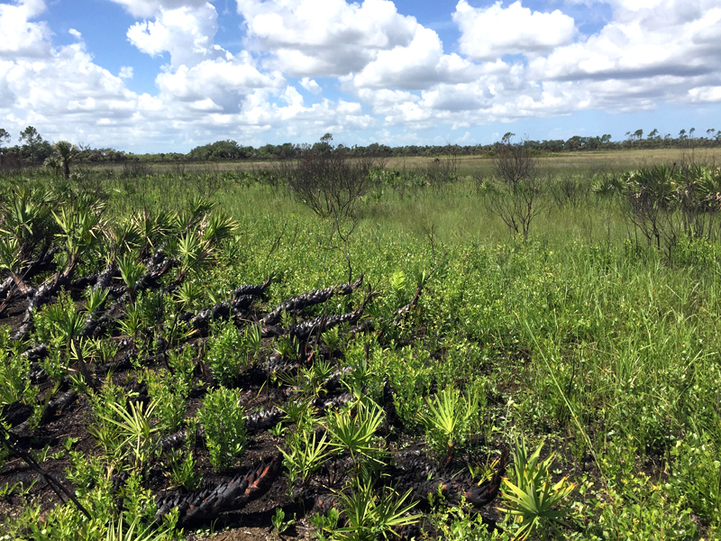
Finally: Roller-chopping 101
3. Consider fire shadow when planning your pattern.
Notes:
Fire shadow is a natural occurrence in which palmetto thickets sometimes develop on the downwind side of wetlands, as influenced by local prevailing winds.

Slide 47
Finally: Roller-chopping 101
3. The objective is as little ground disturbance as possible.
4. Don’t chop through invasive species
5. Don’t chop through wetlands, no matter how small.
6. Leave a mosaic of chopped & unchopped for diversity.
7. Consider planting plugs or distributing seed after chopping if lack of diversity continues.

Slide 48
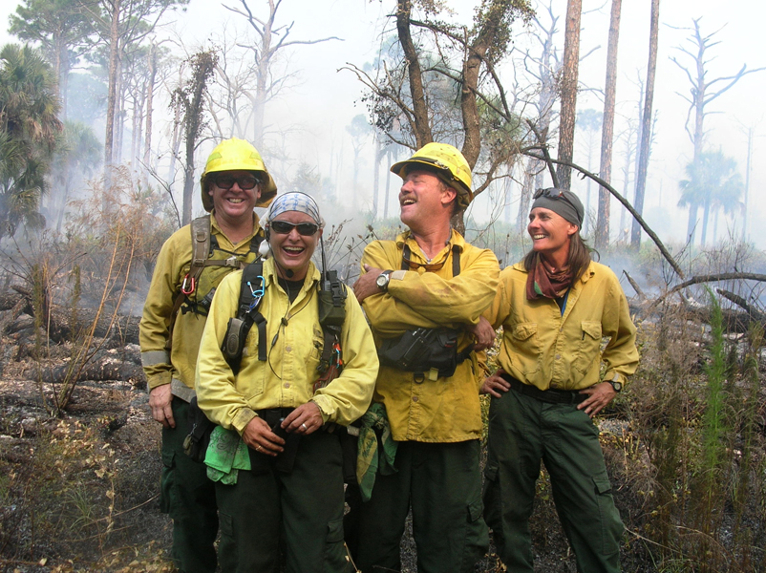
Epilogue
Follow treatment with a lightning season burn, one to two years post chop.

Slide 49
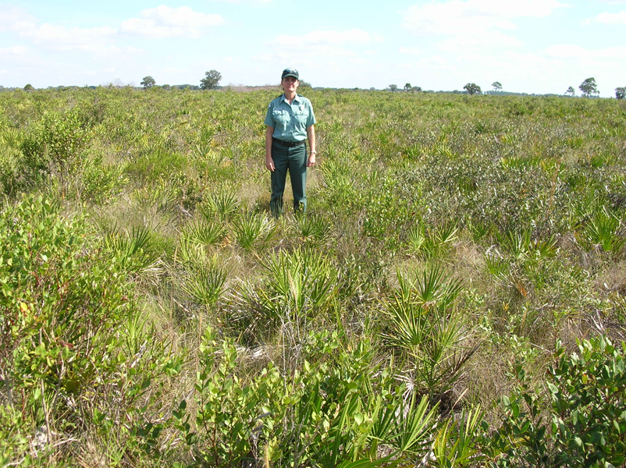
Epilogue
Continue to burn every two to three years or less, prioritizing lightning season burns.

Slide 50
